Slide 1
biblewell.org

Slide 2
7 Days of Children’s Evangelization
biblewell.org

Slide 3
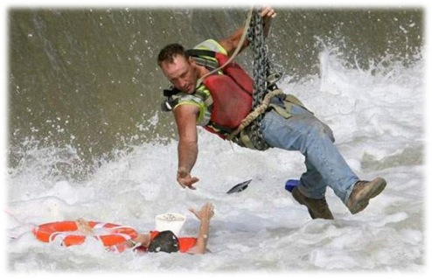
^{Salvation}
Day 1
Notes:
Day 1
Salvation
Biblical Base: John 3:16, Psalms 68:19, Psalms 104:24, Psalms 116:12, Romans 3:23, Romans 6:23, Romans 5:8
Main lesson: God wants to give you salvation.
Story: A child poorly spoken of is saved.
Objectives
That the children may know that:
God has a plan to save us.
God gave us His son to die for us.
Accept the salvation that God offers them.
Materials
Drawings for the lesson. Theme song of the day, and Bible memory verse in illustrative drawings. Illustrative materials for prayer. Souvenirs with the Bible text of the day so that every child may take it home. Materials for crafts.

Slide 4
Welcome
Notes:
Welcome
Give the welcome in a happy and fun way. Greet the children as a group. Present yourself to the children along with all the other teachers that will be participating in the activity.

Slide 5
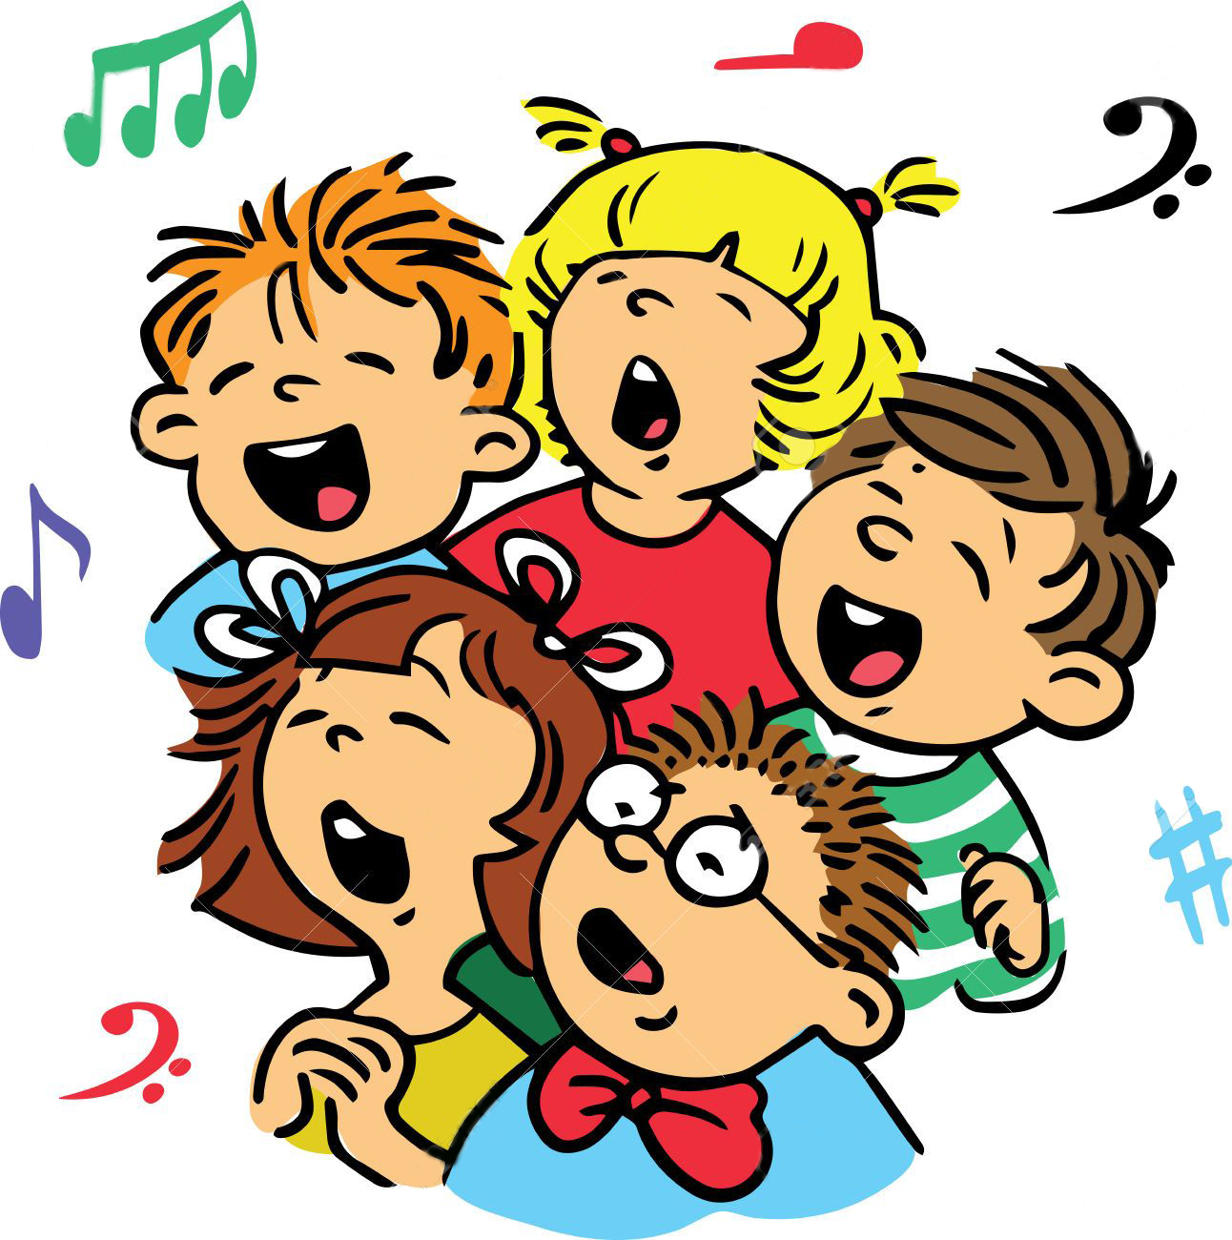
Music Time
Welcome!
Notes:
Music Time
Begin teaching happy songs that will motivate the group. A greeting song can be used for this occasion.
After greeting and singing the opening song, practice the motto song.
Options: Welcome!

Slide 6
Lesson of the day
Notes:
Lesson of the day
Introduction
Find an element that the story contains (for example: a wagon, a nurse’s apron, a flashlight, a backpack) so that you can use it as an intro to the lesson.
Example 1
Hey kids, how are you? Look what I have brought: a small wagon! This type of transportation is used in some places. It is pulled by horses, and can reach a medium speed. Today I will tell you a story where you will see what happened with a wagon like this.
Example 2
Put on some ripped and teared clothes to imitate a homeless person…you can also dress a child that you know like this. He/she could carry a piece of cardboard to put on the floor to sleep on.
-Hey kids! How are you? Let me present a friend to you. What happened to you? -I am a very poor child and live on the streets. I sleep underneath cars on this cardboard. -But that is dangerous. Go sleep at your home…
(Establish a small conversation like this, introducing the story).

Slide 7
Notes:
In a big city in Ireland a group of people, driven by the love of Christ and desire to serve their Savior, made a home for street children. They went out at night to go through the public streets to pick up these children and save them from their bad ways, guiding them to a correct path.
How wonderful! Many children have been benefited by these people! Surely through those people many others were favored.

Slide 8
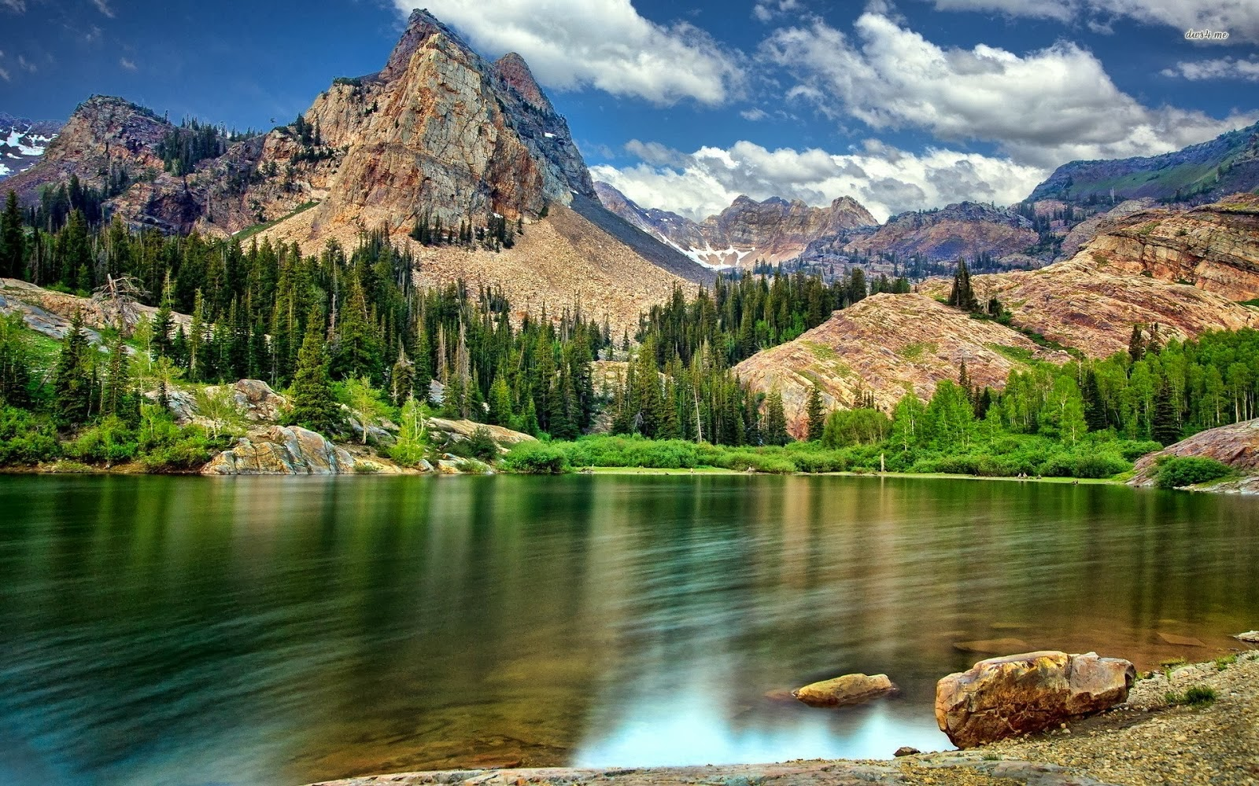
“Blessed be the LORD, who daily loadeth us with benefits, even the God of our salvation”
Psalm 68:19
Notes:
You know…God’s love is like the love that these people share. Even though we cannot see him, touch him, or speak to him face to face, God cares for all mankind. He has given us a beautiful place to live, trees that give us oxygen, super-rich fruits to eat…like bananas, strawberries, and many others, friends with whom to play, relatives who love us etc... (Name the God-given benefits that you have observed in the children). The Bible says, “Blessed be the LORD, who daily loadeth us with benefits, even the God of our salvation” Psalm 68:19, Psalm 104:24, Psalm 116:12.
Let's continue with our story...

Slide 9
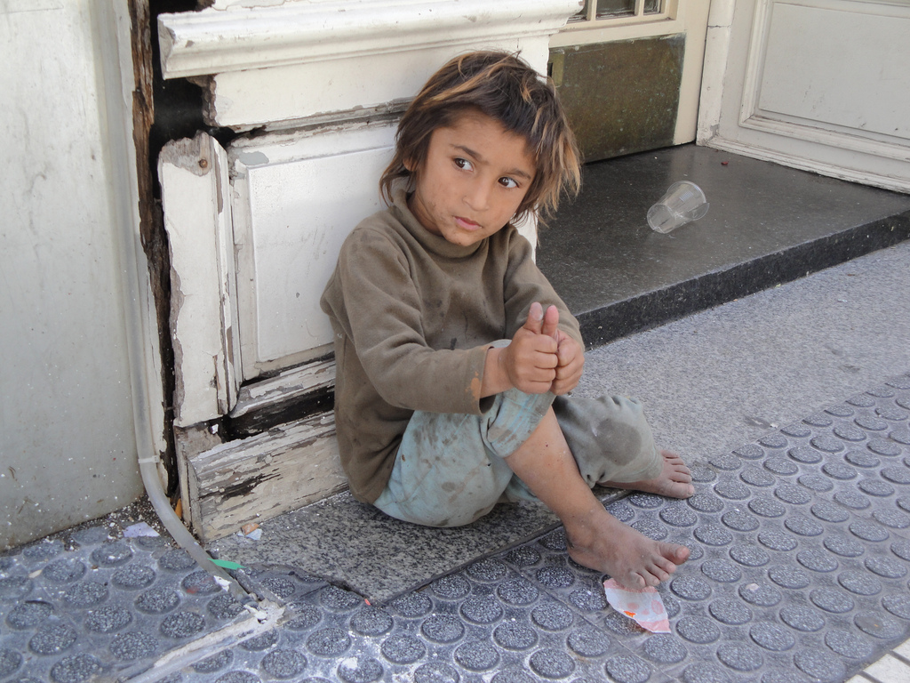
Notes:
On a cold night, one of these children was on an isolated street in the city. He was a child who had grown up without a home or family. His life was sad. He was only accustomed to doing bad things.

Slide 10
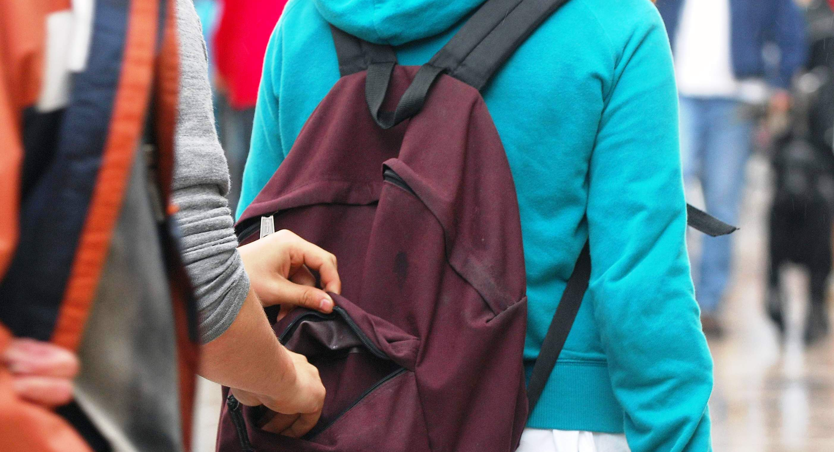
Notes:
He beat children for fun, scared the elderly, lied, and stole not only when he needed something, but also for fun. He was part of a small gang of thieving children. Every night they gathered together to break into a house.

Slide 11
Fights
Lies
Stealing
Gossiping
Bad words
Notes:
Are you anything like this child? Do you do bad things too? You know; many of us aren’t like this child, but we do lie, sometimes we keep something that is not ours, we fight with our friends, we say bad words, and we are gossipers. All the bad things we say or do are called sin. And the Bible says in Romans 3:23, " For all have sinned, and come short of the glory of God.”
How sad! We have all sinned and now we are far from God. We can no longer be children of God. In Romans 6:23 it says that “The wages of sin is death.”
How much pain! The price for so much evil that reigns in our lives is death, but thanks to God's great love for us, he sent us a solution.
But…..what happened to our friend in the story?

Slide 12
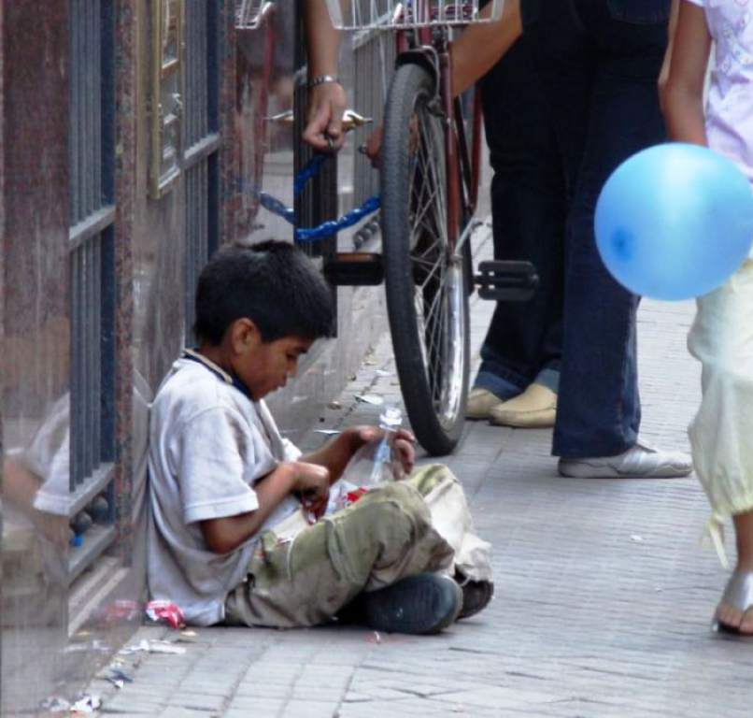
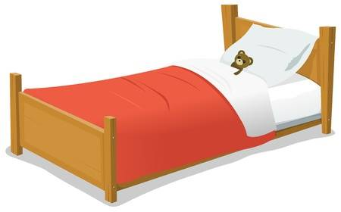
Notes:
At that moment he waited punctually, shivering in the cold while he waited for his companions with whom he would break into a house that night.
Suddenly a strong hand touched his shoulders. It was one of those merciful brothers who had come out to pick up the lost children to take them to the lodge. It was already dark, so he could see only the tall silhouette of this gentleman, for in that corner there was no light. Taken by surprise, he was frightened; But a kind voice said to him:
– Child, what are you doing at this hour on the street? Children your age should not be out on the street at this hour… go to your house and sleep!
-I don’t have a house or bed – It was a short answer, but with an expression of pain painted on his face.
-"What a pity, young man!" If I could find a bed for you tonight, would you come with me?
-"Sure!" replied the child.
-"Then go to x Number x street," said the stranger, "and there you will find a bed."

Slide 13
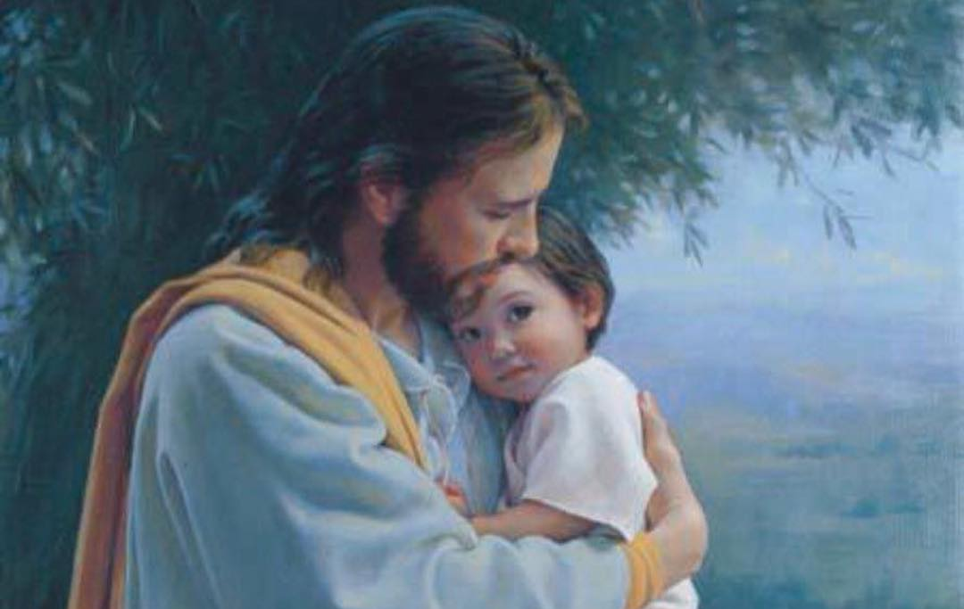
Notes:
God, our Father, also remembered us. Although we are sinners, He gave us a solution so that we can be saved. God gave His son Jesus to come to earth and give His life for every sinner. Romans 5:8 says " But God commendeth his love toward us, in that, while we were yet sinners, Christ died for us.”

Slide 14
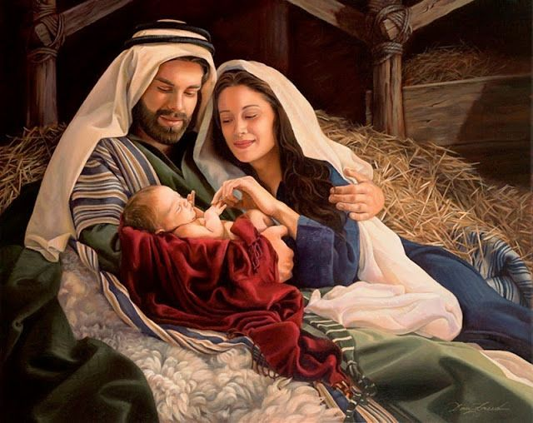
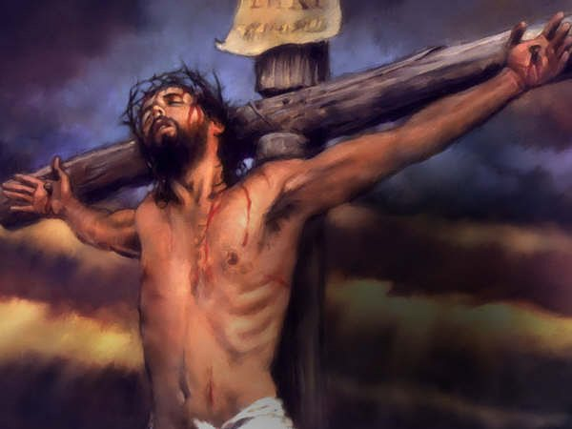
Notes:
Jesus was born like all of us here on Earth. He grew up, became an adult, but you know what? He never sinned. And despite all of that, He gave His life for you and me and died on a cross. His hands were nailed, and they placed a crown of thorns on His head. He did all this for each one of us. He died for our sins.

Slide 15
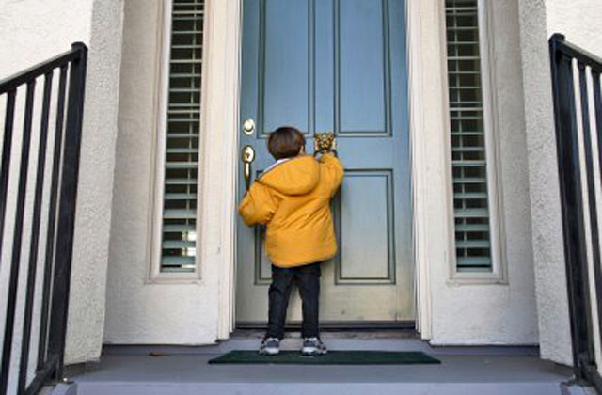
Notes:
The child of the story listened attentively and before saying otherwise, the boy turned and ran to the place the man had told him about.
-"Wait!" said the man. How are you going to get in? You need a permit. No one can enter without knowing the password. Can you read?
-"No," said the child.
– Then you will have to know the following words: John 3:16. Don't forget it, because without this you won't be allowed to enter. John 3:16….this will let you in.
It was a cold and stormy night. It was about to rain. The poor boy longed for a bed and a yummy plate full of hot food. It seemed more advantageous to him to accept the new offer than to wait for his friends whom he didn’t know what time they would arrive. So he accepted and went, repeating John 3:16, John 3:16...to himself.
Soon he came to the street and found himself in front of the indicated house. There was an entrance with a big iron door. Will you let me in here? The child thought. He was not a shy, but a daring child. So he loudly rang the bell. The night Porter opened and asked:
– Who is it?
-"It is I, please, Sir; I am John 3:16.
– Okay; Just enter, that’s the password. – He took the child and closed the heavy iron door.

Slide 16
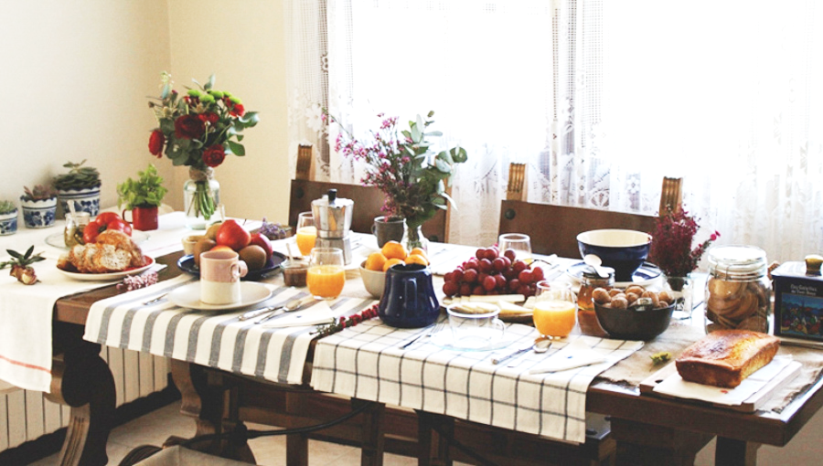
Notes:
Our little friend entered a well-lit and clean room; They gave him new clothes, and let him take a clean bath before he changed. Then they took him to the kitchen and gave him a hearty soup with a large piece of bread. Next they took him to a nice, sheltered bed, like he had never seen before. As he was falling asleep, he thought: "This name brings luck! From today on, I'll call myself that!

Slide 17
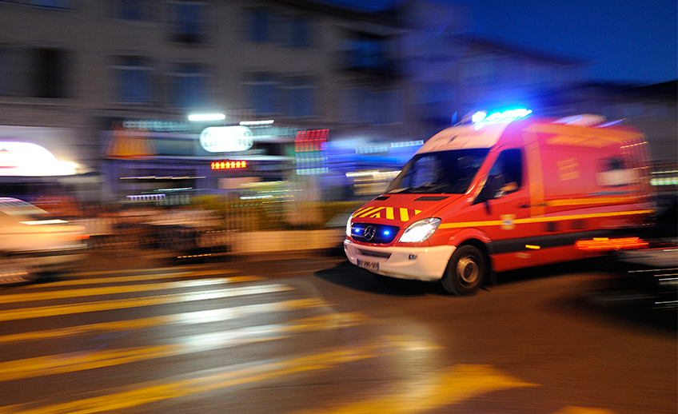
Notes:
The next morning, after a rich breakfast, the boy was let go because the place was just for sleeping.
He walked through the streets uneasily, and always afraid to meet his companions with whom he used to steal. What would they say now that he had not presented himself the night before at their meeting place? But the events of the previous night and his new name occupied his mind so much that he did not pay attention to the street, and when he turned at the busy street corner, a wagon hit him. Soon a great number of people gathered: they brought a stretcher and took him to the hospital because he was wounded very badly.

Slide 18
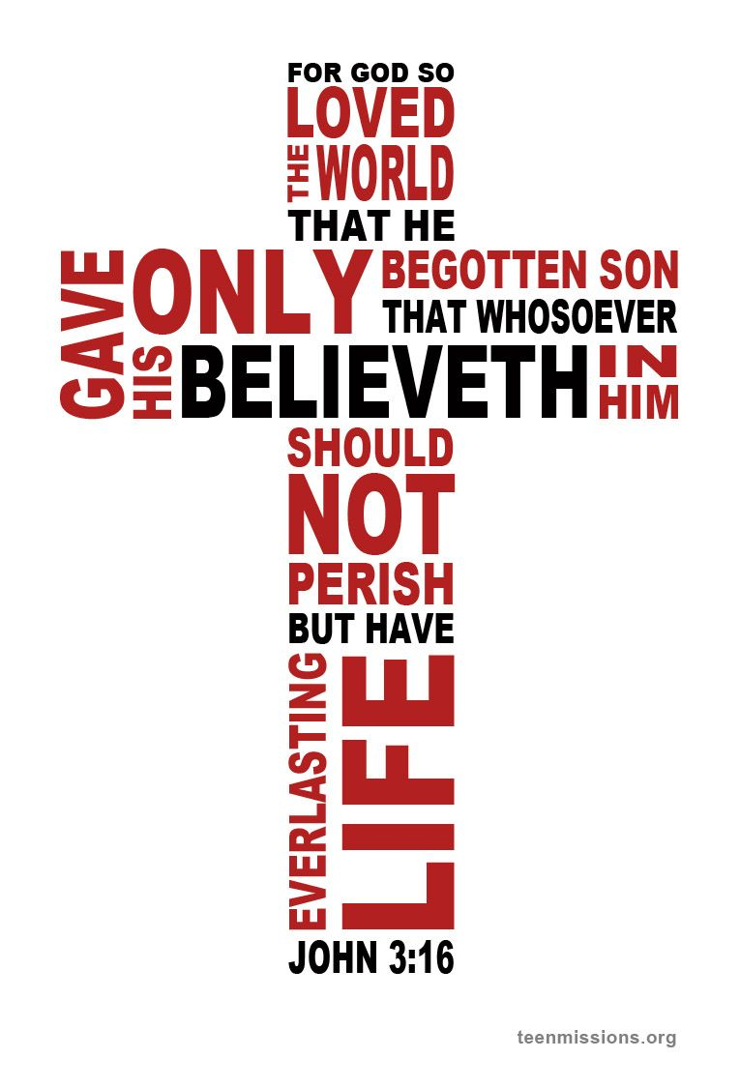
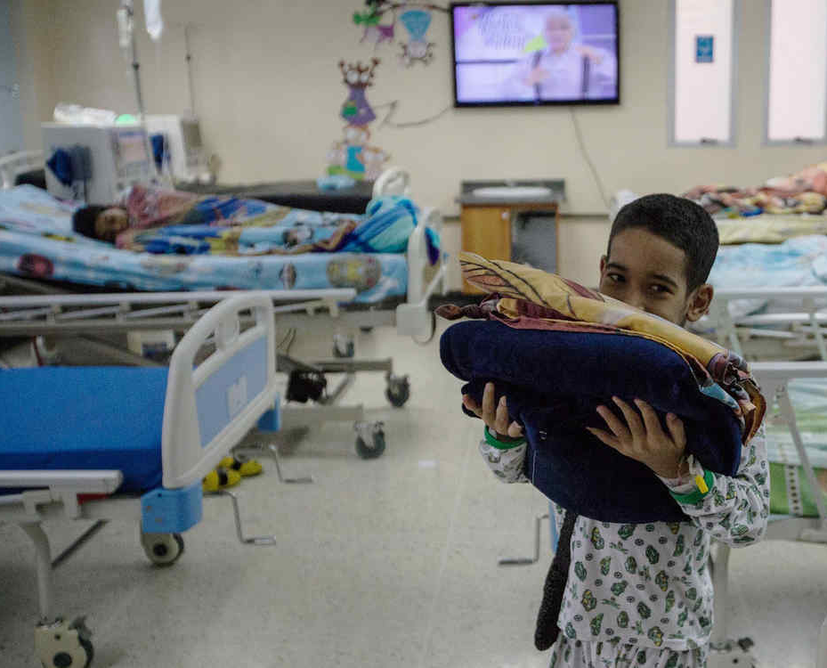
Notes:
There he regained consciousness, and a nurse approached him to get his name and address. When he was questioned, he answered:
What shall I tell them? I used to have another name, but now my name is John 3:16.
This response provoked laughter…. they thought that it was because of the strong blow to his head. The wounds were bandaged and the patient was taken to the recovery room. Many of his wounds were severe, and he soon began to have a fever.
But only one idea seemed to dominate his fever-caused fantasies; His clear voice always echoed through the room:
– John 3:16; John 3:16 This has to help me…this has helped me.
These words caused curiosity in the room. What did the child mean by the words John 3:16? Immediately, one took out the Bible, searched for these lines, and read the precious words: "For God so loved the world, that He gave his only begotten Son, that whosoever believeth in Him should not perish, but have everlasting life."
God loved us so much that He gave us His only son, Jesus Christ, so that if we believe in Him, we too will have eternal life.

Slide 19
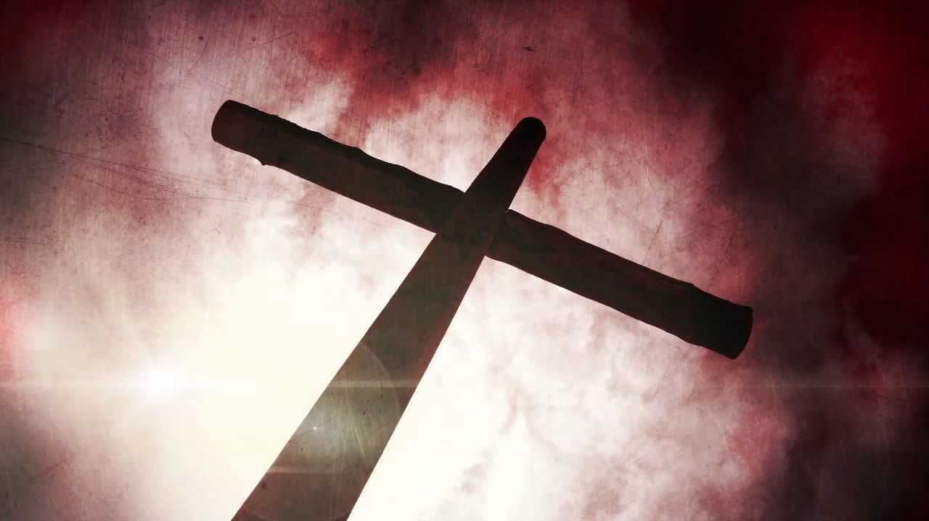
JESUS
Notes:
Jesus died on the cross for you and for me. He died in our place. But we must believe now. If we believe in Jesus ' sacrifice for us, then we will have eternal life.
Do you believe that Jesus died for you?

Slide 20
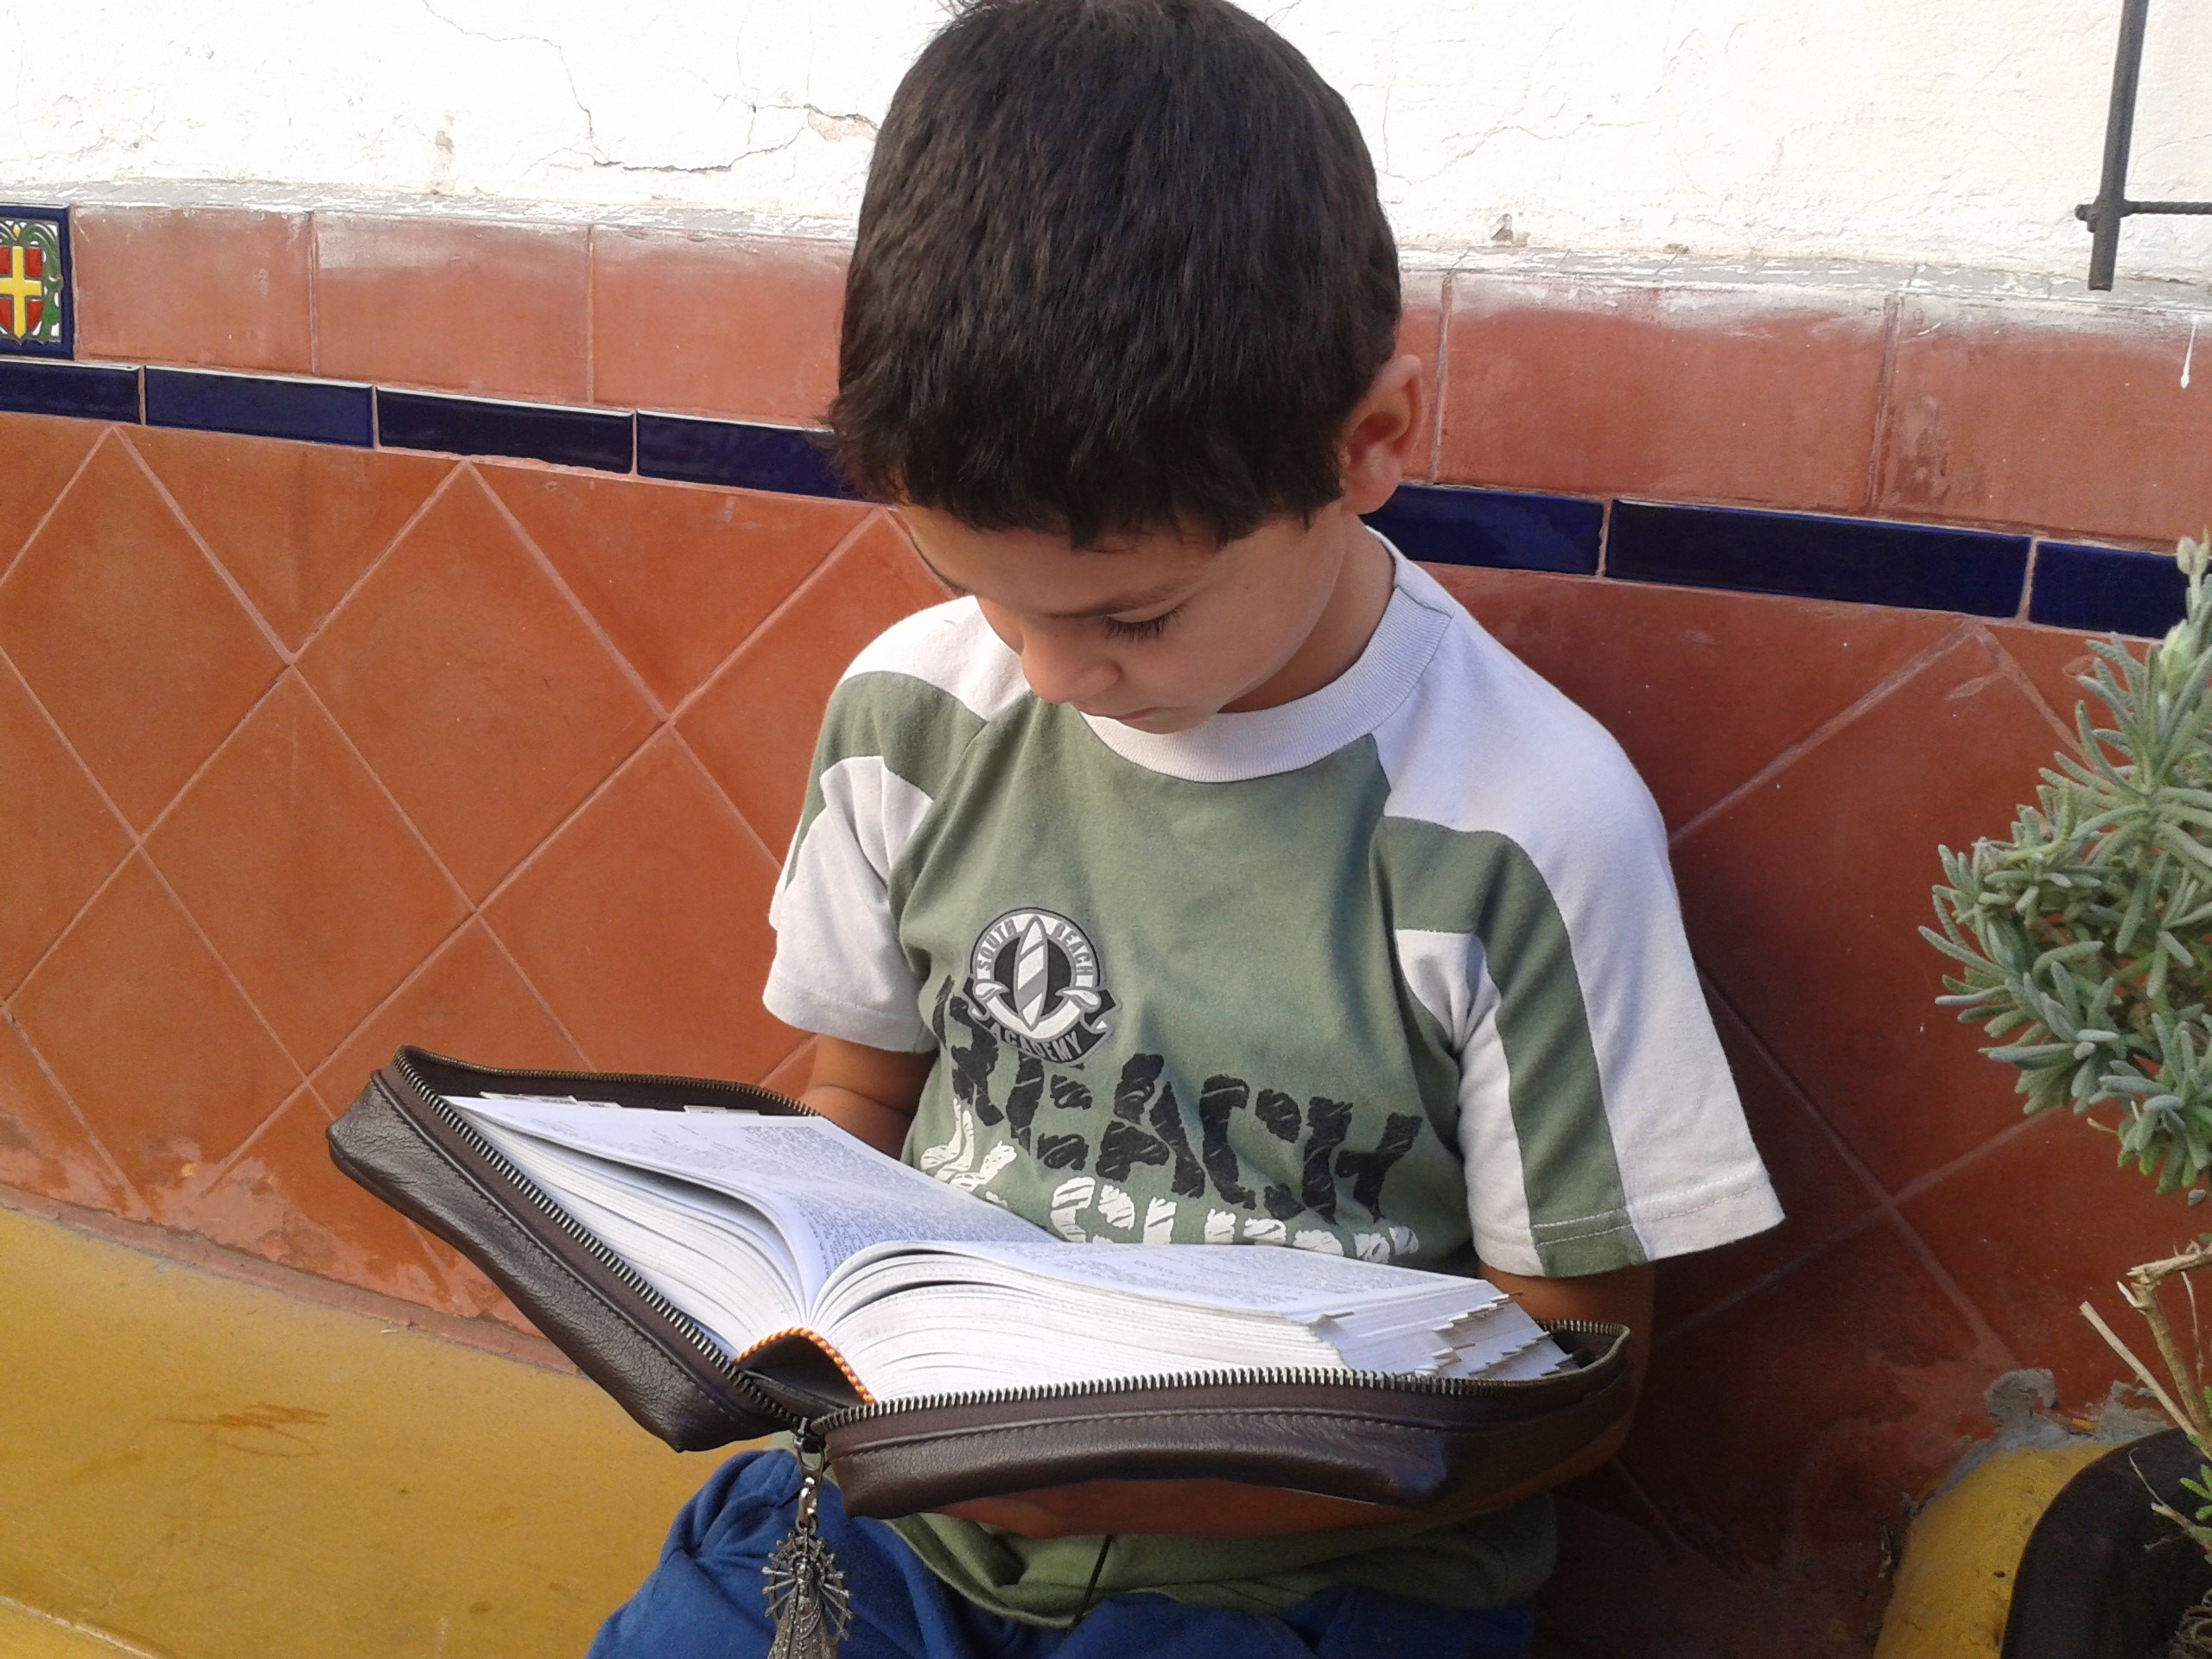
Notes:
Deep silence reigned in the room when the poor sick heard these precious words with the strong confidence of the small boy.
This had to help me, and this has helped me.
So many hearts were opened to this wonderful message—that God so loved the world. And without knowing it, the words of this small boy served as an instrument from God.
When the night of fever passed, and they boy improved, he looked around with a lot of attention. Everything was very peaceful and quiet around him. At that instant he heard a voice from a neighboring bed:
– John 3:16 How are you today?
From where do you know my new name?" asked the child.
-"From where do I know it?" You didn’t stop saying John 3:16 while you were sick.. and I say blessed be John 3:16! Don't you understand what it means? John 3:16 is a verse in the Bible, it is a message from God to man.
-"Read me something from the Bible!" he begged.
For the first time the words of love and consolation penetrated their ears.
-"This is very nice," he murmured.
Soon, he knew this verse by heart and with his vivid eyes said: – I don’t only have a new name, but also something else that is new and better!

Slide 21
JESUS
Notes:
John 3:16 is a gift for you today. A wonderful promise for your life. And you- do you also want to accept what God says to you? He has given you the solution for your life, just as He gave it to this little boy.
He gave you His son, Jesus, to die for you on the Cross of Calvary. He died a long time ago so that you may have life. He died in your place, and gave His life for every sinner. Even though He did not commit sin, or do bad things, He died so that each one of us could live.

Slide 22
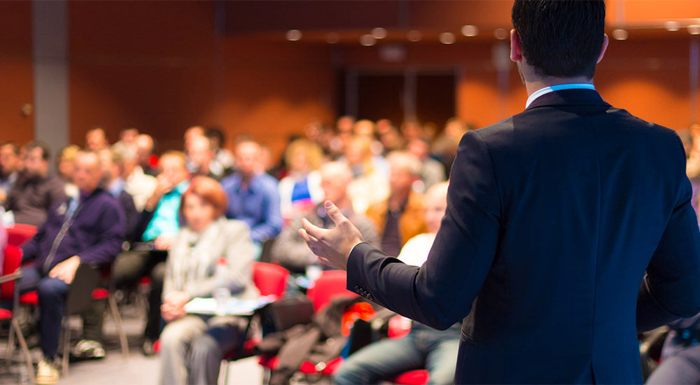
Notes:
You know what? The boy in this story decided to change his life forever. After a few days he recovered fully. He helped all the sick people in that hospital with words of encouragement. He then met with the hostel's friends who led him to live in a Christian home to go to school. After a few years he became a great preacher.

Slide 23
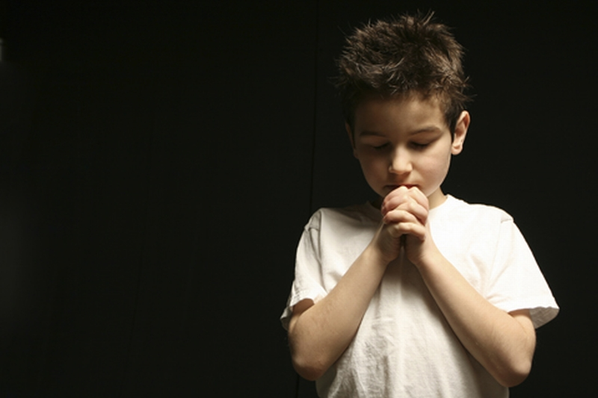
Notes:
What's your decision today? Will you continue like this? Lying, stealing, saying bad words, fighting, disobeying? God calls you to give Him your heart. God tells you: I gave my son Jesus to die in your place.
You only have to do one thing: Ask forgiveness for all those bad things you do, and God will forgive you.
Do you want to give the Lord Jesus your heart today? Pray with all the children who want to give their heart to Jesus.

Slide 24
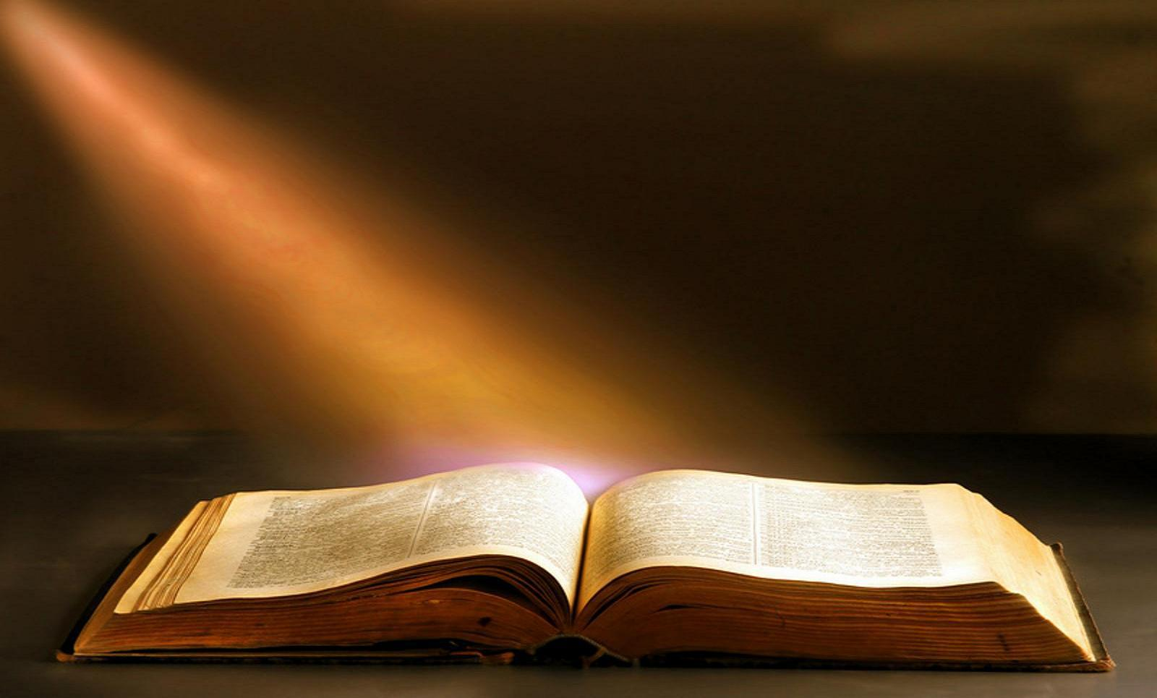
Bible Verse
John 3:16
Notes:
Teaching the Biblical text
This moment is important because we are recording the word of God in the children’s minds.
Introduction: We have heard so much about John 3:16! I want to learn it by heart now! Who can teach me?
(Prepare the visual beforehand. One suggestion is to make it on a large cardboard so that it can be read clearly)
Text from John 3:16.
John 3:16
“Because God so loved the world,
That He gave his only begotten Son,
That Whosoever believeth in him,
Shall not perish, but have everlasting life.”
Presentation: Show the Biblical text presented in a visual.
Let someone read it. Then look it up in the Bible and have someone present read it again.
Show that it is written in the Bible.
Explanation: Explain each part of the text carefully so that the student may understand it better.
Application: God- He loved you so much, that before you even existed, He sent His son Jesus to die for your sins. If you only believe in Him, you will have eternal life. When Jesus returns to this earth one day, we will go to live in heaven with Him forever. How wonderful! Shall we learn it?
Repeat: Invite children to read the text, and repeat it several times. We can do boys first, then women, then all, then the tall ones, then the middle ones, the short ones, etc. using different modes of repetition.

Slide 25
For God so loved the world,

Slide 26
That He gave His only begotten son,

Slide 27
That whosoever believeth in Him,

Slide 28
Should not perish, but have everlasting life

Slide 29
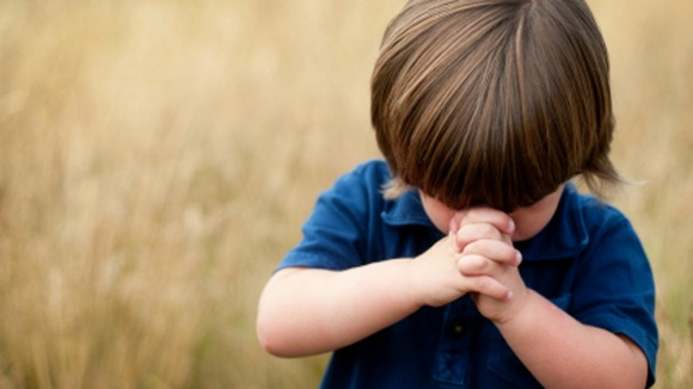
Time of Prayer
Notes:
Time of Prayer
Continue the program without stopping, have the time of prayer.
At this moment, we will dedicate ourselves briefly to teaching the kids how to pray. Since it is the first time they pray, teach it in a simple and easy way.
For example:
It’s a good time for us to talk to God again!
Whenever we want to talk to God, we can do it because He always listens to us. We call this praying. Praying is talking to God like talking with a friend.
We will pray together. (Remember to always speak plural, us, including gratitude for always listening to us).
Optional activities
Oral activity
Counseling
After the topic, call all the children who decided to believe on Jesus as their Savior. Counseling is used to know how much the child understood from the message, to find out how he/she responded to the message, to clarify doubts, and to correct misconceptions.
Encourage them to continue coming every day, and to base their decisions on the word of God.
With the help of several teachers, talk to the children in small groups. Review the message of salvation to know their understanding and clarify the difficult points. Written texts are provided for the child to read during the week; (More details in the Evangelism Handbook).

Slide 30
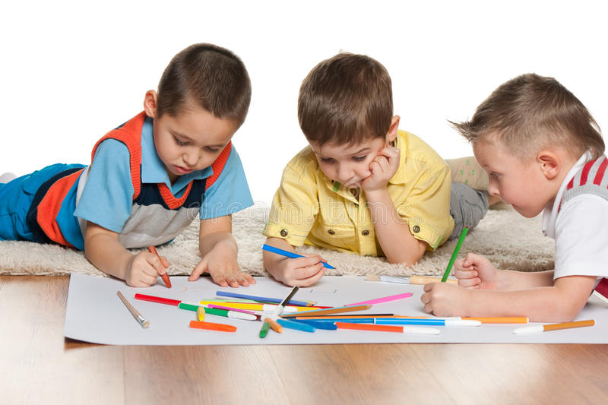
Craft of the Day
Notes:
Craft of the day
We will prepare a small painting with the text John 3:16 so that the kids may hang it in their homes. If they are over 9 years old, they can draw the letters themselves. If they are underage, paint the letters for them, so that they may color the letters in. The picture can have two sides. The text without letters can have the verse represented with drawings like: a heart-world-cross; a white heart with the word “believe” in the center; a sky, and on the other side the written text.

Slide 31
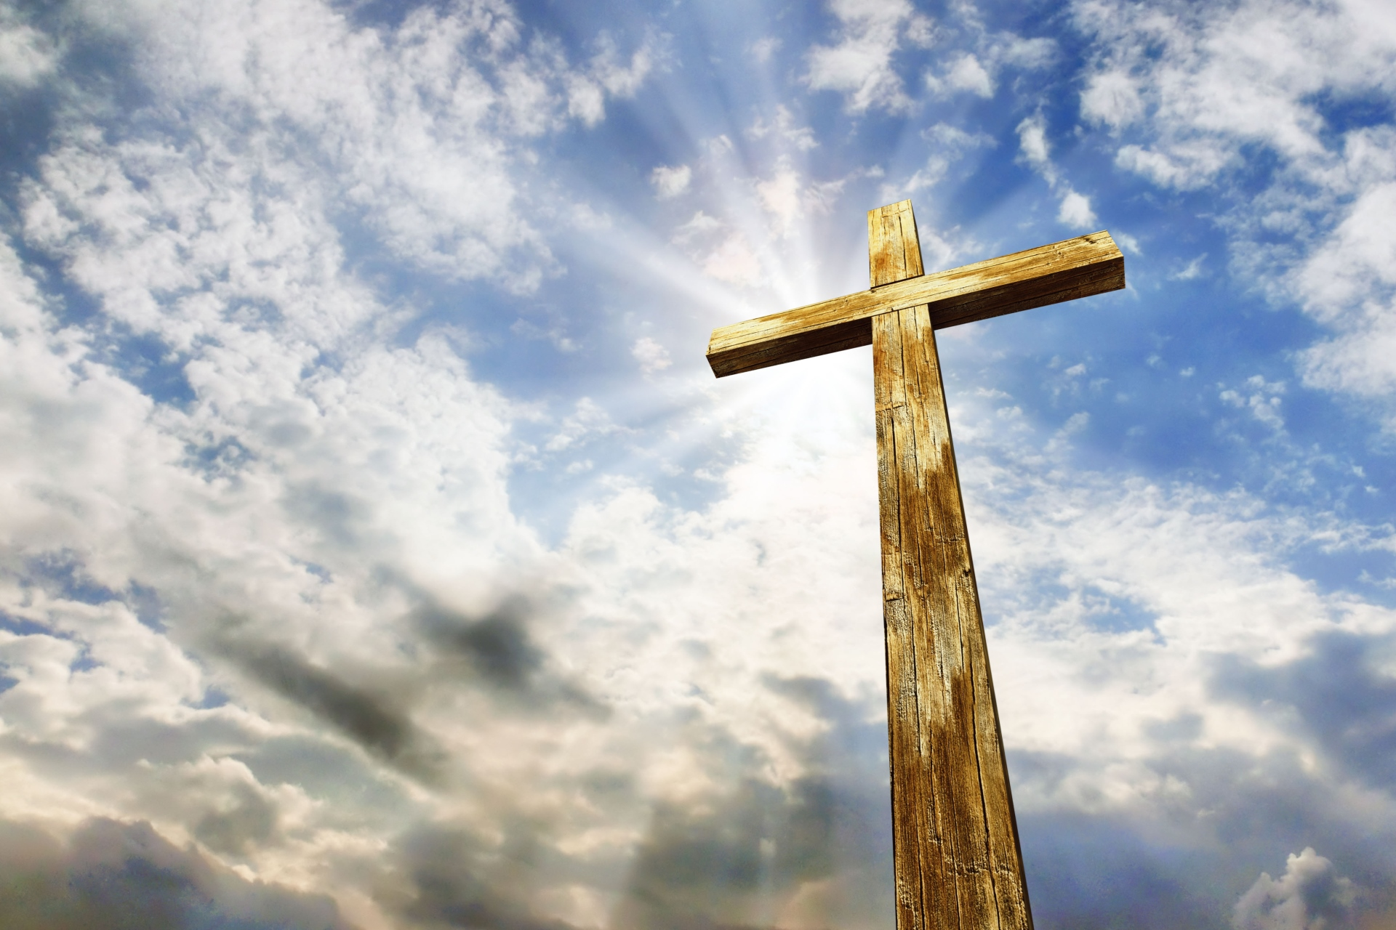
Conclusion
Thank you Father, because Jesus died on the cross for me
Notes:
Conclusion, Thank you Father, because Jesus died on the cross for me.

Slide 32
Next Topic: Children of God
biblewell.org
Notes:
Next Topic: Children of God

