Slide 1
7 Days of Children’s Evangelization
biblewell.org

Slide 2
Walk with me
Jesus tells you:
biblewell.org

Slide 3
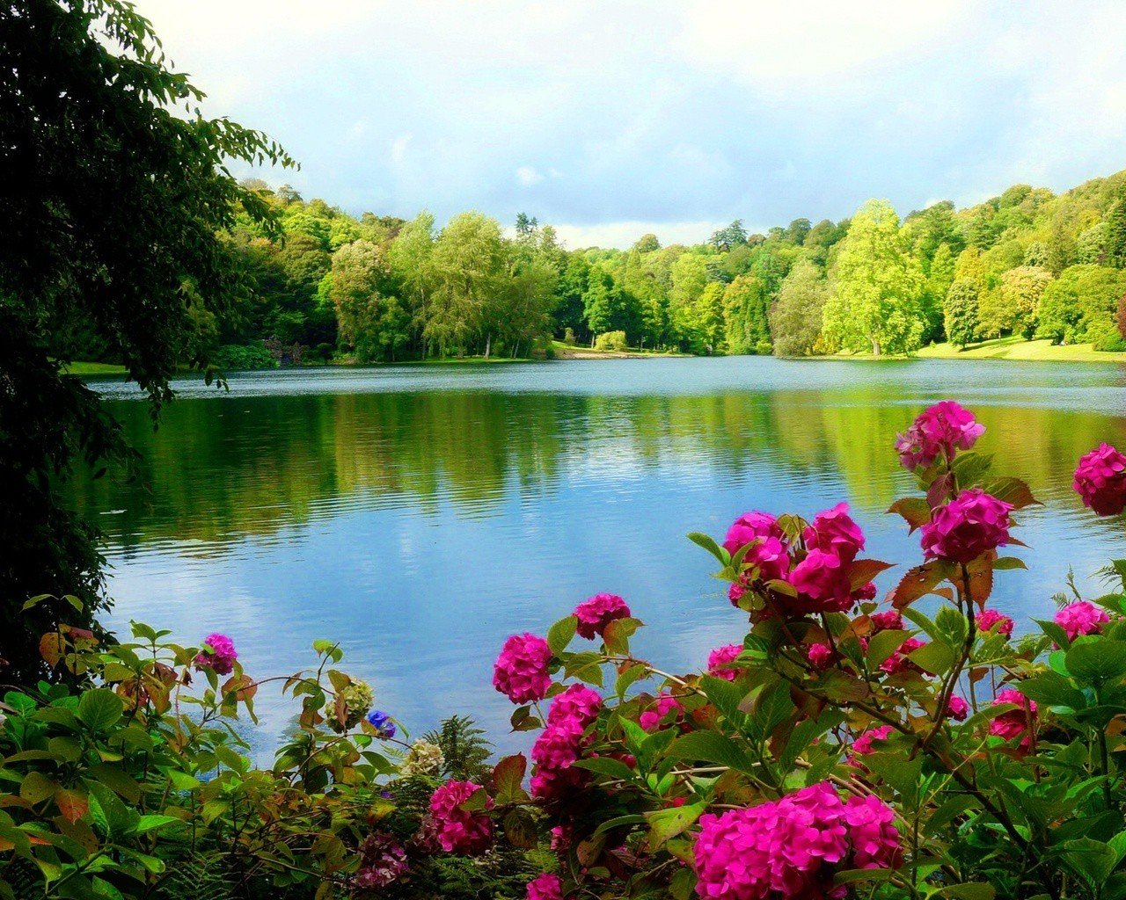
An incomparable love
Day 3
Notes:
Day No.3
An Incomparable love
Biblical Base: Creation. Genesis 1-3; 2:1-5, John 8:12, Isaiah 43:1, John 14:1-3, Revelation 21:21, Revelation 21:4.
Main teaching: God wants to show you His love.
Story: Creation.
Objectives
That children can:
Understand God’s love.
Understand how great God’s love for us is.
Be sure that God loves us.
Materials
Drawings for the lesson. Theme song of the day and memory verse in illustrative images. Illustrative materials for prayer time. Souvenirs with the Bible text of the day so that every child may take it home. Materials for crafts.

Slide 4
Welcome
Notes:
Welcome
Give the welcome in a happy and fun way. Greet the children as a group. You can start with a small act between the teachers reminding the kids of what was studied the day before.

Slide 5
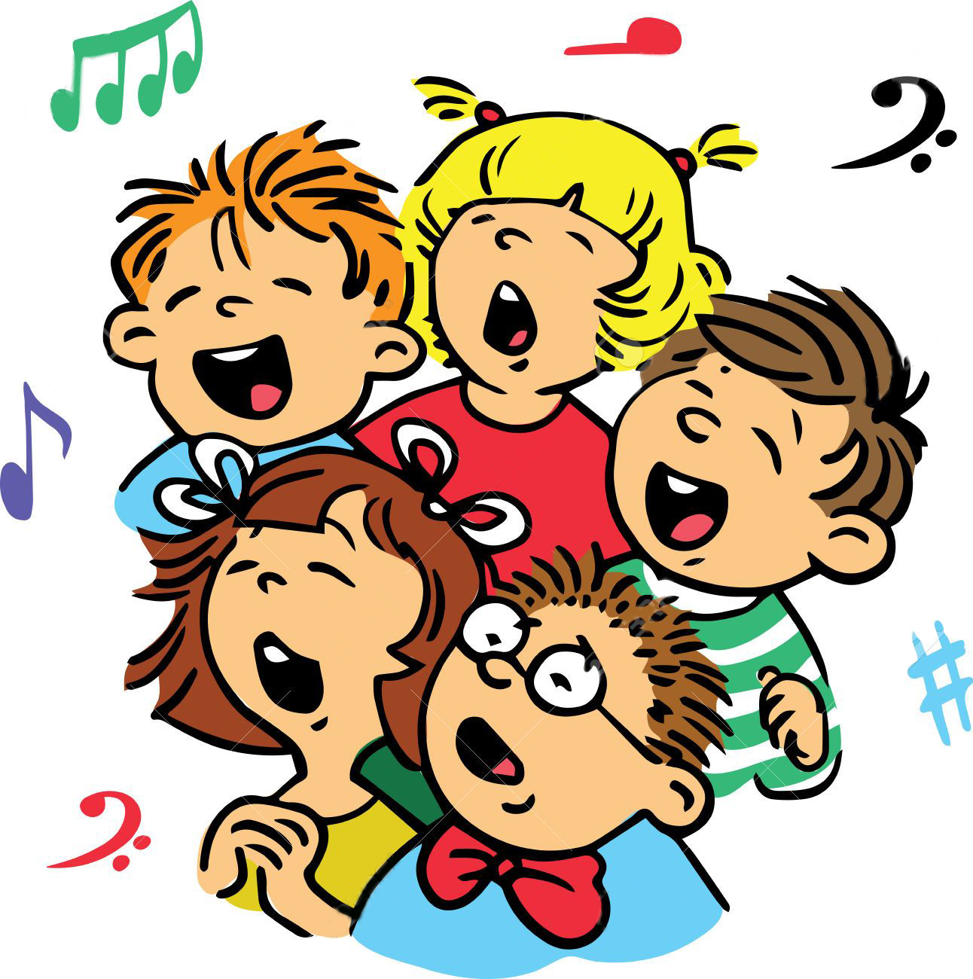
Music Time
He is great!
Notes:
Musical moment
Start with cheerful songs that can motivate the group. You can use a greeting song for this occasion.
Then teach the theme song of the day. Note the instruction leaflet.
Option: He is great!

Slide 6
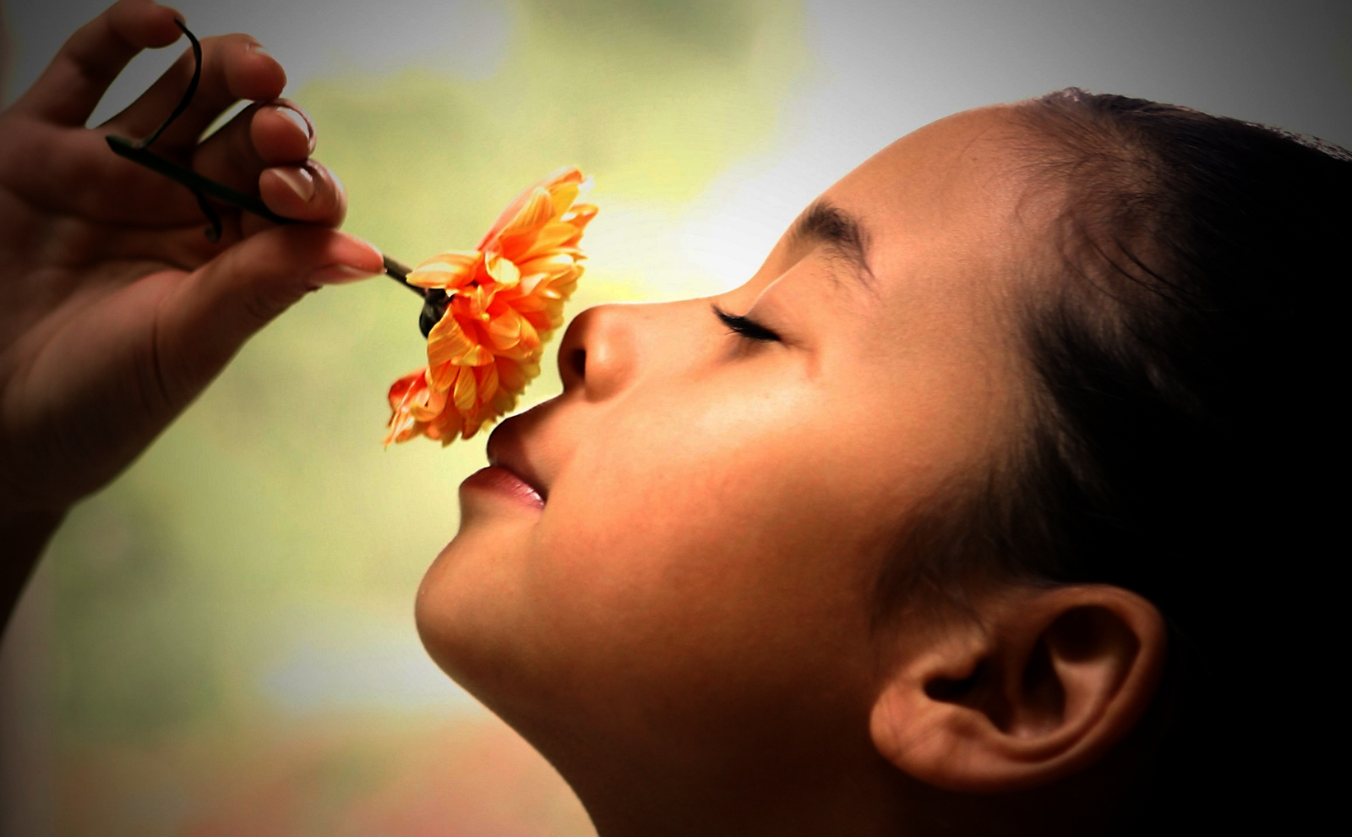
Bible Lesson of the day
Notes:
Bible Lesson of the day
Introduction
Blindfold two children. Let them sit in a chairs and have them guess a flower by its smell. Do the same with some fruits, letting the kids play and try.
Today we’re going to study how God made these things.

Slide 7
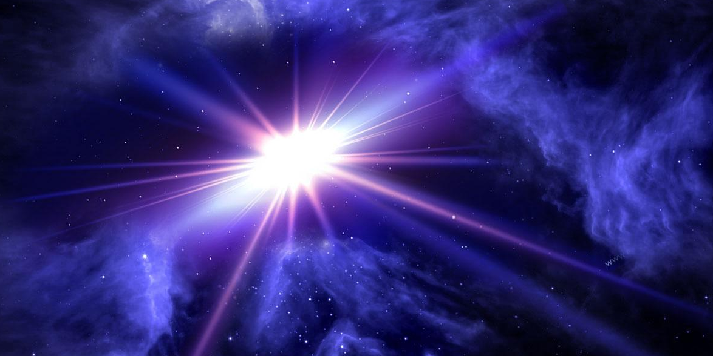
Genesis 1:1-5
Notes:
Genesis 1:1-5.
That’s how it all began.
The Earth was a total chaos, the darkness covered the abyss, and the spirit of God moved on the surface of the waters.
And God said, let there be light! And the light came to exist.
God considered the light to be good and separated it from darkness.
He called the light day, and the darkness, night.
And the evening and the morning came: that was the first day.

Slide 8
Notes:
He called the light day, and the darkness, night.
And the evening and the morning came: that was the first day.
You know what?
Our lives were also like the earth before we met Jesus- cluttered and empty. But when we hear what Jesus did for us, it’s like a light entering our hearts.
Once again Jesus turned to the people, and said to them, “, I am the light of the world: he that followeth me shall not walk in darkness, but shall have the light of life.” (John 8:12).
Our life changes when we let ourselves be guided by that light- the light of God in our lives.

Slide 9
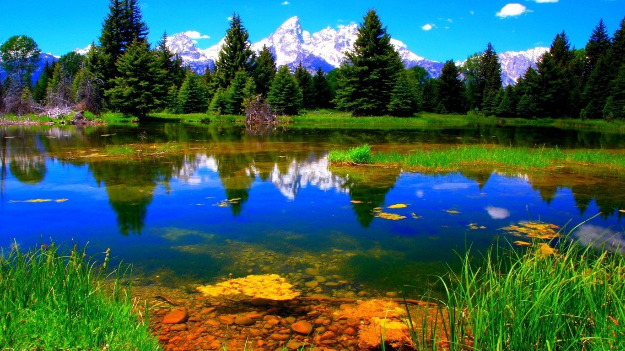
Notes:
Then God separated the waters from the firmament. Do you know how this happened? Genesis explains it.
And God said, let the firmament exist in the midst of the waters, and let them be separated!
And so it happened: God made the firmament and separated the waters that are below, from the waters that are above. God called the firmament heaven.
And the evening and morning passed: that was the second day.
And God said, let the waters below the sky gather in one place, and let dry land appear! And so it happened. God called the dry land earth, and all the waters sea And God felt this was good.
And God said, let there be vegetation upon the earth; Let it produce herbs that give seed, and trees that give their fruit with seed, all according to their species!
And so it happened. The vegetation began to sprout: herbs that gave seeds, and trees that gave their fruit with seed, all according to their species. And God felt that it was good.
Close your eyes for a moment and imagine how it all happened step by step. It must have been wonderful to see the trees grow. The flowers form, the grass... Mmm How wonderful! The second and third day of creation had passed.

Slide 10
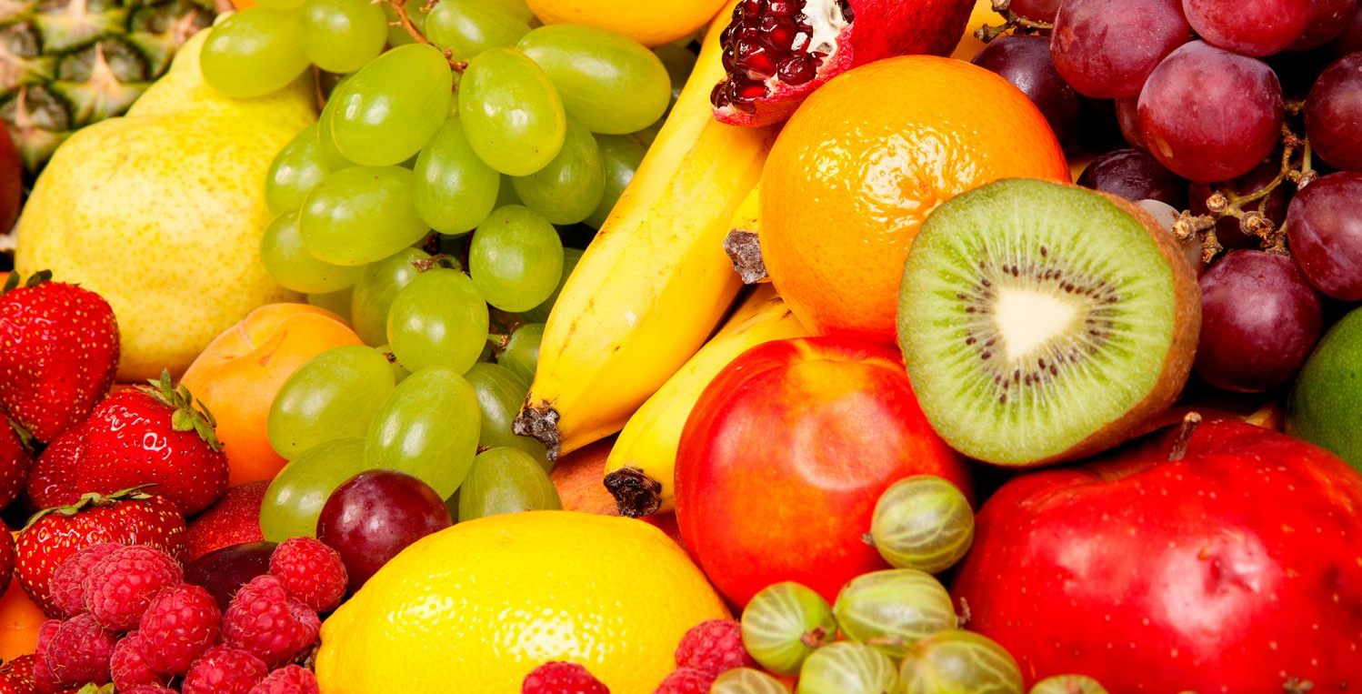
Notes:
And you...
Do you know of the benefits that come from water and everything else on earth?
There are many plants that have great benefits for us. For example: Lemons are very good, especially when our throat hurts. Then we can eat lemons, and it will heal us.
(talk about the benefits of plants for us. Take into account the best known in your city).

Slide 11
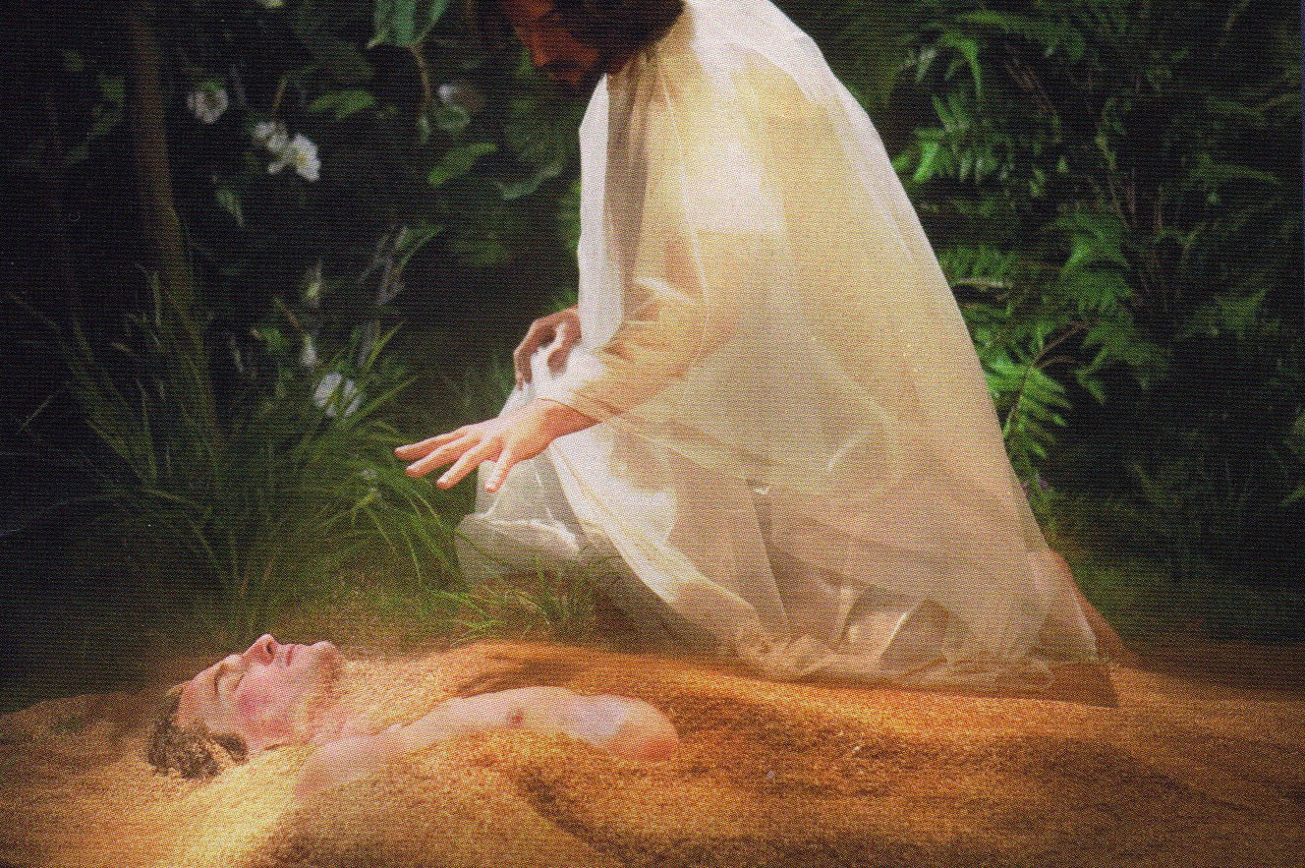
Notes:
Creation continued and birds, fish, the sun, moon, and stars, were all created. All the animals were created. That happened on the fourth and fifth day.
A great work was created on the sixth day. God created man and woman. He took dust of the earth and formed man. Then he blew the breath of life and the man became a living being.

Slide 12
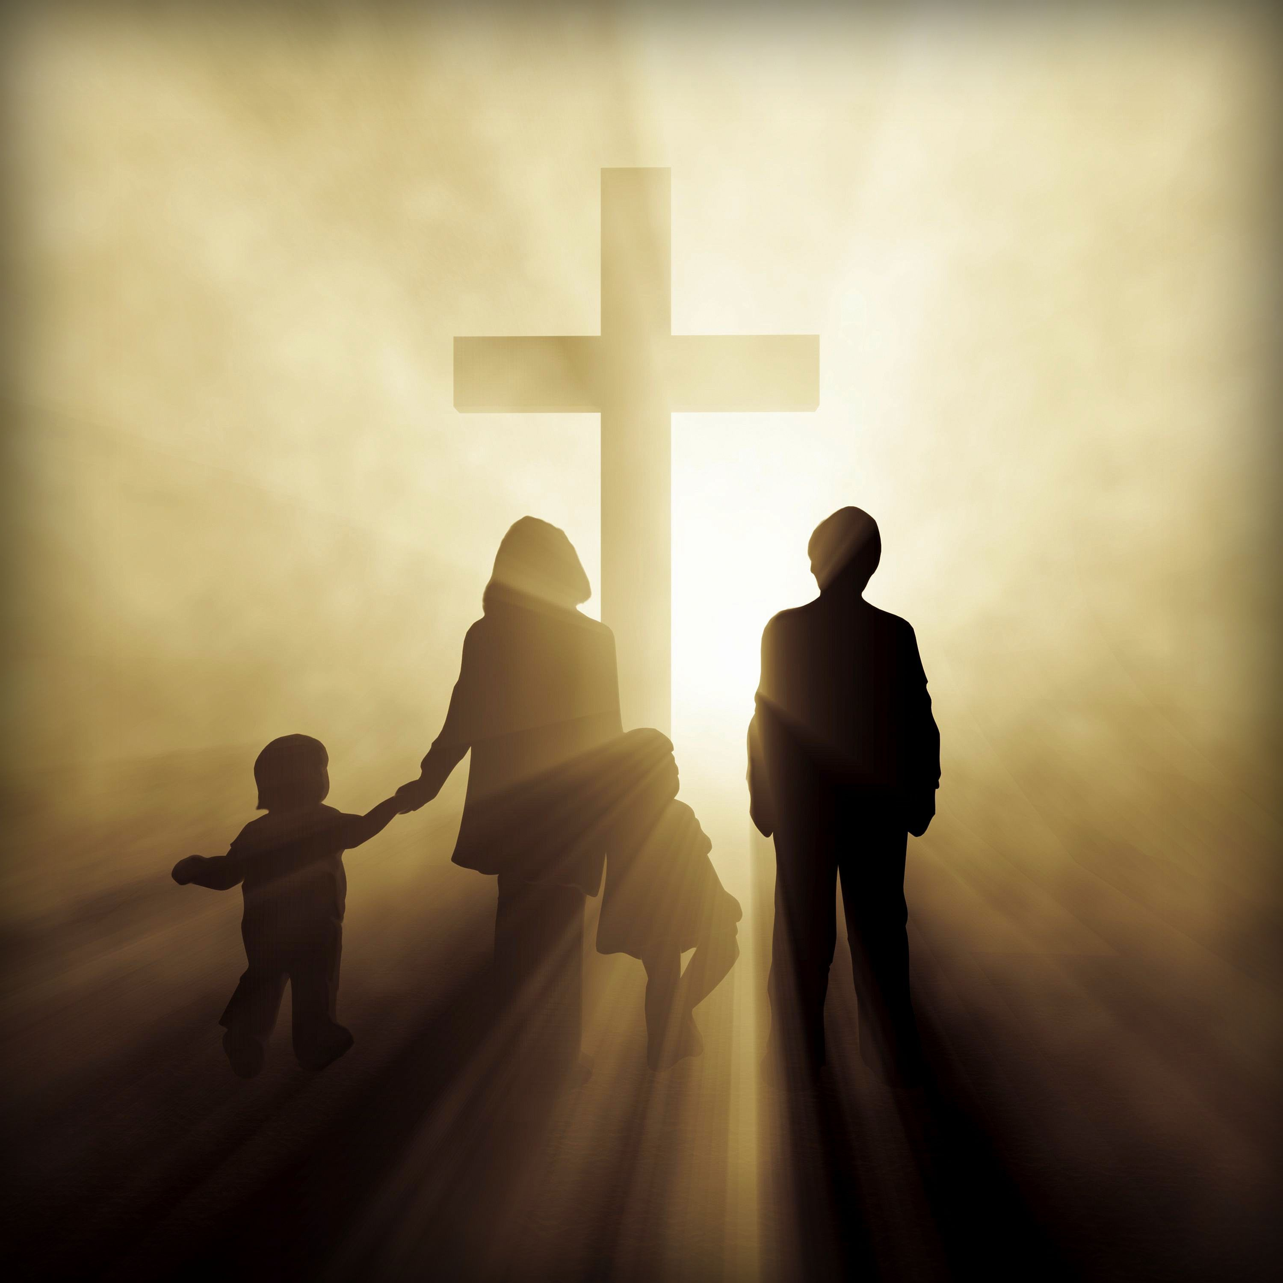
Notes:
We exist thanks to the wonderful love of God. He made each one of us—we are his children.
We are God’s because He created us, and he also died for us (Isaiah 43:1).

Slide 13
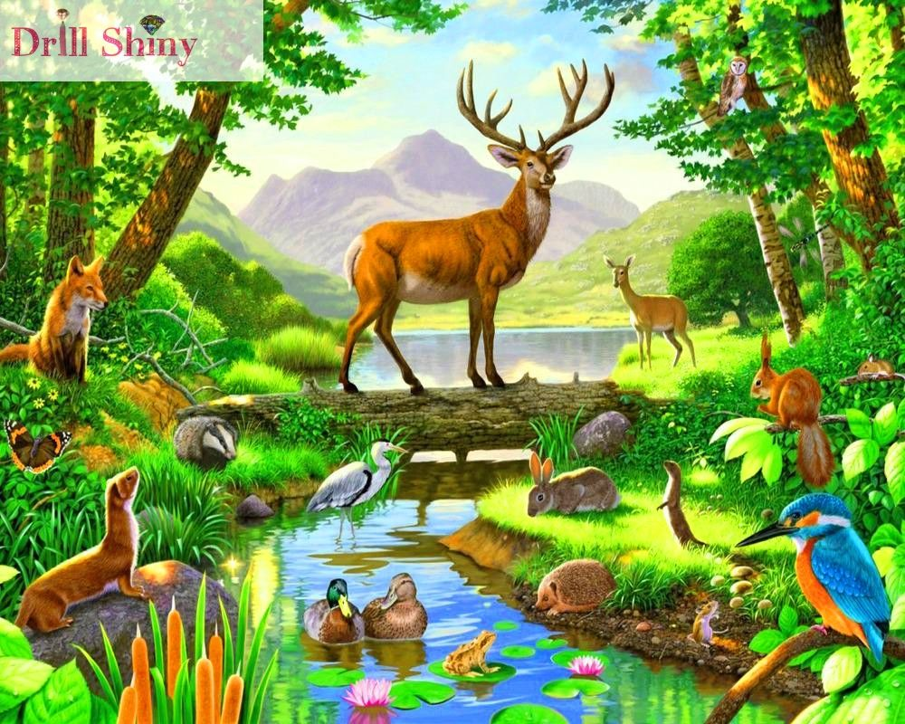
Notes:
The earth had been finished beautifully so that we could live in it. That was creation.

Slide 14
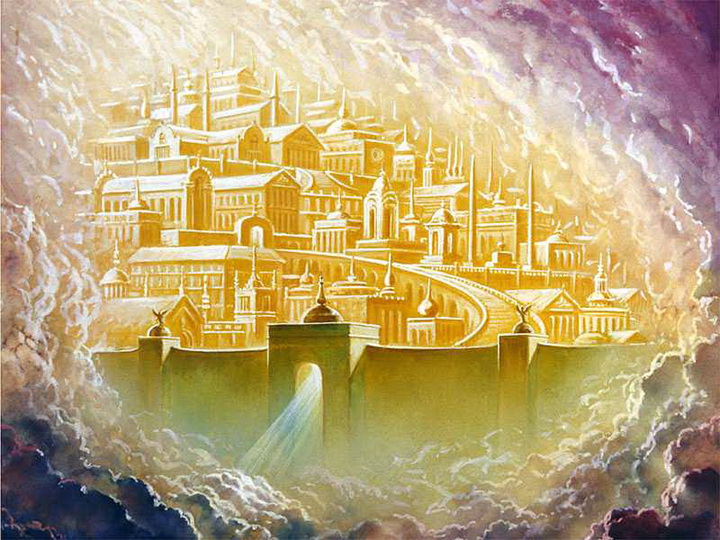
Notes:
God is now preparing another city so that we can live in. A beautiful city where there will be no more death, or pain. That place is in heaven.
“And God shall wipe away all tears from their eyes; and there shall be no more death, neither sorrow, nor crying, neither shall there be any more pain: for the former things are passed away.” (Revelation 21:4).
Jesus tells us: Do not be in anguish. Trust in God, and trust in me too. “In my Father’s house are many mansions: if it were not so, I would have told you. I go to prepare a place for you. 3And if I go and prepare a place for you, I will come again, and receive you unto myself; that where I am, there ye may be also. 4And whither I go ye know, and the way ye know.” (Joh n 14:1-3).
Do you know what this city is like? The Bible tells us.
The twelve doors are twelve pearls, and each door is made of a single pearl. The main street of the city is pure gold, as transparent glass (Revelation 21:21).
That’s a wonderful city! We can’t imagine what it’ll be like.
Soon He will come looking for us, so that we may go live with Him in that beautiful city! God has such a great love for us, that he desires us not to be here in a world full of evil but in heaven- where he lives! God has so much love for us!

Slide 15
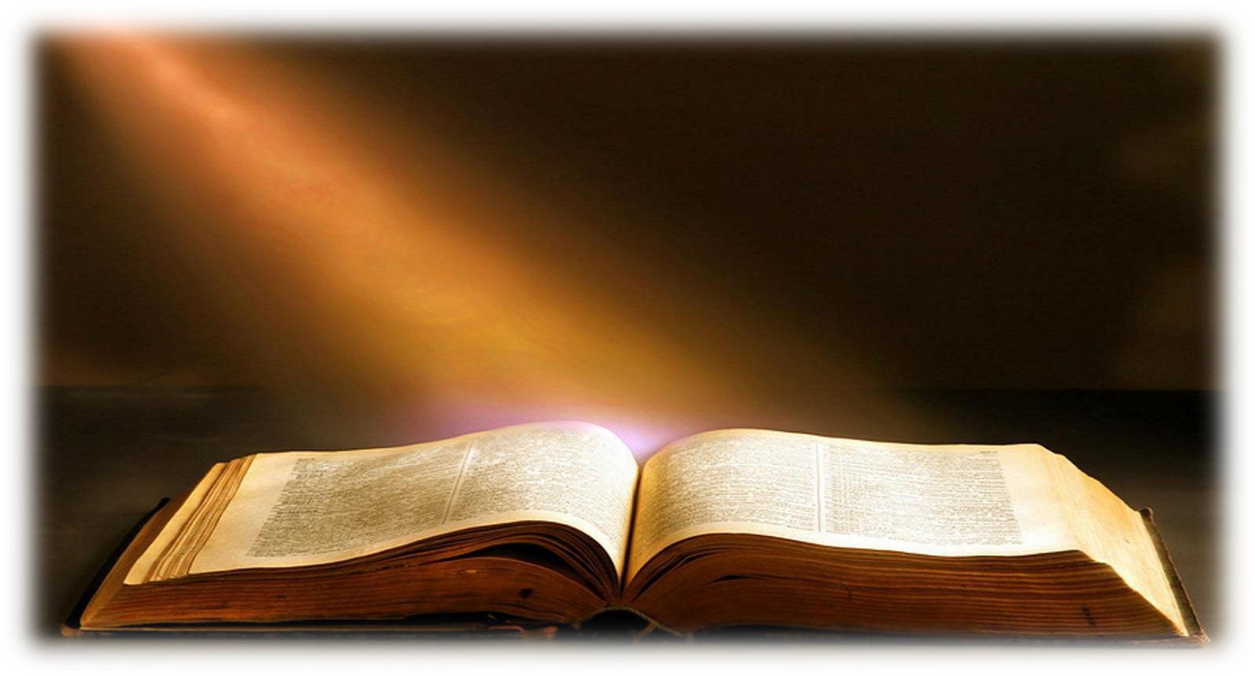
Bible Verse
Jeremiah 31:3
Notes:
Teaching the Biblical text
Jeremiah 31:3
Let us remember that this is a very special moment. It is when we record the word of God in our student’s hearts.
Prepare the verse in large cards beforehand. e.g.
The LORD hath appeared
of old unto me, saying,
Yea, I have loved thee with an everlasting love:
therefore with lovingkindness have I drawn thee.
Follow the steps shown in the instruction leaflet.
Introduction: Today I want everyone to give each other a hug. A big, big hug. Give the kids a few minutes for this activity.
Presentation: Allow the children to read the Bible text. The teacher should read strong to accompany the children in reading.
Explanation: In this step, explain the most difficult words of the text: they are manifested, eternal, prolong, and mercy.
Application: Talk about what God wants the child to learn from this text.
Repetition: Be innovative and creative in this step.

Slide 16
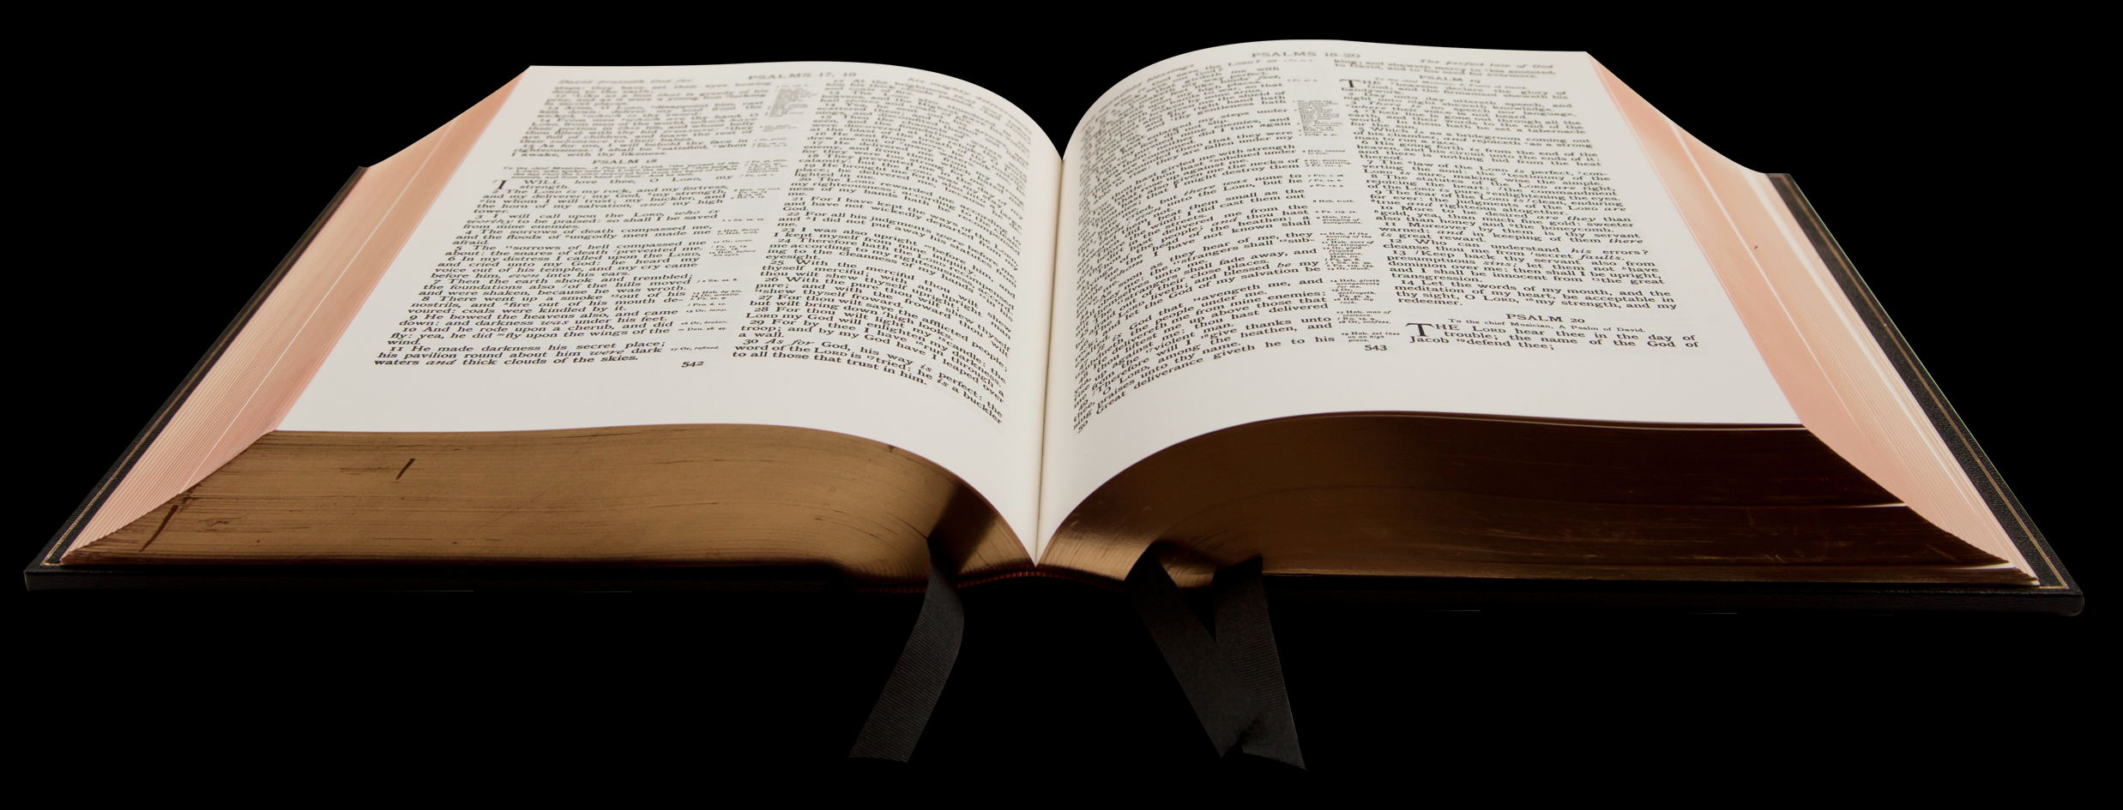
The LORD hath appeared

Slide 17
of old unto me, saying,

Slide 18
Yea, I have loved thee with an everlasting love:

Slide 19
therefore with lovingkindness have I drawn thee.

Slide 20
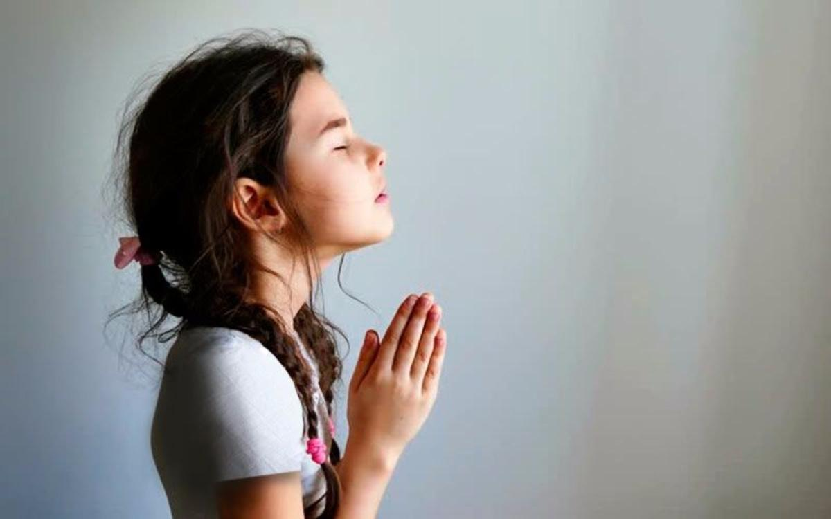
Time for Prayer
Notes:
Time for Prayer
It is time to talk to God. Start the class by going over what was learned about the time of prayer. This class will be a time of prayer requests.
We can take a very big role and let the children write down their petitions there. It is important to pray, (if we have many students) in a general way. But if we have only a few names in each of the prayer petitions, then it is important that our students know that we pray for them and do not leave anyone out.
Be careful with petitions that may have doctrinal problems. e.g. Praying for a dead grandfather... For my dead animal, etc...

Slide 21
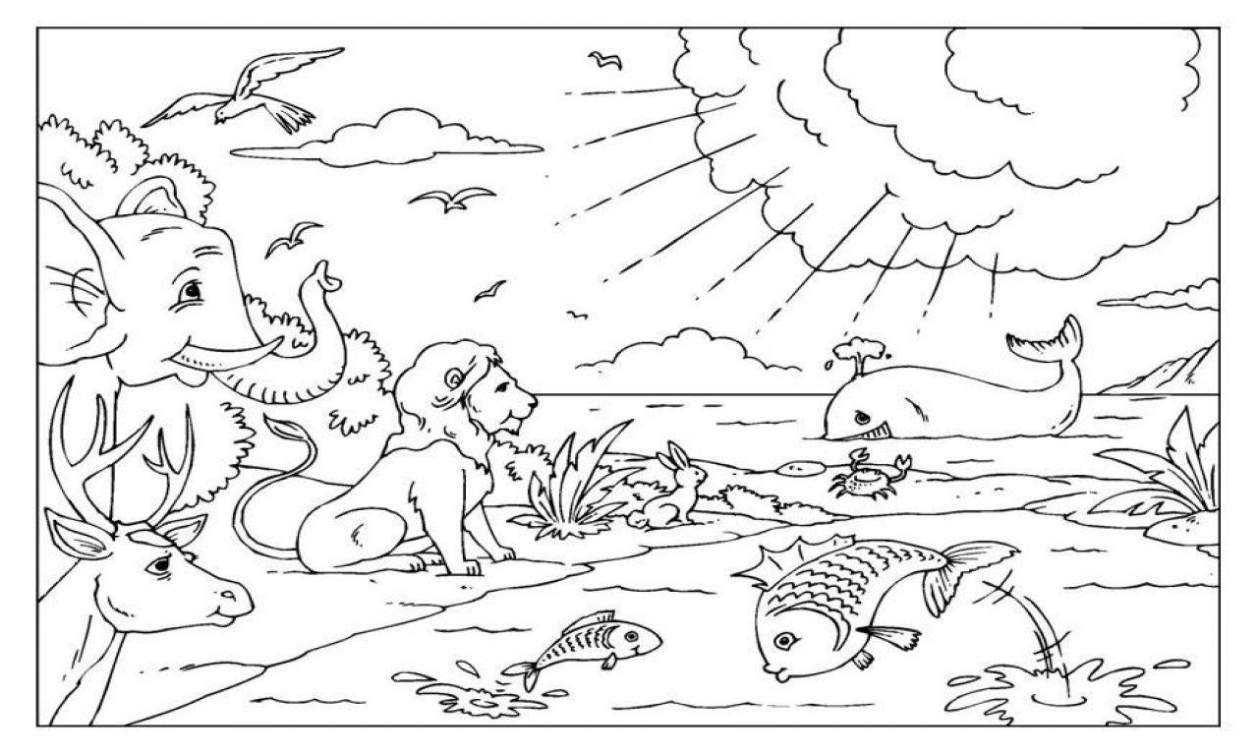
Notes:
Optional activities
In this class, a mural will be made; a great landscape where all of God’s creation is shown. Fruit trees, terrestial animals, reptiles, birds, sun, moon, stars, man, plants in general, flowers.
We can bring pictures to color in, and allow the children to cut and paste. or let them draw it all.
You can give some of the pictures to the kids so that they can color them in at home, and then bring them the next day to class so that they can glue it.

Slide 22
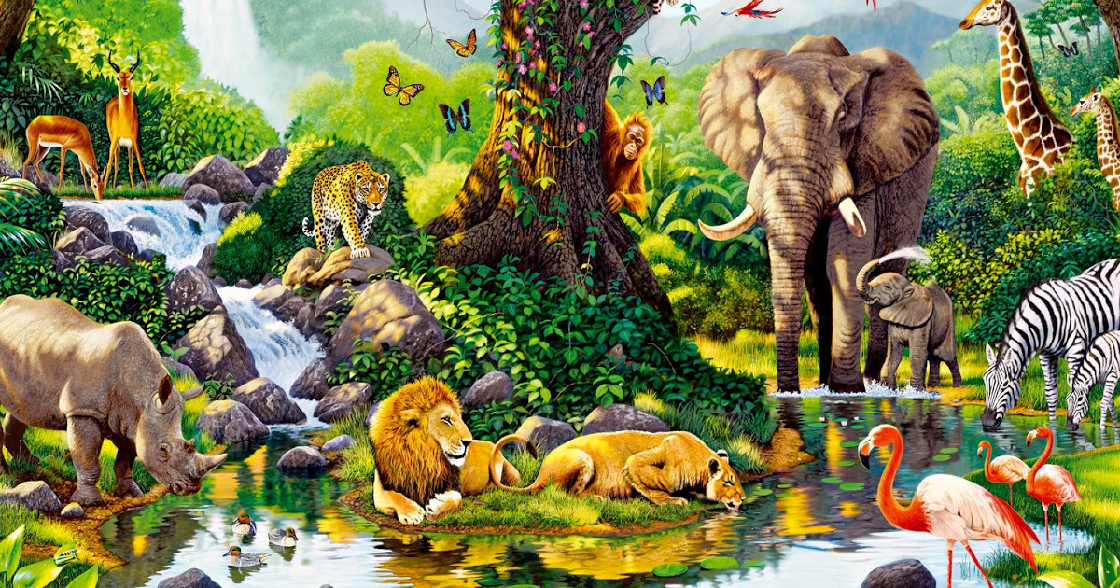
Conclusion
Thank you Lord for your great love towards me
Notes:
Conclusion, Thank you Lord for your great love towards me

Slide 23
Next topic: Release
biblewell.org
Notes:
Next topic:
Release

