Slide 2
7 days of programs for children
biblewell.org

Slide 3
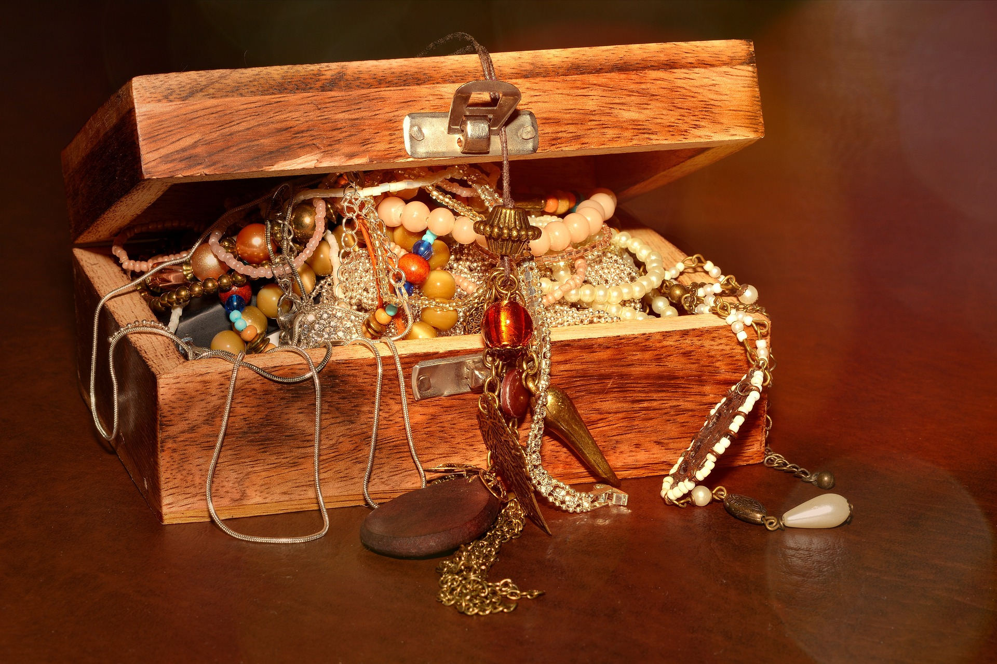
The Great Treasure
Day 1
Notes:
Day 1
The Great Treasure
Biblical Reference: Hebrews 4:12, 2 Timothy 3:16-17, Psalms 119:105,
Psalms 18:30, John 8:31-36.
Main theme or Lesson: The Bible is a treasure trove of teachings to me.
Bible Story: Bible.
Specific Objectives:
That the children may:
Learn that God has given us the Bible as a treasure for us to discover.
Feel the desire to discover the treasures that the Bible has for us.
Decide to discover the treasures that the Bible has.
Memory Verse
Psalms 119:105 “Thy word is a lamp unto my feet, and a light unto my path.”
Materials
1. Coloring pages for the lesson.
2. Theme song of the day and memory verse in illustrative pictures.
3. Illustrative materials for the time of prayer.
4. Craft activity with the memory verse of the day for each child to take home.
5. Materials for craft activities.

Slide 4
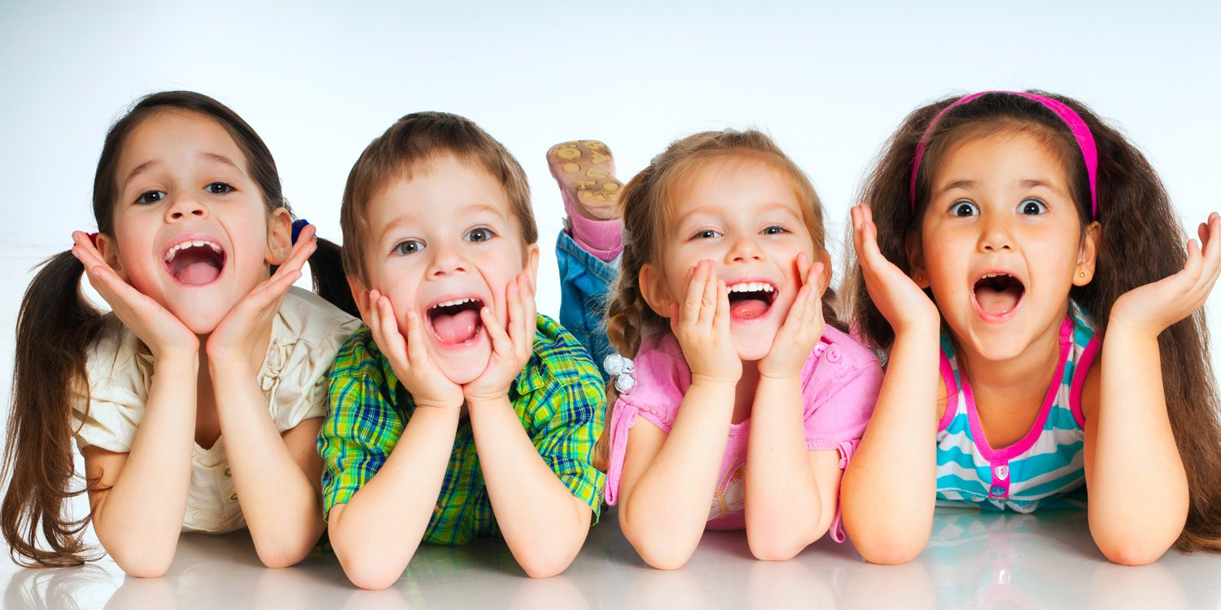
welcome!
Notes:
PROGRAM DEVELOPMENT
Welcome
Welcome everyone in a friendly, cheerful, and fun way, expressing affection to all attendees by greeting all children in a group and general way. Introduce yourself to them and to all the teachers who will be in front during the day’s activity so that the children may identify the teachers.
The welcome is a very important part since it is the first impression we give our attendees. This will influence if they return the second day or not.
Strive to make the children happy so that they may come back and invite their friends to join them the next time they come.

Slide 5
Musical Moment
Notes:
PROGRAM DEVELOPMENT
Welcome
Welcome everyone in a friendly, cheerful, and fun way, expressing affection to all attendees by greeting all children in a group and general way. Introduce yourself to them and to all the teachers who will be in front during the day’s activity so that the children may identify the teachers.
The welcome is a very important part since it is the first impression we give our attendees. This will influence if they return the second day or not.
Strive to make the children happy so that they may come back and invite their friends to join them the next time they come.

Slide 6
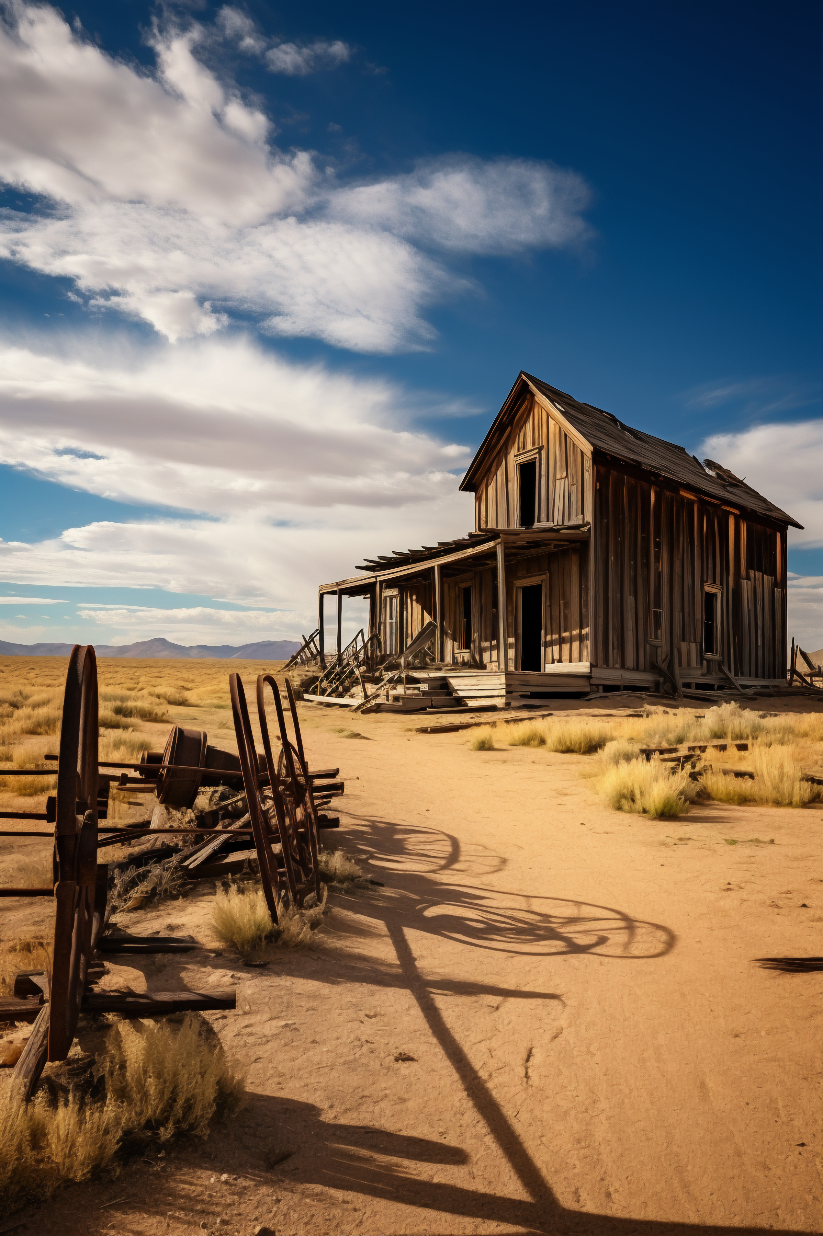
Today’s Bible Lesson
Notes:
Today’s Bible Lesson
Introduction
Once upon a time, a poor man lived in a dry area that had almost no vegetation in Texas, USA.
His house was very humble and he had no luxuries. In fact, he barely had enough to eat.
This man had acquired many debts because he hardly earned any money. The people he owed money would come by again and again to collect from him.
His situation made him sad and he didn’t know what to do.
When he was about to lose his house and his land as he wasn’t able to pay his mortgage, some men came by, asking if they could have permission to check his field for oil.

Slide 7
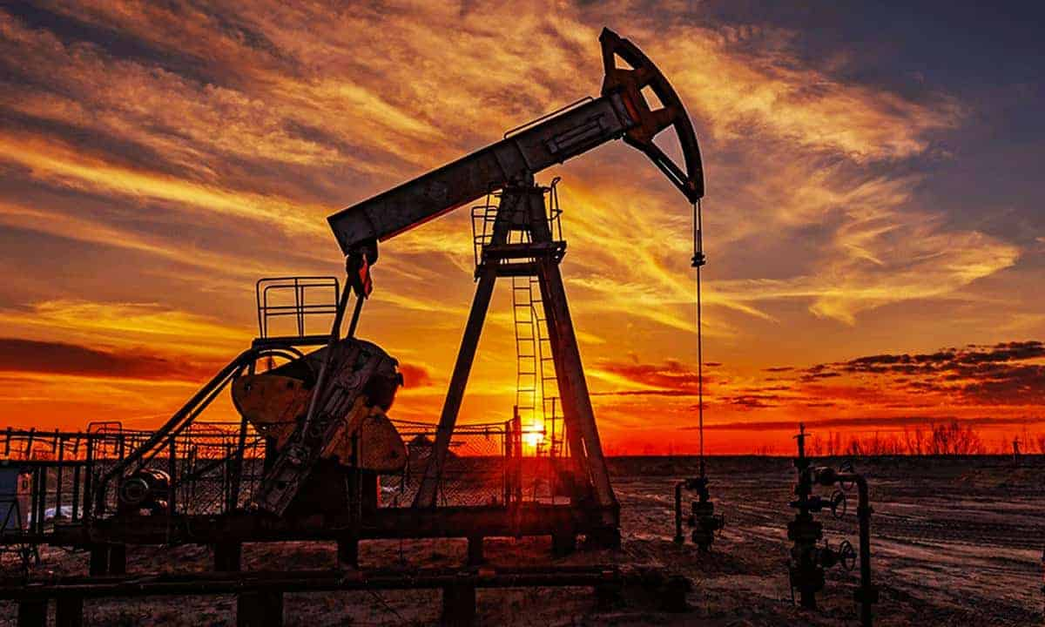
Notes:
Do you know what oil is? It is a liquid that is extracted from the earth and is used for many things such as fuel, energy, factories, and many other things.
The poor man agreed. They analyzed the land with machines and left.
A few days later they returned, this time to make a contract with him, because they had found a lot of oil there. Thanks to that, he would now earn a lot of money and soon become one of the richest men in the area.
Soon after, a pump was built, extracting a large amount of oil. The profits that the owner of the field received made him a millionaire. But in reality, he was already a millionaire before this happened. He just didn’t know it.

Slide 8
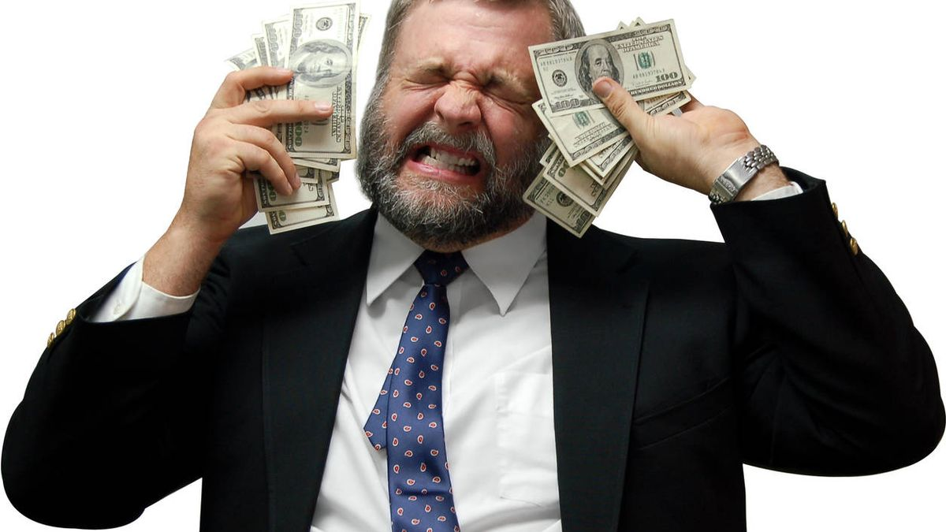
Notes:
There have been people who have found treasures and others who received an inheritance and became rich overnight, but they were not always happy.

Slide 9
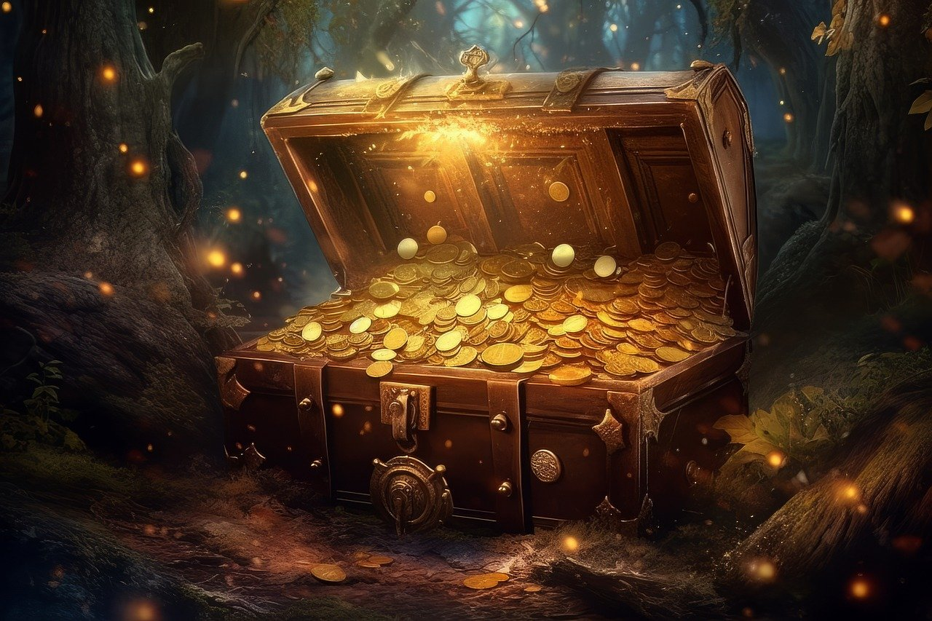
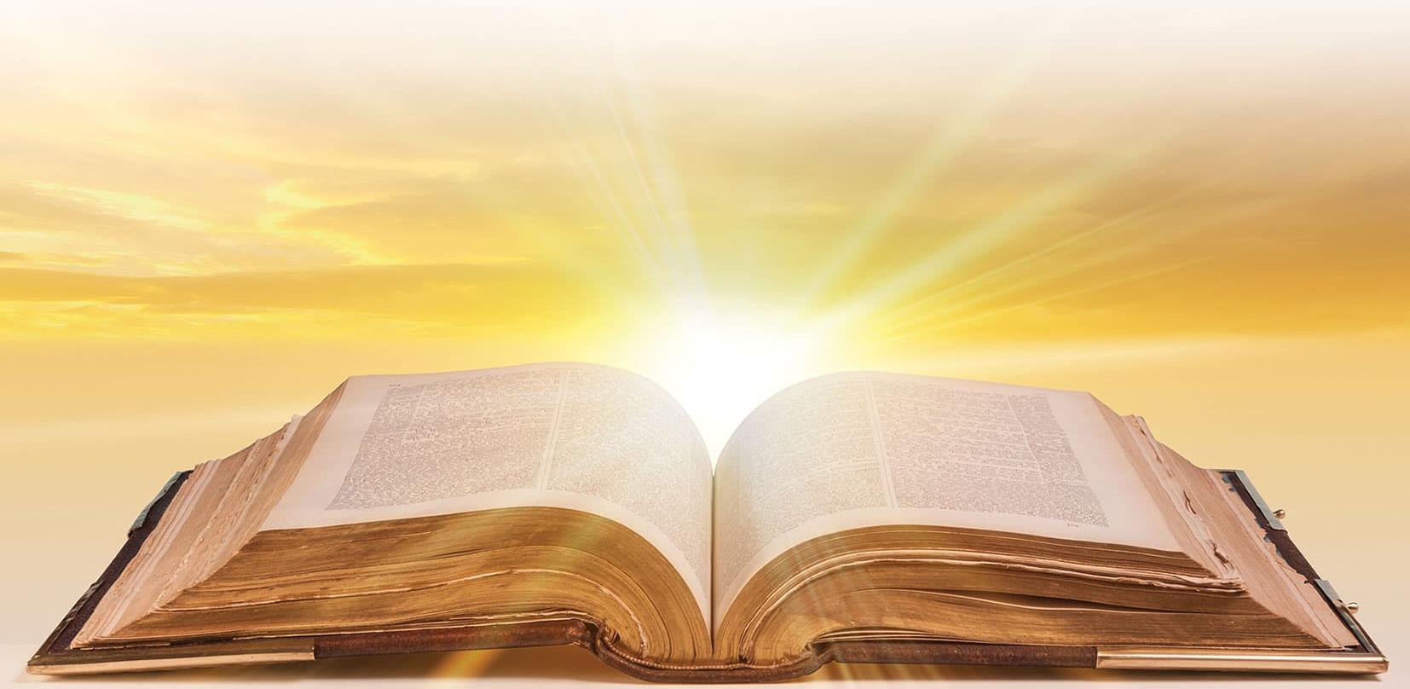
Notes:
Lesson
We are actually also rich and we often don’t know it. Do you know why?
God gave us a great treasure. Yes, a great treasure to be discovered.
It is called the Bible. Yes, the Bible is a treasure- not of monetary value, but a different type of treasure. It has many teachings for us. And it has many names. Word of God, Holy Bible, Divine Letter, Holy Scriptures, Book of Books.
Let me ask you…
Do you have a Bible? Or maybe your parents or grandparents have one? Have you ever seen it?
Look, I’m going to show you a Bible (show you a Bible).
Have you ever seen one?

Slide 10
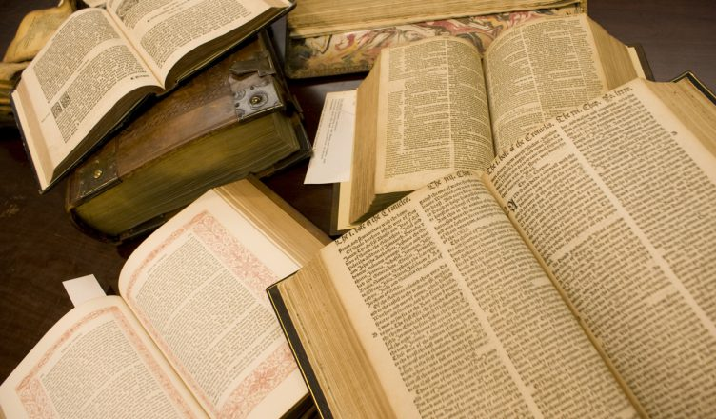
Notes:
Some Bibles are big and have big letters. Others are medium and others are small. Some are written with simpler words and others with words that are a little more difficult to understand.
The Bible is a set of books. It is made up of 66 books within one book and was written over many years. It is divided into two parts. One is called the New Testament and the other is called the Old Testament.

Slide 11
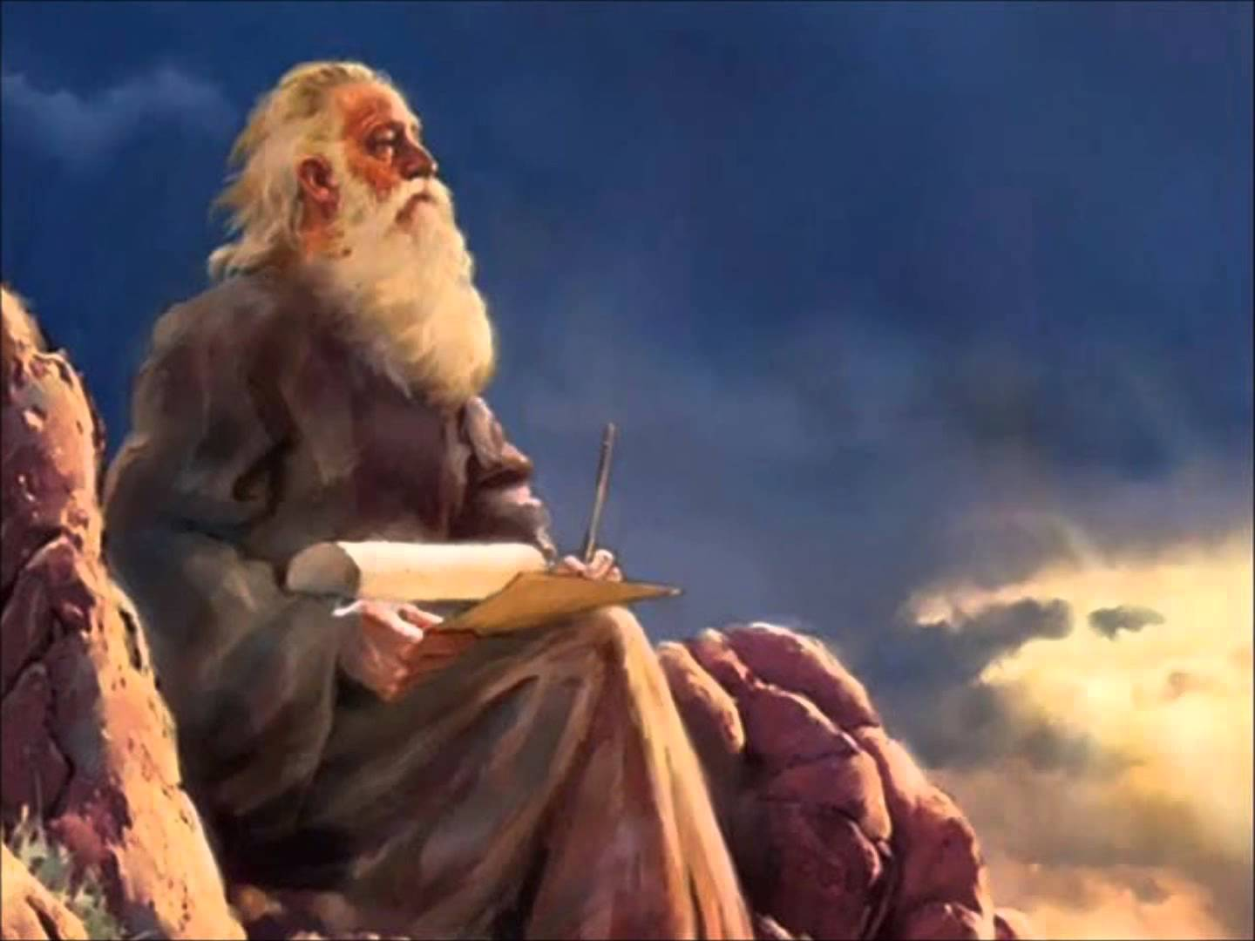
Notes:
In the Bible, there is a Scripture in 2. Timothy 3:16-17 that says: “All scripture is given by inspiration of God, and is profitable for doctrine, for reproof, for correction, for instruction in righteousness: That the man of God may be perfect, thoroughly furnished unto all good works.” This verse says that the Bible is inspired by God.
To inspire means to breathe. God told the prophets what to write in the Bible and they wrote. That is why it is the Word of God.

Slide 12
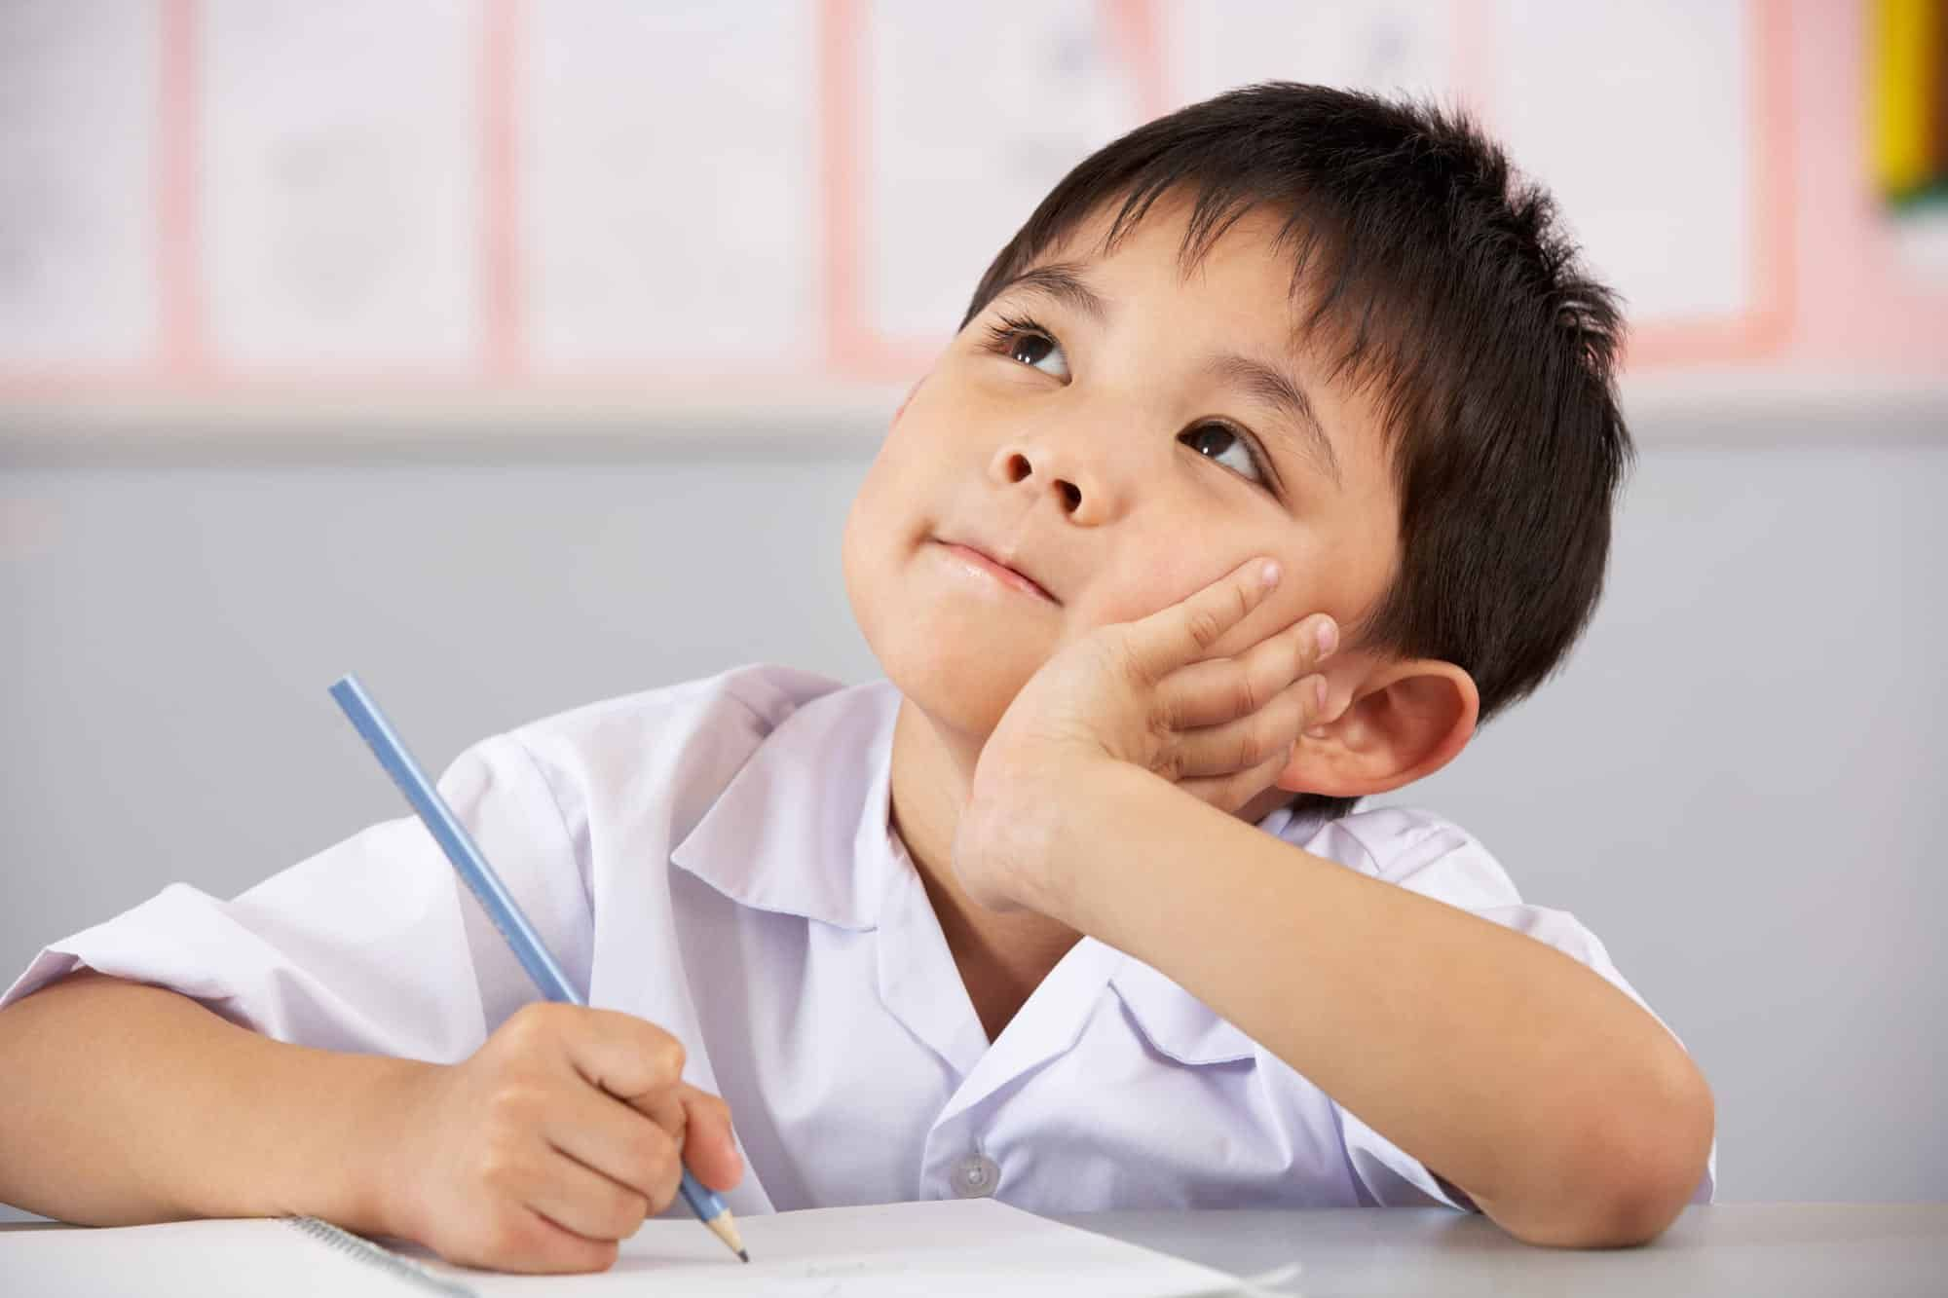
Notes:
For example, your mother may ask you to write a message for your aunt. If she dictates the message to you, who is the author of the message? You or your mother? You wrote the message, but the message was sent by your mother. This is why the prophets wrote the Bible- because God told them to write His message.
It also says that the Bible is useful for reproof, which means that it corrects us when we are wrong. For example, the Bible says that we should not lie. So when you learn that you should not lie, you stop doing it and when you want to do it, you remember what the Bible says about it and you decide not to do it anymore.

Slide 13
“Thy word is a lamp unto my feet, and a light unto my path.” Psalms 119:105
Notes:
In Psalms 119:105, the Bible tells us something important: “Thy word is a lamp unto my feet, and a light unto my path.” The Bible is like a light that helps us to see how we should live better. It is the light that tells us what we should do and how we should live in this life.
Isn’t that wonderful?
God’s Book teaches us the true way to be good people.
In it, we can also find promises, stories, and rules that help us at every moment.

Slide 14
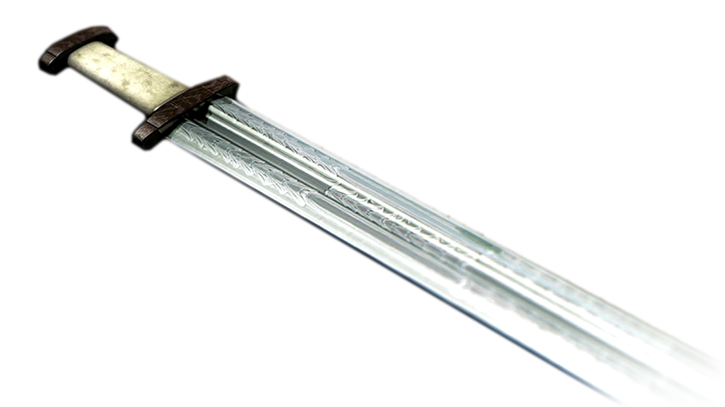
Notes:
Hebrews 4:12 says: “For the word of God is quick, and powerful, and sharper than any twoedged sword, piercing even to the dividing asunder of soul and spirit, and of the joints and marrow, and is a discerner of the thoughts and intents of the heart.”
Have you ever seen a sword? I’m sure you have, even if only through a picture. Look at this picture.
Yes, this is a sword. Swords are like knives but with a sharp edge on both sides. If you stab something with the sword, it sinks quickly and goes in deep. Because it has a double edge.
The Bible is like a sword because when we read it, it continues to speak to our life.

Slide 15
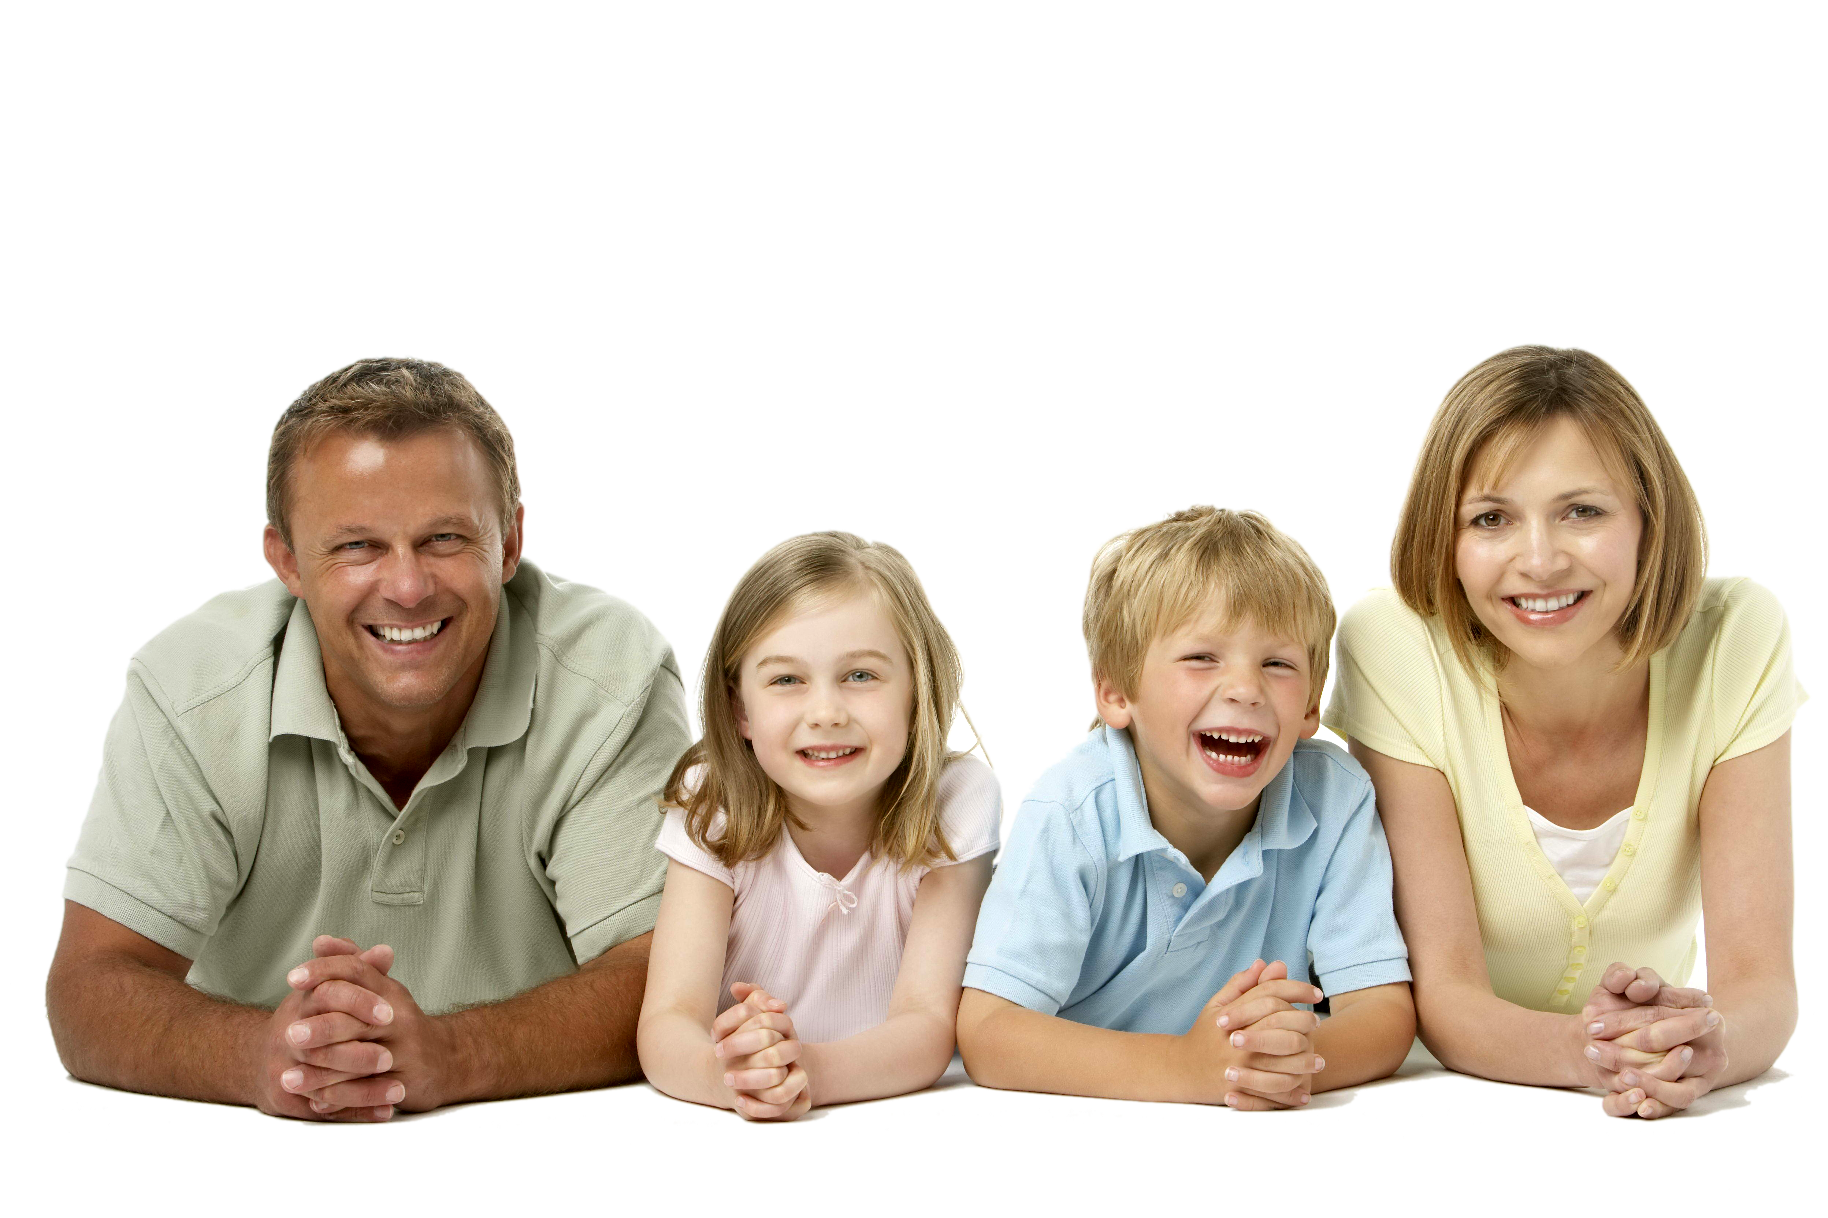
Notes:
For example: you read “Honour thy father and thy mother: that thy days may be long upon the land which the Lord thy God giveth thee.” (Exodus 20:12).
“Aah,” you say. “Here God is trying to teach me that I should obey my parents in order to live long. If I obey, I will have a long life.”
Then when you want to disobey, your mind tells you:
-Don’t do it. The Bible taught you this other way. So you obey.
Isn’t it wonderful?
The Bible always teaches us, and through the Holy Spirit, we can remember all the teachings we’ve learned.
Have you ever read the Bible?

Slide 16
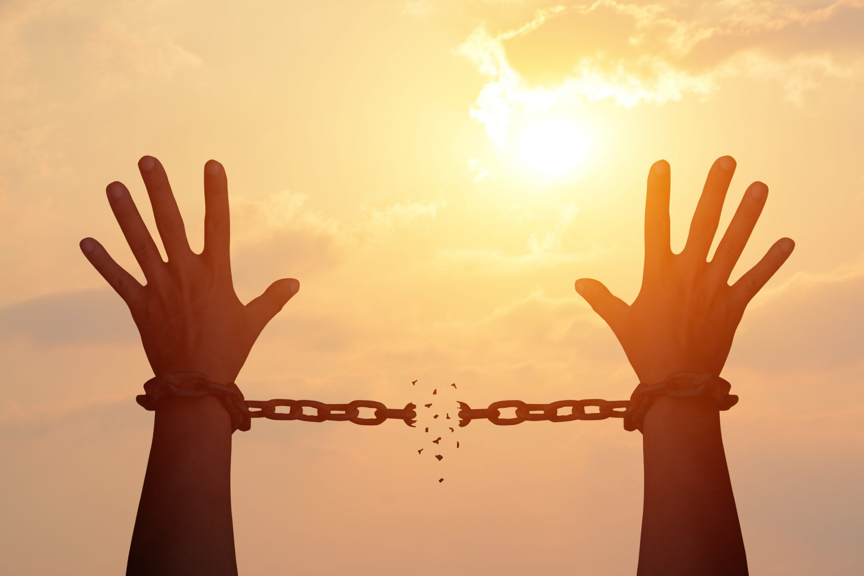
FREE!
Notes:
You should read the Bible, because in it you will discover treasures for your life.
John 8:31 says: “Then said Jesus to those Jews which believed on him, If ye continue in my word, then are ye my disciples indeed”.
If we read God’s Word, we can find truths and teachings in it that can bring us freedom. Freedom from what? Freedom from sin. Freedom from all temptations. We will know what to do to do things right and what not to do anymore.
In the Bible we find out how to defend ourselves from sin and how to live with Jesus forever.
Would you like to learn more about the Bible and discover the treasures that God left there?

Slide 17
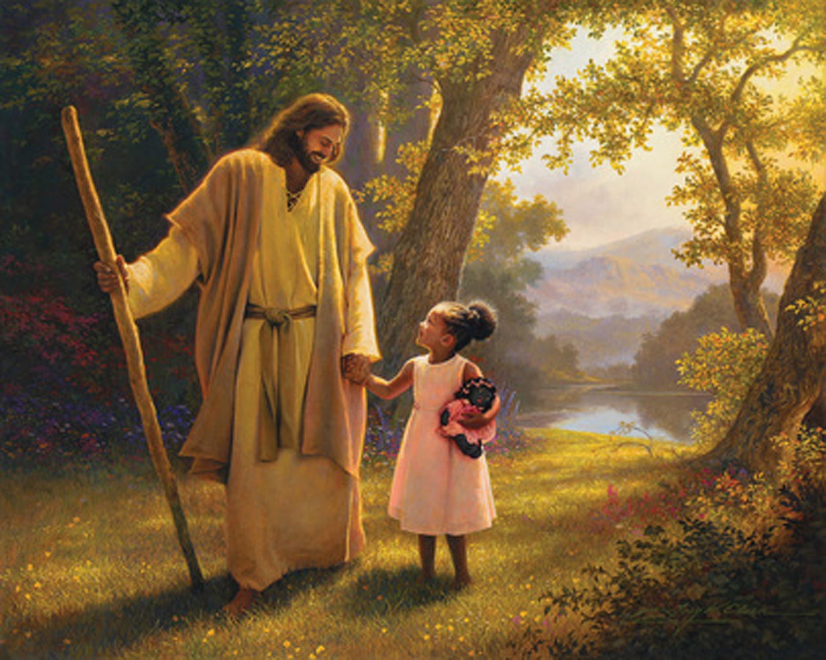
“Commit thy way unto the Lord; trust also in him; and he shall bring it to pass.” Psalms 37:5.
Notes:
You can ask someone to lend you one, or you can look it up on an adult’s phone or ask your parents to buy you one. If you read it, you will discover great treasures for your life.
But while you get one, I’m going to leave you with a little piece of the Bible called the Bible text for you to memorize this week. How does that sound?
It goes like this: “Commit thy way unto the Lord; trust also in him; and he shall bring it to pass.” Psalms 37:5
This means that if you give your life to Jesus and trust in Him, you will always do well.
Keep discovering treasures in these programs. We will continue to talk about the Bible.

Slide 18
Psalms 119:105
Notes:
Teaching the Memory Verse
This moment is important, as we are engraving the very Word of God in the hearts and minds of the children.
Review the instruction manual to remember how to teach the verse.
Today’s verse is: “Thy word is a lamp unto my feet, and a light unto my path.” Psalms 119:105.
Illustrate the text with different drawings. For example: Lamp, feet, Bible, path.
Introduction: Today we are going to learn a small portion of the Word of God, something written in the Bible. It is through the Bible that God teaches and speaks to us. Today’s verse is written in Psalms 119:105.
Presentation: Show the presented Bible verse as a picture or visual image. Allow someone to read it. Then look it up in the Bible and have one of those present read it again. Show that it is written in the Bible.
Explanation: For better understanding of our students, explain each part of the verse in detail “Thy word is a lamp unto my feet, and a light unto my path” Psalms 119:105.
Application: We have studied today that the Bible is a treasure. It is a light that teaches us how we should walk in this life. The Bible tells us how we should behave ourselves and what we should do.
Repetition: Invite the children to read the verse by repeating it several times. Repetition should be joyful, with enthusiasm and understanding. Repetition suggestions: First the boys, then the girls, then everyone, then the tall, the medium, those with shoes, etc.

Slide 19
Thy word is a lamp unto my feet,
Notes:
Thy word is a lamp unto my feet,

Slide 20
and a light unto my path.
Notes:
and a light unto my path.” Psalms 119:105.

Slide 21
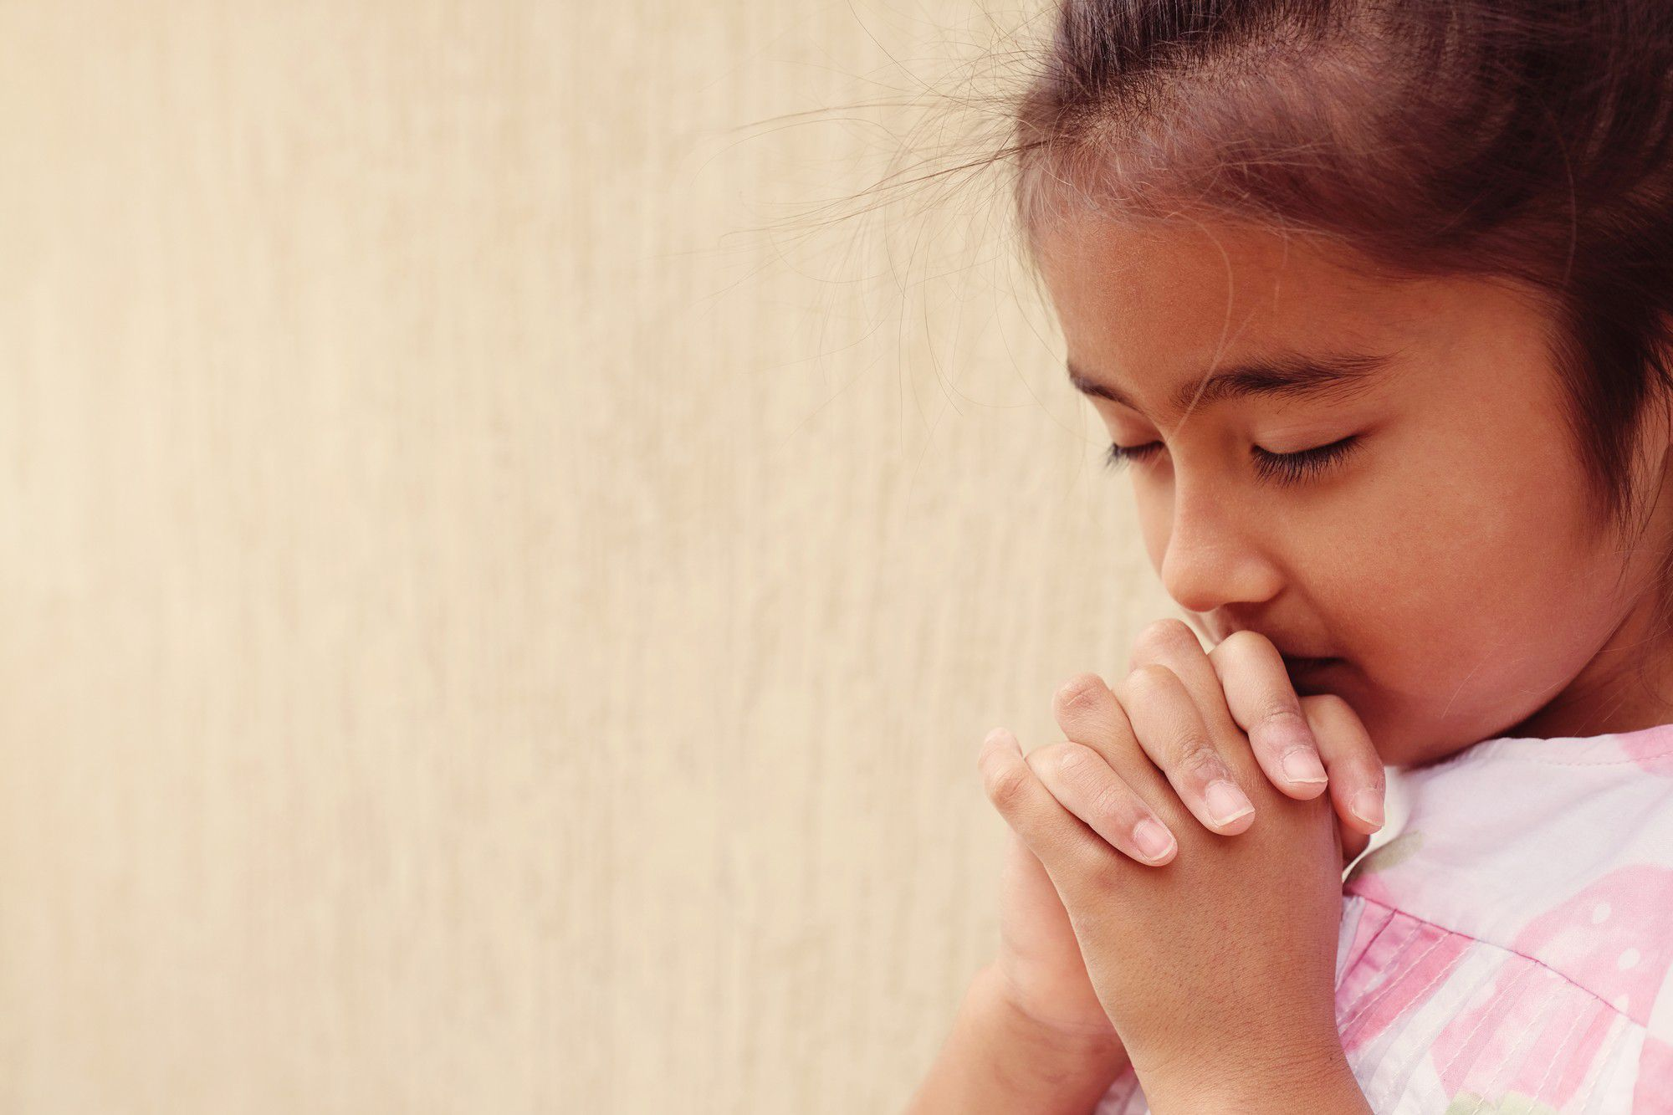
Prayer Time
Notes:
Moment of Prayer
Each part of the program must be carried out continuously, without spaces of silence.
Prayer time is a very important part of the program because we teach our students to talk to God. We teach them that we can communicate with Christ.
You can review the time of prayer in the instruction manual. Teach the children what prayer is. Compare prayer to talking to a friend.
Talk about the importance of talking to God every day. Perform a short and simple prayer so that the students can learn by example.
Example:
We have reached a very special moment. Let’s talk to God.
This is what we call a prayer. To pray is to talk to God. We can talk to God like we talk to a friend.
We tell them how we feel, ask them for things, and thank them.
We talk to our friends every day. Likewise should we speak to God every day. It’s very important to
be friends with God.
Today I will teach you how to pray. This is how we pray:
“Our Father who art in heaven, hallowed be Thy name. We thank You for leaving us a treasure to discover. We know that You have left us many teachings there. Open our mind to learn them. Forgive our faults. In the name of Jesus, amen.

Slide 22
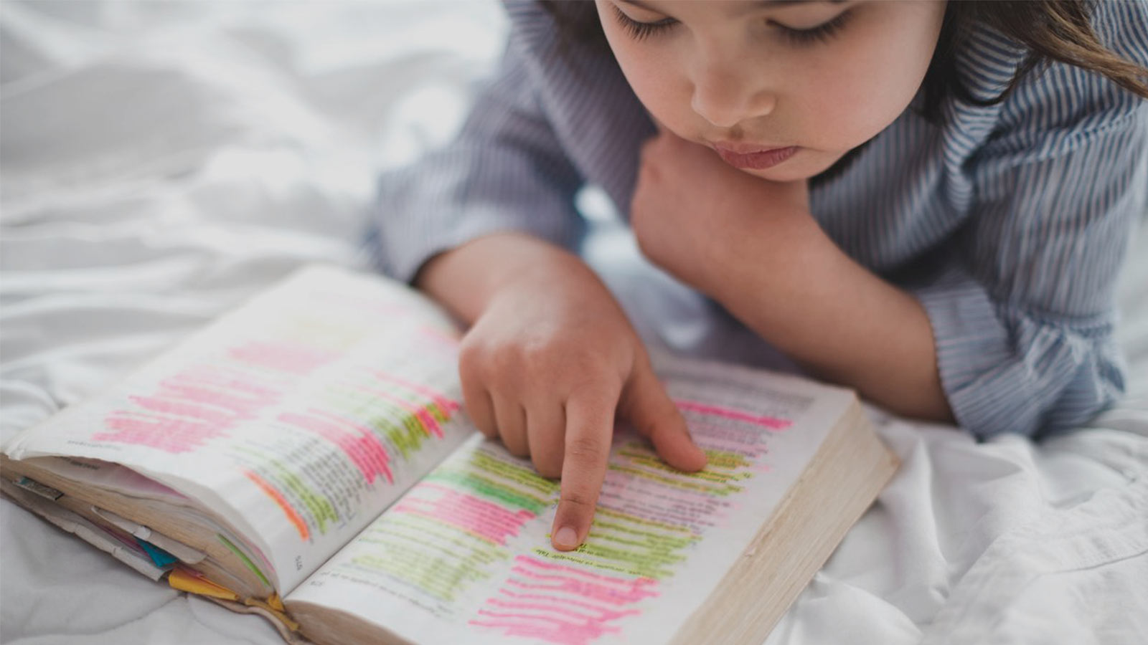
ACTIVITIES
Notes:
Activities
Activity 1
Have a conversation with the students, asking who has a Bible and if they have ever read it.
Bring Bibles so that the children may take some time to read it.
Activity 2
Make a small Bible with Bible verses for the children to read during the week.

Slide 23
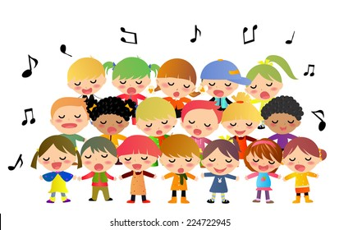
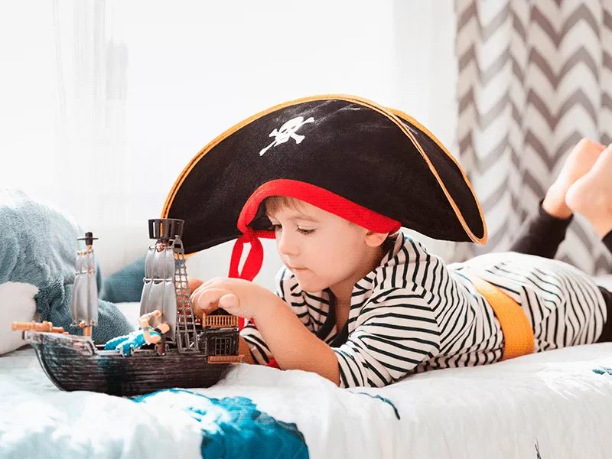
Musical Moment
“I am not a pirate”
Notes:
Musical Moment
“I am not a pirate”

Slide 24
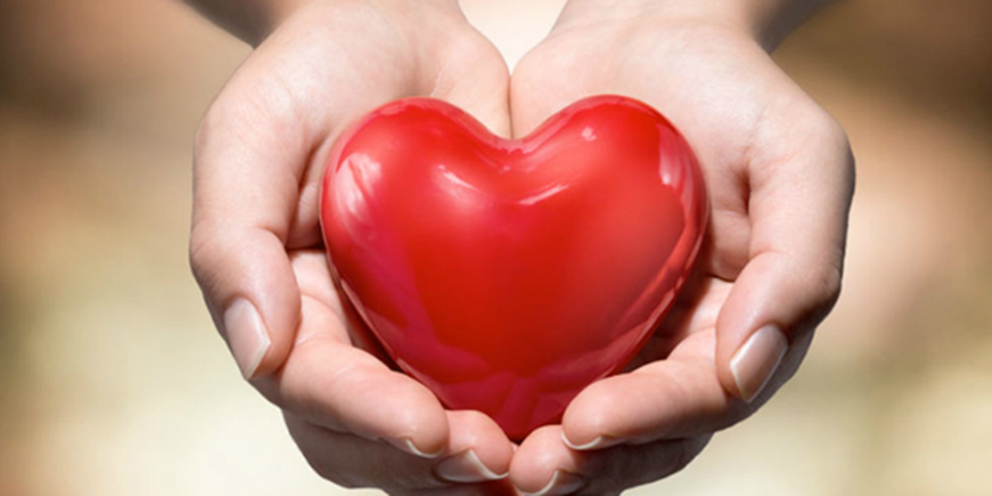
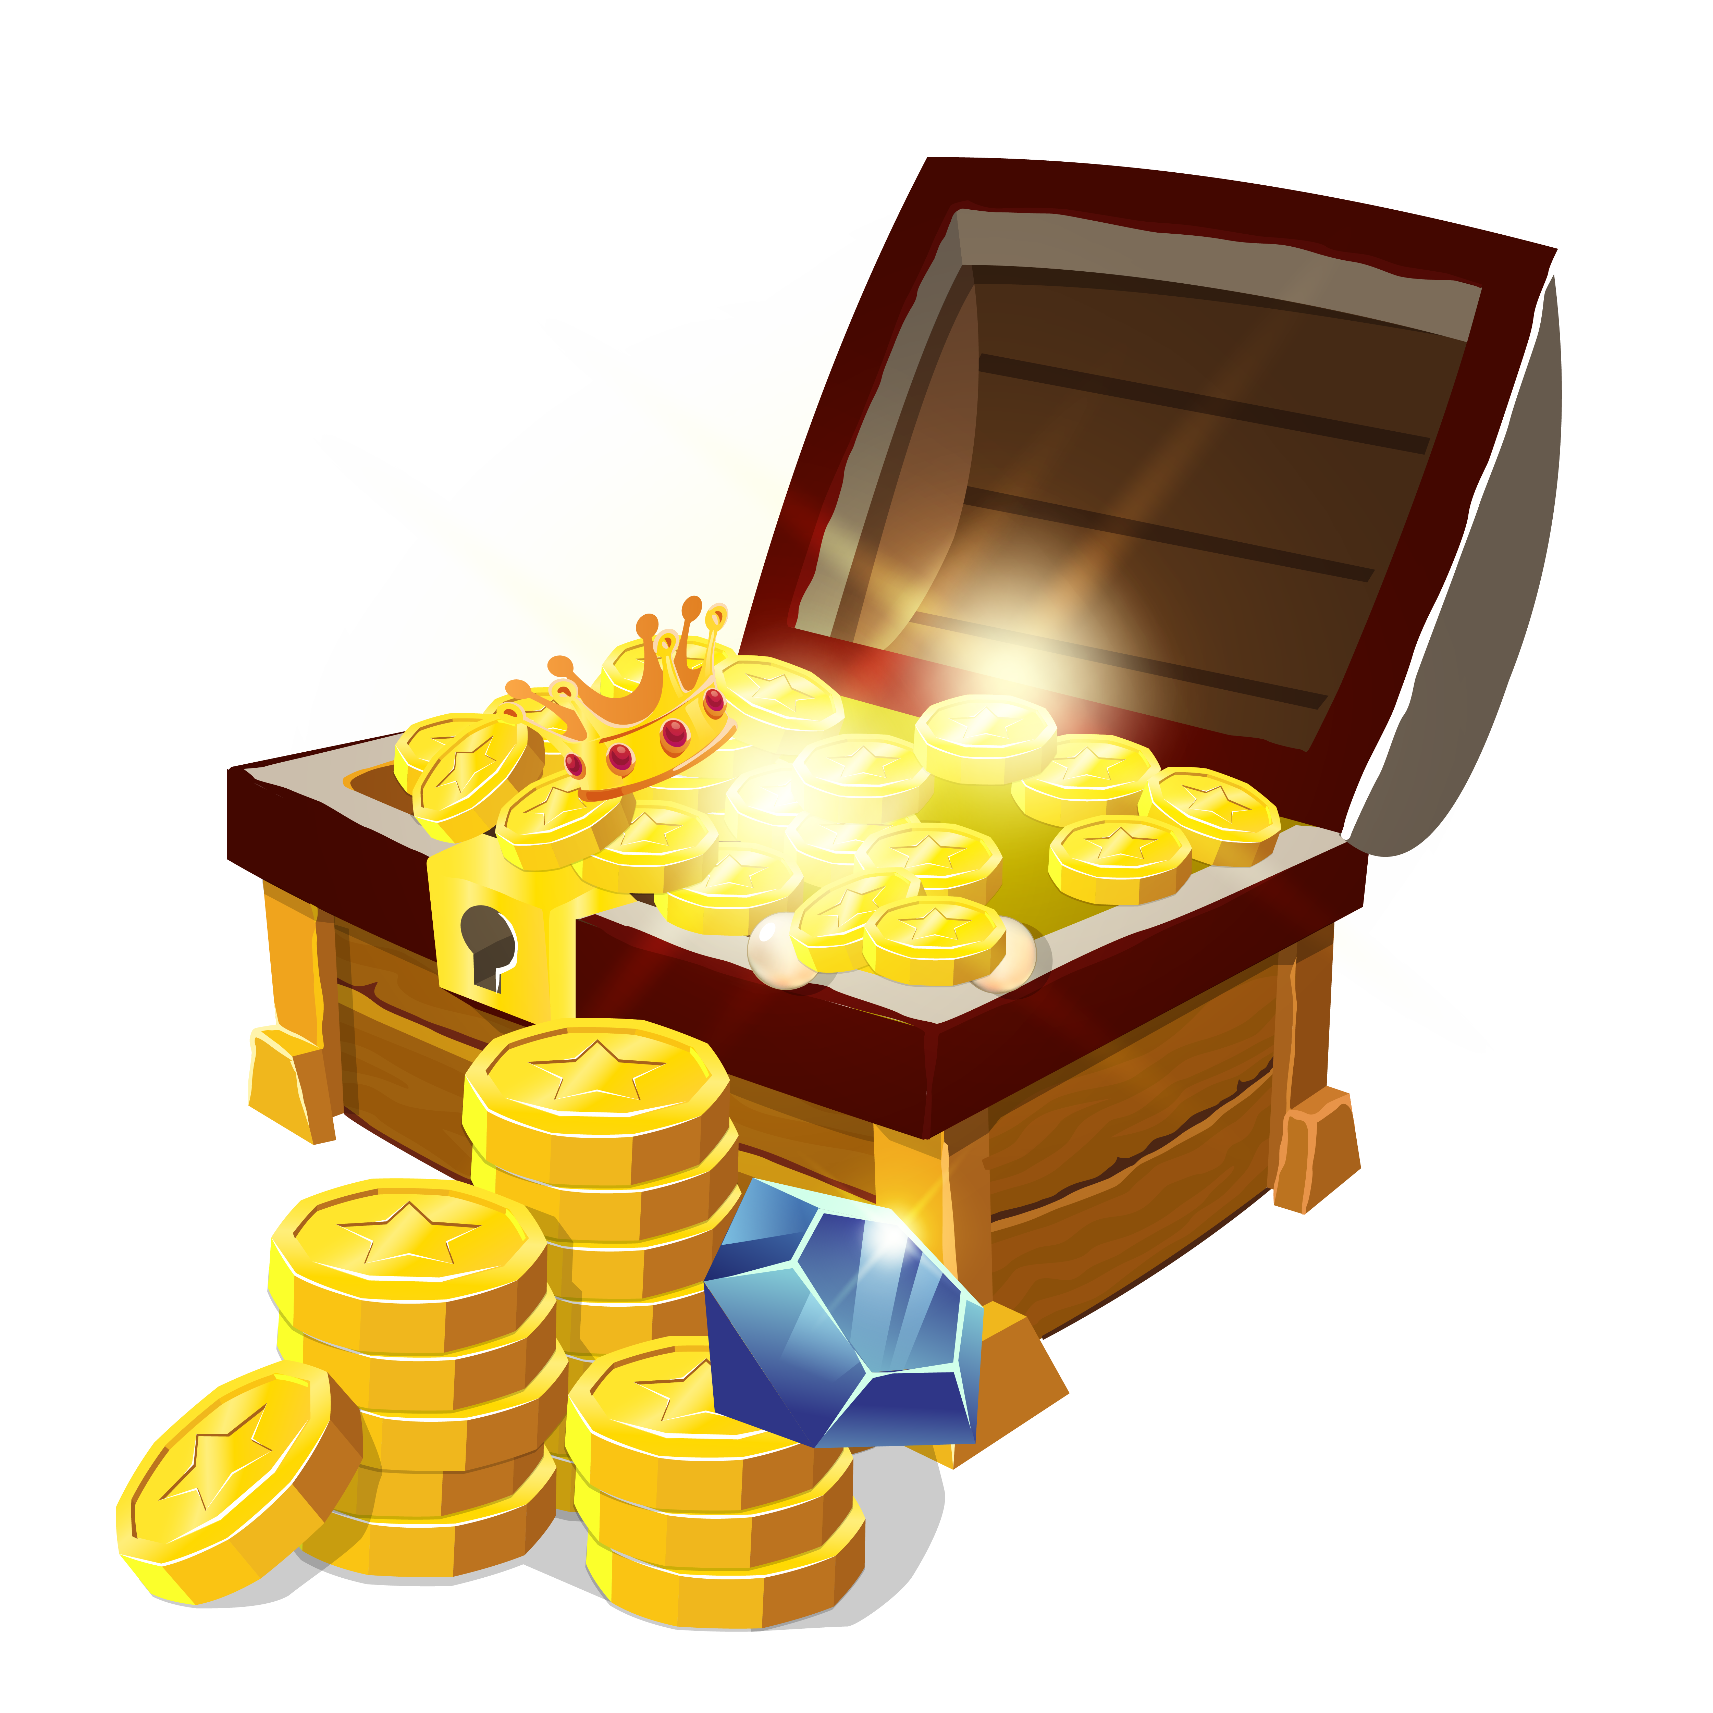
Musical Moment
I am not a Pirate
I am not a pirate, gold I do not seek.
But my heart it holds a treasure,
Hidden very deep.
Notes:
I am not a Pirate
I am not a pirate, gold I do not seek.
But my heart it holds a treasure,
Hidden very deep.

Slide 25
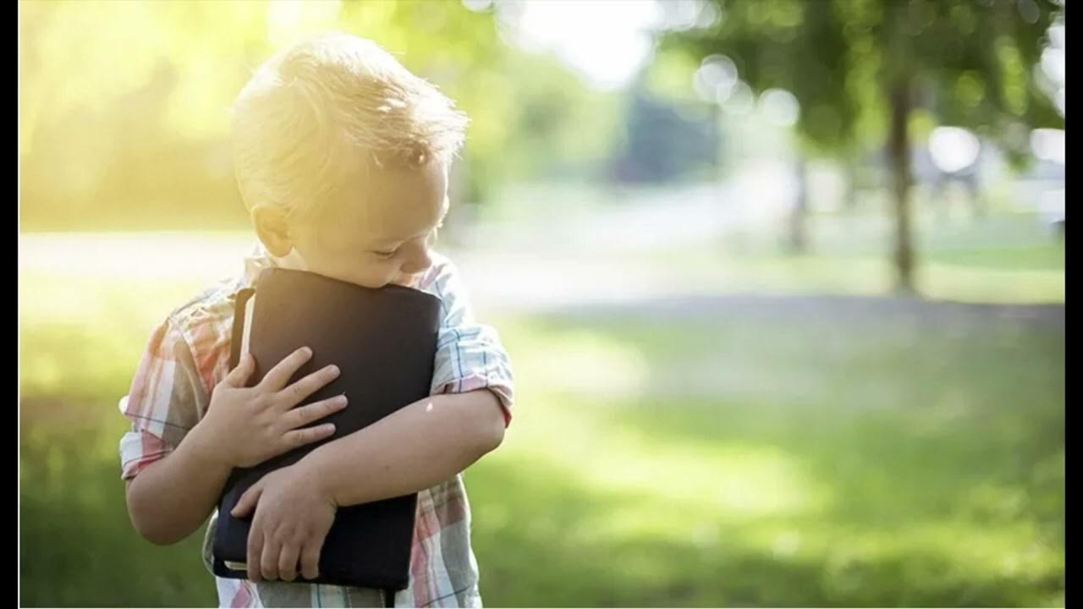
Musical Moment
I am not a Pirate
Come and join and let me share this treasure with you today;
It’s a special book of value,
That will always guide your way.

Slide 26
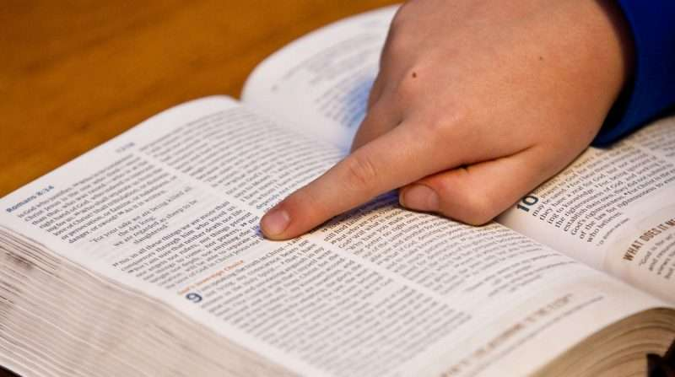
Musical Moment
I am not a Pirate
The Bible has power,
Changing many lives
Taking time each day to read it makes you very wise,
Notes:
The Bible has power,
Changing many lives
Taking time each day to read it makes you
very wise,

Slide 27
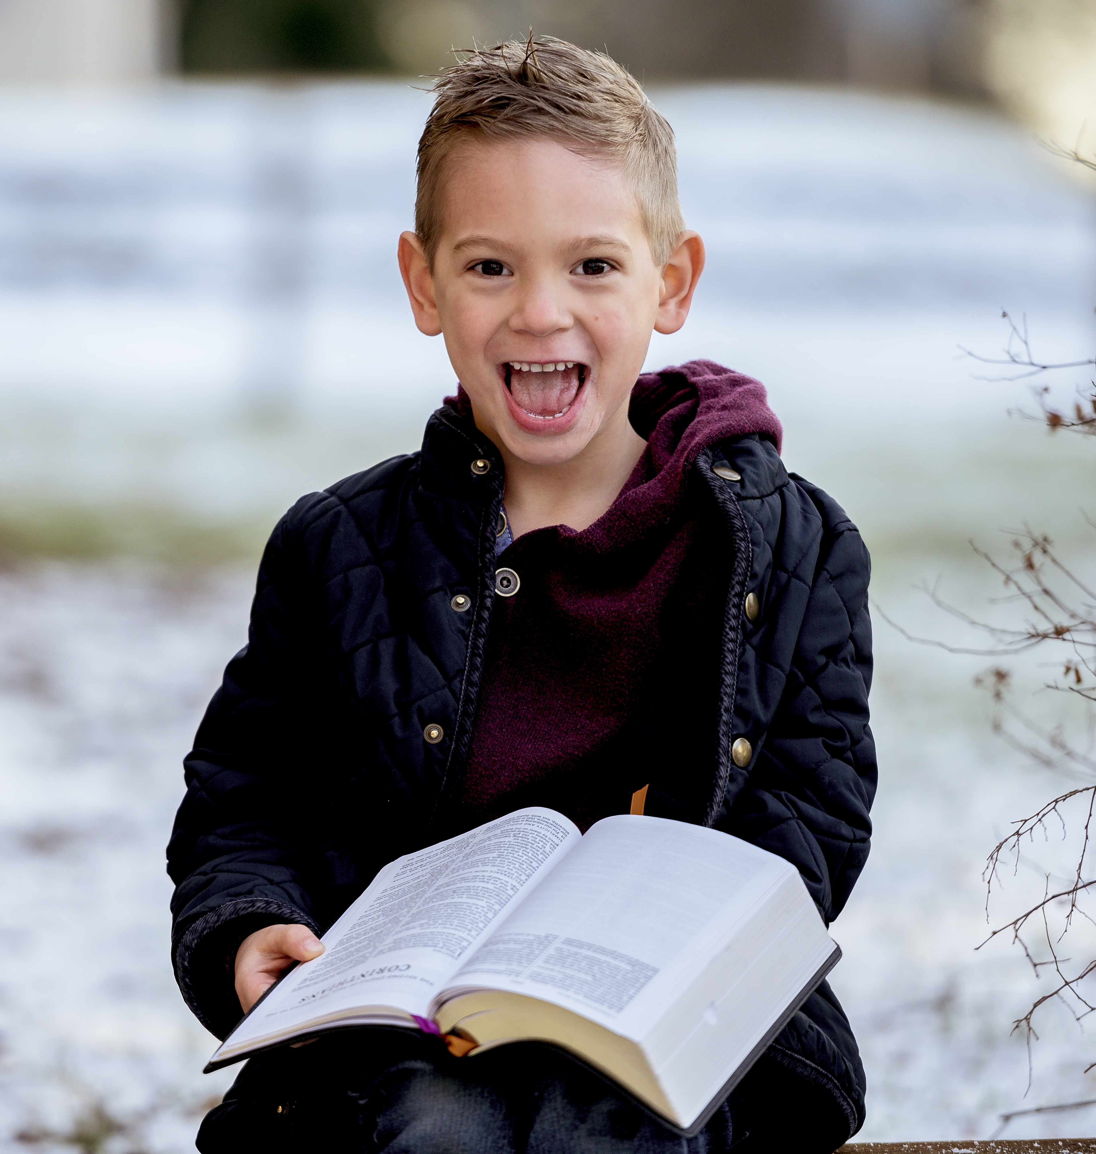
Musical Moment
I am not a Pirate
As we’re learning about Jesus Christ,
It brightens each day;
Through this special book of value,
That will always guide your way.
Notes:
As we’re learning about Jesus Christ,
It brightens each day;
Through this special book of value,
That will always guide your way.

Slide 28
NEXT TOPIC:
^{An Amazing Treasure}
biblewell.org
Notes:
Next Topic:
An Amazing Treasure

