Slide 2
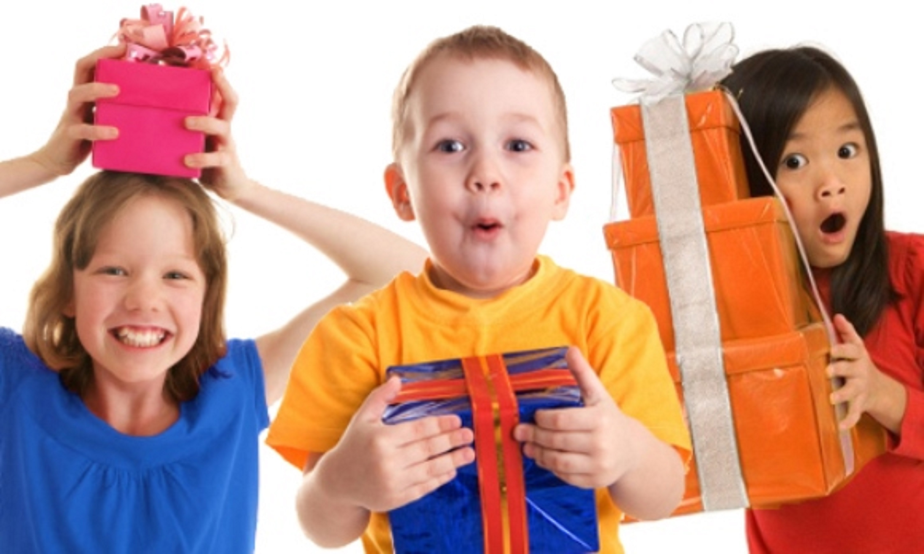
7 Days of Children’s Evangelization
^{God’s Gifts for} ^{His Children}
biblewell.org

Slide 3
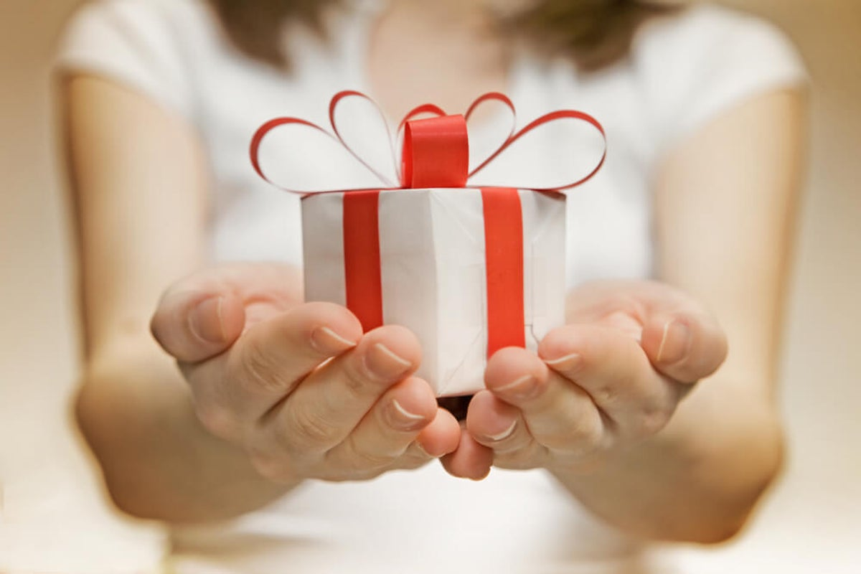
God Wants You to Grow Spiritually
Bible Lesson No. 3
Notes:
Bible Lesson No. 3
God Wants You to Grow Spiritually
Biblical base: La creación. 2 Peter 3:18; 1 Peter 2:2; Ephesians 4:15; Colossians 1:10, Psalm 119:105; Malachi 4:2; John 3:8; Psalm 84:4.
Enseñanza principal: We must grow spiritually every day.
Story: The growth of a seed.
Objectives
That the children may...
Understand that we have a lot to learn every day.
Feel the desire to learn more every day.
Want to grow spiritually every day.
Materials
Drawings for the lesson. Theme song of the day and illustrated memory verse. Illustrative materials for prayer time. Souvenir consisting of the day’s memory verse for each child to take home. Materials for crafts.

Slide 4
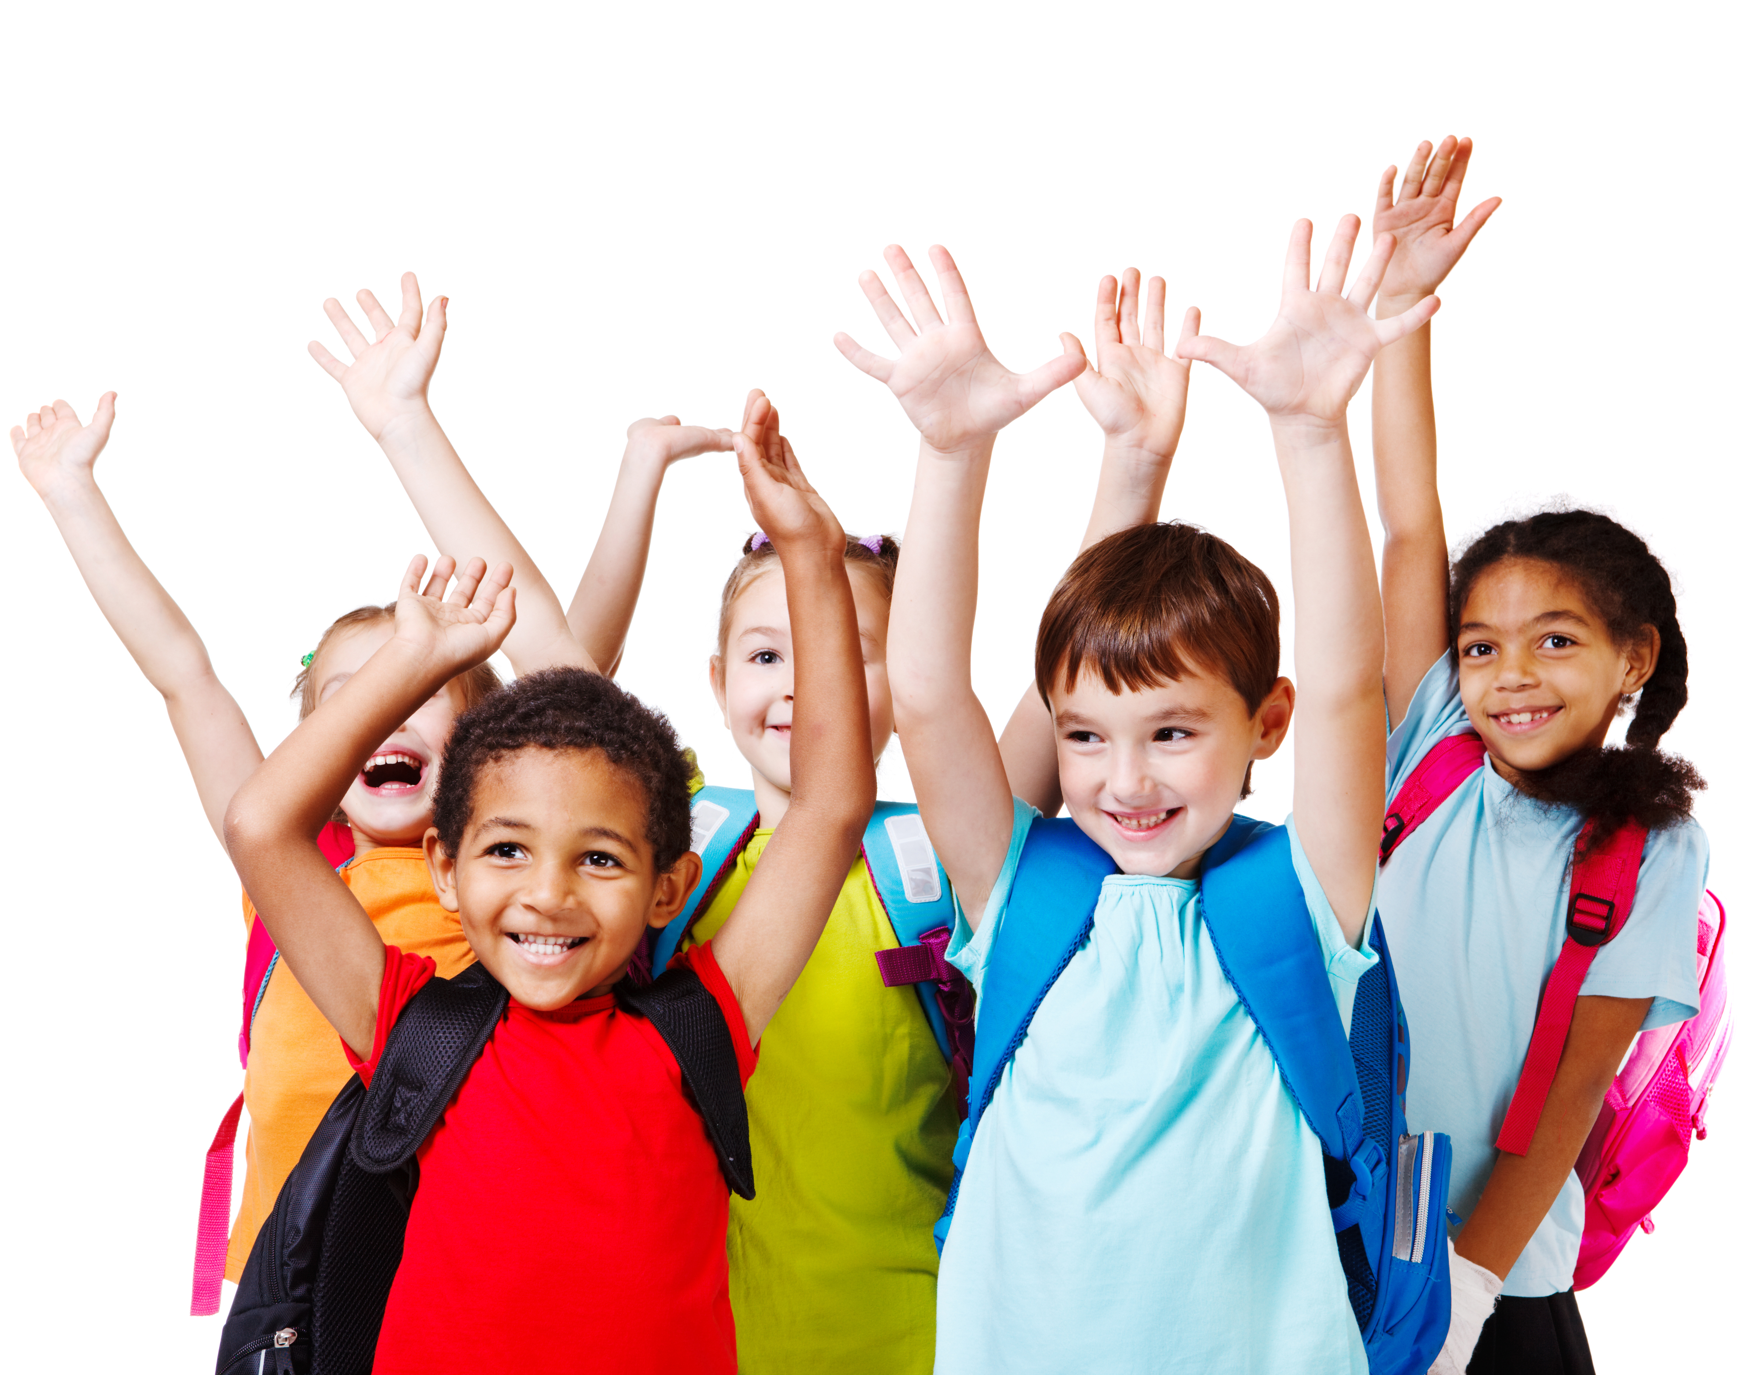
Welcome!
Notes:
Welcome
Give the welcome in a cheerful and fun way. Greet all the children as a group. Introduce yourself and all the teachers who will teach today’s activity. Start by talking about how they’ve spent the day. Remind the kids of some activities done the day before.

Slide 5
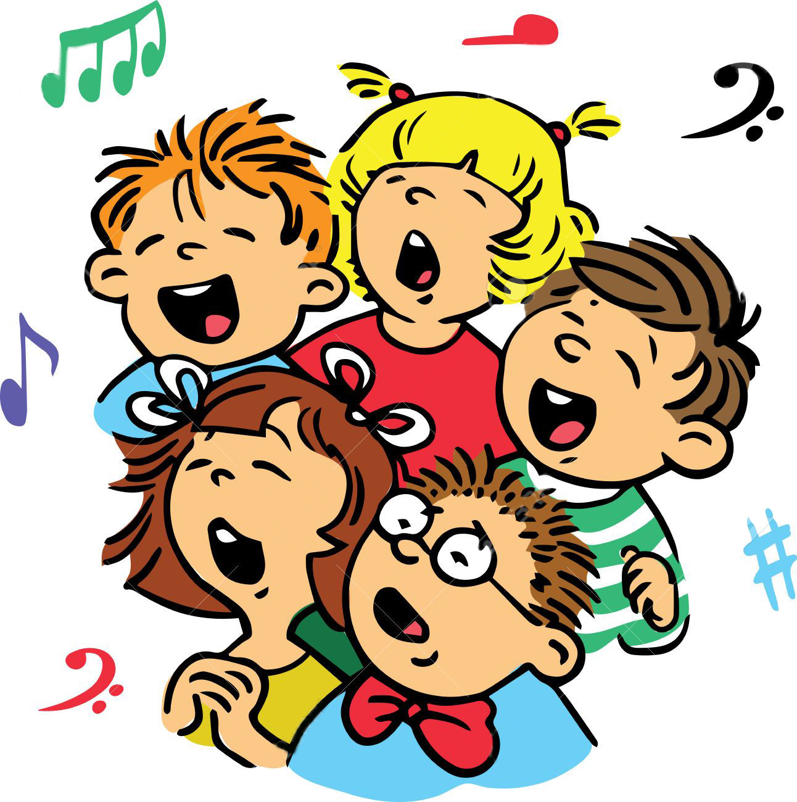
Music Time
I’m happy, happy
Notes:
Music Time
Go over the song “I’m happy, happy,” “We’re happy to be here,” and learn the song “I Have Great Victory”. Consider the instruction booklet. Do not forget that it is a moment of joy where we will show our love for children.

Slide 6
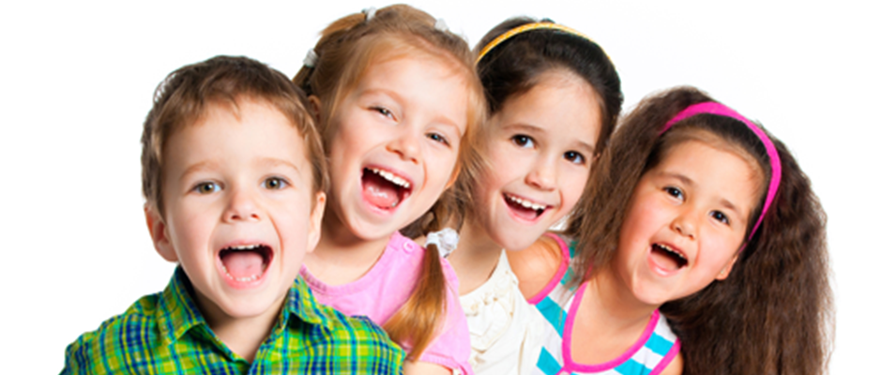
Music Time
I’m happy, happy
We’re happy
Notes:
We’re happy

Slide 7
Music Time
HERE
to be here,
Notes:
to be here,

Slide 8
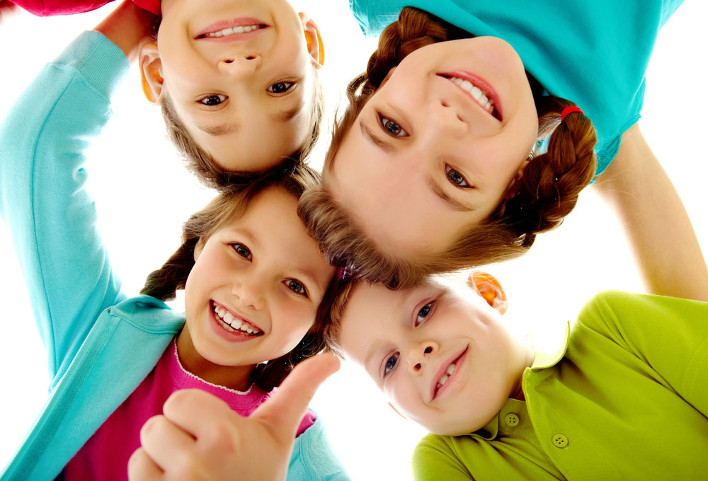
Music Time
Our smiles you see,
Because today we will have fun.
Notes:
Our smiles you see,
Because today we will have fun.

Slide 9
Music Time
We’re happy
Notes:
We’re happy

Slide 10
Music Time
to be here,
Notes:
to be here,

Slide 11
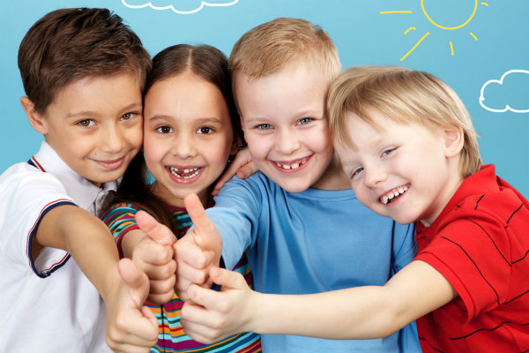
Music Time
Our smiles you see,
Because today we will have fun.
Notes:
Our smiles you see,
Because today we will have fun.

Slide 12
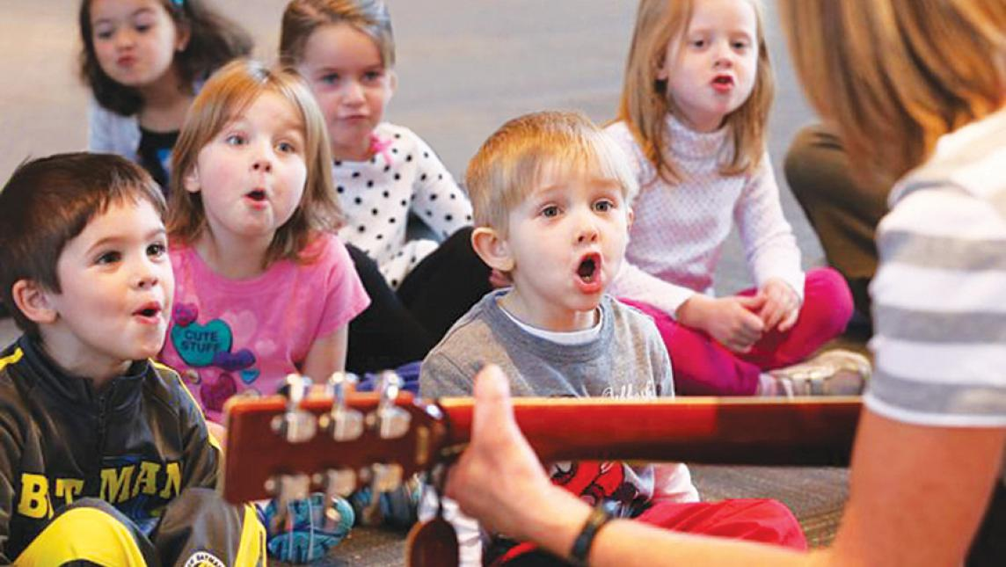
Music Time
So we will sing, La la
Notes:
So we will sing, La la

Slide 13
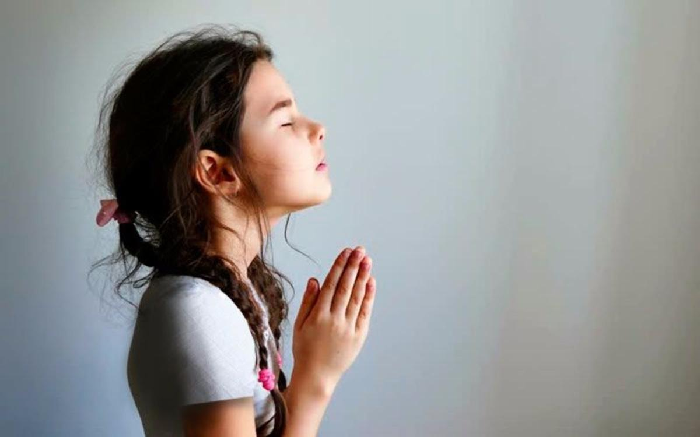
Music Time
And we will talk to God,
Notes:
And we will talk to God,

Slide 14
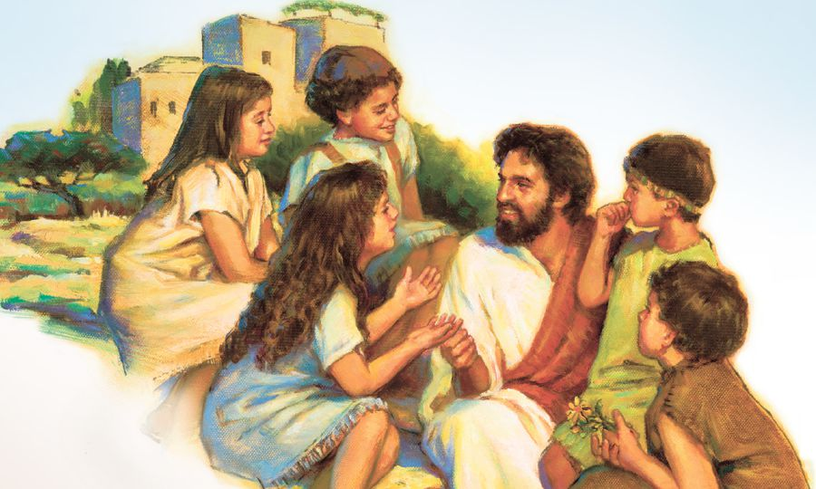
Music Time
We’ll get to learn about,
Notes:
We’ll get to learn about,

Slide 15
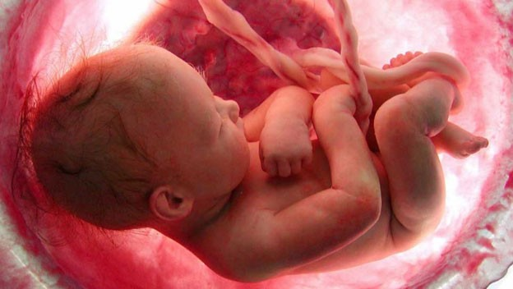
Music Time
The great Creator-God.
Notes:
The great Creator-God.

Slide 16
Music Time
Now let me lift my hands,
Notes:
Now let me lift my hands,

Slide 17
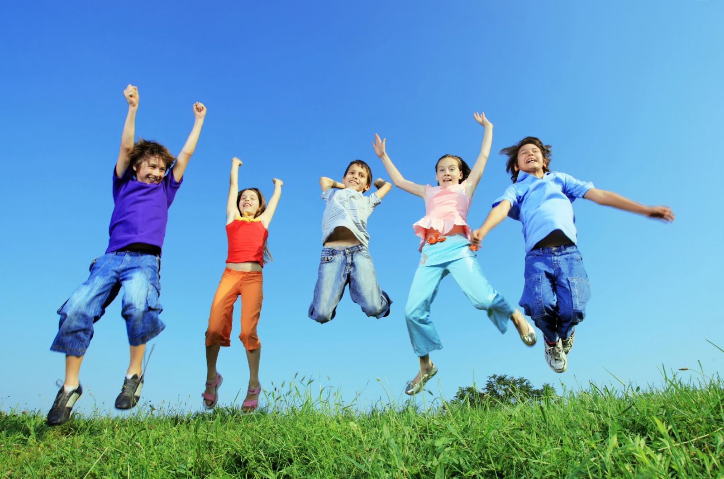
Music Time
And let us jump up high,
Notes:
And let us jump up high,

Slide 18
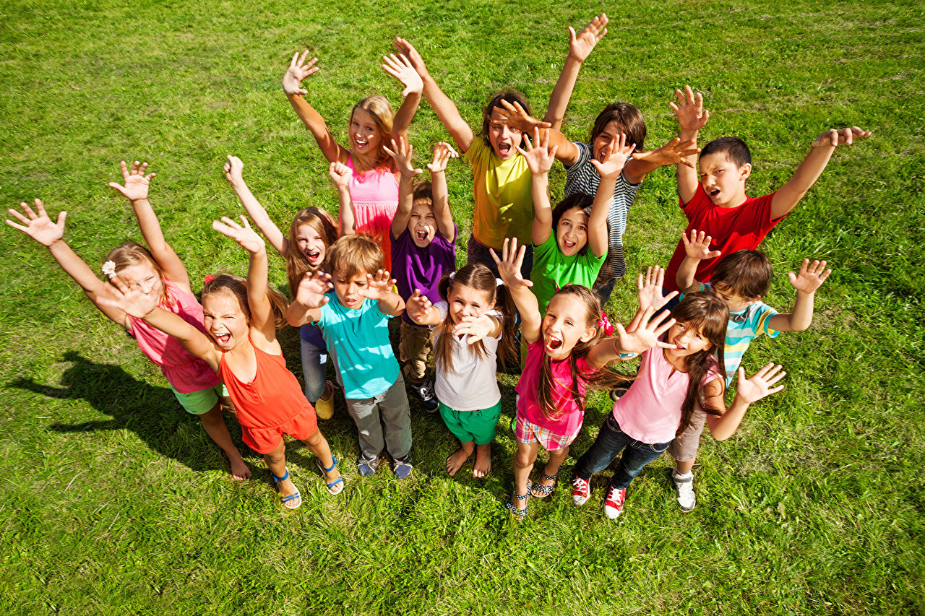
Music Time
Because to see you here,
Notes:
Because to see you here,

Slide 19
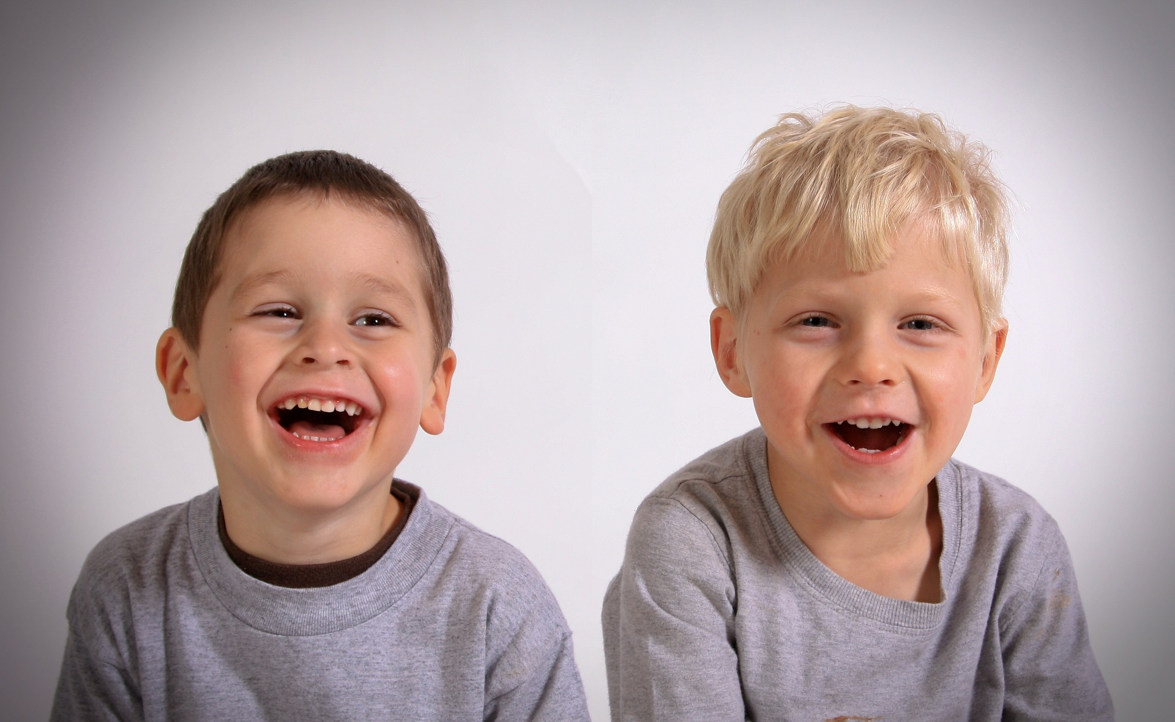
Music Time
Is great and brings me joy.
Notes:
Is great and brings me joy.

Slide 20
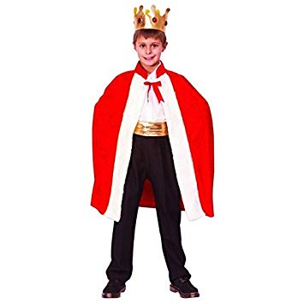
INTRODUCTION
Notes:
Introduction
1. Look what I brought you, how beautiful! I have a crown and this is a cape. Have you ever met a king? I haven’t met any of them. The kings live in palaces, in important houses of great luxury, which have many rooms, and they often have servants and soldiers to take care of them. It would be wonderful to be able to live in one of those king’s palaces. Today we are going to study the story of a man who emerged victorious in the face of difficulties.

Slide 21
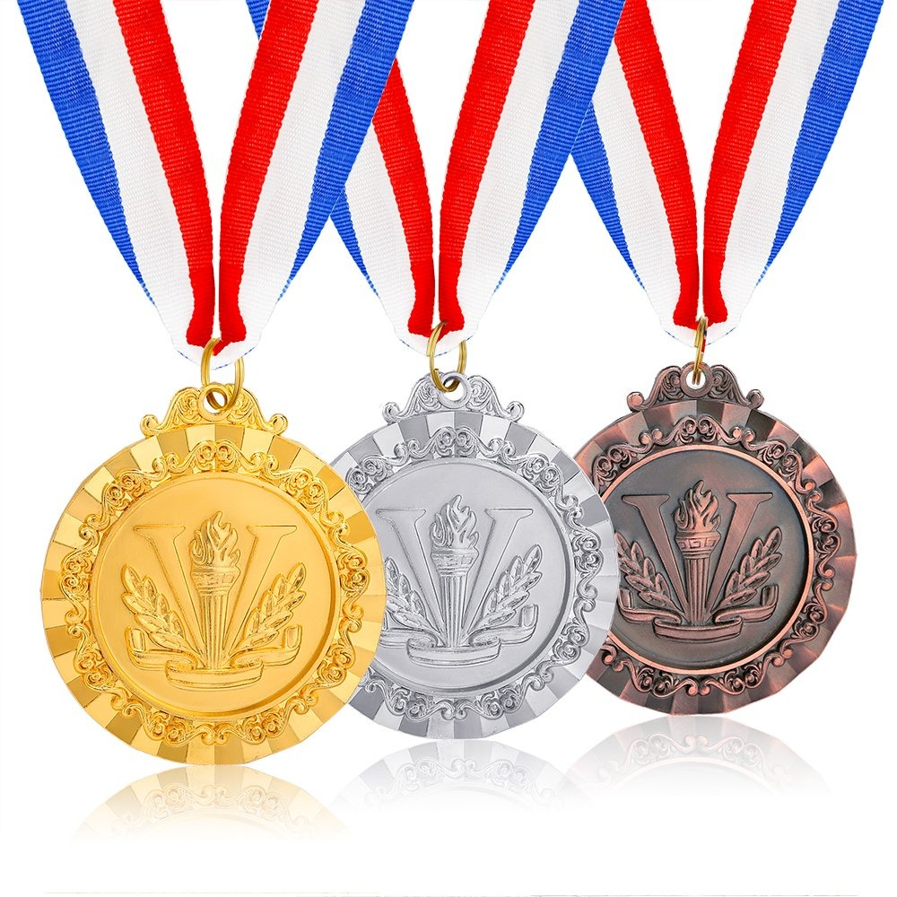
Notes:
2. Today I want to show you something very special. Look, here we have different types of medals. Do you know what medals are? Aaah! Right! We may think of medals as something that is given to people as a prize for something special. If that’s right, medals are gifts given to you for victories you get. Today we are going to talk about a gift that God wants to give us- the gift of victory. There was a king... (start with the story)

Slide 22
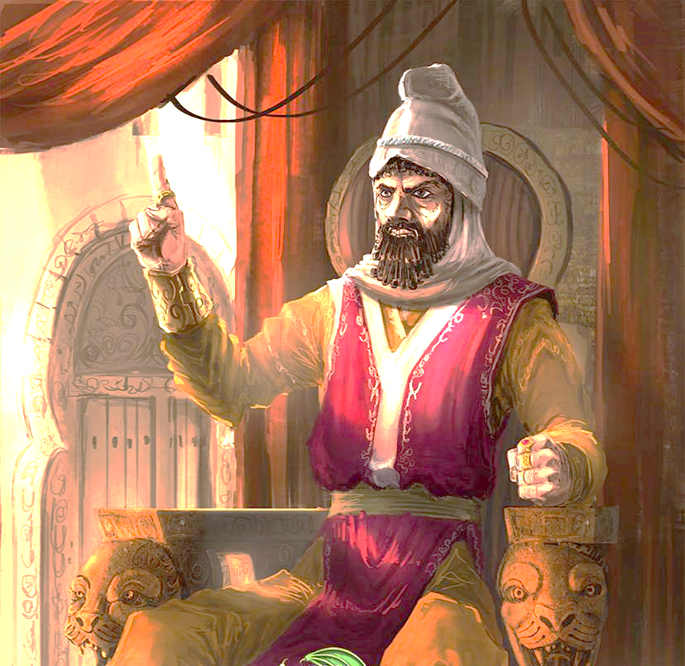
Notes:
Lesson
There was a king, his name was Darius. He had conquered many cities—and among them was Babylon. They were all under the rule of his reign.
When he conquered Babylon, there was a very wise Israelite named Daniel, who was very responsible and above all, reverent to his God; so the king put him in a very important position.
King Darius greatly appreciated Daniel, because he knew that he worshipped the true God. But this king often lived his life in ways that were not pleasing to God.

Slide 23
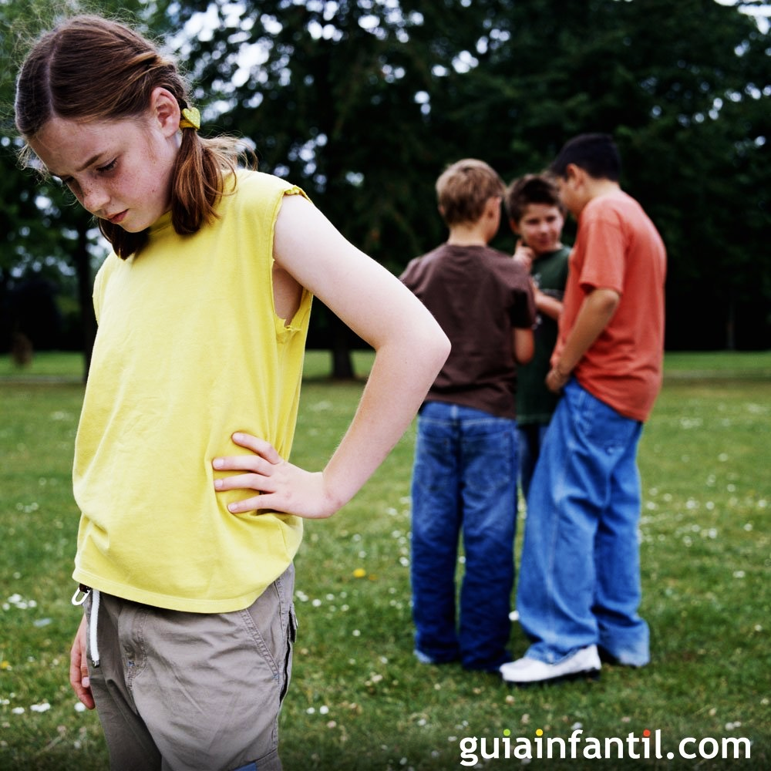
Notes:
We wake up, go to school, come and hear about Jesus, but what do we do? We are like that king, we know that God exists, but sometimes we do not know what to do, whether to listen to the voice of God or the voice of an enemy that makes us do evil things. We’re in doubt.

Slide 24
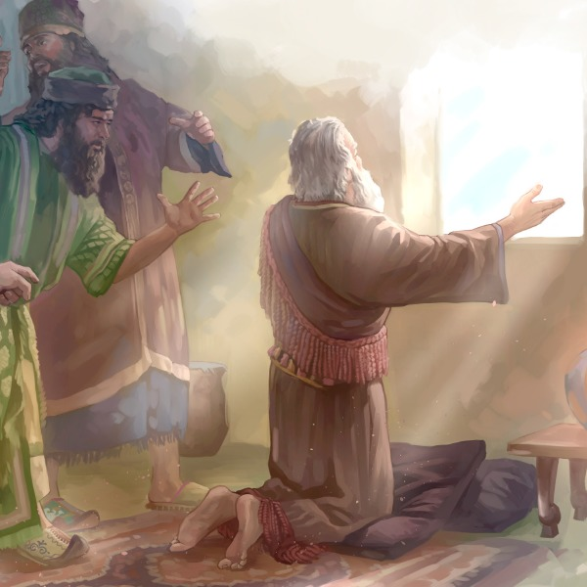
Notes:
But there were many people in that kingdom who did not believe in God and only sought to destroy Daniel. They were following him to see what he was doing. Daniel had a habit, he loved doing it every day. He would go to his window and pray. He spoke to the Lord from that place, and of course, the whole city could see him, because he was at the window.
These men watched Daniel pray, and said:
-Let’s trap him! We’re going to make Daniel die for this!
Then they went to where the king was, and said:
“King, why don’t you make a law so that for a while only you will be worshipped? And whoever worships another god that isn’t you, will be thrown into the lion’s den.
The king was a very proud man and said:
-That is good. Let it be written and done.
The trap was set. The decree came out. Daniel saw it and said:
-I will continue to pray, because the God I have, is a God of power, and He wants me to speak to Him. I’m not going to stop talking to my friend because of this law.

Slide 25
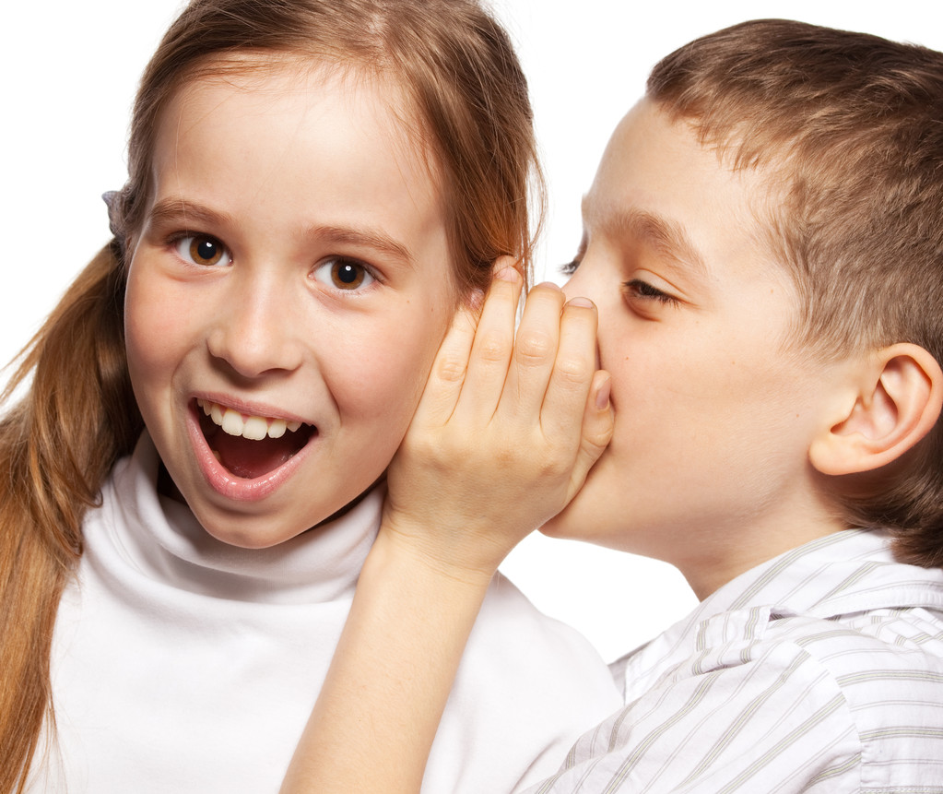
Notes:
You know what? We sometimes go through difficult moments and have to decide to do good or do what others want. We’re afraid of what’s going to happen to us. Satan wants that; he wants us to be afraid and he wants us to turn away from the Lord. He wants us to do evil, he wants to live in our hearts too, and he wants us to follow his ways. He does not want Jesus to live in our hearts.

Slide 26
Notes:
Now it’s up to us to decide… what do you decide?
You know what? The Bible says in Luke 11:28,” Blessed are those who hear what God says and obey.” We have two choices: to follow God or to follow Satan.

Slide 27
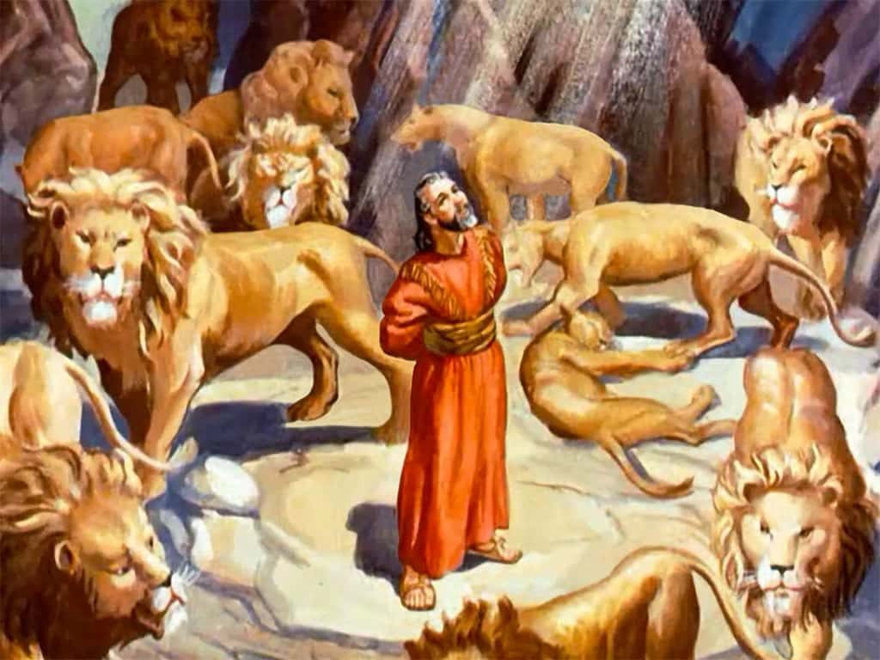
Notes:
What did Daniel do? Those who saw Daniel praying quickly went to the king to accuse Daniel of breaking the law and to throw him into the lion’s den!
Daniel did not run away when they went to capture him, he only trusted God.
The king didn’t know what to do!
-Oh! My friend Daniel! Now I realize that this law was a trap!
But he had no alternative. He had already made the decree and signed it. All He had to do was comply with the law and throw Daniel into the lion’s den.
Daniel prayed more earnestly than ever before and trusted that he would emerge victorious.

Slide 28
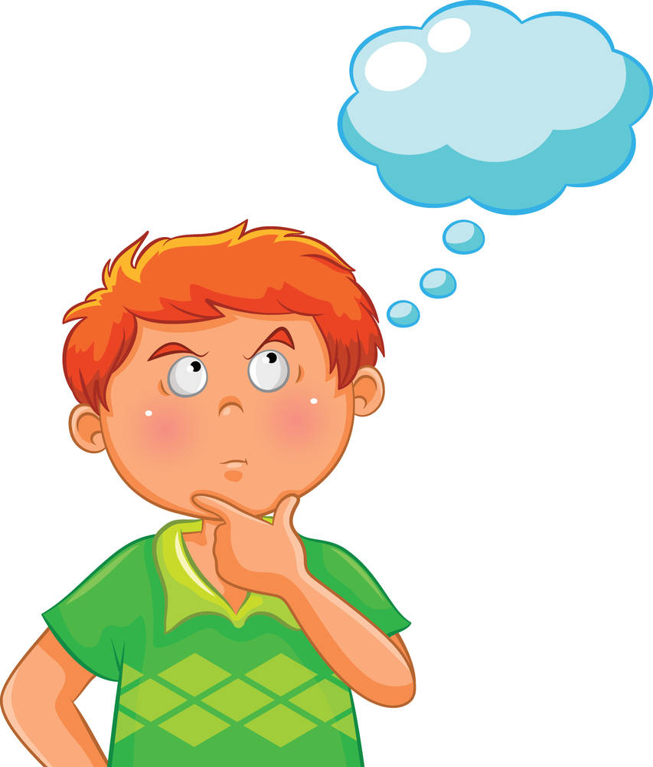
Notes:
When you face challenges, are you courageous and do you trust in God? Or do you listen to Satan because of fear?
In school, we often struggle and have to choose between something that God’s word tells us not to do and what we really should do. The Bible says in 1. Corinthians 15:57 “But thanks be to God , which giveth us victory through our Lord Jesus Christ” we can be sure that we can have victory in Jesus. So now you may wonder how would you act? Will you trust God, believing that you’ll surely have victories or will you let yourself be overcome?

Slide 29
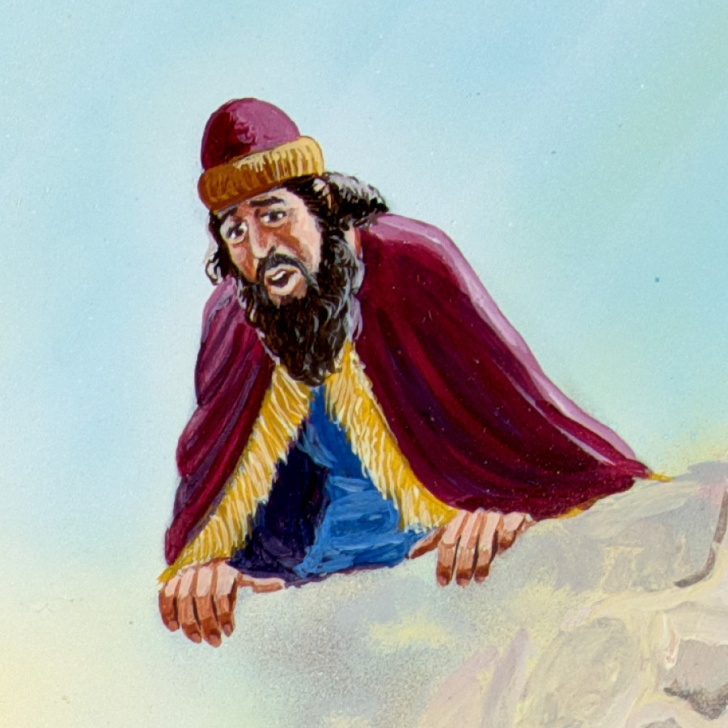
Notes:
The king went to the lion’s den early in the morning to see what had happened to Daniel. He was sure that God had given him a solution.
When he peeked in, the king asked:
-Daniel, are you there?
“Yes, I’m here!” he replied.
They opened the door, and saw that Daniel was alive!

Slide 30
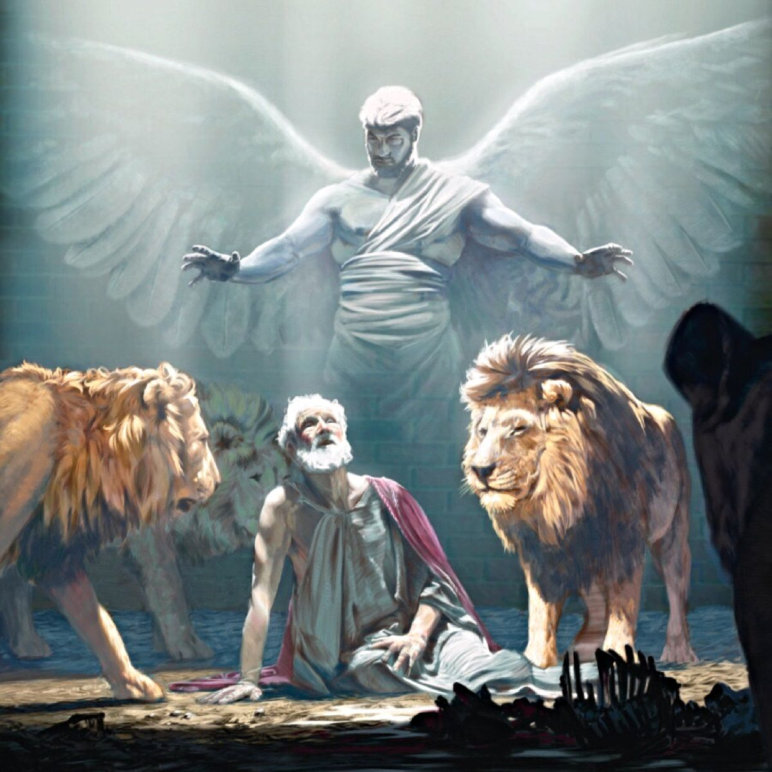
Notes:
As he left, the king asked him:
^{-What happened?}
-God sent an angel and shut the lions’ mouths! Now I’m victorious! I am alive!

Slide 31
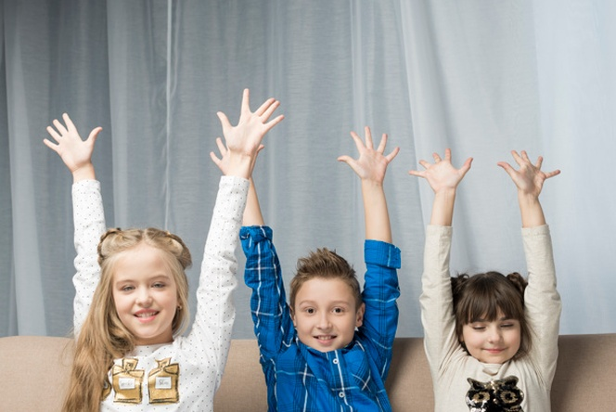
Notes:
How wonderful! We, likewise, can emerge victorious, in Jesus we can overcome!
Whenever Satan wants to tempt you or seek you to do something wrong. Ask the Lord for help and you will be assured of victory.
In Isaiah 41:13 it says, “Fear not, I will help you.” The promise is ready, all you have to do is pray, so that you can emerge victorious with the help of Jesus.

Slide 32
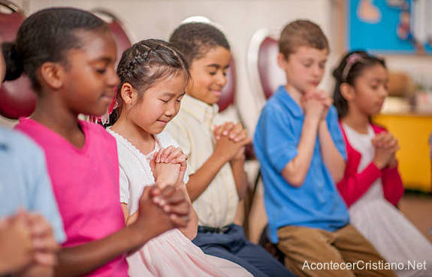
Notes:
How about we pray now, and ask Jesus to always help us out when temptation comes?
You’re going to be there many times, there, about to do the wrong thing! Hit that kid! Hit that kid! Hit that kid! You want to hit that kid, but no! You know that’s wrong, if you ask the Lord for help, He’s going to give you strength not to hit him.
Let’s pray:
“Dear Heavenly Father, we thank you because we have a promise that you will always help us. Thank you because we can be victorious with your help. Forgive our sins and help us to always overcome. In the name of Jesus. Amen.”
How good it is to be able to say: thank you Lord, because you gave me the gift of always being victorious!

Slide 33
1 Corinthians 15:57
Notes:
Teaching the Memory Verse
(You may choose to memorize the Bible verse with the children before or after the lesson.)
To teach the Bible verse at this time, we suggest preparing it with large letters (depending on the size of your group of children) on an old scroll. Make sure the paper scroll is big enough and glue the letters onto it.
Memory Verse:
• “But thanks be to God,
• which giveth us the victory
• through our Lord Jesus Christ.”
• 1 Corinthians 15:57
Introduction: You can talk about how it was written in ancient times and show your scroll. If it’s big, ask two volunteers for help so that they can help you hold it in the front so that everyone may see.
Presentation: Allow the children to read the text together as you open the scroll. Then you will read it in a strong and clear way.
Explanation: con breves palabras explicarás el texto. Recordando y enfatizando la lección del día de hoy.
Explanation: in a few words you will explain the verse. Remind and emphasize today’s lesson to the kids.
Example: Today we have studied, that with Jesus, we can emerge victorious. That’s why we must always thank God. With His help, victory will be assured.
Repetition: Uses innovative methods for reviewing the lesson.
Application: It is important to apply the day’s lesson and memory verse to the child’s life as it was studied that day.
I recommend that you read the Instruction Manual so that you can perfect the way you teach children every day.

Slide 34
“But thanks be to God,
Notes:
“But thanks be to God,

Slide 35
which giveth us the victory
Notes:
which giveth us the victory

Slide 36
through our Lord Jesus Christ.”
Notes:
through our Lord Jesus Christ.” 1 Corinthians 15:57

Slide 37
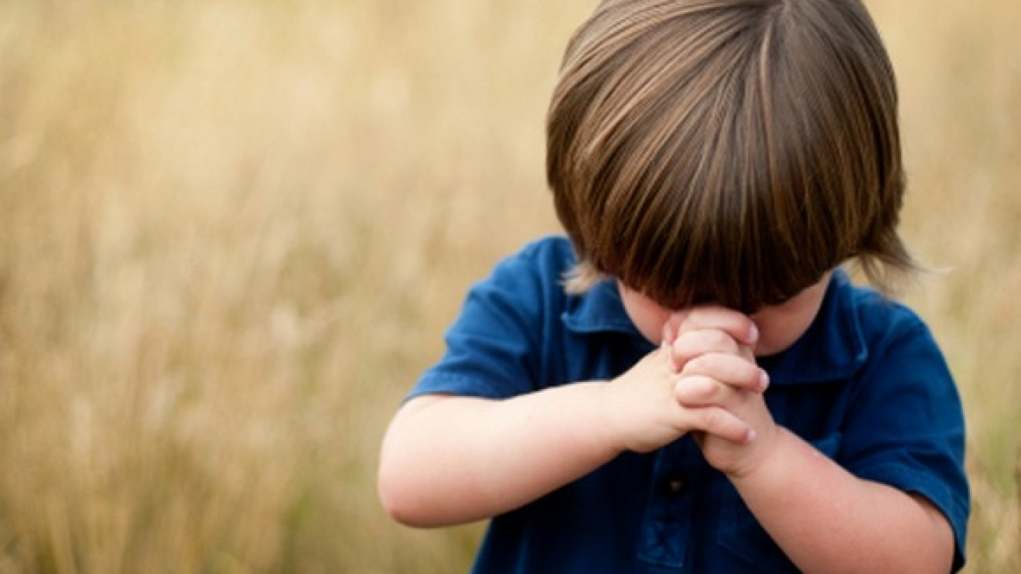
Prayer Time
Notes:
Prayer Time
As you know, this is an important moment when we bring the children closer to speak to God.
Tip: Give 3 or 4 children the opportunity to share some of the victories they have had with Jesus’ help.
Today we will thank God for our victories
Gather the children in a circle, hold hands, and pray together.

Slide 38
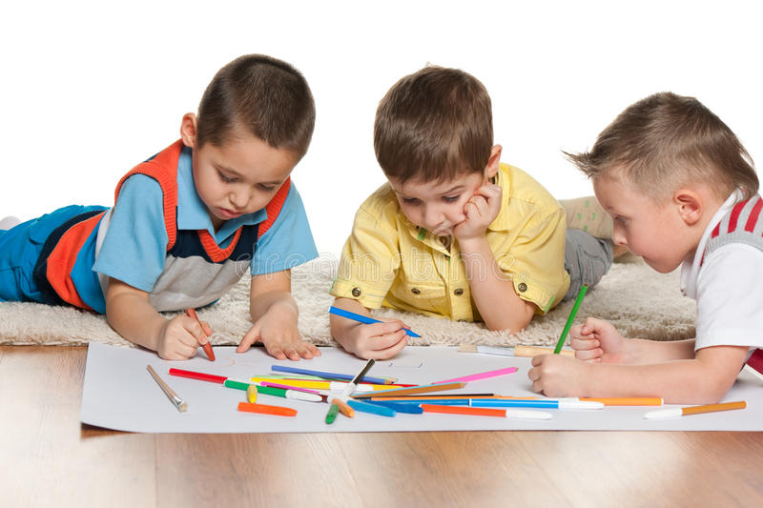
ACTIVITIES
Notes:
Activities
Children +8: Complete the chart by writing down life situations where you’ve had to take important decisions. Mark with a cross the results that were obtained.
Children 0 – 7: Color the drawing.
Opcional:
Write 2 or 3 situations for which to pray for on a large sheet, so that they may be victorious.

Slide 39
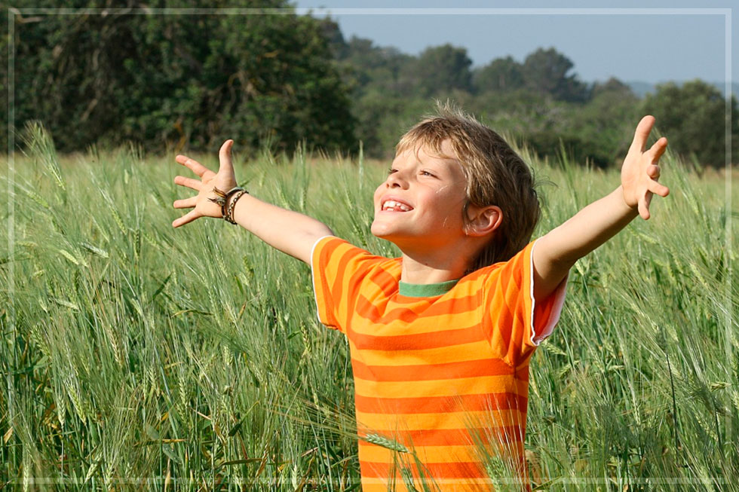
Thank you Father for giving me victories.
Notes:
Conclusion
Thank you Father for giving me victories.

Slide 40
Music Time
I HAVE GREAT VICTORY
Notes:
Music Time
We learn the song “I Have Great Victory”. Consider the instruction booklet. Do not forget that it is a moment of joy where we will show our love for children.

Slide 41
Music Time
I HAVE GREAT VICTORY
/I am victorious, victorious, victorious with Christ./
Notes:
I am victorious, victorious, victorious with Christ,
I am victorious, victorious, victorious with Christ.

Slide 42
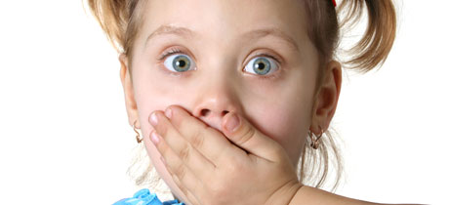
Music Time
/Cuando Satanás me viene a tentar
Notes:
/Cuando Satanás me viene a tentar

Slide 43
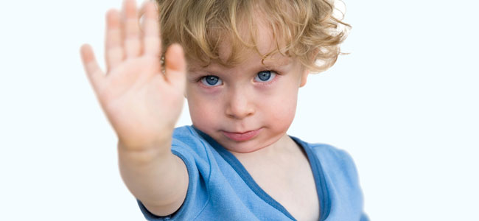
Music Time
Jesus Christ is ready to help me out. /
Notes:
Jesus Christ is ready to help me out. /

Slide 44
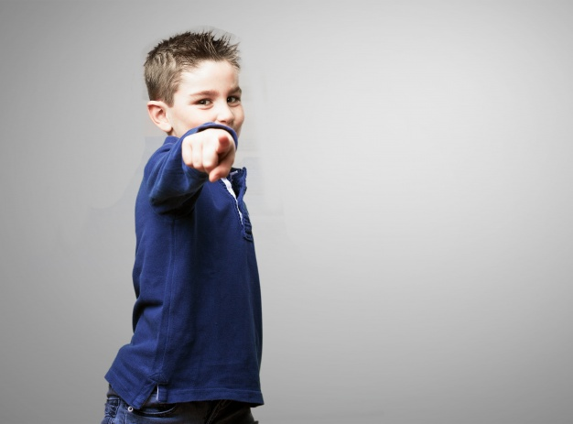
Music Time
When temptation comes,
Notes:
When temptation comes,

Slide 45
Music Time
I will say, no, no.
Notes:
I will say, no, no.

Slide 46
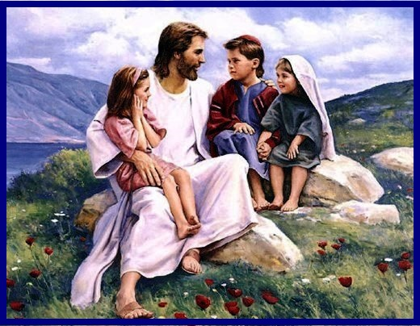
Music Time
Jesus Christ is ready to help me out.
Notes:
Jesus Christ is ready to help me out.

Slide 47
Next Lesson:
^{God Wants You to} ^{Grow Spiritually}
biblewell.org
Notes:
Next Lesson
God Wants You to Grow Spiritually

