Slide 2
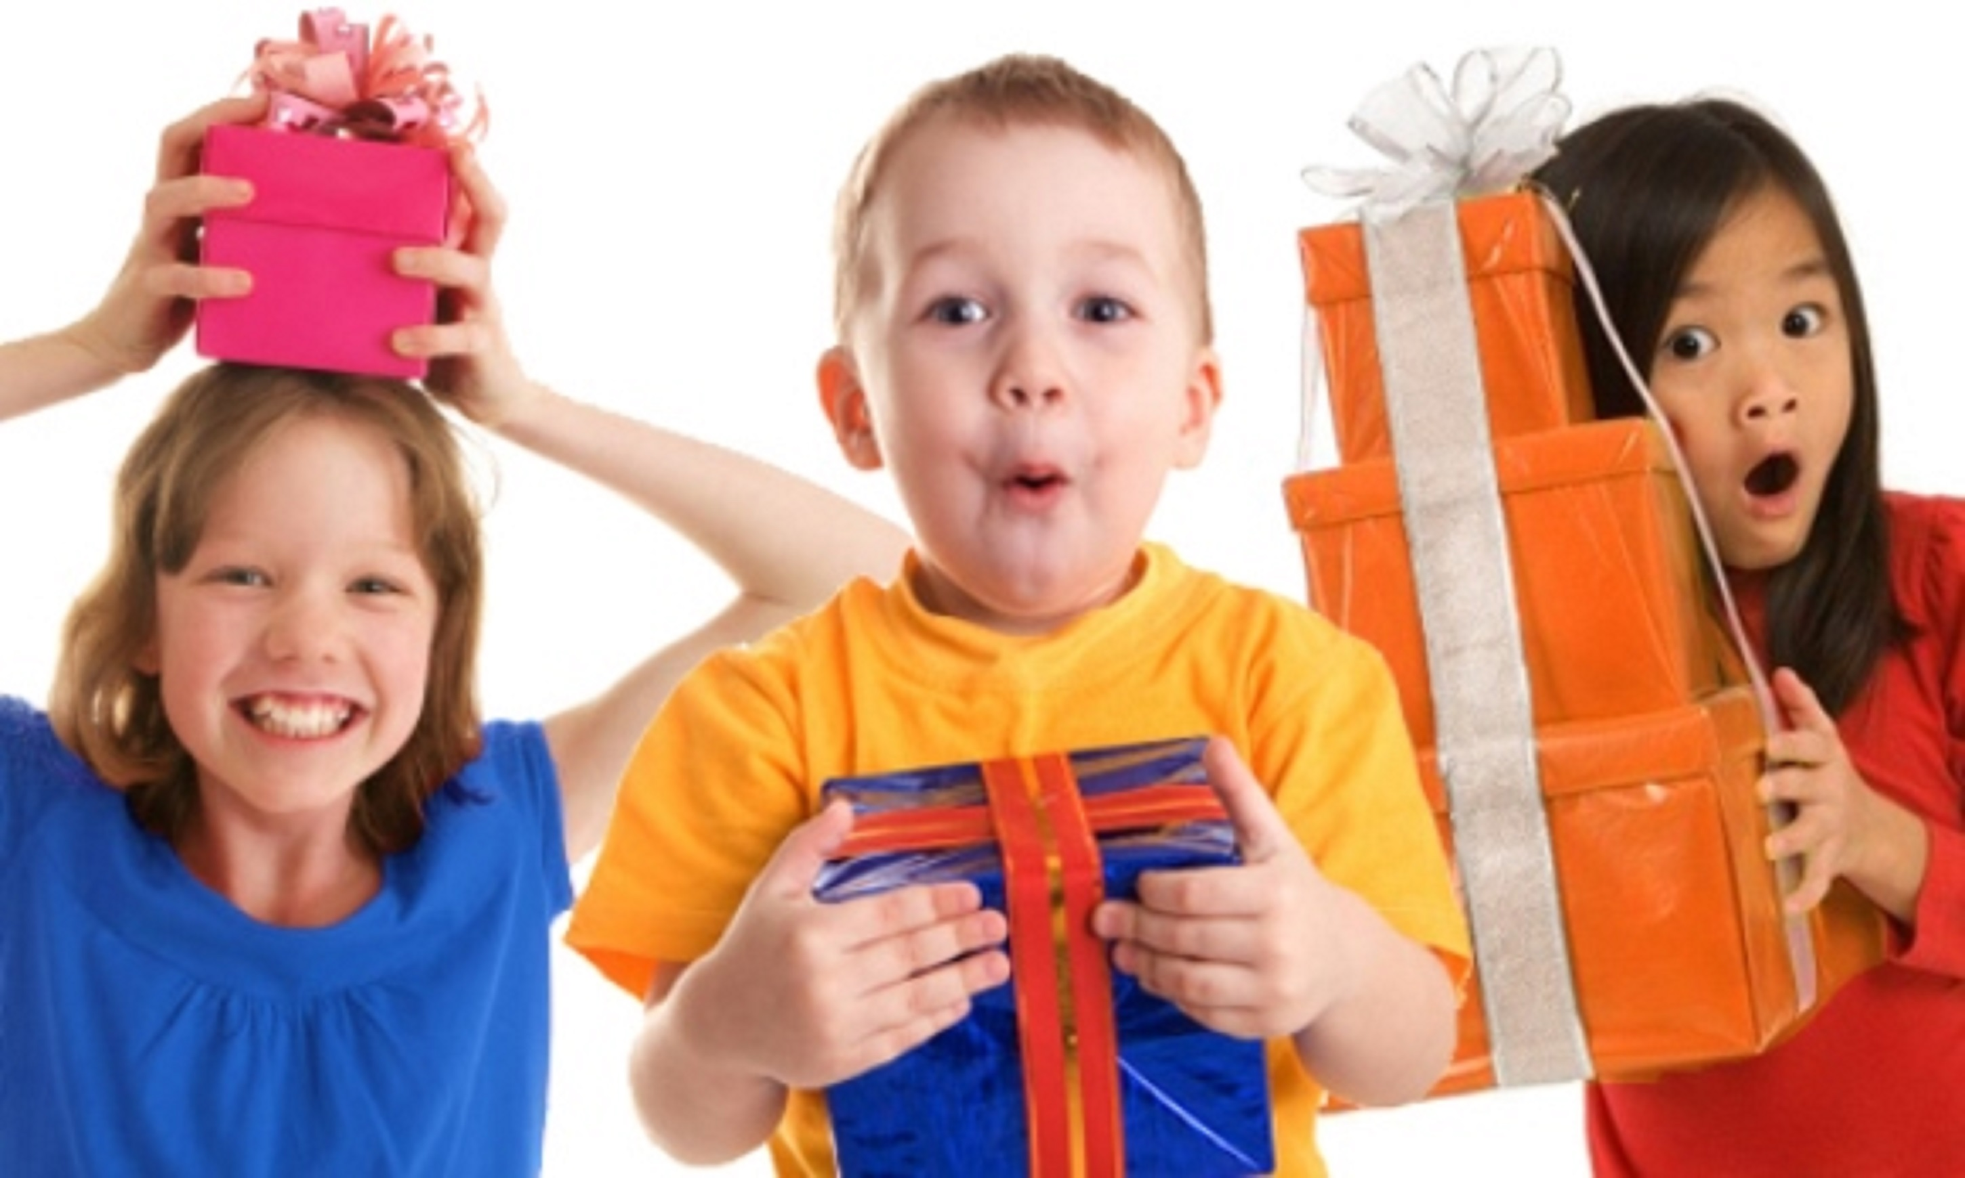
7 Days of Children’s Evangelization
^{God’s Gifts for} ^{His Children}
biblewell.org

Slide 3
Dios quiere que crezcas espiritualmente
Día 3
Notes:
Bible Lesson No. 3
God Wants You to Grow Spiritually
Biblical base: La creación. 2 Peter 3:18; 1 Peter 2:2; Ephesians 4:15; Colossians 1:10, Psalm 119:105; Malachi 4:2; John 3:8; Psalm 84:4.
Enseñanza principal: We must grow spiritually every day.
Story: The growth of a seed.
Objectives
That the children may...
Understand that we have a lot to learn every day.
Feel the desire to learn more every day.
Want to grow spiritually every day.
Materials
Drawings for the lesson. Theme song of the day and illustrated memory verse. Illustrative materials for prayer time. Souvenir consisting of the day’s memory verse for each child to take home. Materials for crafts.

Slide 4
Welcome!
Notes:
Welcome
Give the welcome in a cheerful and fun way. Greet all the children as a group. Introduce yourself and all the teachers who will teach today’s activity.

Slide 5
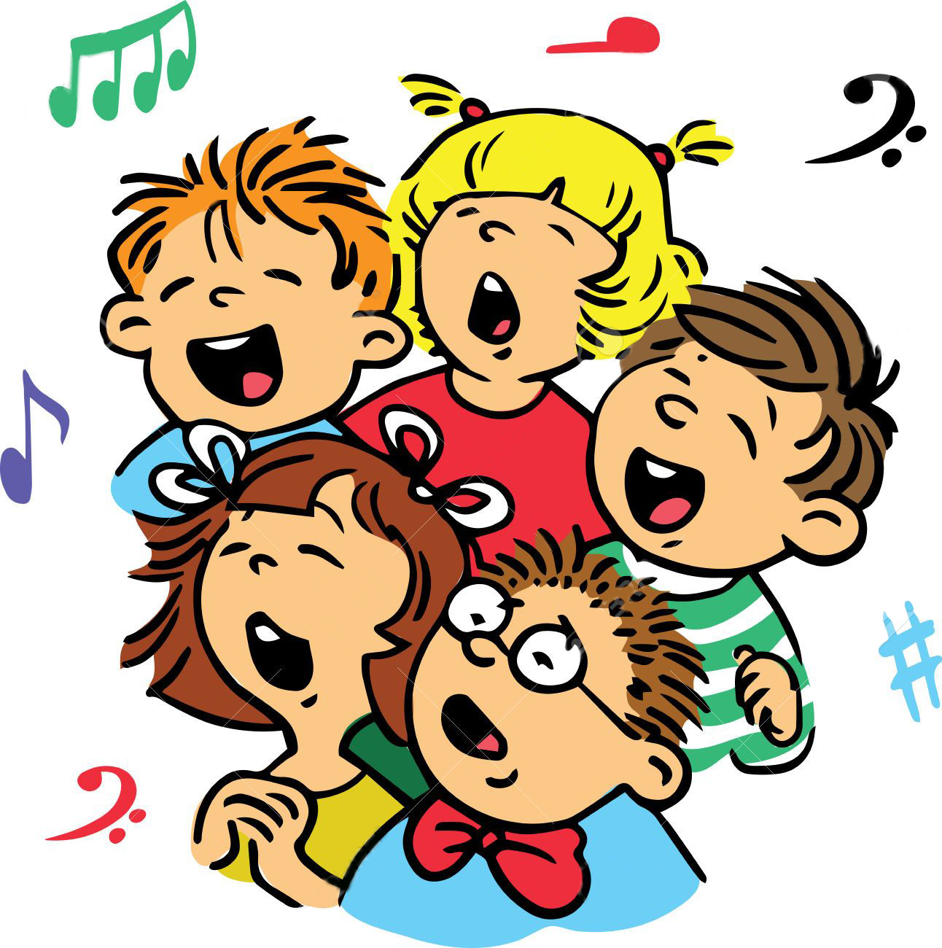
Music Time
I will grow
Notes:
Music Time
Start with joyful songs that can motivate the group. You can use some greeting songs for this occasion.
Then teach the theme song of the day. Consider the instruction booklet.
Option: “I will grow”. It is important to demonstrate mimics showing growth in this song. It will help our students learn the song faster.

Slide 6
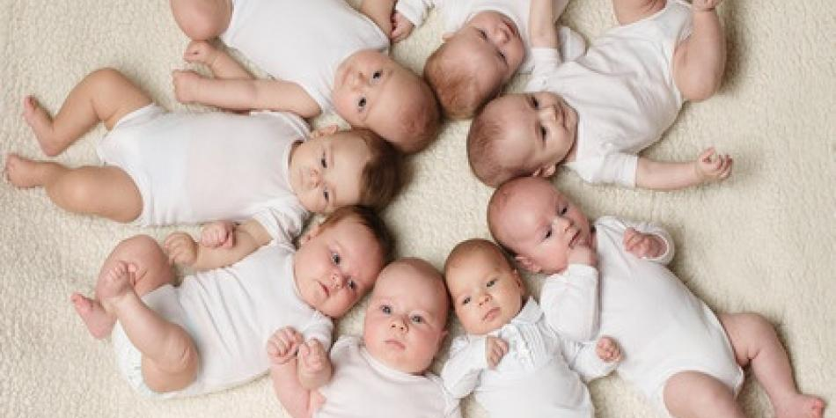
Music Time
I will grow
I will grow more and more each day
Notes:
I will grow more and more each day

Slide 7
Music Time
Each day I’ll grow and grow and grow,
Notes:
Each day I’ll grow and grow and grow,

Slide 8
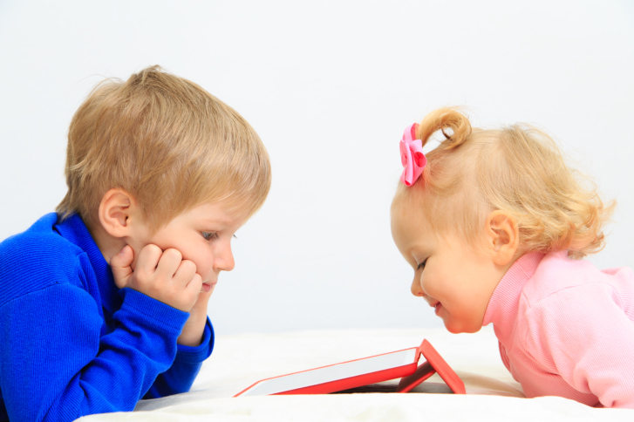
Music Time
Oh yes, I’ll grow and grow, and grow
Notes:
Oh yes, I’ll grow and grow, and grow

Slide 9
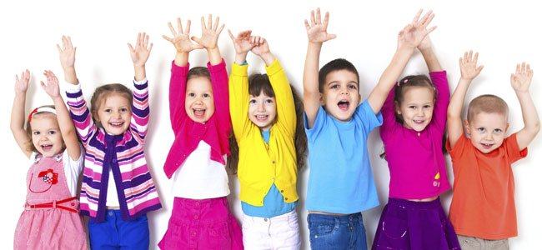
Music Time
More and more, I will grow.
Notes:
More and more, I will grow.

Slide 10
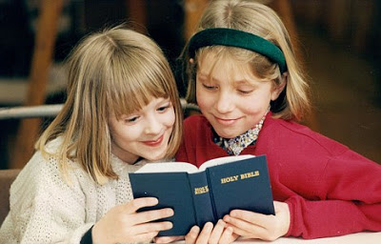
Music Time
By reading what God says in the Bible,
Notes:
By reading what God says in the Bible,

Slide 11
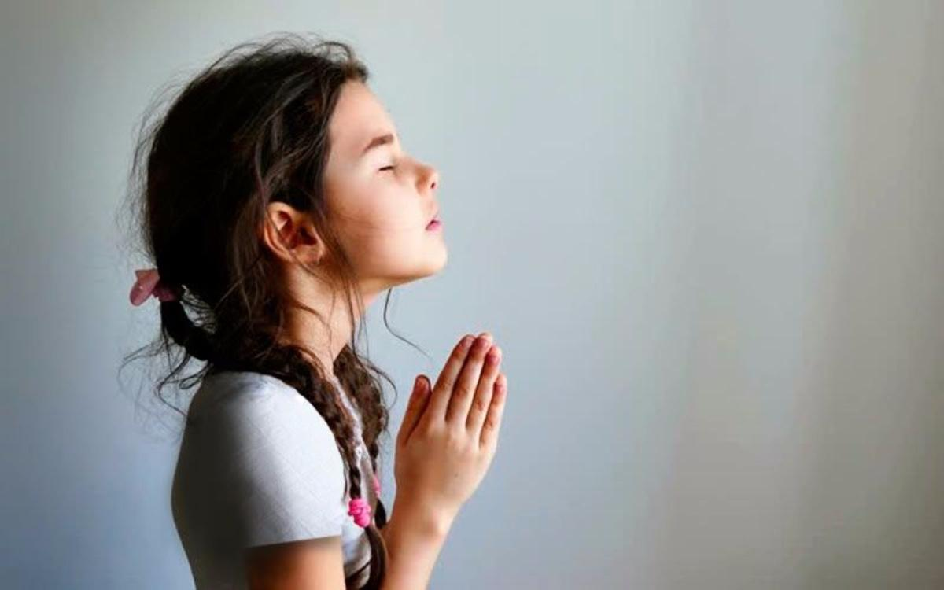
Music Time
By taking time to talk to the Lord,
Notes:
By taking time to talk to the Lord,

Slide 12
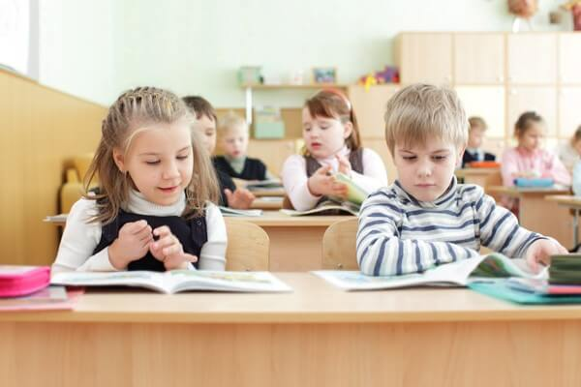
Music Time
And every week, with all our friends
Notes:
And every week, with all our friends

Slide 13
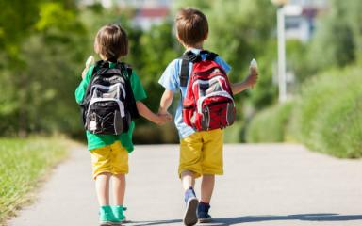
Music Time
we go to church, Oh..oh..oh..
Notes:
we go to church, Oh..oh..oh..

Slide 14
Music Time
I want to go to heaven; meet Jesus,
Notes:
I want to go to heaven; meet Jesus,

Slide 15
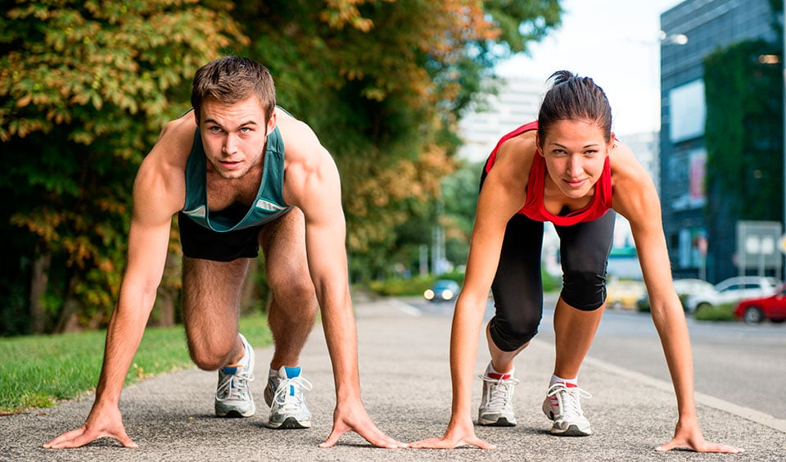
Music Time
For that event I need to prepare,
Notes:
For that event I need to prepare,

Slide 16
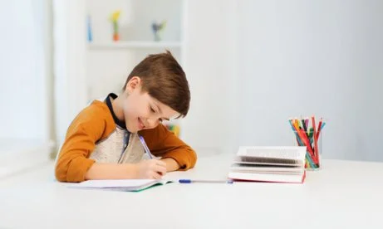
Music Time
I am learning, I’ll keep studying,
Notes:
I am learning, I’ll keep studying,

Slide 17
Music Time
From God’s word, Oh…oh…oh..
Notes:
From God’s word, Oh…oh…oh..

Slide 18
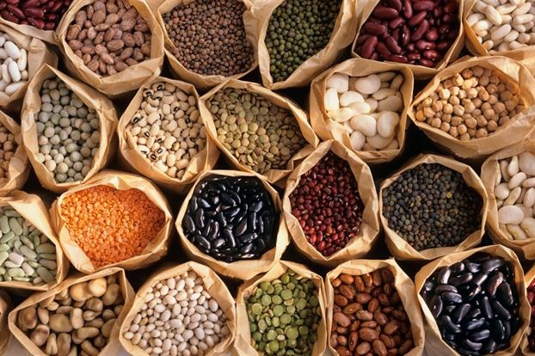
INTRODUCTION
Notes:
Introduction
I brought you something small but very special today. I brought you a lot of seeds so that we can take a look at them together.
There are millions of different types of seeds… as many as the amount of plants that exist. They’ve discovered over 100,000 different plant varieties in only one place. Imagine!
Every seed has its own size and growth time. We will study how a seed grows today. For example, this one (choose and bring a seed/plant).

Slide 19
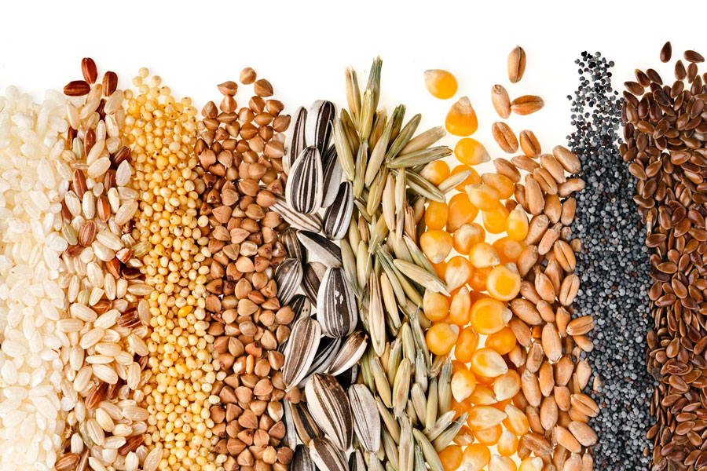
Notes:
Lesson
Have you seen a plant grow? First, we have to understand that a plant has several steps in its growth process. The first thing is to find the best seed to plant. When we find it, then we have to look for a suitable place to plant it. There the seed will grow and grow.

Slide 20
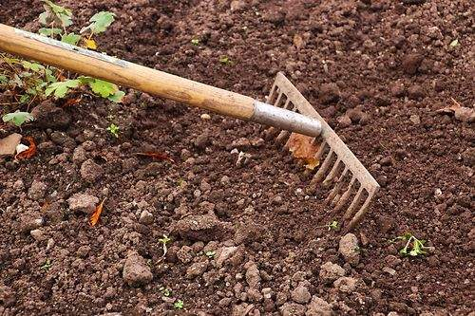
Notes:
We always need to have a piece of land to plant the seed on. This land must be ready. We need to remove all the stones and big elements found in it, which might hinder our seed from growing.
The soil is very important in the growth of our seed. It is the food for the seeds. Soil is composed of minerals and other elements that are absorbed by the seeds to help them grow.

Slide 21
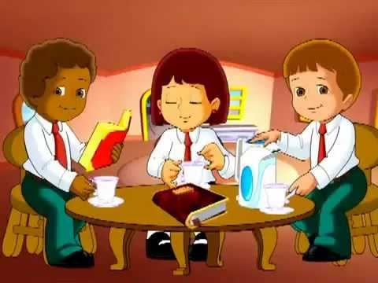
Notes:
You know what? We’re like seeds. We’ve heard about what Jesus came to do on this earth, remember? Let’s review it for a moment: Jesus lived in heaven, he came to this earth to die in our place, for our sins. He was crucified for me and you. We just have to believe and apologize for all the evil we’ve thought, done, or said.
When we accept Jesus into our lives and He lives in us, it is like He is sowing a seed in our hearts. We are that land in which a small seed was sown.
Let’s continue and see what the second step for a plant to grow is.

Slide 22
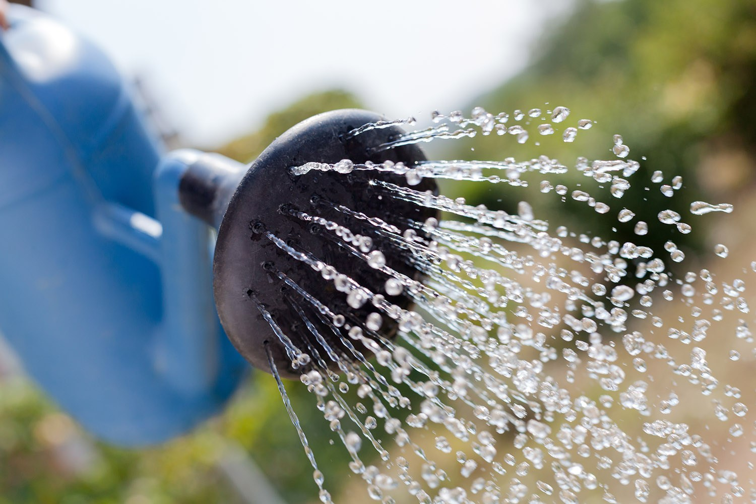
Notes:
The seed, once sown in the soil, needs water. Water refreshes the seed, and moisturizes it so it can begin growing. But the most important thing is that water allows the seed to absorb all the nutrients from the earth.

Slide 23
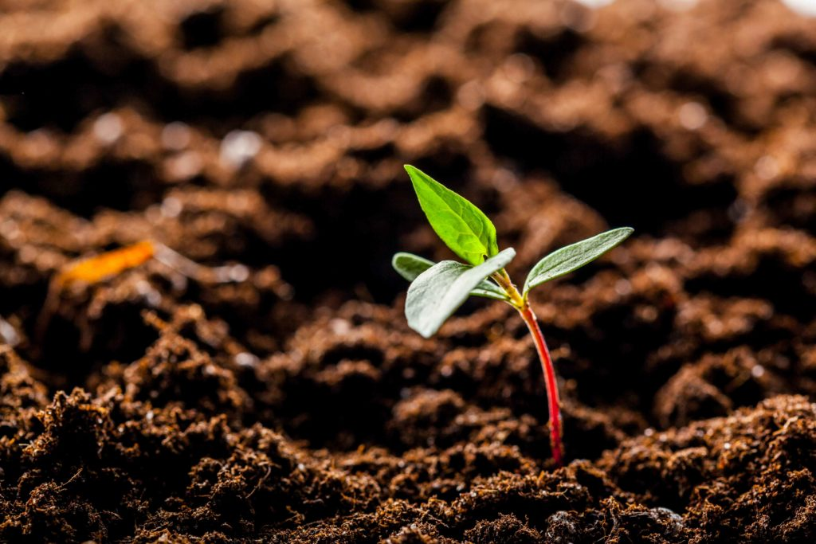
Notes:
In other words, the seed needs the water to be able to eat and grow.

Slide 24
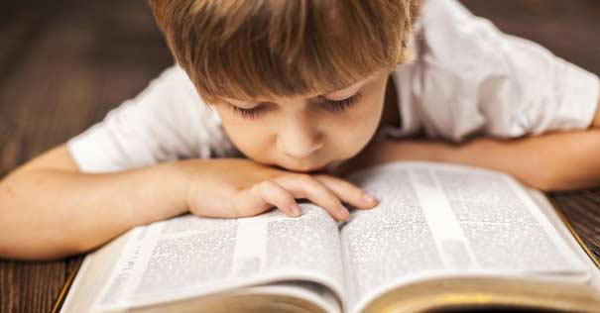
Notes:
We have to grow up, too. After hearing from Jesus, we must continue to learn from Him. We can do this because God has given us the Bible with messages for all his children.
In it, we find many teachings for our lives, promises for when we feel bad, warnings, and interesting things to delight ourselves in the Lord. He tells us what will happen in the future, and the most important thing is that He allows us to know more about God and his love for us.

Slide 25
Notes:
The Bible says in Psalm 119:105 “They word is a lamp unto my feet and a light unto my path.” The word of God tells us what to do. It is like a light that lights us up and tells us how to act.

Slide 26
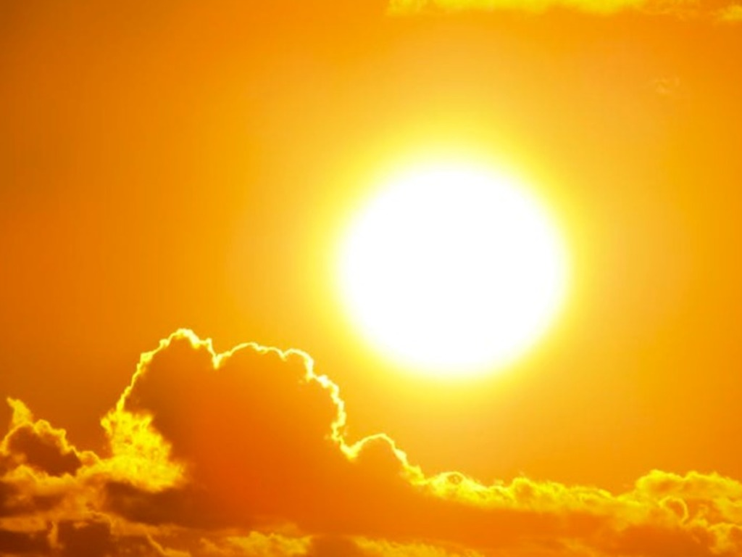
Notes:
Every plant not only needs water, but also needs the sun. The sun gives it energy, that is, strength to grow. Energy allows the plant to produce its own food. Sunlight causes the plant to convert carbon dioxide into good nutrients.

Slide 27
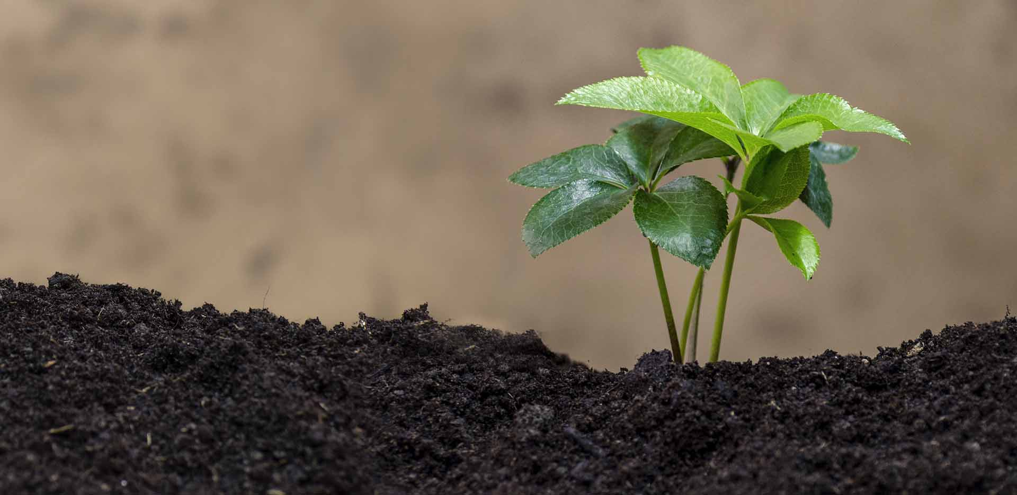
Notes:
Without sunshine, a plant can’t grow.

Slide 28
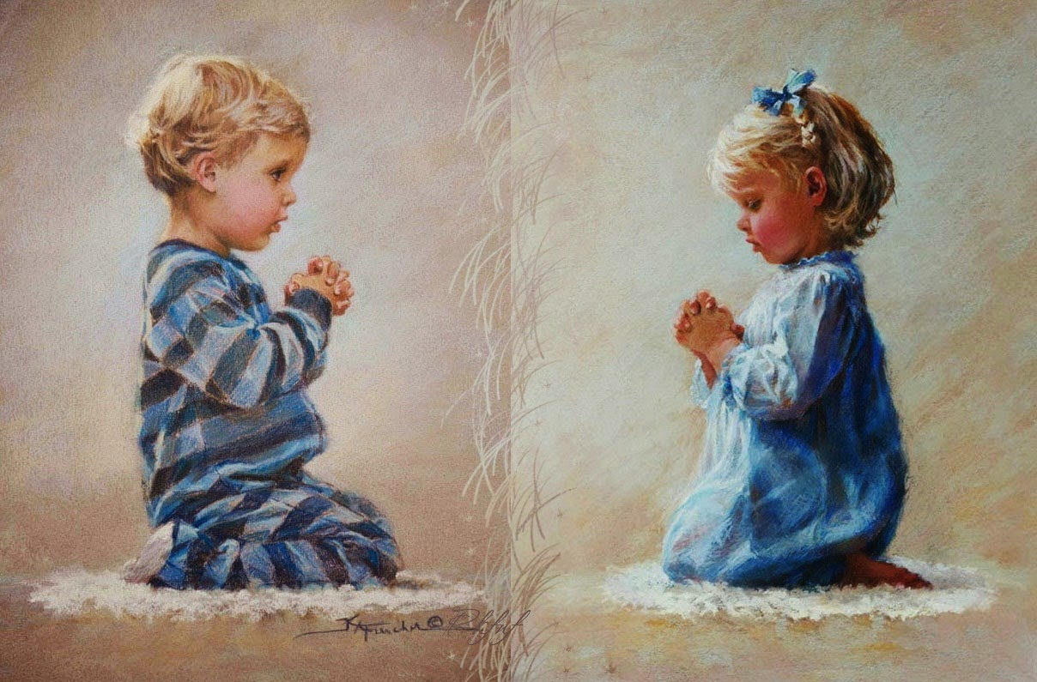
Notes:
You know what? We all need light from a special sun. The Bible speaks of a Sun of righteousness in Malachi 4:2 “The sun of righteousness arises with healings in his wings.”
Jesus came to this earth and brought salvation for all men. Jesus is compared to the sun.
All of us need Him. We need a Savior. That is why God has given us prayer—so that we can talk to our Savior and with our Father.
Prayer is speaking to God like speaking to a friend with whom we share all our secrets. It is where we can apologies for all our faults. How good it is to be able to have prayer so that you can speak to God!

Slide 29
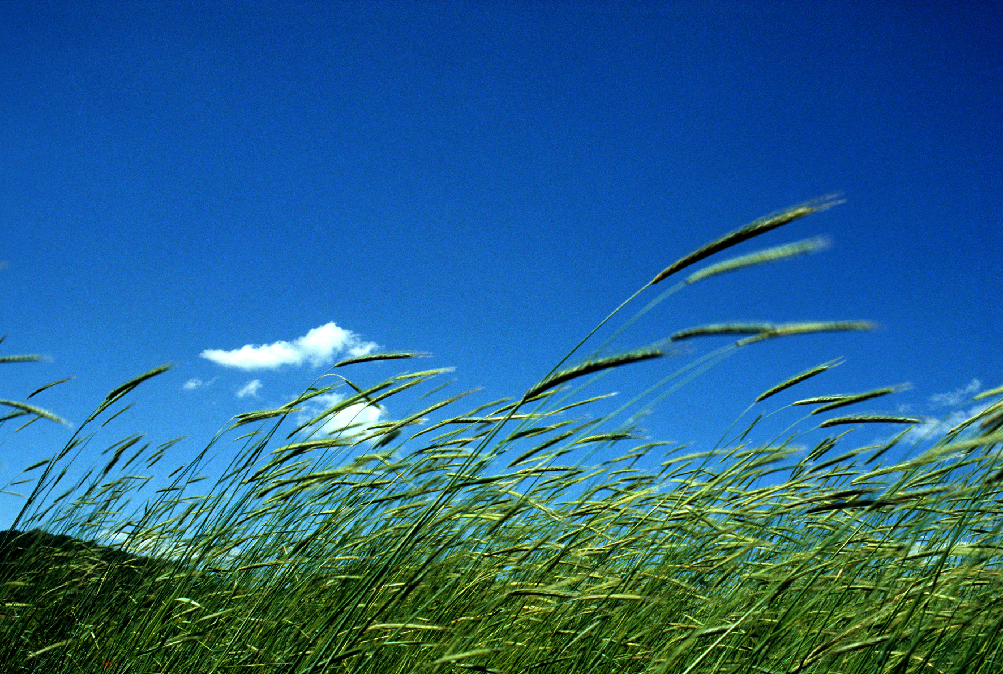
Notes:
Let’s go back to the plant.
There’s something else plants need to grow…. Do you know what it is? Air, or oxygen. We said the plants need water, sun and now air. Air makes plants strong.

Slide 30
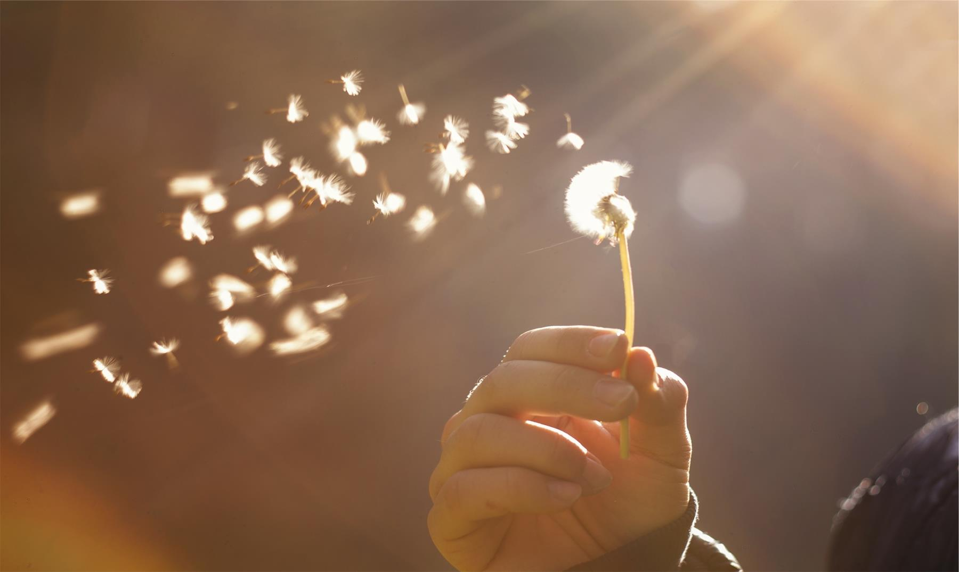
Notes:
It helps them fulfill the task that they have. With it they can perform photosynthesis.

Slide 31
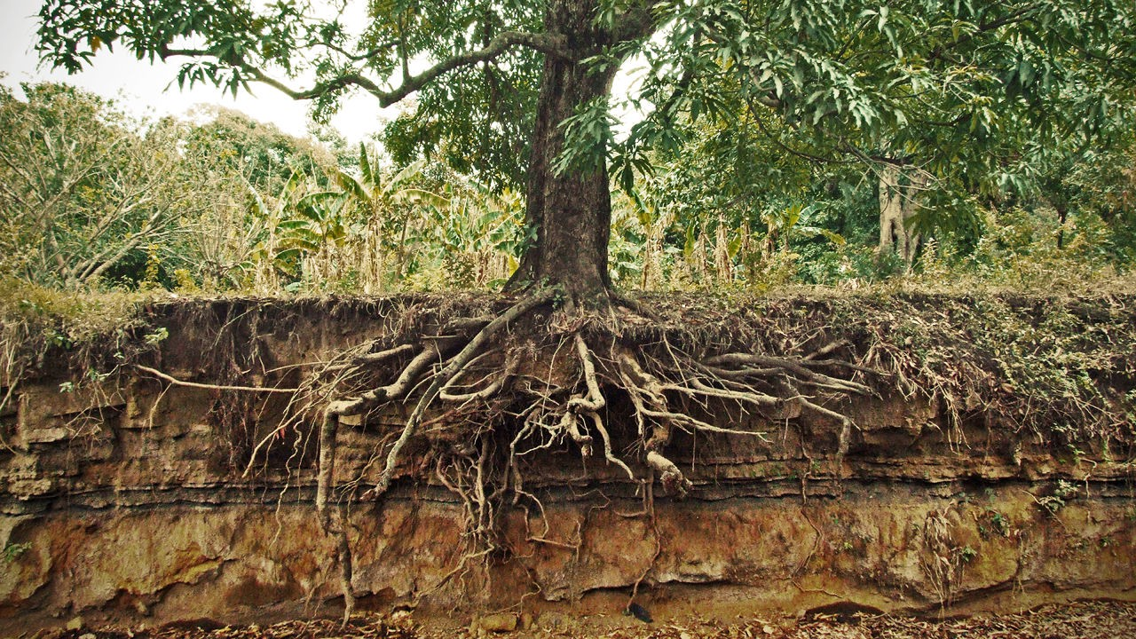
Notes:
The wind also helps them to grow stronger roots.

Slide 32
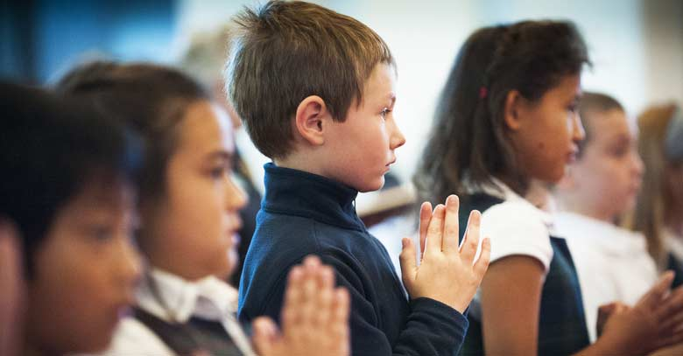
Notes:
We need to always listen to God. And how can we do that?
One way is to go to the church meetings each week to hear about God’s Word and in this way learn more about Him every time. The Holy Spirit is transforming our lives. In John 3:8, Jesus said,” The wind bloweth where it listeth, and thou hearest the sound thereof, but canst not tell whence it cometh, and whither it goeth: so is every one that is born of the Spirit..”

Slide 33
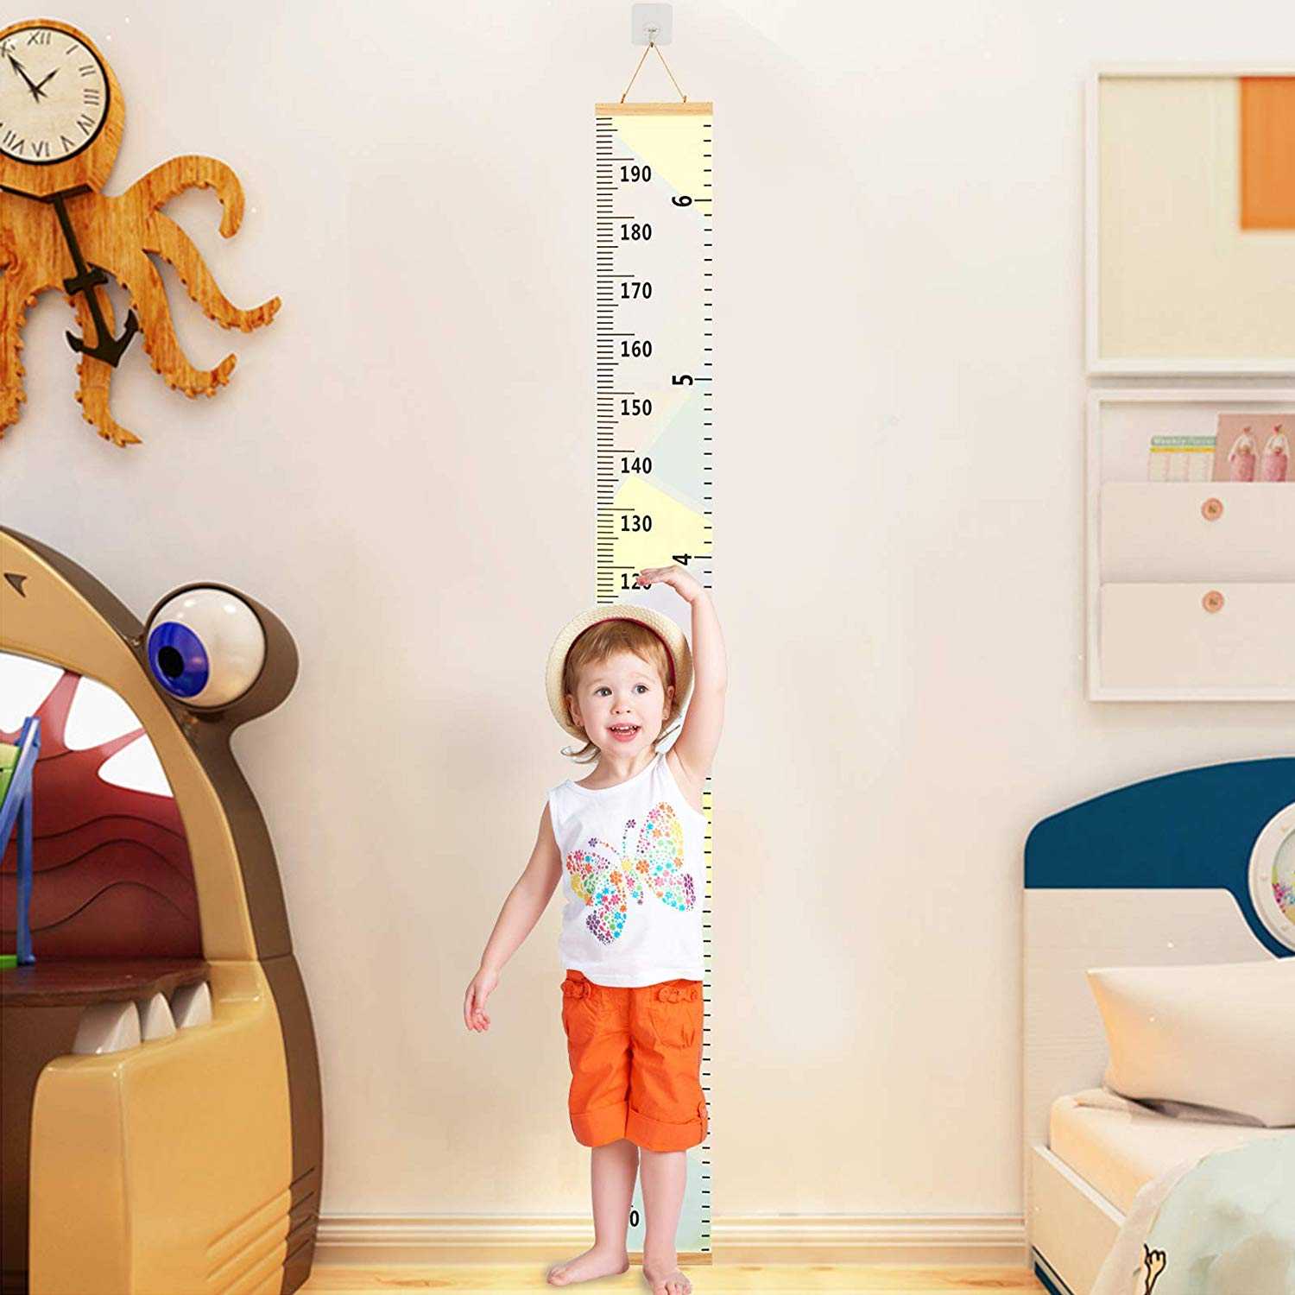
Notes:
That’s how we can grow. We’re getting stronger and stronger.
In Psalm 84:4 it says, “Blessed are they that dwell in your house.” To hear from God is a blessing.

Slide 34
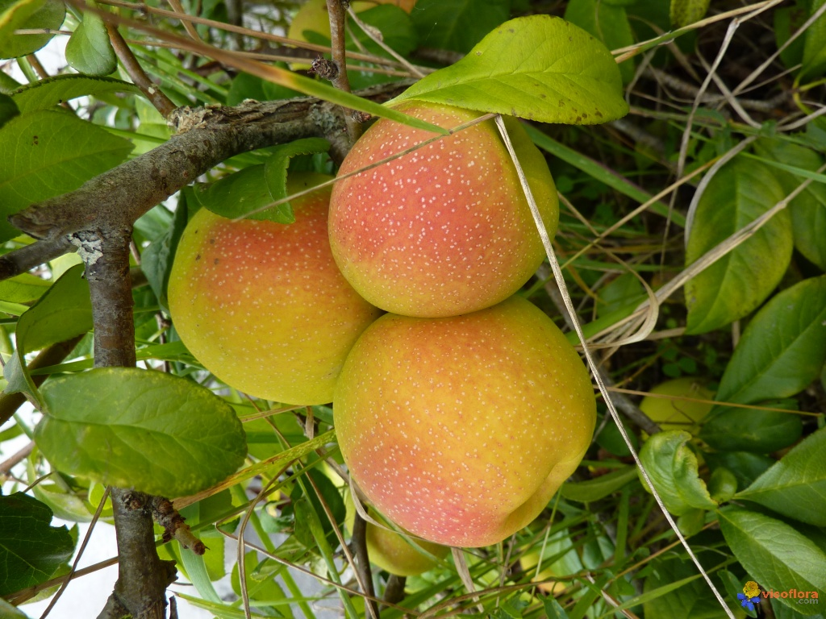
Notes:
As we said, plants grow because they have water, sun and air. Many people enjoy plants because of their flowers, leaves, and fruits.

Slide 35
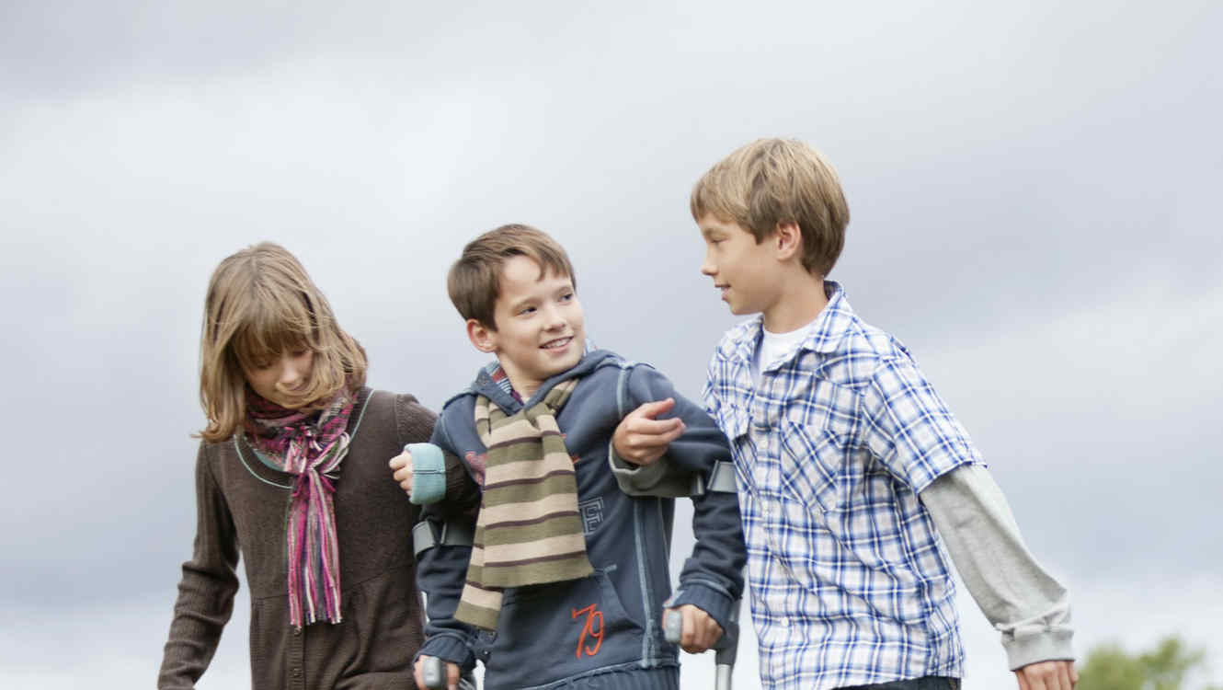
Notes:
God has given us the Word of God to study, prayer to speak with Him every day, and the possibility to gather together and hear from Him.
Let us always show others what God has done in our lives today.
Let us thank God for the gift of being able to grow spiritually!

Slide 36
2 Peter 3:18
Notes:
Teaching the Memory Verse
(You may memorize the Bible verse with the children before or after the lesson.)
Let’s remember that this is a very special moment. This moment is important, because we are helping the children keep the word of God in their minds.
Prepare the verse in advance on large cards with phrases.
Memory Verse:
• But grow in the grace and knowledge
• of our Lord and Savior Jesus Christ
• To Him be glory both now and forever! Amen.
• 2 Peter 3:18
Introduction: Make a brief introduction for the verse of the day.
Presentation: Allow children to read the Bible verse. The teacher should read loudly to accompany the children in reading.
Explanation: In this step, explain the most difficult words in the verse.
Application: Talk about what God wants the child to learn about this verse.
Repetition: Be innovative and creative in this step.
I recommend that you read the Instruction Manual, so that you may perfect the way you teach the Bible verse to the children every day.

Slide 37
But grow in the grace and knowledge
Notes:
But grow in the grace and knowledge

Slide 38
of our Lord and Savior Jesus Christ
Notes:
of our Lord and Savior Jesus Christ

Slide 39
To Him be glory both now and forever! Amen.
Notes:
To Him be glory both now and forever! Amen. 2 Peter 3:18

Slide 40
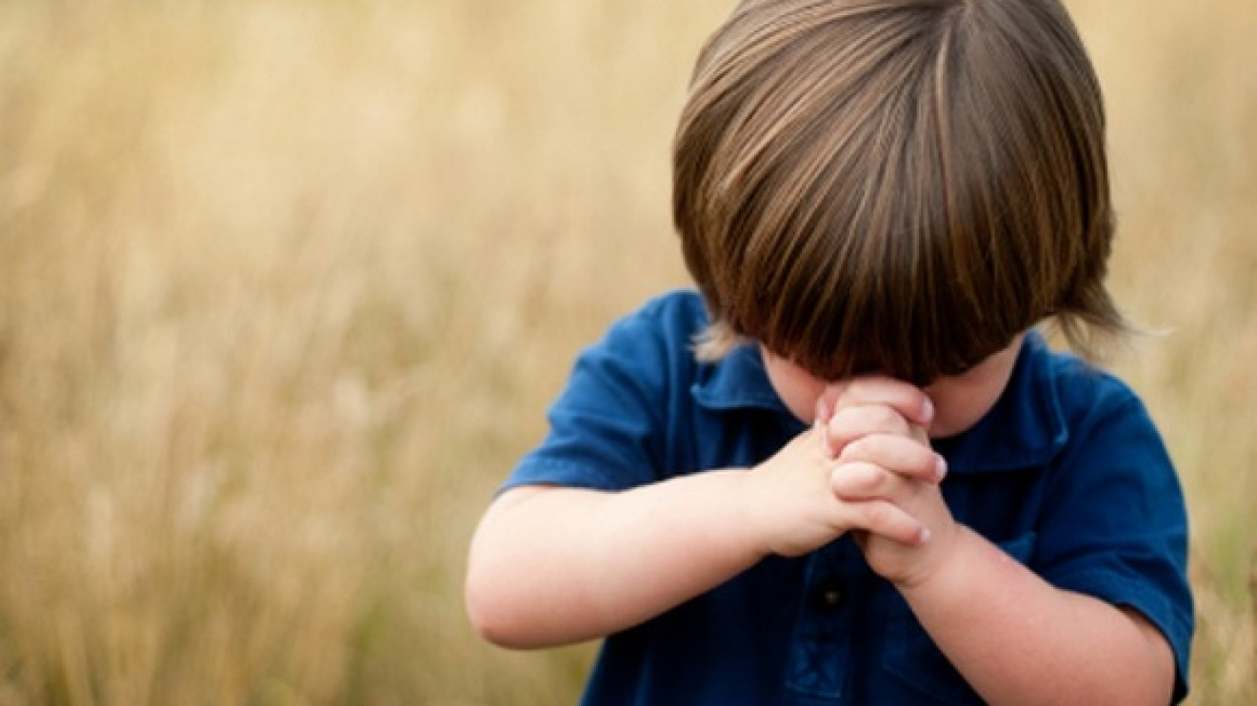
Momento de oración
Notes:
Prayer Time
Time to talk to God. Start this part by reviewing what was learned about prayer time. This class will be focused on prayer requests.
You can bring a big paper and let the children write down their requests there. If there are many students, then it is important to pray in a general way. But if there are only a few kids, one can pray for each request. It is important for our students to know that we pray for them and do not leave any of them out.
Beware of requests that may have doctrinal problems. For example. Praying for a dead grandfather... For a dead animal, etc...

Slide 41
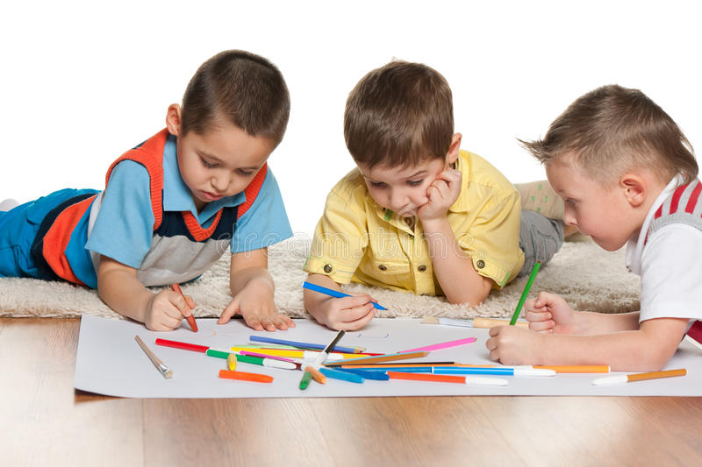
ACTIVITIES
Notes:
Activities
Children +8: Text box to read every day and answer. What does God tell me?
Children 0-7: Color drawings of activities that help you grow spiritually.
Option: Color the drawing.

Slide 42
Thank you, Lord, because you help me grow.
Notes:
Conclusion
Thank you, Lord, because you help me grow.

Slide 43
Music Time
I will grow
Notes:
Music Time
Start with joyful songs that can motivate the group. You can use some greeting songs for this occasion.
Then teach the theme song of the day. Consider the instruction booklet.
Option: “I will grow”. It is important to demonstrate mimics showing growth in this song. It will help our students learn the song faster.

Slide 44
Music Time
I will grow
I will grow more and more each day
Notes:
I will grow more and more each day

Slide 45
Music Time
Each day I’ll grow and grow and grow,
Notes:
Each day I’ll grow and grow and grow,

Slide 46
Music Time
Oh yes, I’ll grow and grow, and grow
Notes:
Oh yes, I’ll grow and grow, and grow

Slide 47
Music Time
More and more, I will grow.
Notes:
More and more, I will grow.

Slide 48
Music Time
By reading what God says in the Bible,
Notes:
By reading what God says in the Bible,

Slide 49
Music Time
By taking time to talk to the Lord,
Notes:
By taking time to talk to the Lord,

Slide 50
Music Time
And every week, with all our friends
Notes:
And every week, with all our friends

Slide 51
Music Time
we go to church, Oh..oh..oh..
Notes:
we go to church, Oh..oh..oh..

Slide 52
Music Time
I want to go to heaven; meet Jesus,
Notes:
I want to go to heaven; meet Jesus,

Slide 53
Music Time
For that event I need to prepare,
Notes:
For that event I need to prepare,

Slide 54
Music Time
I am learning, I’ll keep studying,
Notes:
I am learning, I’ll keep studying,

Slide 55
Music Time
From God’s word, Oh…oh…oh..
Notes:
From God’s word, Oh…oh…oh..

Slide 56
Next Lesson:
^{God Gives You} ^{a Mansion}
biblewell.org
Notes:
Next Lesson:
God Gives You a Mansion

