Slide 2
biblewell.org

Slide 3
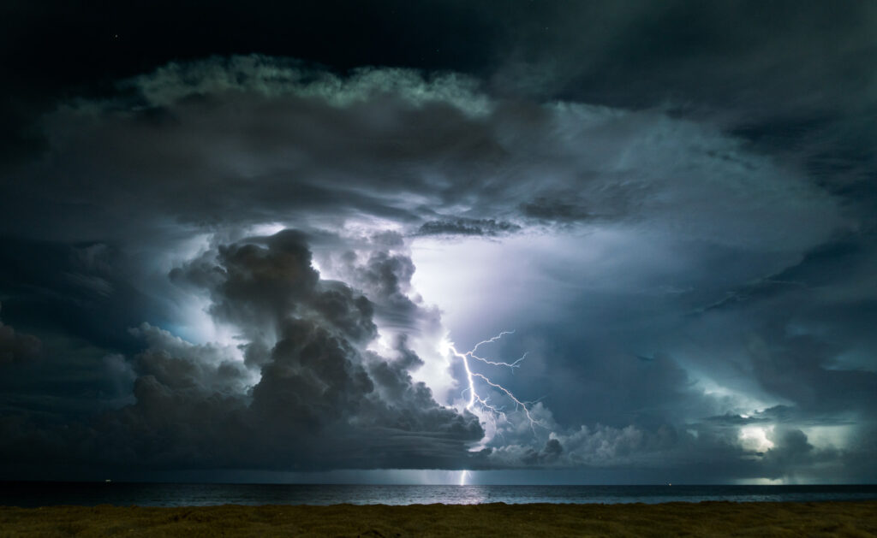
^{Overcoming Storms}
Day 5
Notes:
Bible Lesson Nº 5
Overcoming Storms
Biblical Reference: Mark 14:22-33; Isaiah 41:10; Isaiah 41:13; Isaiah 44:2; Matthew 28:20.
Main Topic: “Tools to overcome temptations.”
Bible Story: Jesus walks on water.
Specific Objectives
That the children may:
Learn that God has left us tools to overcome fear.
Understand that God has left us tools to feel safe by His side.
Deciding to Obey God’s Commandments.
Memory Verse: “Blessed is the man that endureth temptation: for when he is tried, he shall receive the crown of life, which the Lord hath promised to them that love him.” James 1:12.
Materials
1. Coloring pages for the lesson.
2. Theme song of the day and memory verse in illustrative pictures.
3. Illustrative materials for the time of prayer.
4. Craft activity with the memory verse of the day for each child to take home.
5. Materials for craft activities.

Slide 4
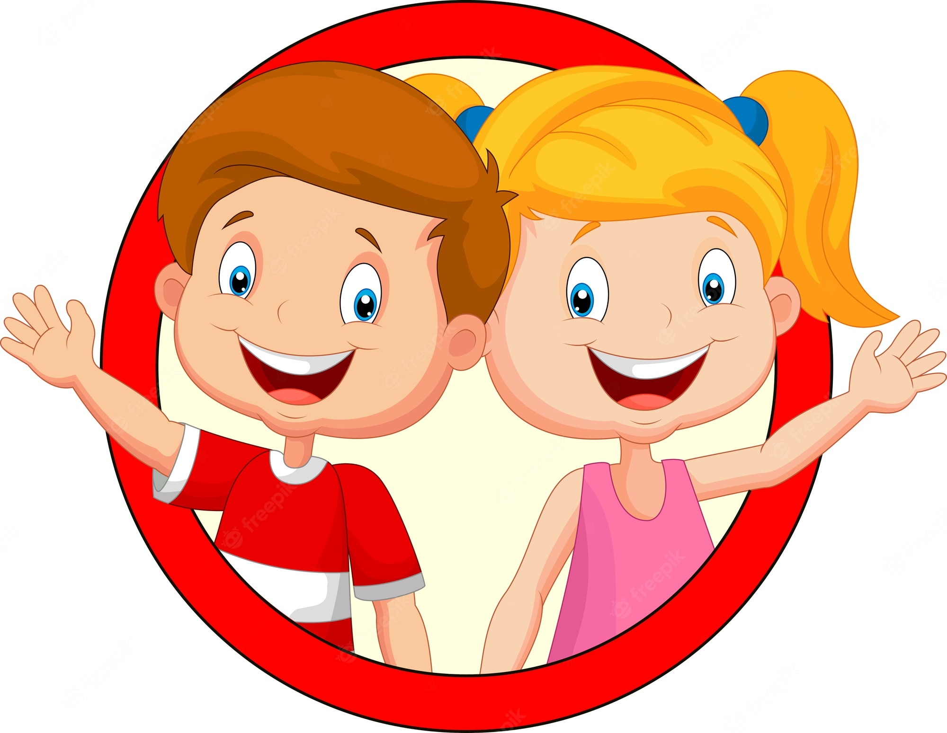
Welcome!
Notes:
Program Development
1. Welcome
Welcome everyone in a friendly, cheerful, and fun way, greeting the children in a group and general form. Present yourself and the other teachers.
Ice breakers can be done to welcome the new children. Reward those who invited new friends or congratulate those who attended every day.

Slide 5
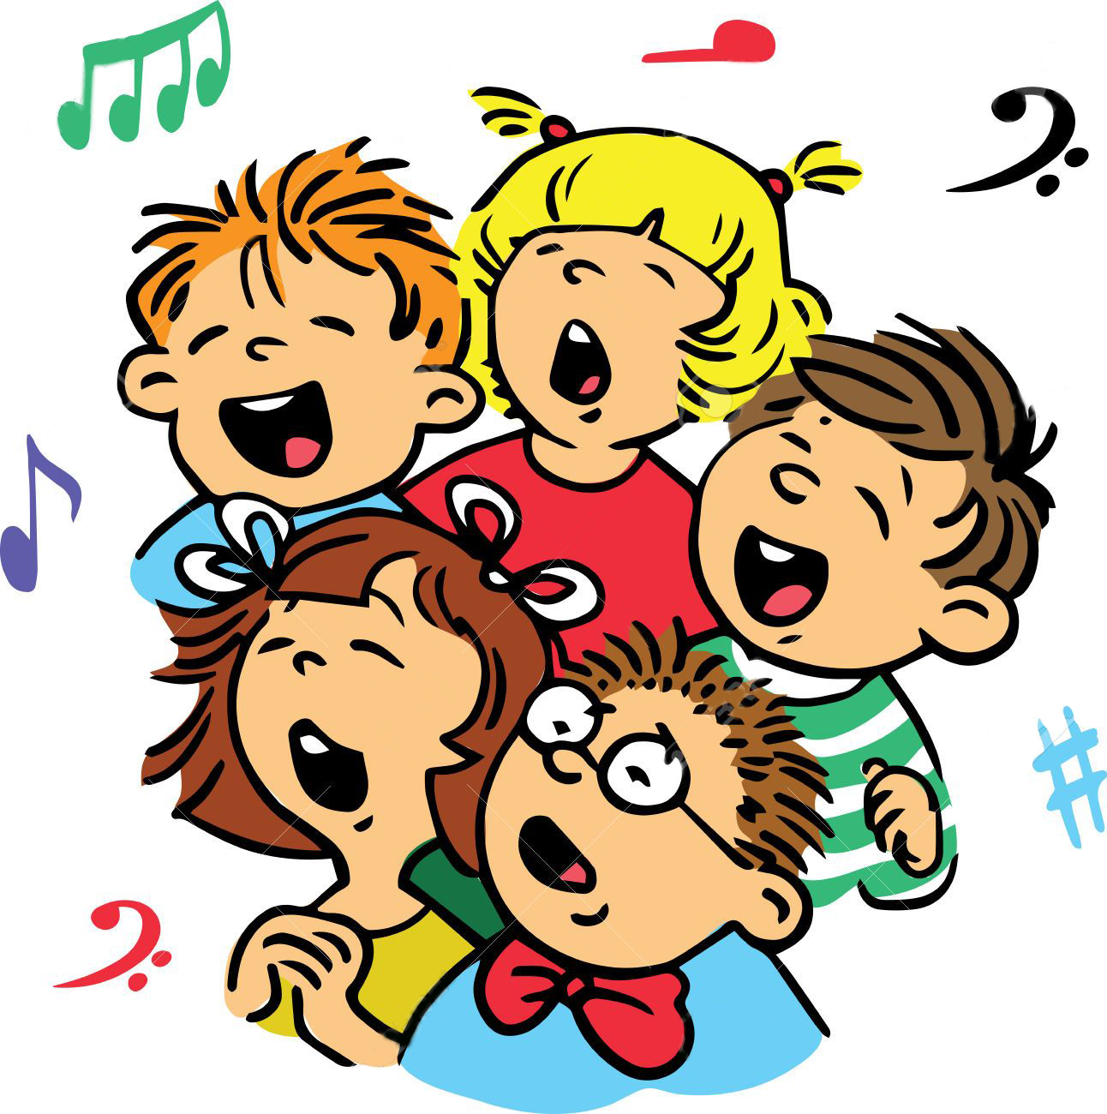
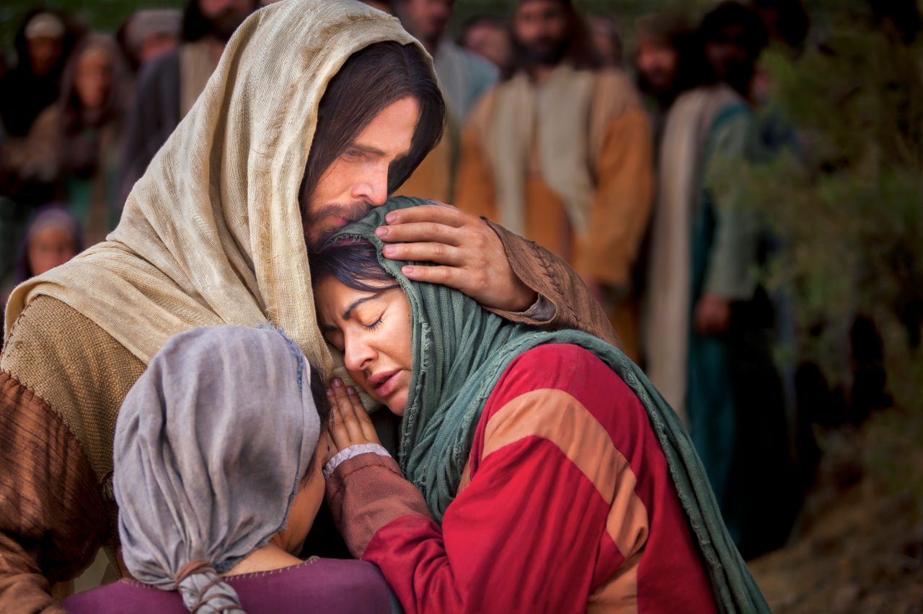
Musical moment
MY LOVE FOR GOD
Notes:
MY LOVE FOR GOD

Slide 6
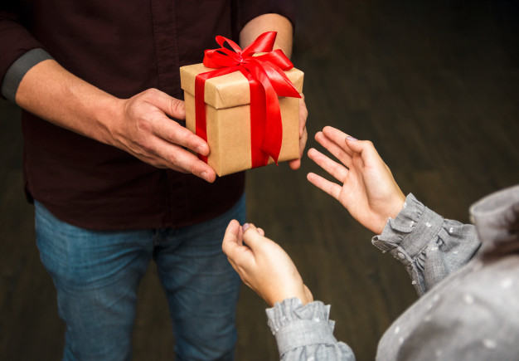
Musical moment
I have received God’s greatest gift
Given to me through his precious love
Notes:
I have received God’s greatest gift
Given to me through his precious love

Slide 7
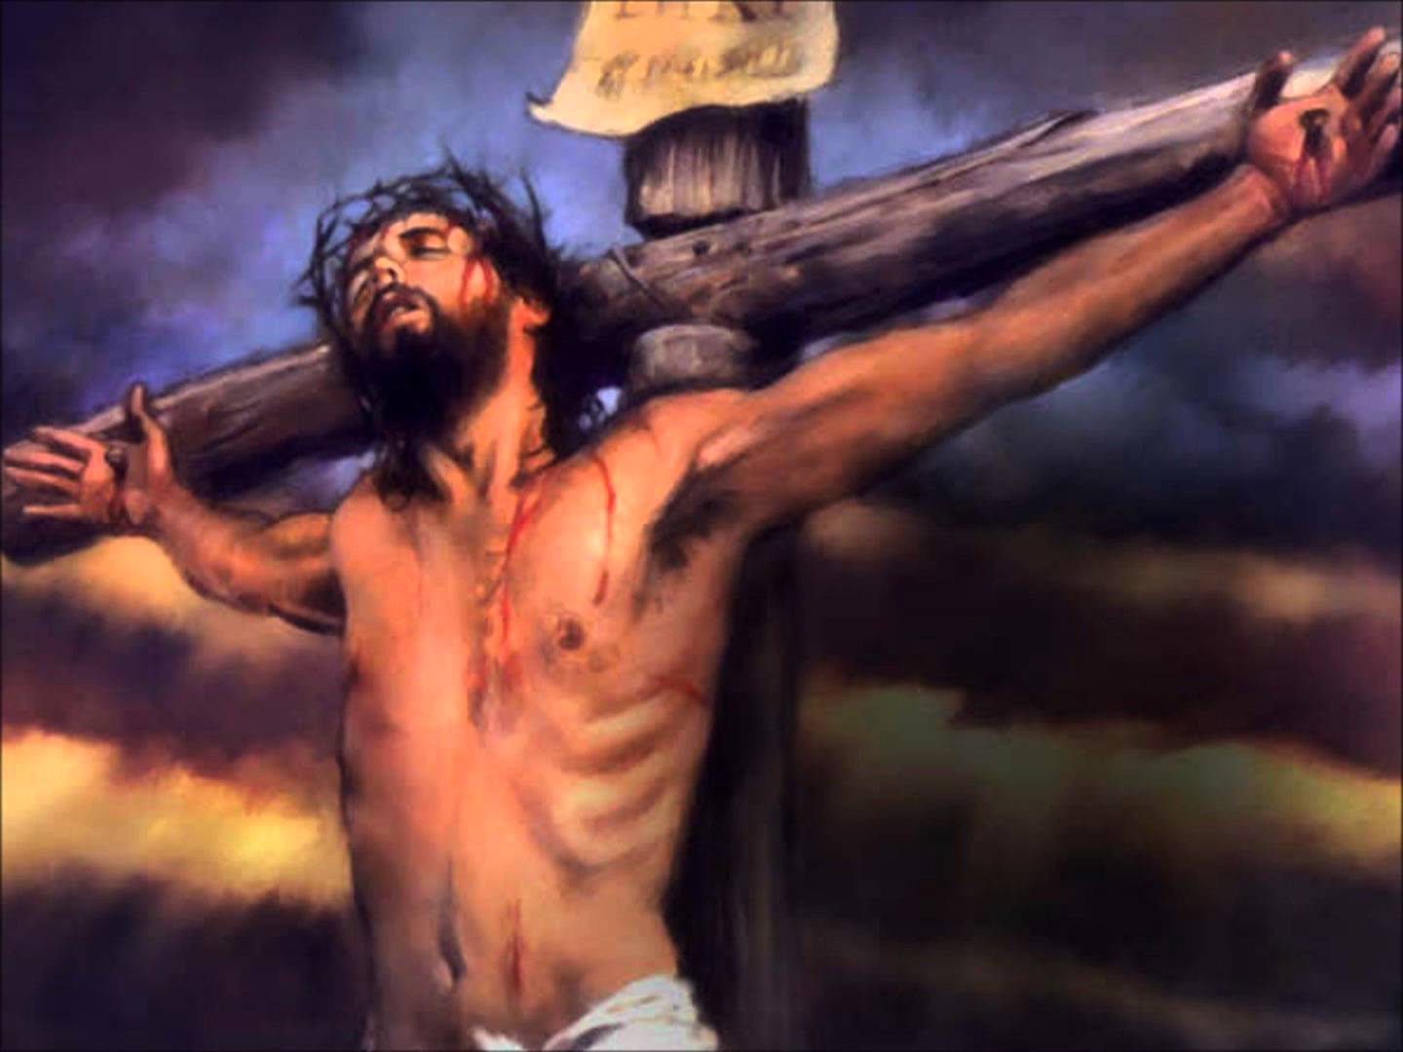
Musical moment
Upon a cross’ his life he gave
That through his love’ sinners be saved
Notes:
Upon a cross’ his life he gave
That through his love’ sinners be saved

Slide 8
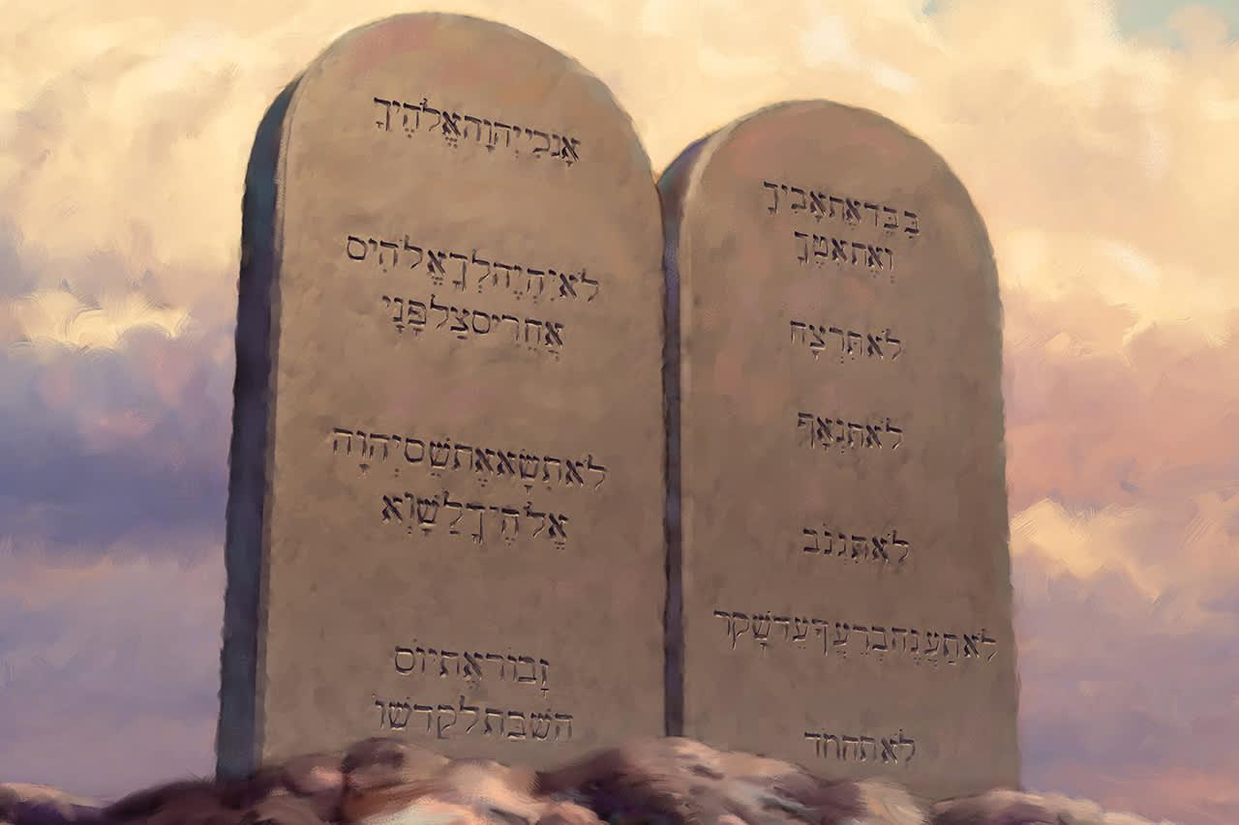
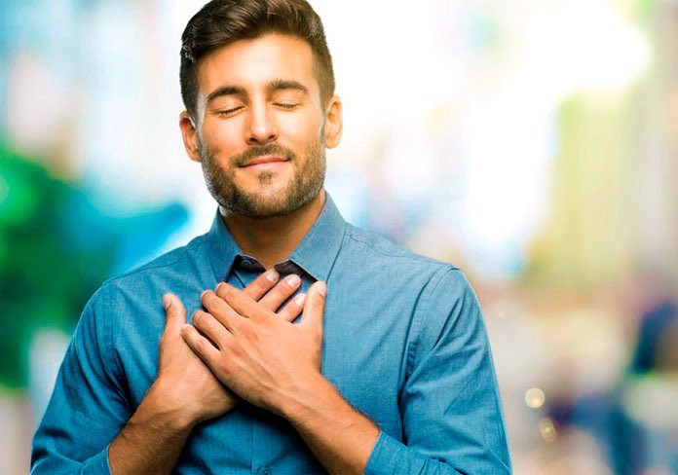
Musical moment (Pre-Chorus)
And to give him thanks will I now keep his law
Notes:
And to give him thanks will I now keep his law

Slide 9
Musical moment (Chorus)
All Ten Commandments have I received
All for my good if I believe
Notes:
All Ten Commandments have I received
All for my good if I believe

Slide 10
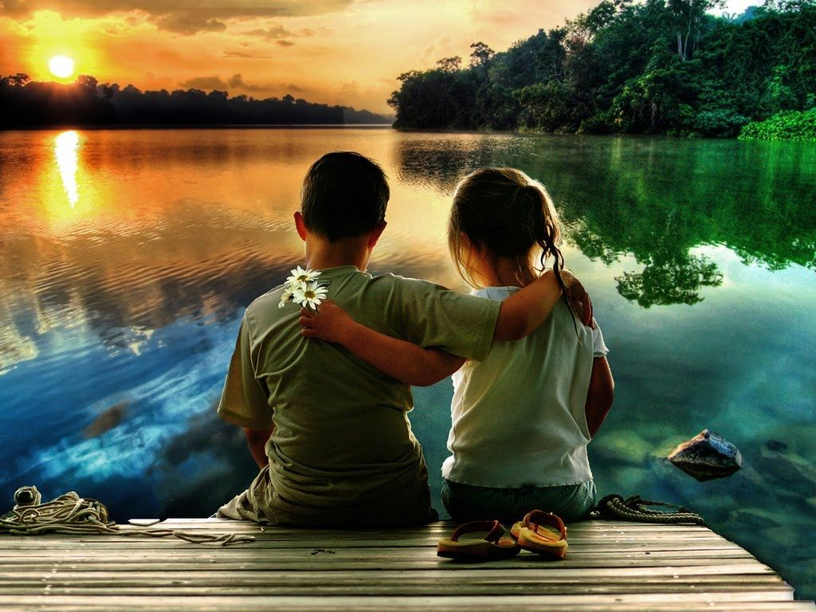
Musical moment (Chorus)
Love for those next to me,
and most of all’ my love for God, my love for God.
Notes:
Love for those next to me,
and most of all’ my love for God, my love for God

Slide 11
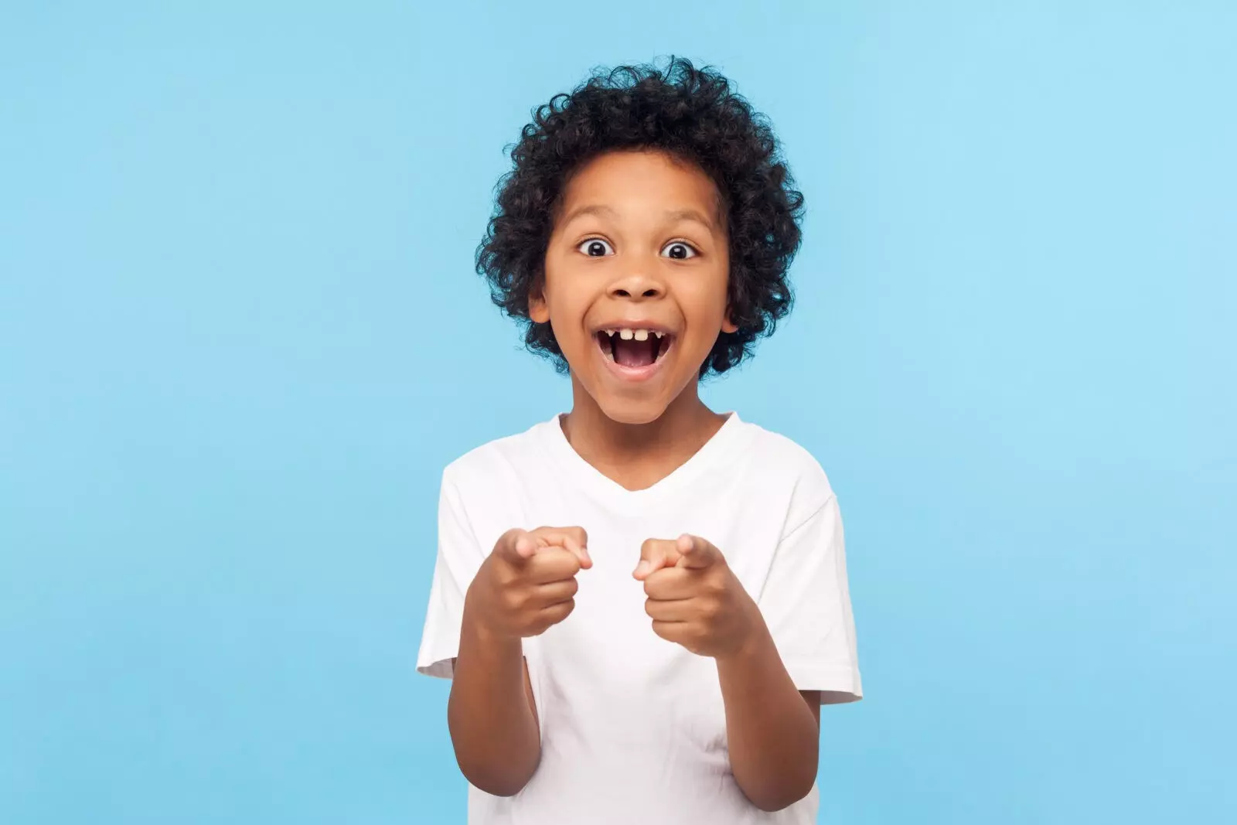
Musical moment
I want to share something with you
That youre invited to give thanks too
Notes:
I want to share something with you
A B
That youre invited to give thanks too

Slide 12
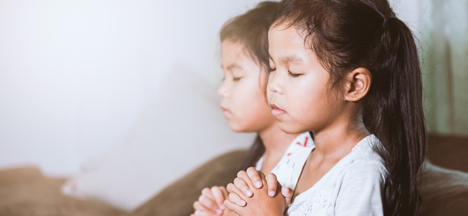
Musical moment
On to share more about his great love
All to give thanks to the father Above
Notes:
On to share more about his great love
All to give thanks to the father Above

Slide 13
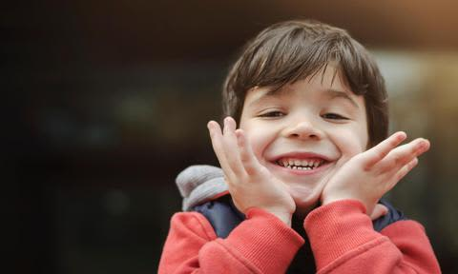
Musical moment (Pre-Chorus)
And to give him thanks will I now keep his law
Notes:
And to give him thanks will I now keep his law

Slide 14
Musical moment (Chorus)
All Ten Commandments have I received
All for my good if I believe
Notes:
All Ten Commandments have I received
All for my good if I believe

Slide 15
Musical moment (Chorus)
Love for those next to me,
and most of all’ my love for God, my love for God.
Notes:
Love for those next to me,
and most of all’ my love for God, my love for God

Slide 16
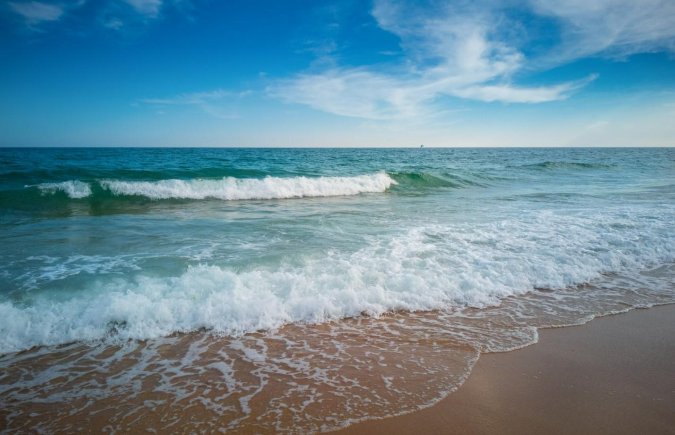
BIBLICAL LESSON
Notes:
3. Lesson
Do you know the sea? What do you see when you go to the sea?
Lots of water, waves, birds flying, maybe fish or dolphins, or seals. Boats.
What is the noise the sea makes?
Fshsh fshsh fshsh
Today I will tell you a story that happened on a sea with several people involved.

Slide 17
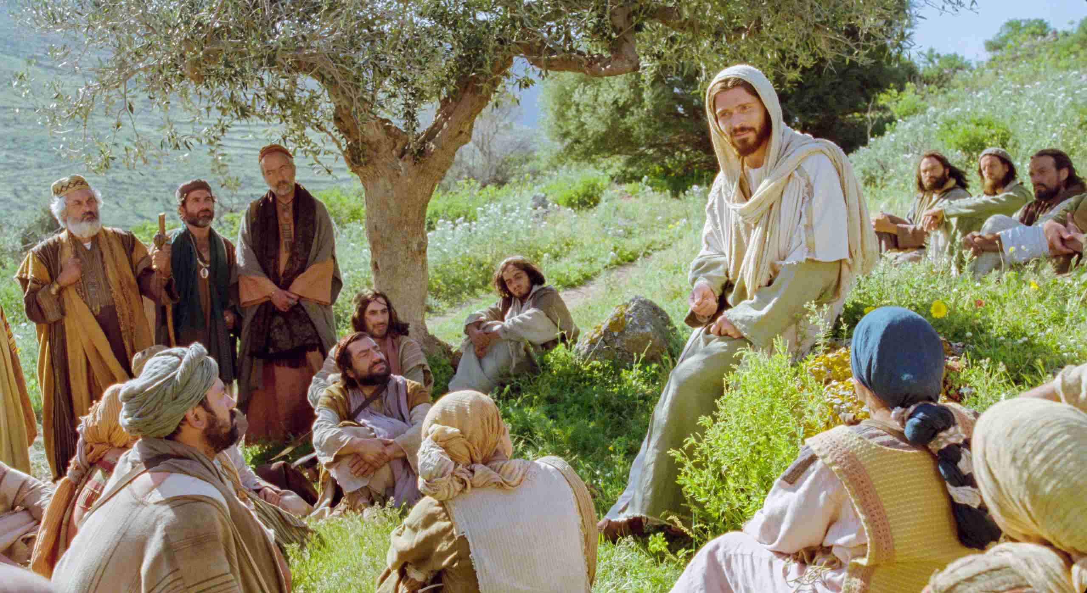
Notes:
Jesus had taught many people in different places. He would heal them, feed them, and teach them. When he was tired he would go out alone on the mountain and talk to God.
He spent many hours praying.
At dawn he would sit somewhere and many people would surround him so that he could teach them about God.
One day after he had been teaching all day, Jesus said to his disciples:
-It is now evening go to the other side of the lake I will come later.
The disciples did not want to leave Jesus alone, but they obeyed his word because he was their teacher.
Jesus continued to teach all the people and dismissed them one by one. He was tired but decided to go to the mountain to talk to God. He went to pray.
Meanwhile the disciples got into the boat, as Jesus had said, and went out to the other side of the lake.
They were obedient to the word of their teacher Jesus.

Slide 18
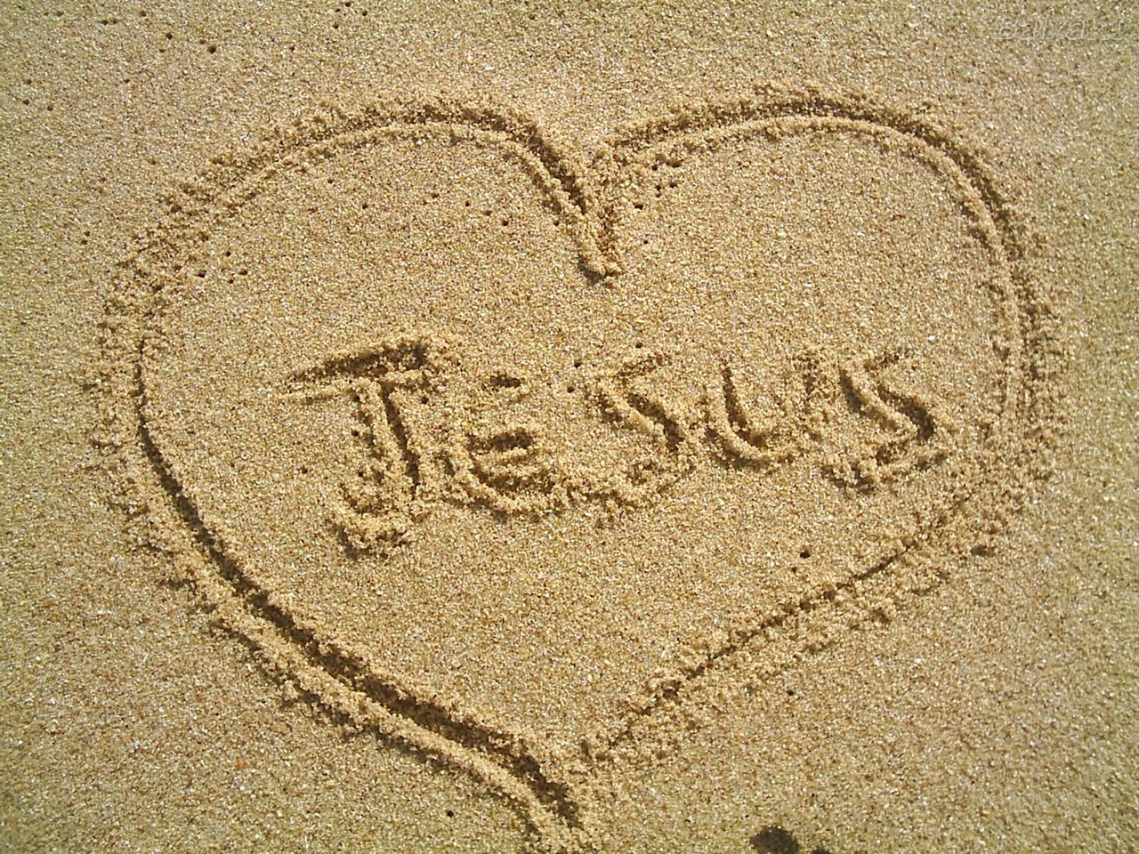
Notes:
In the stories that we have seen the previous days, we have studied that Jesus wants to live in our hearts.
Many of us pray and ask him to forgive our sins and we have let the Lord live in our lives.
Have you done it? If you haven’t, you can do it. Just pray and talk to God and tell him to forgive all your sins.
Now we can say that we are also with Jesus because we have asked him to dwell in us.

Slide 19
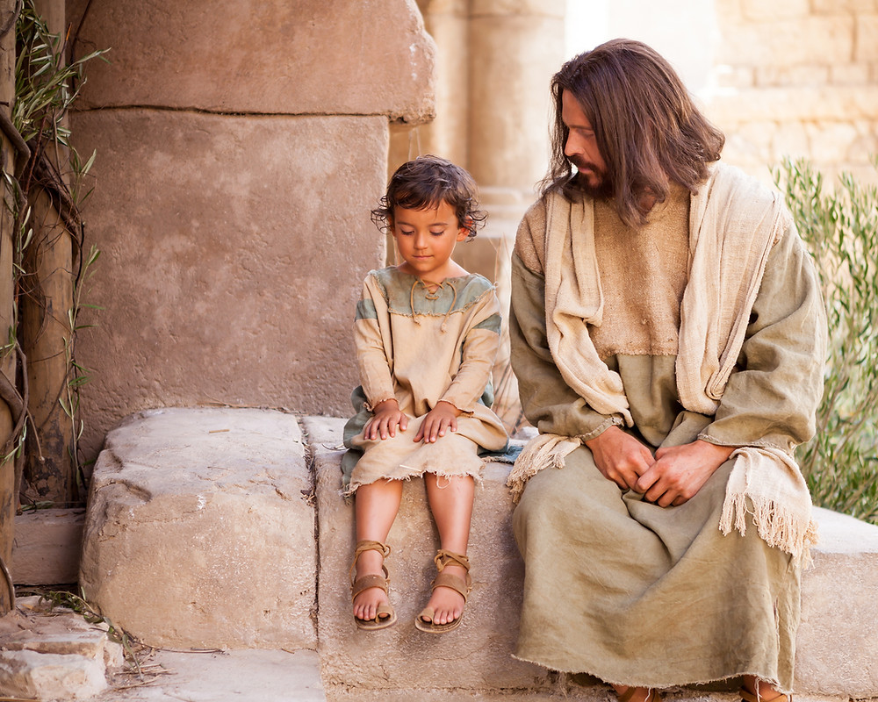
“I am with you alway, even unto the end of the world. Amen” Matthew 28:20 l.p.
Notes:
The bible tells us about a promise that Jesus left us and it goes like this:
Matthew 28: 20, last part, says: “I am with you alway, even unto the end of the world. Amen”
He is with us! That is the promise. But now you may ask yourself:
How can we talk to him?

Slide 20
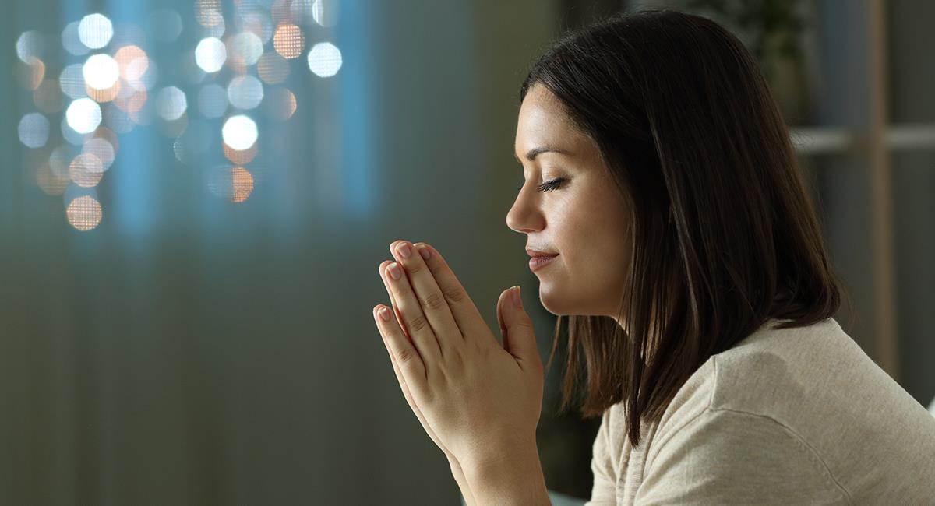
Notes:
Through prayer, we can communicate with God. Prayer is talking to God as we talk to a friend. It is telling him what is happening to us, it is telling him our joys and sorrows.
Jesus did it with God. He always went to places alone to talk to Him.
It is very nice to take time to talk to God. Have you ever talked to God? You can start by saying “Our Father who art in heaven and then tell Him what you want. At the end you should say in the name of Jesus. Amen, which means So be it.
Tonight before you go to bed, say a prayer. What do you think?
But let’s continue with the story.

Slide 21
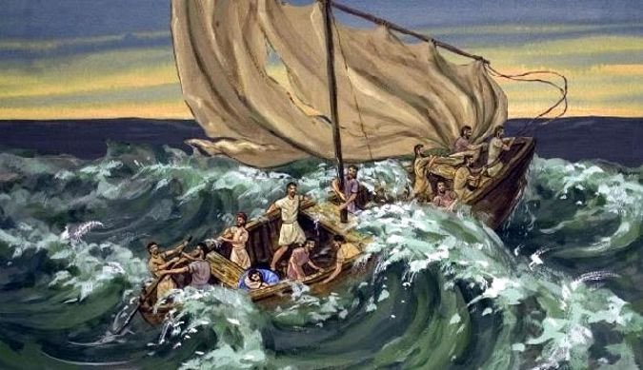
Notes:
Jesus was praying as the disciples crossed to the other side of the lake. They were traveling in the boat quietly. When suddenly, the wind came up. The wind got stronger and a strong storm began. The waves of the sea grew stronger and stronger.
Jesus’ disciples were rowing hard to get to the place where Jesus was.
They rowed and rowed and the storm hit the boat hard.
The disciples began to be afraid. They said:
Row, my companions, we are going to die in this storm. I can’t go on any longer! said another.
We are lost.
They became more and more afraid of dying out there in the sea.

Slide 22
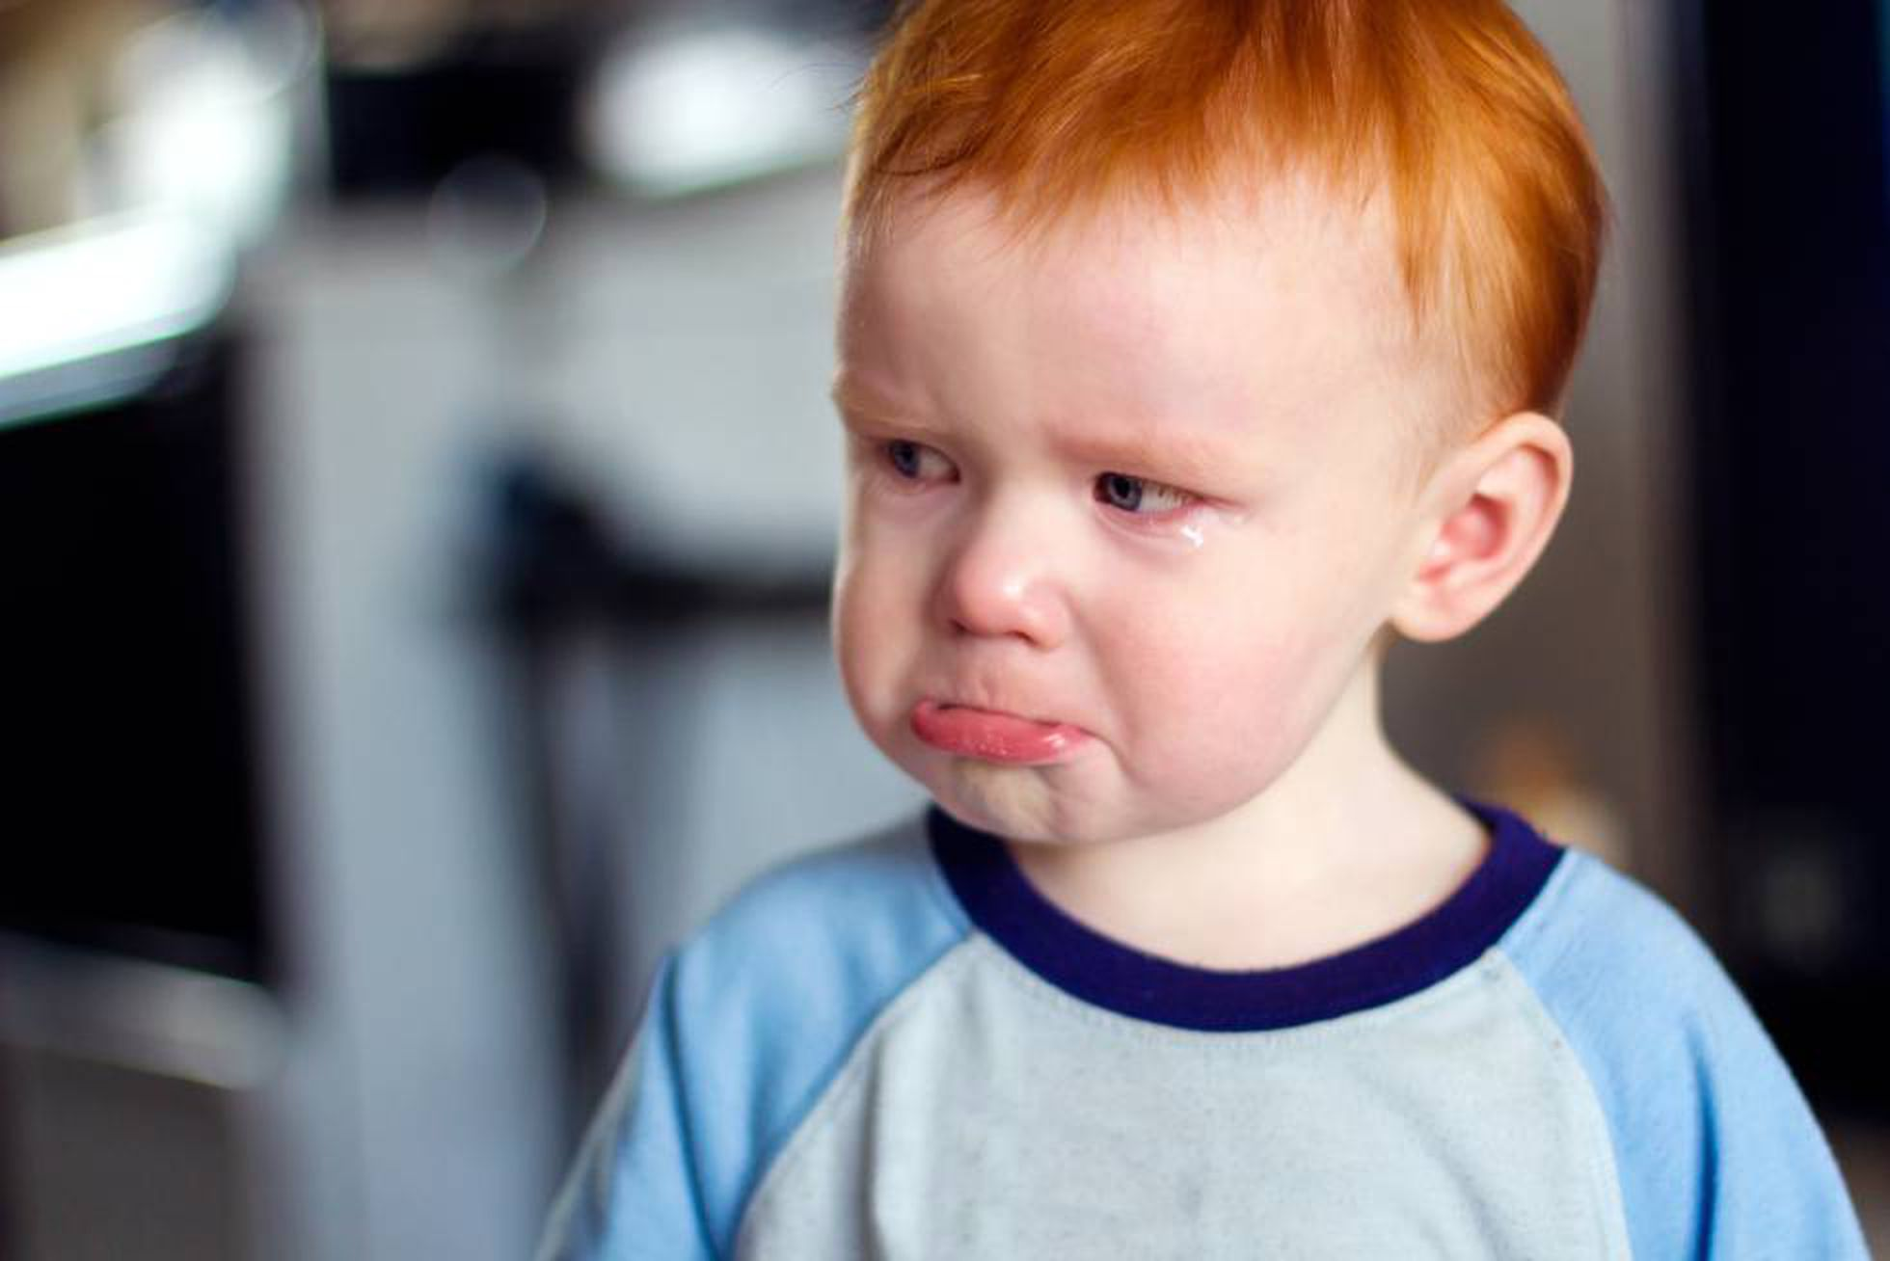
Notes:
They became more and more afraid of dying out there in the sea.
You know, we had a hard time here.
We go through difficult times here. For example, when we are sick, when we are away from our loved ones, or when we have a fight with our best friend.
All those bad things that happen to us are the fruit or consequence of the sin that entered the world.
Satan is happy when we are afraid. He does not want us to be happy children.
Satan wants us to move away from Jesus and to not have communion with him, therefore he sends us trials, storms like the one in our story.
He does not send us rain and storms like the one at sea. But sad moments, or he makes us fight with our friends, or makes us feel bad, or makes us eat things that make us sick or makes us fight with our parents and siblings.
And when we go through difficult times we are sad or afraid that something might happen to them.

Slide 23
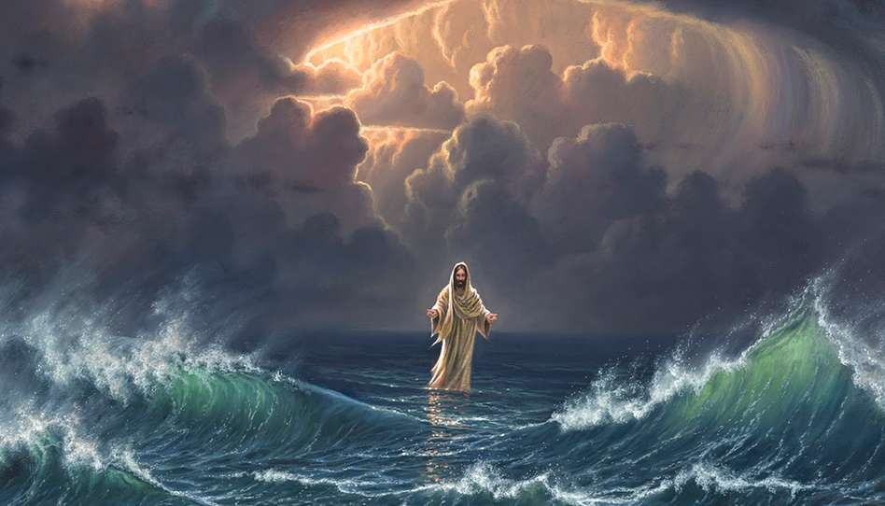
Notes:
The disciples were facing the storm and were already giving up, when suddenly among the waves they saw a white figure.
A ghost is coming! they said.
No, how scary! said another
No, there is no such thing as a ghost.
Yes, look, it’s a ghost walking on the water.
They were scared to death, but the bravest wanted to look to see if they recognized who it was or if it really was a ghost.
It is Jesus walking on the water! said one of them.
It was Jesus.

Slide 24
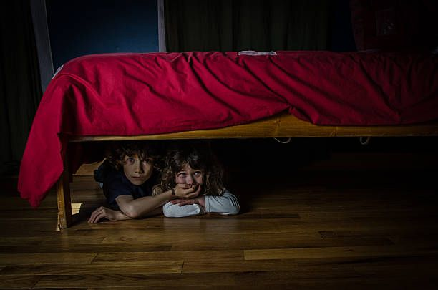
“Fear thou not; for I am with thee: be not dismayed; for I am thy God: I will strengthen thee; yea, I will help thee; yea, I will uphold thee with the right hand of my righteousness” Isaiah 41:10
Notes:
How scared they must have been... can you imagine?
What do you do when you are afraid, or in a difficult situation? How do you face that moment?
Do you hide under the bed? Or do you act brave? Do you cry out for help?
In the Bible we find many promises and teachings for our lives. All of them help us in these difficult moments.
Isaiah 41:10 says, “Fear thou not; for I am with thee: be not dismayed; for I am thy God: I will strengthen thee; yea, I will help thee; yea, I will uphold thee with the right hand of my righteousness.”
How wonderful! God tells us not to be afraid because he will be with us. He is the one who gives us strength, who sustains us when we are in difficulty. He is the one who will always help us. That is God’s promise to each one of us.

Slide 25
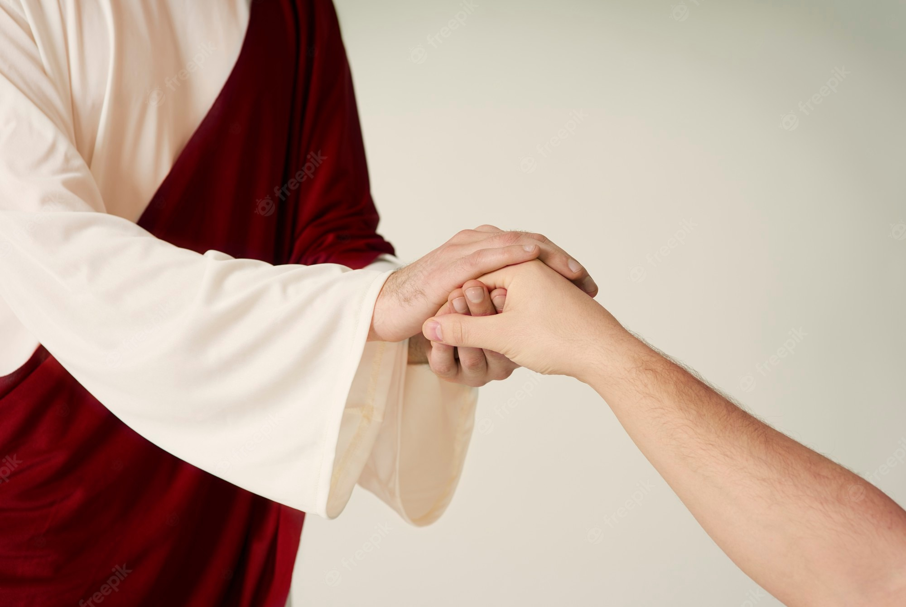
“For I the LORD thy God will hold thy right hand, saying unto thee, Fear not; I will help thee” Isaiah 41:13
Notes:
Isaiah 41:13 says, “For I the LORD thy God will hold thy right hand, saying unto thee, Fear not; I will help thee.”
In this text God tells us that he is holding our hand and that is why we do not have to be afraid. Although we do not see God around us, he is always there. When you are sad, he is by your side. When you are sick, he is holding your hand. If you have to go to the hospital, he is with you.

Slide 26
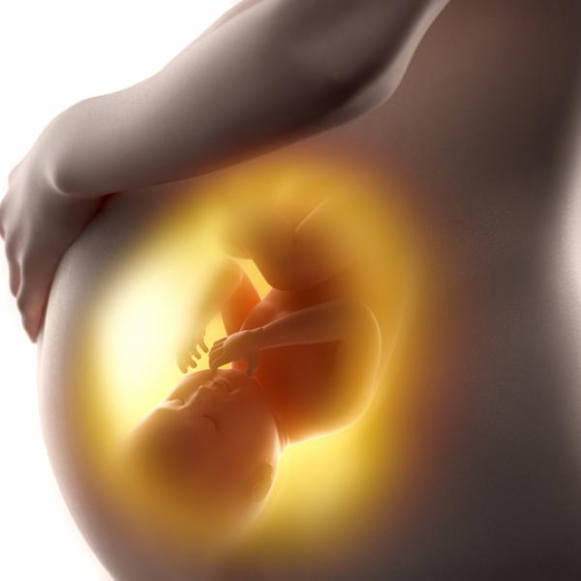
“thus saith the LORD that made thee, and formed thee from the womb, which will help thee; Fear not, O Jacob, my servant; and thou, Jesurun, whom I have chosen” Isaiah 41:13
Notes:
And the last promise I will tell you about is in Isaiah 44:2: “thus saith the LORD that made thee, and formed thee from the womb, which will help thee; Fear not, O Jacob, my servant; and thou, Jesurun, whom I have chosen.”
Do you know why he is with us always? Because he formed us in our mother’s womb. He chose us out of many who could be born. And because we have accepted him in our hearts, he has also chosen us to be his children.
Wonderful, isn’t it?

Slide 27
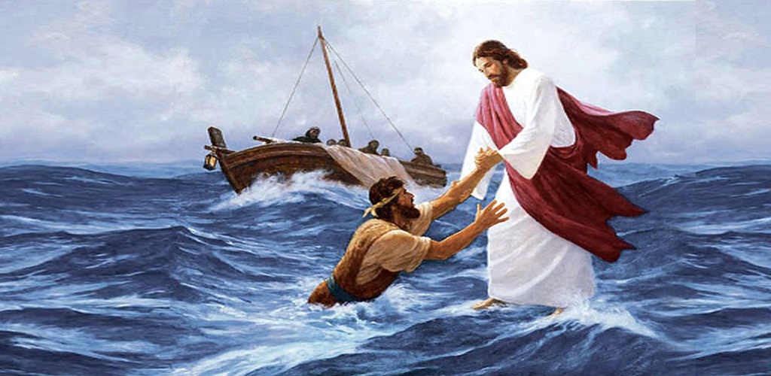
Notes:
Peter saw that it was Jesus and said to him:
Lord I want to walk on the water to where you are.
And Jesus accepted that.
Quickly Peter started to go to Jesus. But the storm was still raging and the waves were very strong.
Peter looked at Jesus and said Oh how great I am sure my friends are watching.
When he looked back, he lost sight of Jesus and began to sink.
The waves were getting bigger and bigger and he began to get scared because he was falling into the sea.
Lord, save me!
Jesus came to Peter and held his hand out kindly.
Peter looked at Jesus again.
And Jesus said to him:
What little faith you have! why did you doubt?
Peter had looked away from Jesus.

Slide 28
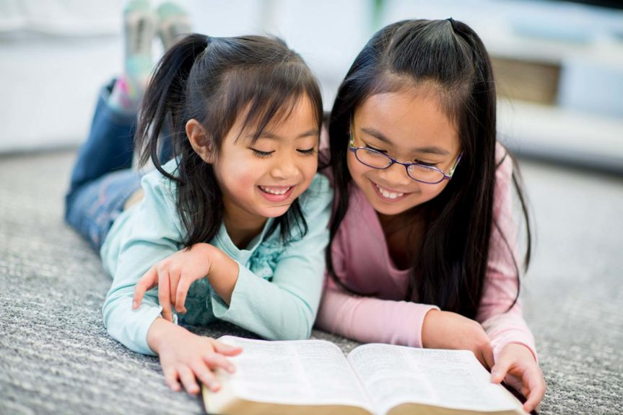
Notes:
Many things can happen to us too, but if we do God’s will, he gives us the strength to overcome.
If we are with Jesus, he will give us the courage to go forward. But what should we do?
We must pray to be united to him.
We must read the Bible to learn more about him.
We must listen to him to grow in knowledge.
We must share with others what he teaches us.

Slide 29
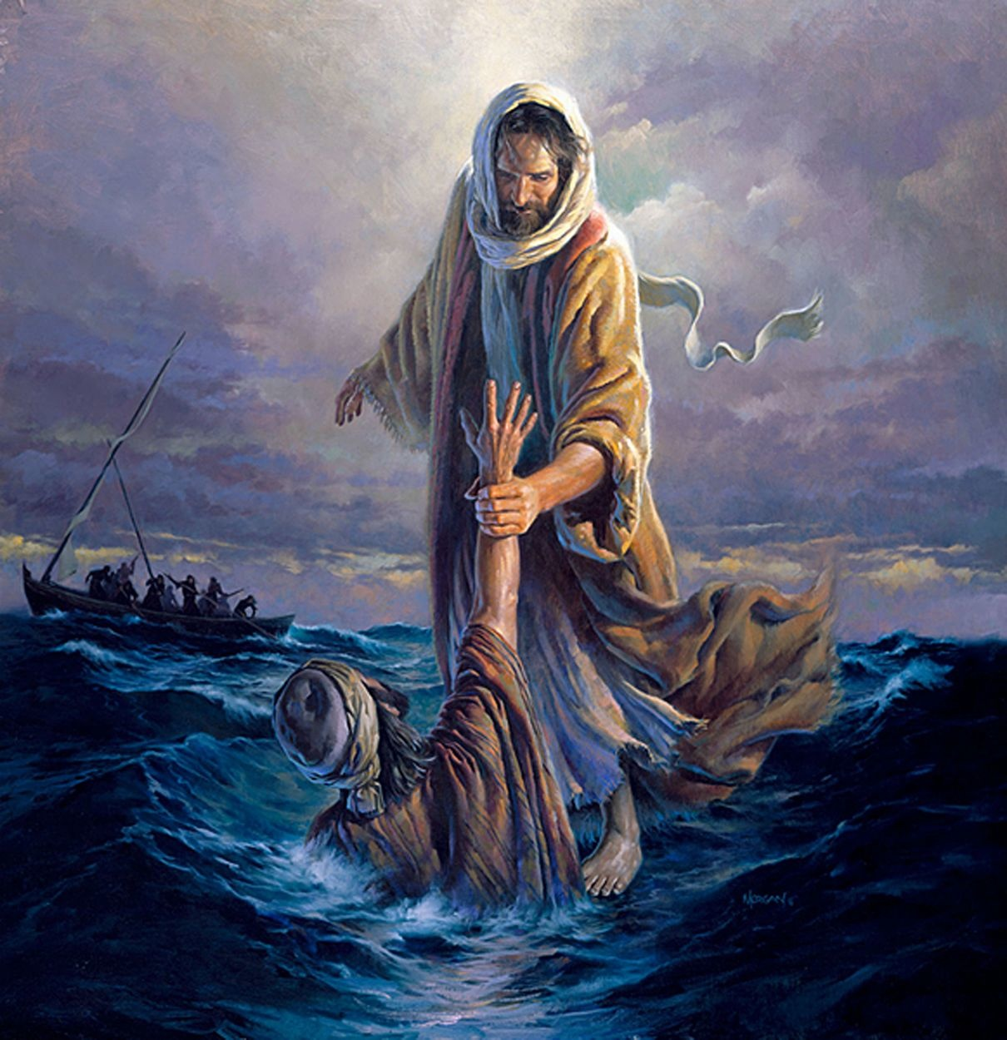
Notes:
Jesus gave Peter his hand and lifted him up. Now Peter was safe because Jesus was with him.
Together they got into the boat and the storm calmed down completely. Now everyone was safe because they were with Jesus.

Slide 30
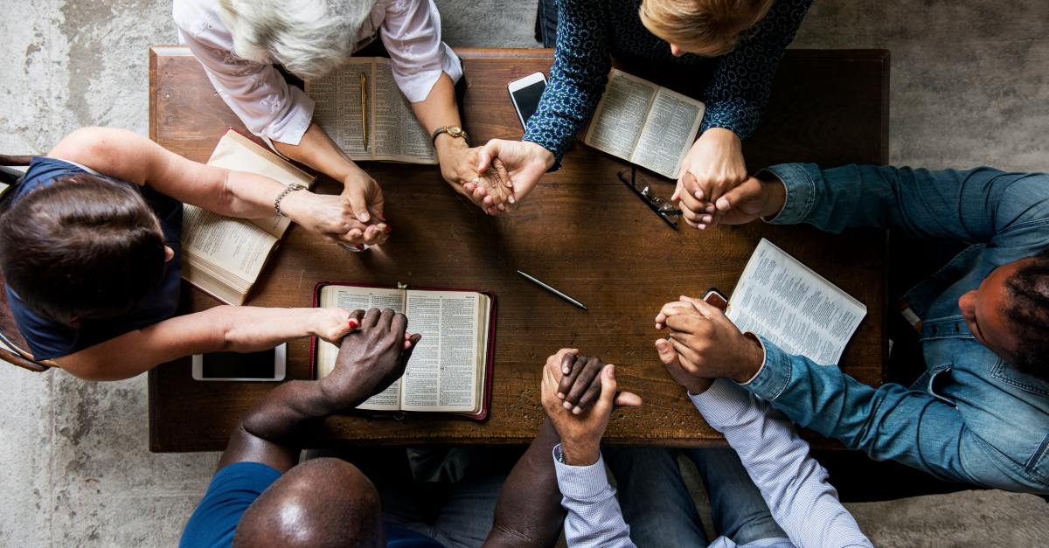
Notes:
How good it is to be able to have Jesus in every moment of our life! When we are sad let us remember that Jesus is with us.
God desires that we always overcome the problems we have at his side. But remember, how can we stand by Jesus’ side?
By reading his word
By talking to him every day through prayer and hearing more about him.
If you want to hear more about Jesus, look for the person who sent you this video or who invited you to this meeting and ask them to teach you more about Jesus and thus overcome all the storms that may come with great courage.

Slide 31
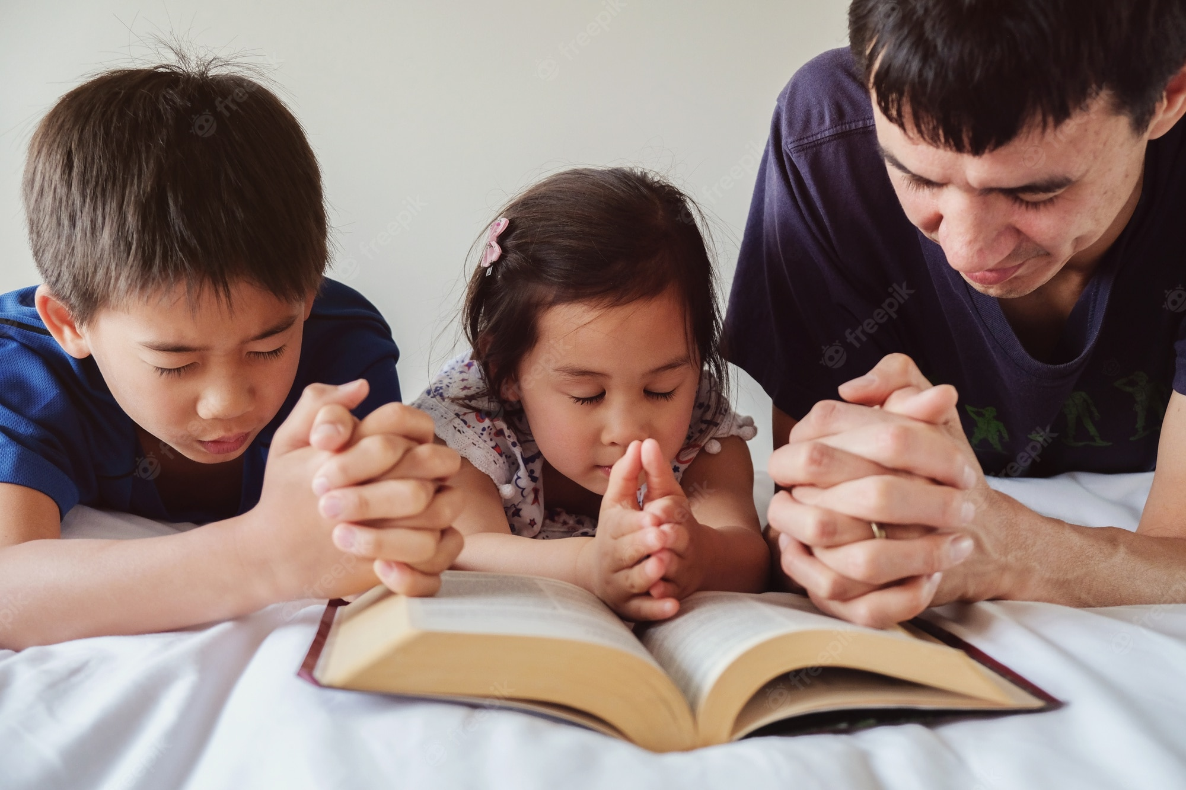
Notes:
Let’s thank God together, shall we? Let’s pray.
Our dear heavenly father, sanctified be your name. We thank you Lord because you’ve given us promises in your Word that tell us that you’ll be with us forever. Thank you because in difficult moments I can be sure that you are by my side. Thank you for holding my hand so that I don’t have to fear. Thank you that I can speak with you through prayer. Thank you for giving me the opportunity to learn more about you every day. Help me to learn more about you every day. I ask you to forgive all my sins and ask you to give me strength to overcome temptation. In Jesus’ name, Amen.
This is how we end today’s story. Did you like it? It was a beautiful story. And always remember the promises. Why don’t you ask someone where those bible verses we heard are found so that you can write them down and don’t forget them? And remember that when the night comes and you’re scared, who is by your side? Jesus. Who holds your right hand? Jesus. He is always with us. Let us never stop looking for Jesus, because we are His children and He has promised to be with us forever.

Slide 32
James 1:12
Notes:
4. Teaching the Memory Verse
This moment is important, as we are engraving the very word of God in the hearts and minds of our children.
Review the instruction manual to remember how to teach the verse.
Today’s verse is:
“Blessed is the man that endureth temptation: for when he is tried, he shall receive the crown of life, which the Lord hath promised to them that love him.” James 1:12.
Prepare the verses into three long strips.
Prepare the verses into three long strips, imitating an ancient scroll. Write the verse on the scroll, preferably with capital letters so that everyone can read it. Another recommendation is to write the verse on straight lines so the little kids can also read the verse.
We advise that you also review this moment from other days to remember how to do it, always taking the different steps into account when teaching the Bible verse.

Slide 33
Blessed is the man that endureth temptation:
Notes:
Blessed is the man that endureth temptation:

Slide 34
for when he is tried, he shall receive the crown of life,
Notes:
for when he is tried, he shall receive the crown of life,

Slide 35
which the Lord hath promised to them that love him”.
James 1:12
Notes:
which the Lord hath promised to them that love him”.
James 1:12

Slide 36
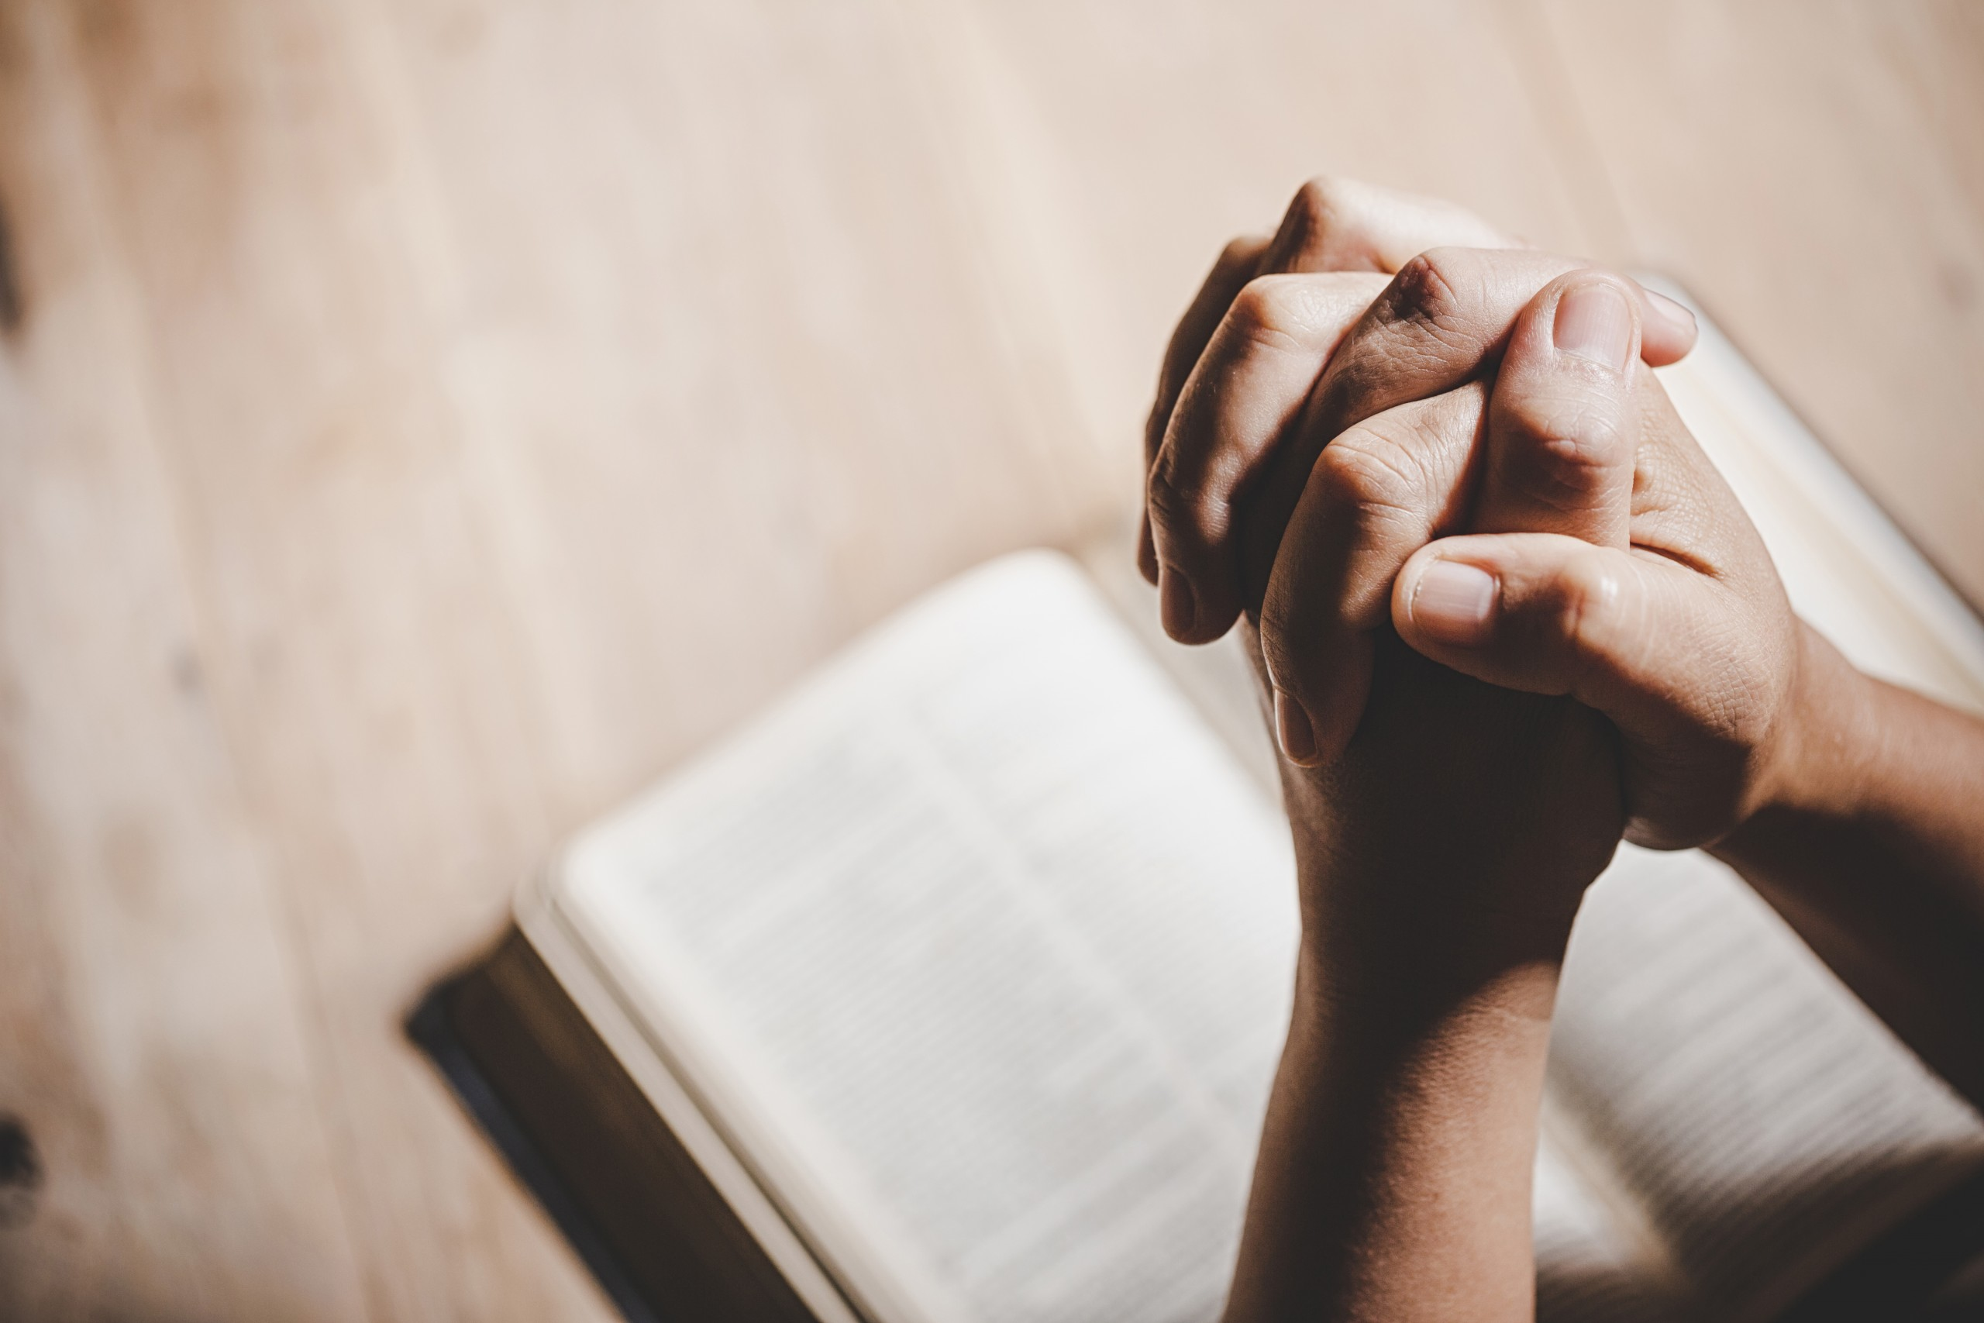
Moment of prayer
Notes:
5. Moment of prayer
Each part of the program must be carried out continuously, without spaces of silence. Review the time of prayer in the instruction manual to know how to do it.
During this class you should teach what prayer is and how we can do it. Teach in a very simple and short way.
Give a child an opportunity to pray. The teachers can help, or also have the children repeat a prayer.

Slide 37
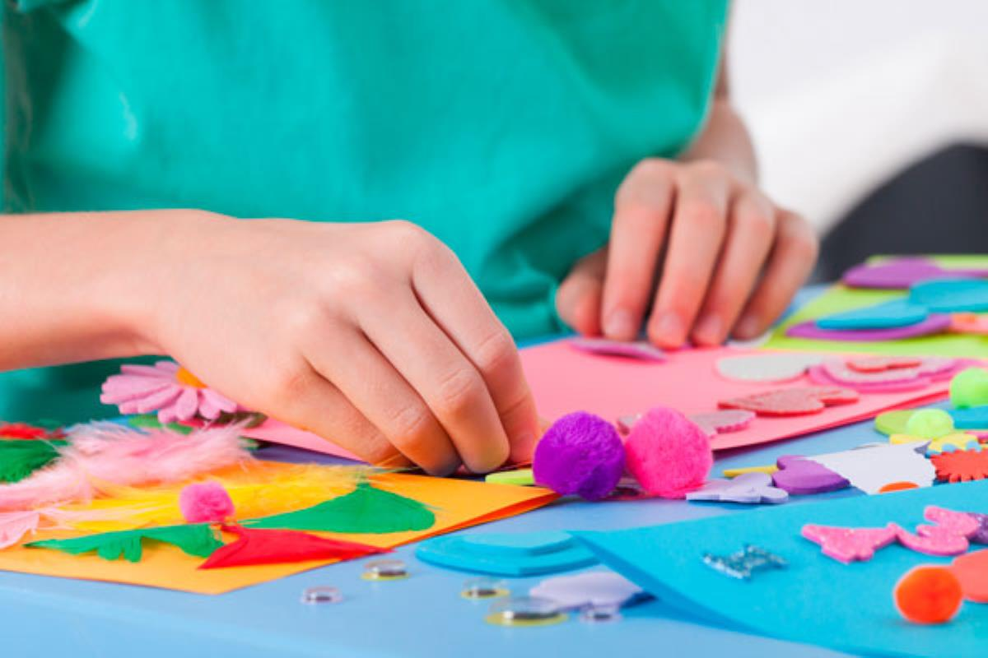
ACTIVITIES
Notes:
6. Activities:
Activity 1
Make a small painting to hang in your room.
Write the promise in the picture so that you can remember the promise of the Lord every night.
Activity 2
Color the drawing.

Slide 38
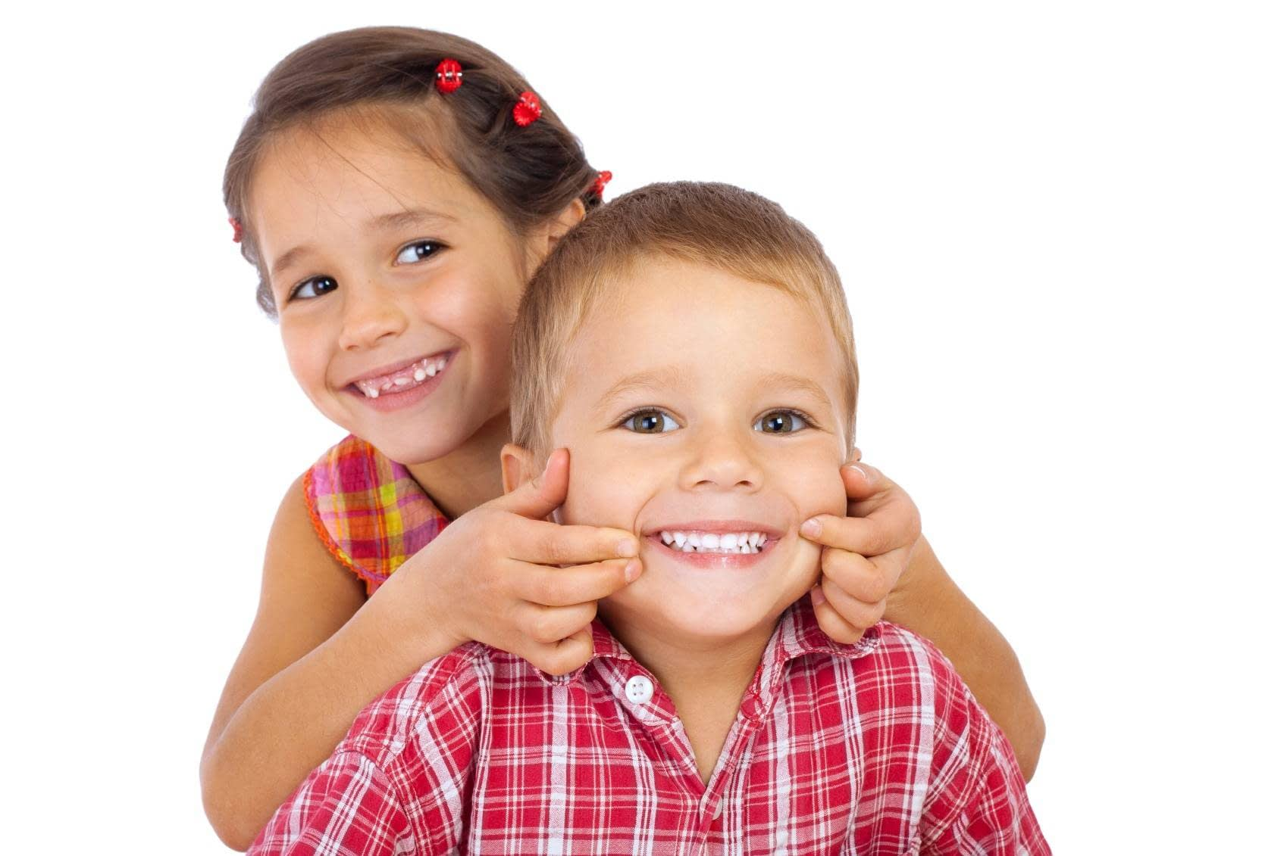
Musical moment
I WILL NOT FEAR
Notes:
I WILL NOT FEAR

Slide 39
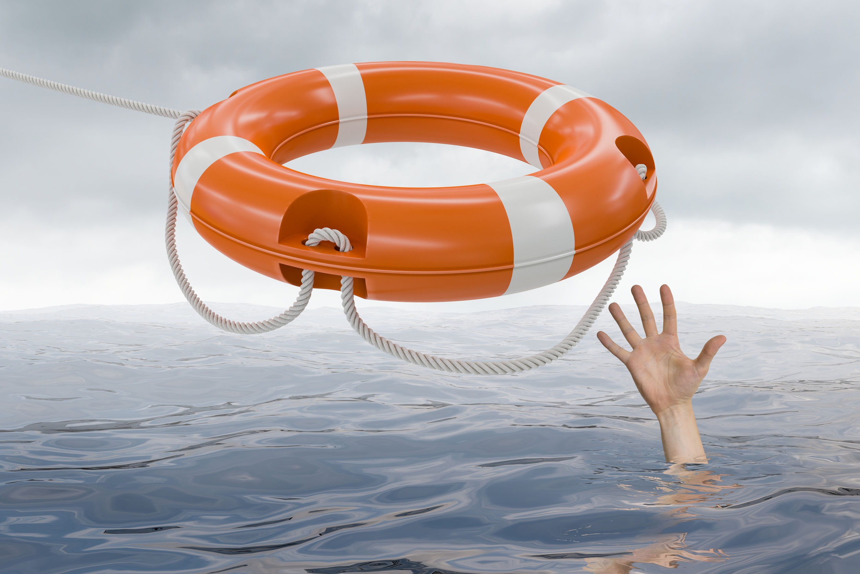
Musical moment
Amid the tempest, in the raging storm
Only you can be my refuge
Notes:
Amid the tempest
In the raging storm
Only you can be my refuge

Slide 40
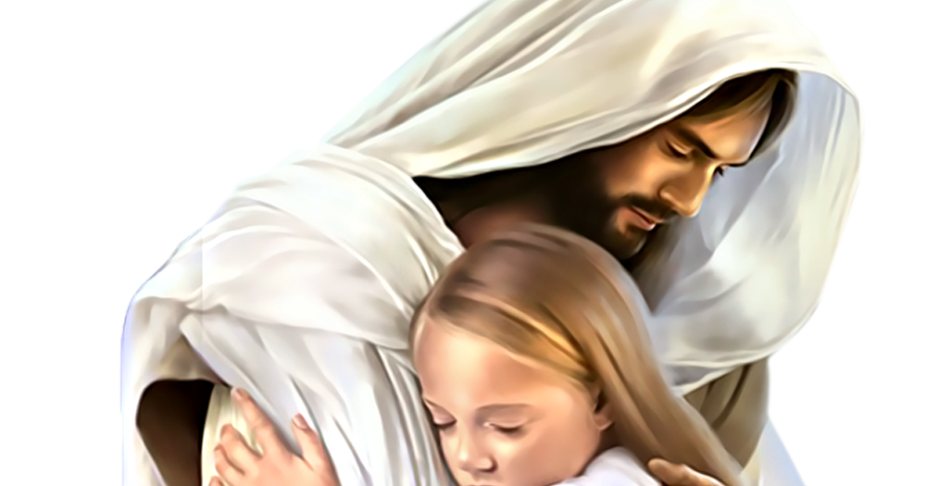
Musical moment
When I’m tired, I can’t anymore
With rest and happiness you bless me.
Notes:
When I’m tired, I can’t anymore
With rest and happiness you bless me.

Slide 41
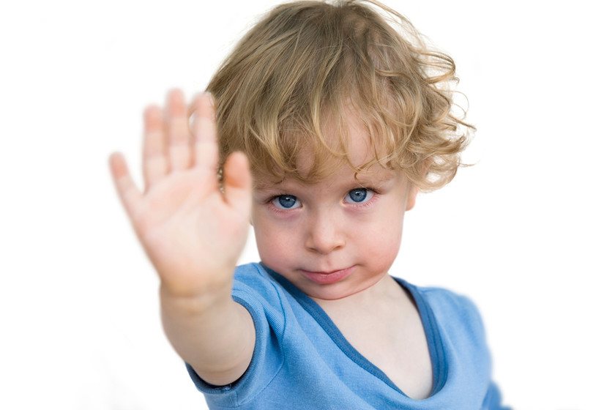
Musical moment (Pre-Chorus)
I will not fear, no, no
I will not fear
Notes:
I will not fear, no, no
I will not fear

Slide 42
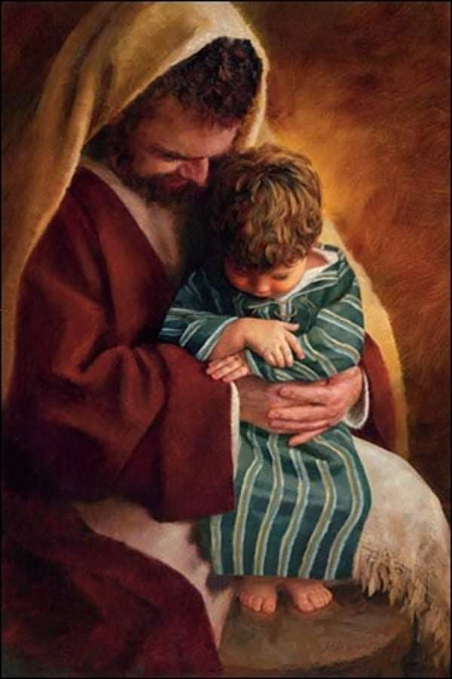
Musical moment (Chorus)
Jesus, Jesus, Just with your words
You calm the stormy seas
Notes:
Jesus, Jesus, Just with your words
You calm the stormy seas

Slide 43
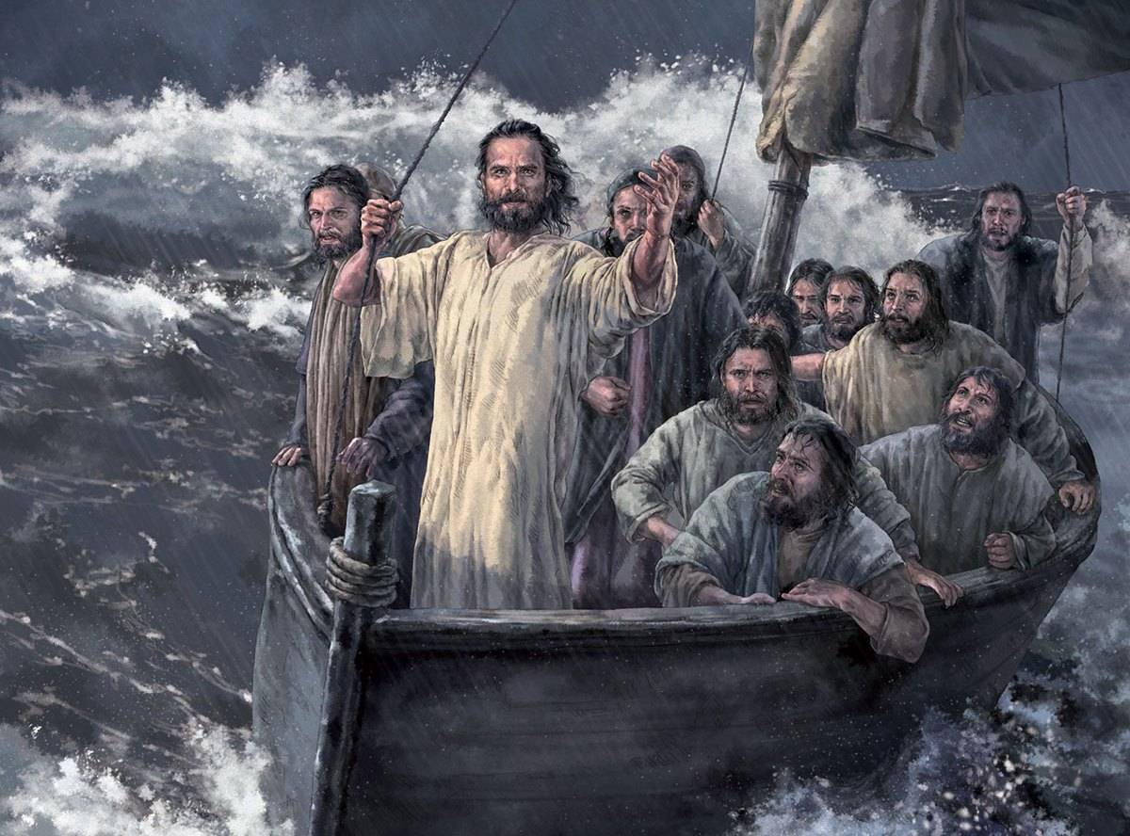
Musical moment (Chorus)
Jesus, Jesus, It’s my ship you guide, my faith I place on thee.
Notes:
Jesus, Jesus
It’s my ship you guide, my faith I place on thee.

Slide 44
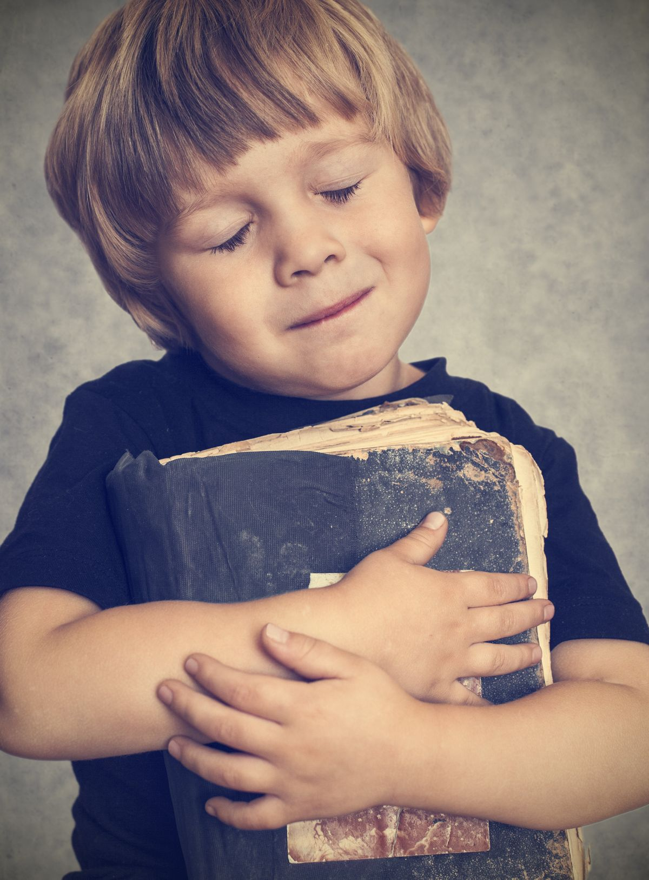
Musical moment
Through each trial, When temptations rise
My strength is rooted in your Holy Word
Notes:
Through each trial
When temptations rise
My strength is rooted in your Holy Word

Slide 45
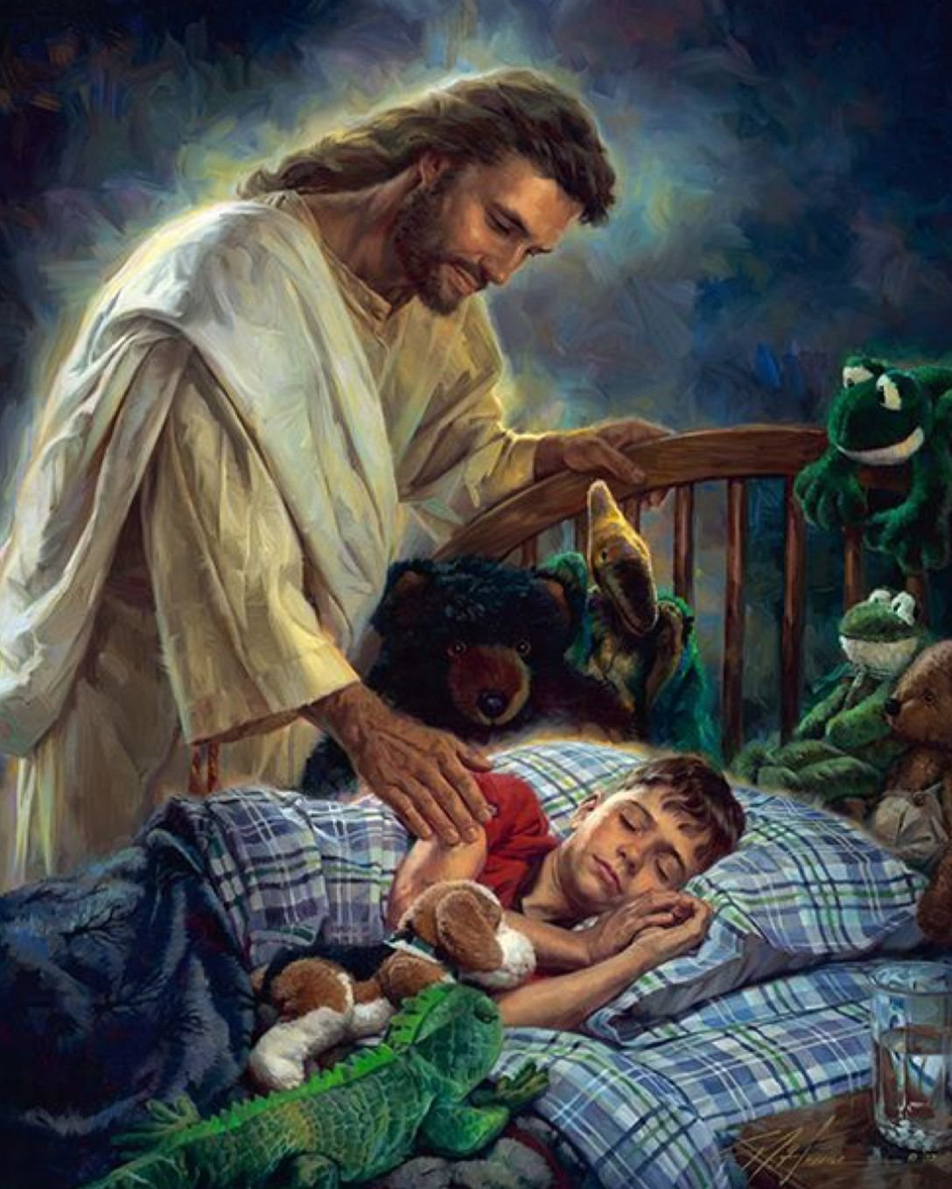
Musical moment
And when I faint your words remind me then
That you fight every single battle
Notes:
And when I faint your words remind me then
That you fight every single battle

Slide 46
Musical moment (Pre-Chorus)
I will not fear, no, no
I will not fear
Notes:
I will not fear, no, no
I will not fear

Slide 47
Musical moment (Chorus)
Jesus, Jesus, Just with your words
You calm the stormy seas
Notes:
Jesus, Jesus, Just with your words
You calm the stormy seas

Slide 48
Musical moment (Chorus)
Jesus, Jesus, It’s my ship you guide, my faith I place on thee.
Notes:
Jesus, Jesus
It’s my ship you guide, my faith I place on thee.

Slide 49
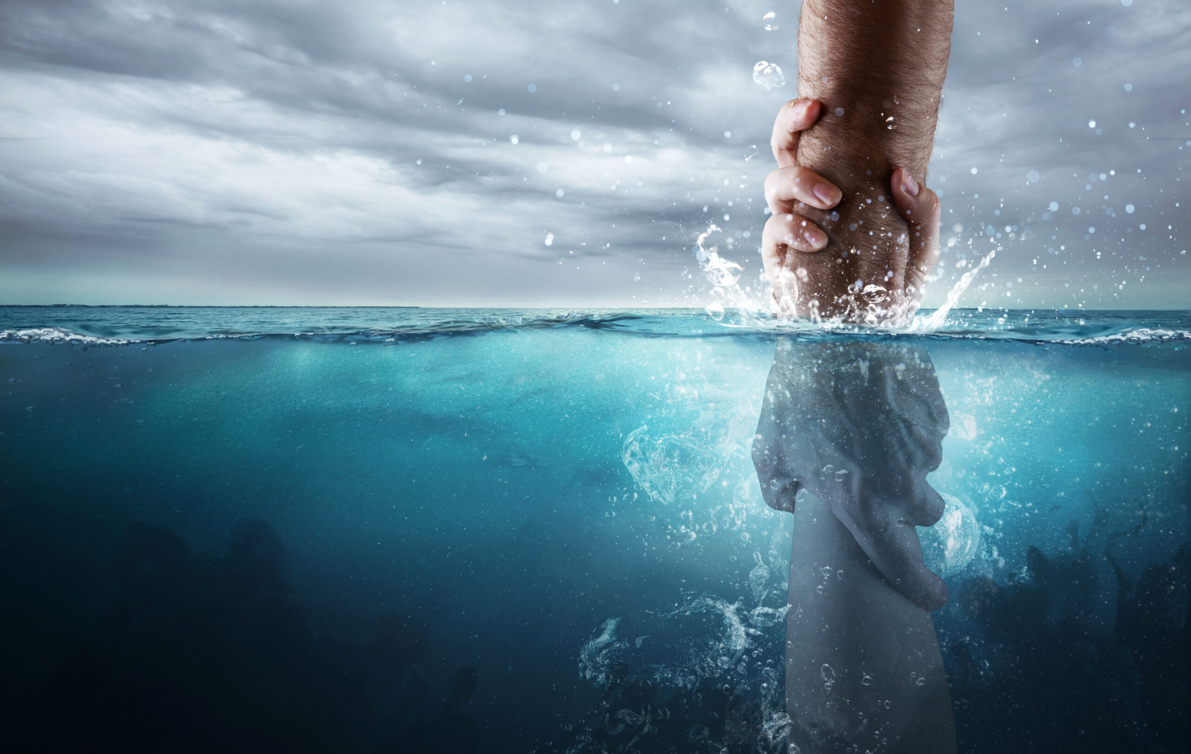
Next Topic:
^{Rescuing Others}
biblewell.org
Notes:
Next Topic:
Rescuing Others

