Slide 2
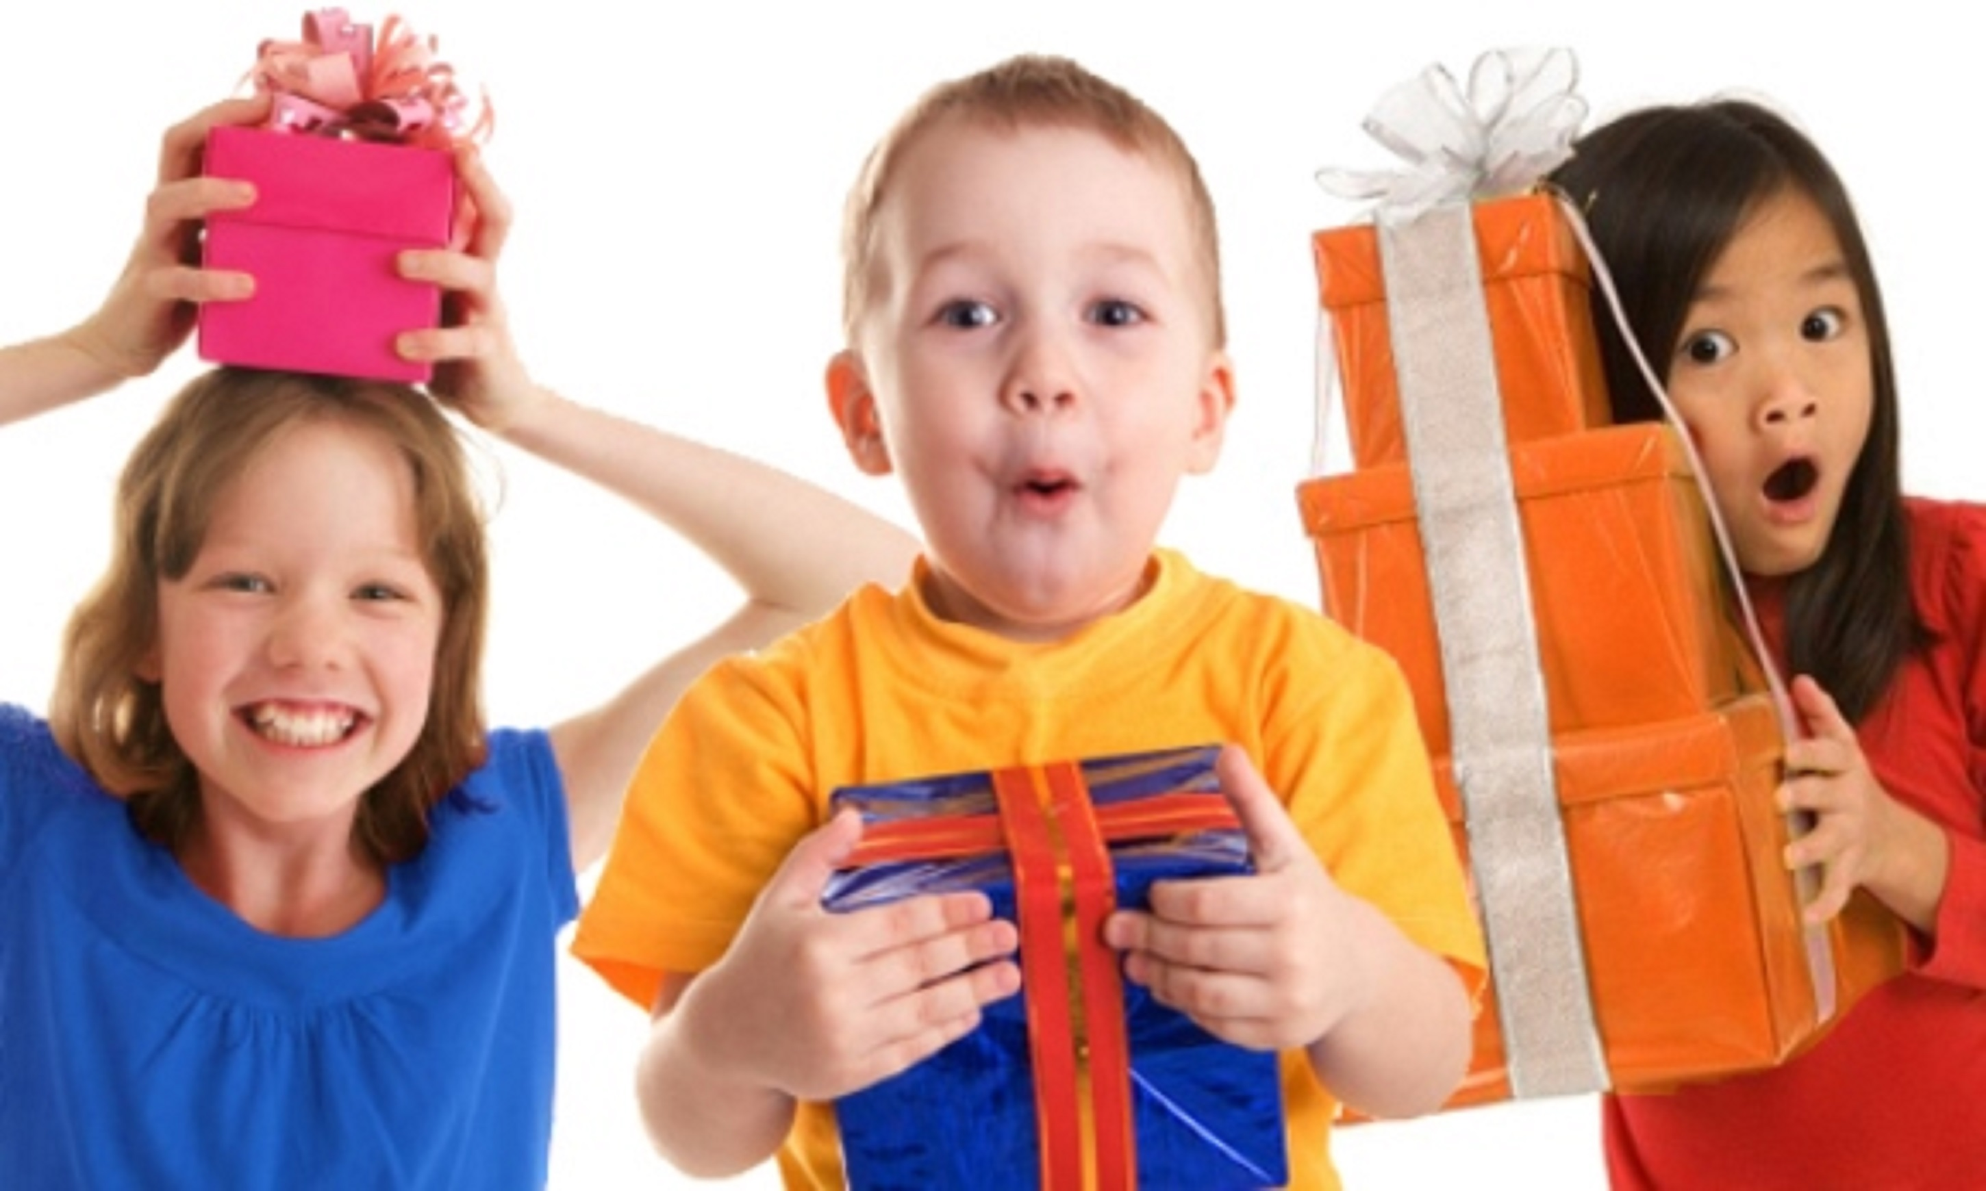
7 Days of Children’s Evangelization
^{God’s Gifts for} ^{His Children}
biblewell.org

Slide 3
Dios quiere que hables de Él
Bible Lesson No. 6
Notes:
Bible Lesson No. 6
God Wants You to Talk About Him
Biblical base: Mark 16:1; Acts 13:47; Acts 20:24;Luke 11:28;Luke 8:39; Matthew 13:23
Enseñanza principal: God wants you to share the wonders He’s done in your life.
Story: Naaman and the girl.
Objectives
That the children may...
Understand that God does many wonders for us
Understand that we must count on what God does for us.
Want to testify to others what God does for us.
Materials
Drawings for the lesson. Theme song of the day and illustrated memory verse. Illustrative materials for prayer time. Souvenir consisting of the day’s memory verse for each child to take home. Materials for crafts.

Slide 4
Welcome!
Notes:
Welcome
Give the welcome in a cheerful and fun way. Greeting all the children in the group in a general way.

Slide 5
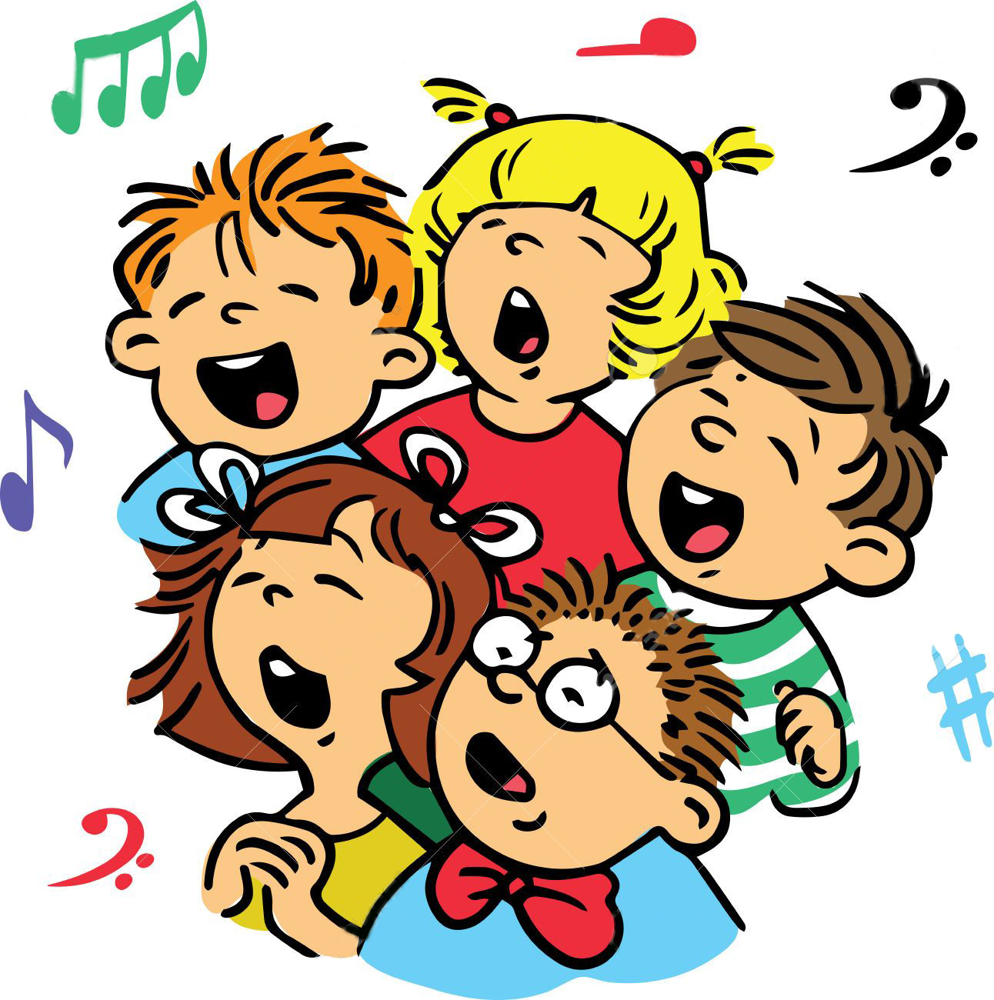
Music Time
Heaven sent a challenge; that’s my mission today
Notes:
Music Time
Start by teaching joyful songs that can motivate the group. You can use a greeting song for this occasion.
Then teach the theme song. Consider the instruction booklet.
Option: “Heaven sent a challenge that’s my mission today.”

Slide 6
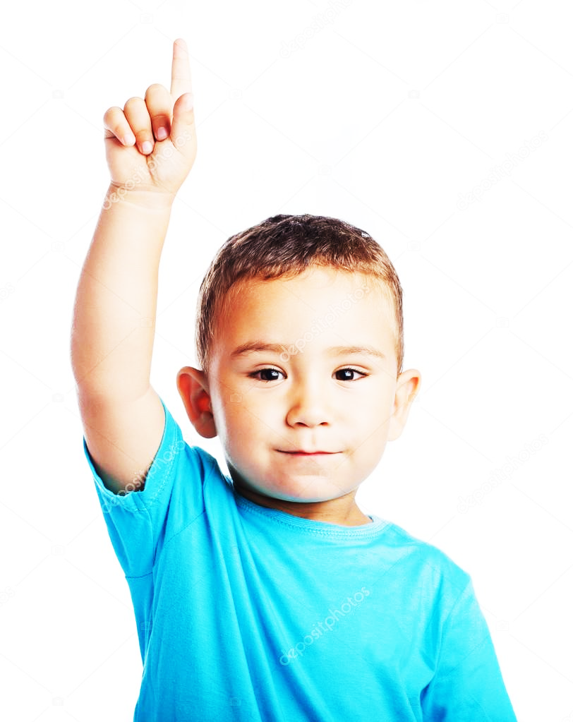
Music Time
Heaven sent a challenge
Tengo un desafío y una gran misión
Notes:
Heaven sent a challenge; that’s my mission today

Slide 7
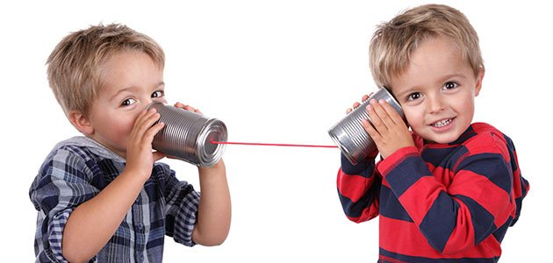
Music Time
To tell others
Notes:
To tell others

Slide 8
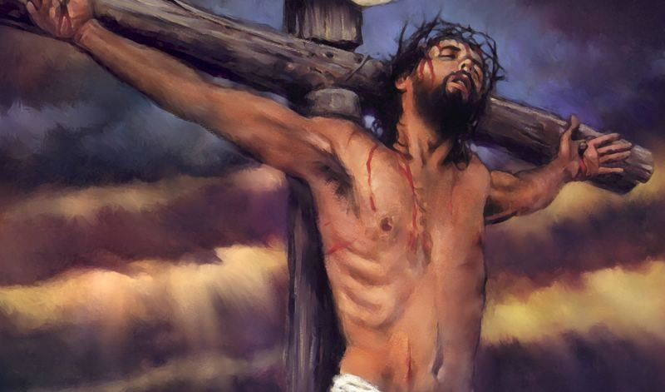
Music Time
who it was that died for me:
Notes:
who it was that died for me:

Slide 9
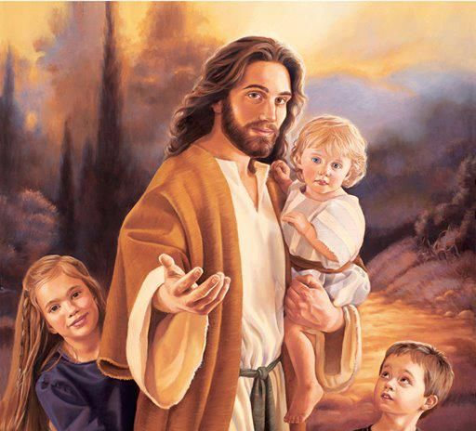
Music Time
It’s my Saviour, Jesus Christ,
Notes:
It’s my Saviour, Jesus Christ,

Slide 10
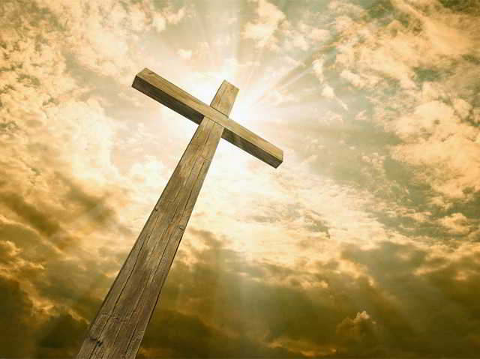
Music Time
On the cross He gave His life,
Notes:
On the cross He gave His life,

Slide 11
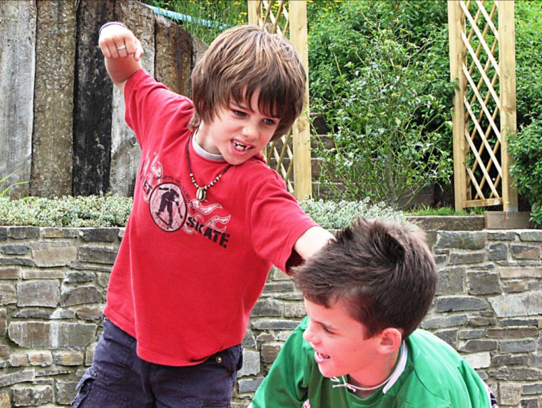
Music Time
With the goal to make us free from sin.
Notes:
With the goal to make us free from sin.

Slide 12
Music Time
Good news,
Notes:
Good news,

Slide 13
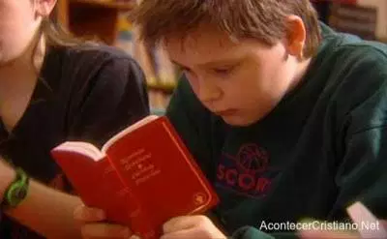
Music Time
I will give of Him,
Notes:
I will give of Him,

Slide 14
Music Time
GOOD
NEWS
Good news,
Notes:
Good news,

Slide 15
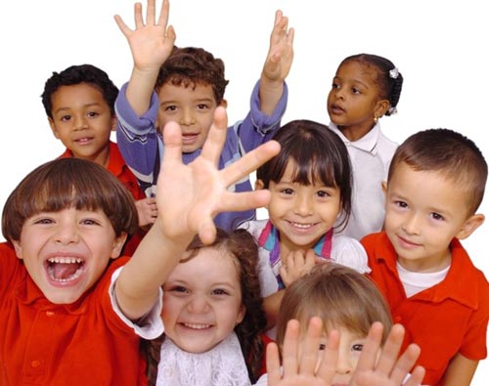
Music Time
sent for everyone,
Notes:
sent for everyone,

Slide 16
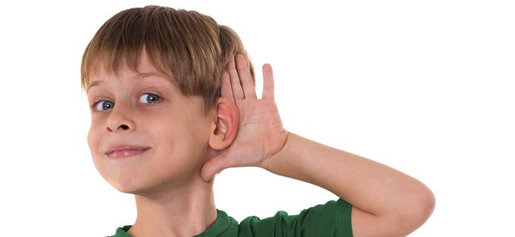
Music Time
A new heart you will receive,
Notes:
A new heart you will receive,

Slide 17
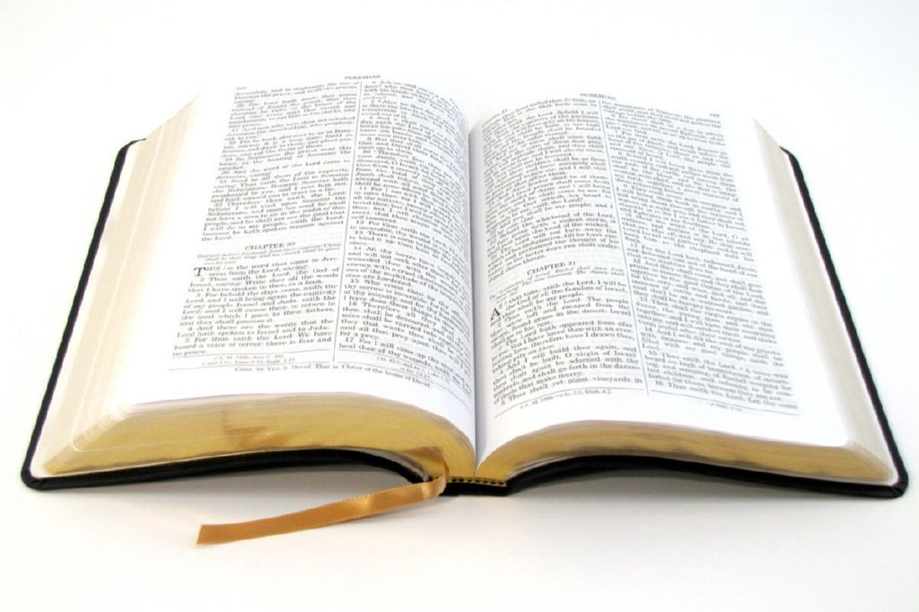
Music Time
Filled with love and joy and peace,
Notes:
Filled with love and joy and peace,

Slide 18
Music Time
POWER
Through the power of the mighty God.
Notes:
Through the power of the mighty God.

Slide 19
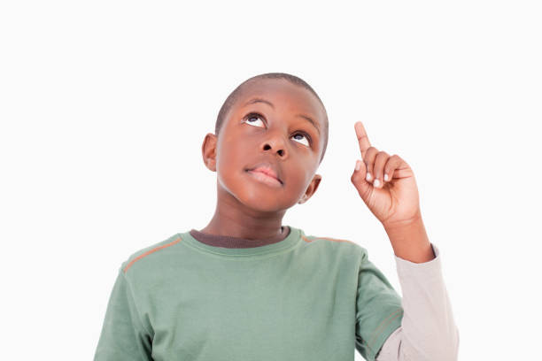
Music Time
Heaven sent a challenge that’s my mission today,
Notes:
Heaven sent a challenge that’s my mission today,

Slide 20
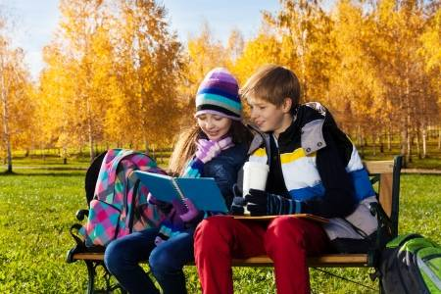
Music Time
To tell others
Notes:
To tell others

Slide 21
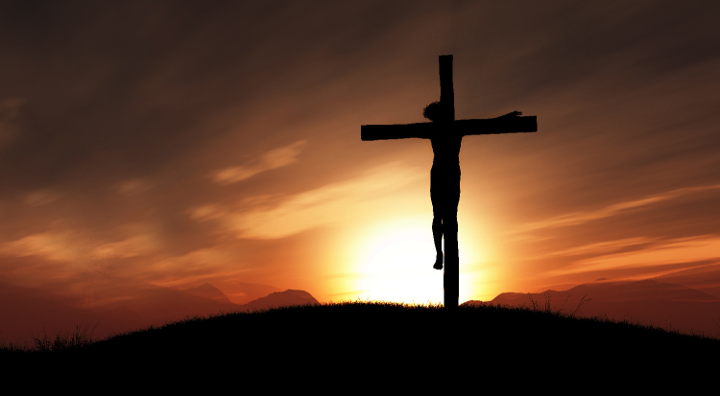
Music Time
who it was that died for me,
Notes:
who it was that died for me,

Slide 22
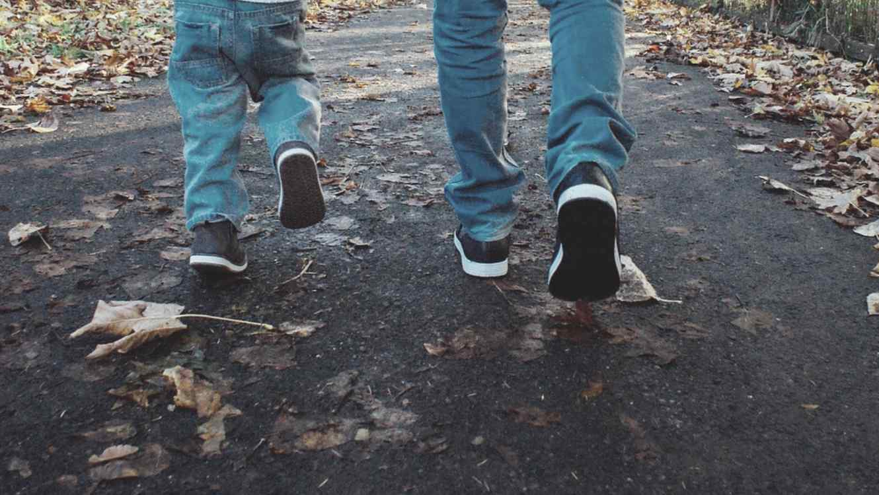
Music Time
Two by two we will go out,
Notes:
Two by two we will go out,

Slide 23
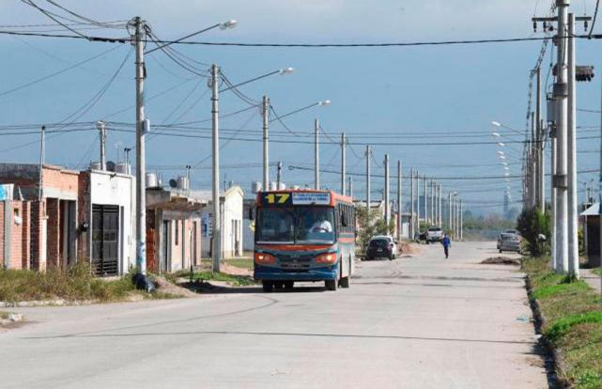
Music Time
Visit every house in town,
Notes:
Visit every house in town,

Slide 24
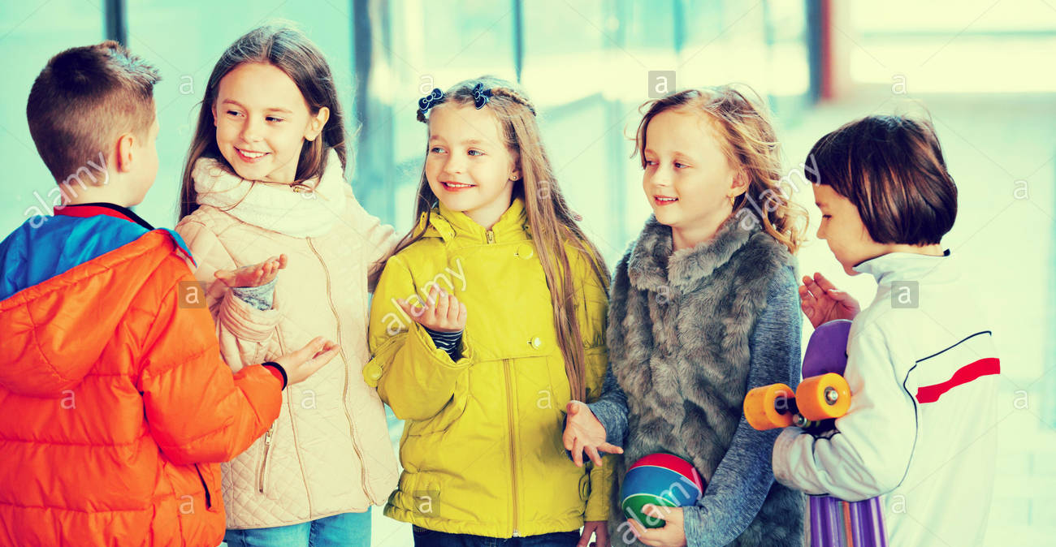
Music Time
Bringing the good news of our Lord.
Notes:
Bringing the good news of our Lord.

Slide 25
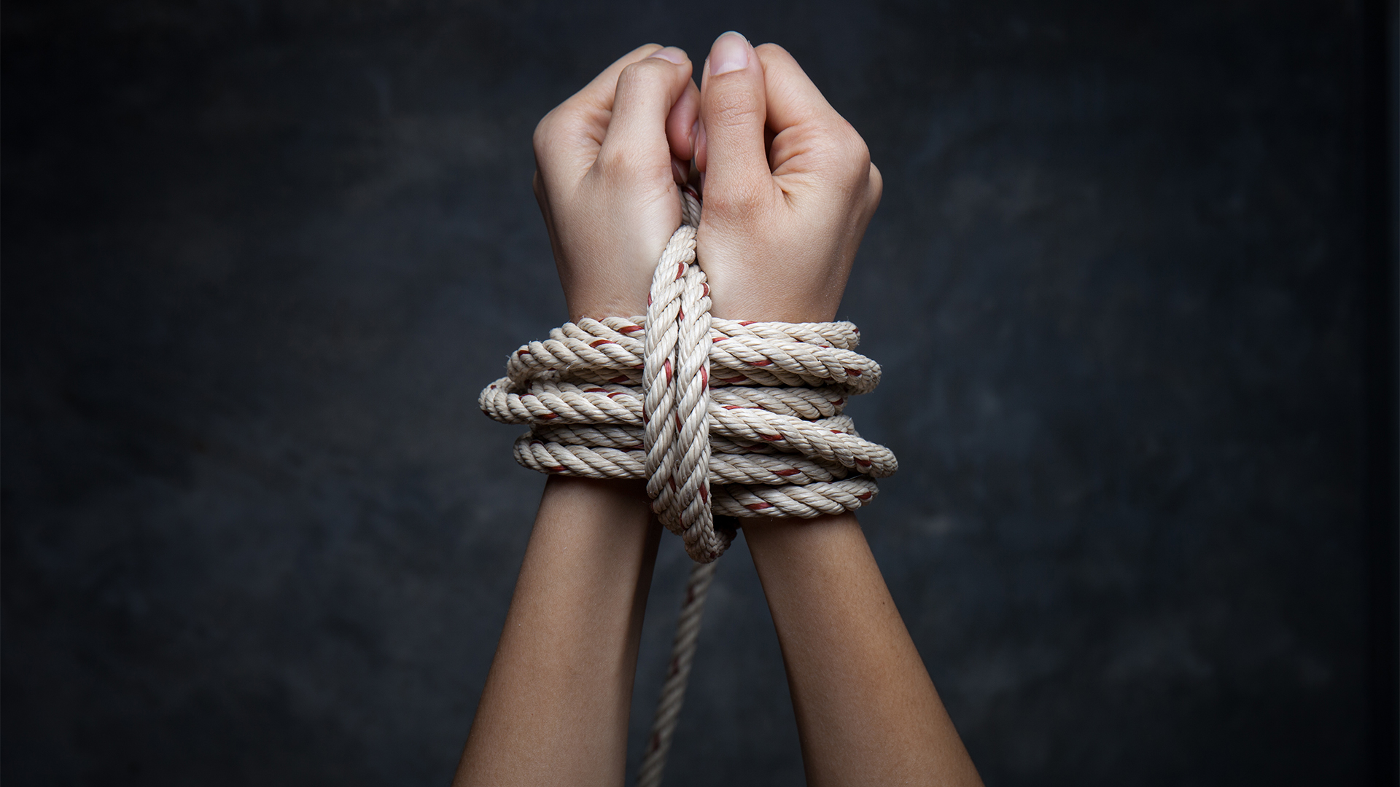
INTRODUCTION
Notes:
Introduction
(Prepare yourself in advance by tying your hands with a rope and acting as if you were a captive, then begin:)
Hello kids, I’m a Bible characters that doesn’t have a name. I’m a captive. Do you know what it’s like to be a captive or a slave? I no longer own myself, now I depend on my master. I have a master. I was taken from my home a long time ago and now I am a slave (talk for a moment about what it meant to be a slave). ¿You know what? There were a lot of people who were slaves in ancient times. It still happens these days, but it’s not legal. Slaves couldn’t make their own decisions. They were taken tied up, just like my hands are. Sometimes their feet were put in chains, so that they couldn’t escape. This is what happened to the little girl in today’s story.

Slide 26
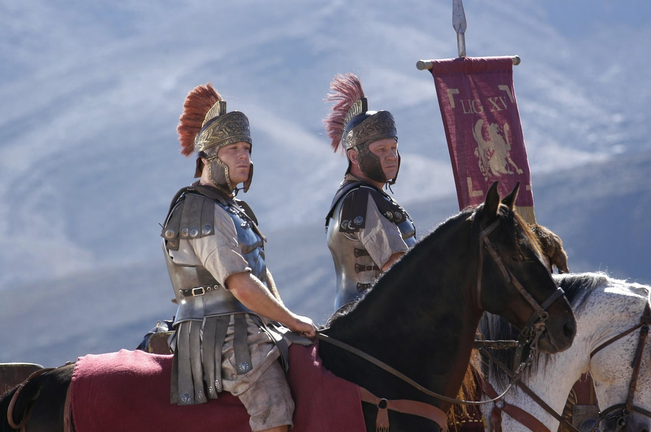
Notes:
Lesson
One day soldiers came to Israel. They were running around the city with their horses, and they could hear cries of people screaming… No! I don’t want to go! The soldiers grabbed a lot of people by force and took them away. A little girl, whose parents are not mentioned in the Bible, was taken as a slave. She was taken to a city where she would live with all the other slaves, and when she got there they were sold and handed over to different families. The girl was handed over to the house of the chief of the army. His name was Naaman, and she was to be a slave in that house. It was the girl’s duty to clean, sweep, do the shopping, wash the clothes, and tend to Naaman’s wife, the owner. She worked there, and yet she didn’t forget what her parents had taught her. She kept it all engraved in her heart and knew that she should continue loving God—the God her mom and dad had taught her about back in Israel. She remembered her past with great affection and did her work with a lot of joy.

Slide 27
Notes:
What about you? You come to class every week, and hear about the Lord, are you learning? Every word we hear must always be remembered and put into practice. In Luke 11:28 he says, “ But he said, Yea rather, blessed are they that hear the word of God, and keep it..” This helps us grow more and more like the girl in the story we’re learning about today. We must always keep everything we learn in our hearts. You must put into practice all that you learn from the classes where you hear about the Lord. For example, if today we learn about love, you must love all people wholeheartedly; If we learn to talk to God, we should pray every day and talk to God.

Slide 28
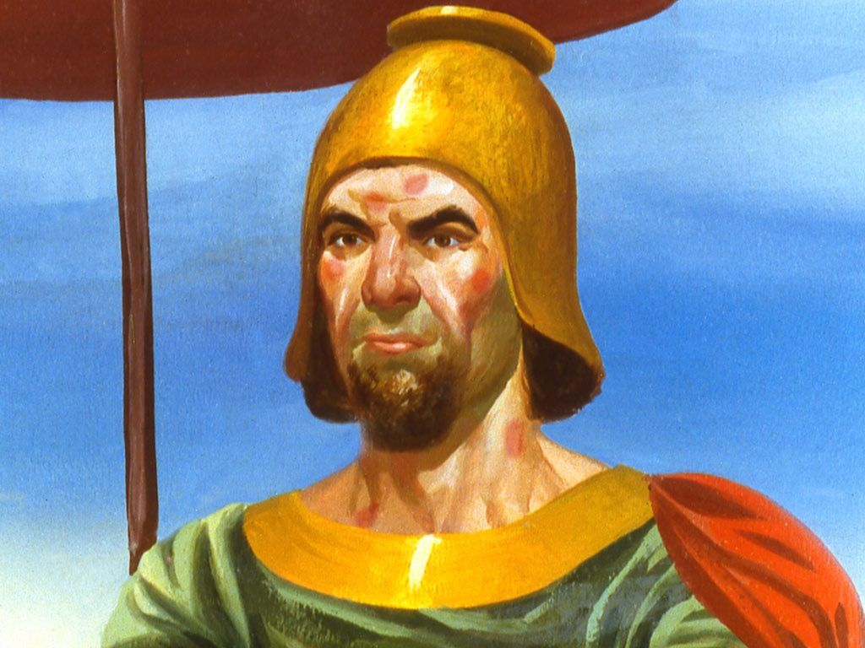
Notes:
What happened to the girl? Although she missed her land and her parents very much, she worked with great happiness because that’s how she had been taught to work. She would talk to God every day and tell Him everything that was happening.
One day the girl heard about something strange and bad that was happening! Her boss, Naaman’s wife was crying:
-No! This can’t happen to me! No! This can’t happen to me!
The girl continued working in silence but was trying to hear what was going on. She then suddenly heard it.
-No! he’s sick!
The girl heard that Naaman was very ill with a very, very serious illness: her master had leprosy. Many doctors had come to see if He could be cured, but no, as stated, he had leprosy.

Slide 29
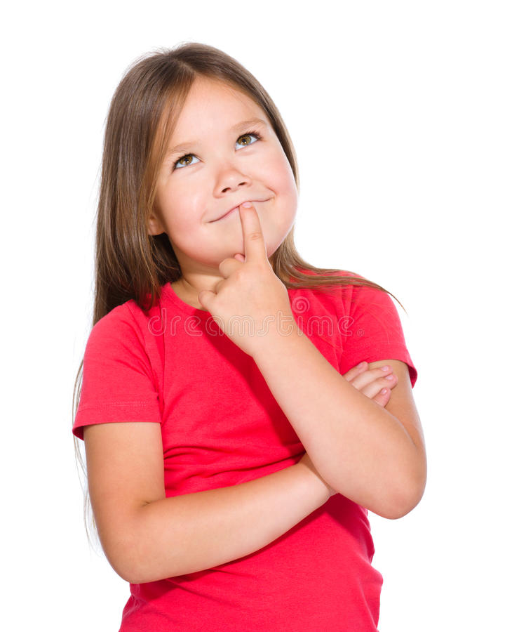
Notes:
So, the girl went to her room and said, I know how it can be cured. I have to tell Him; I have to be courageous and tell him.

Slide 30
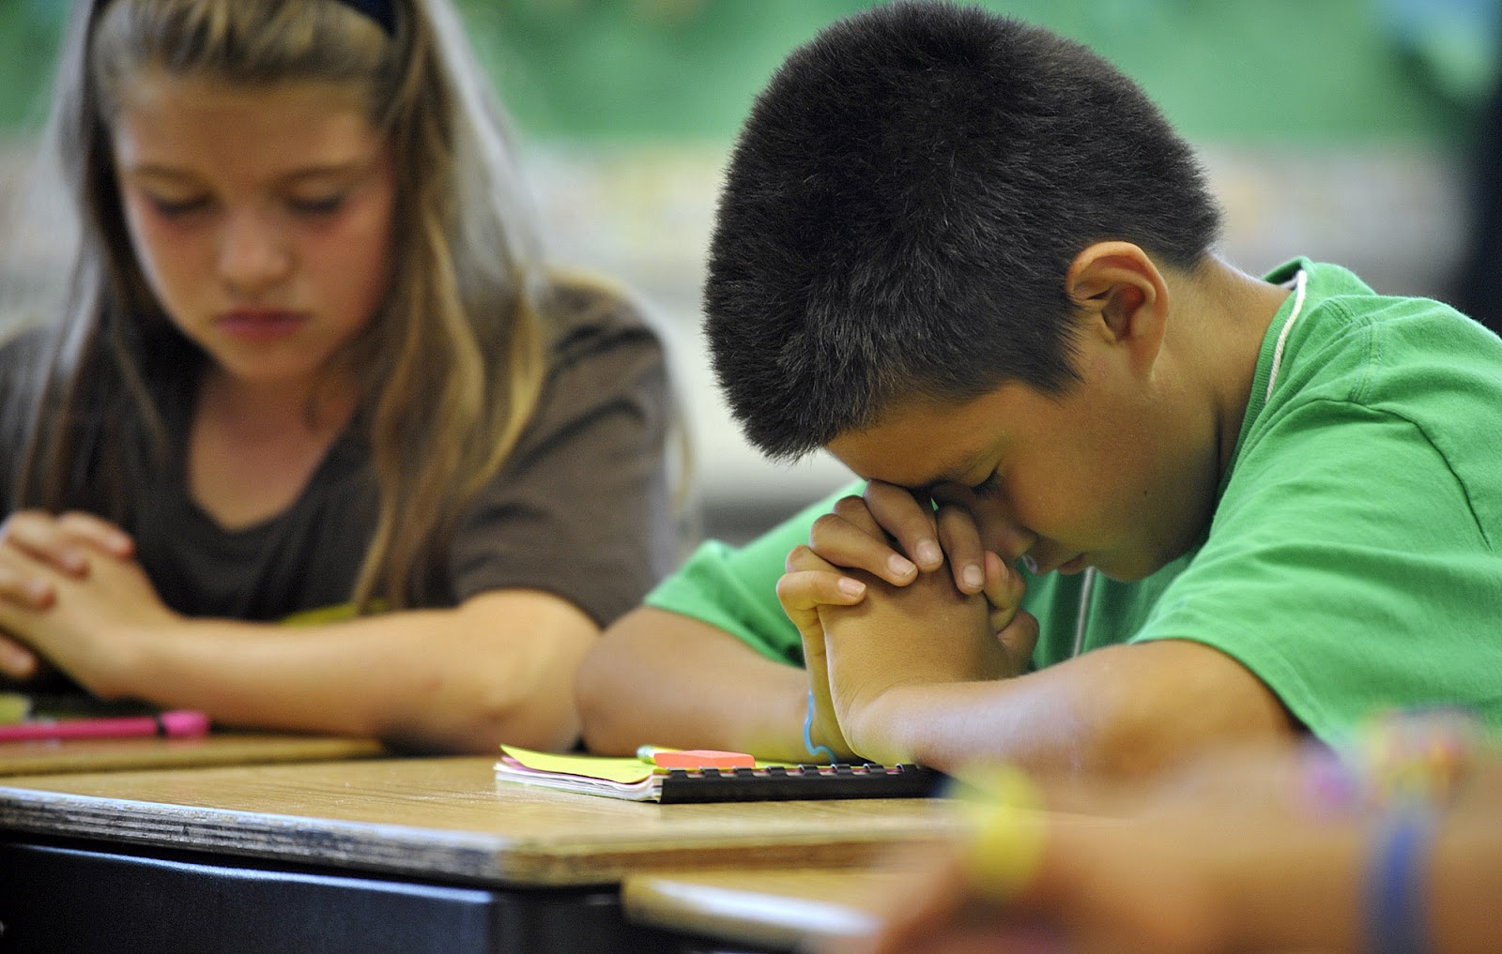
Notes:
You know what? Similar situations happen to us… there are many sick people in the world. There are two ways to get sick—sick in the body, and sick in the soul. This means that many people are sickened by diseases, yet others with a sickness of the soul. The sickness of the soul is sin and we all have this sickness. We commit sins and make many mistakes. We, who have already known Jesus, know what the solution is; the solution is Jesus. It is to give our hearts to Him, to ask Him for forgiveness of our sins. He will help us overcome and stop committing sins.

Slide 31
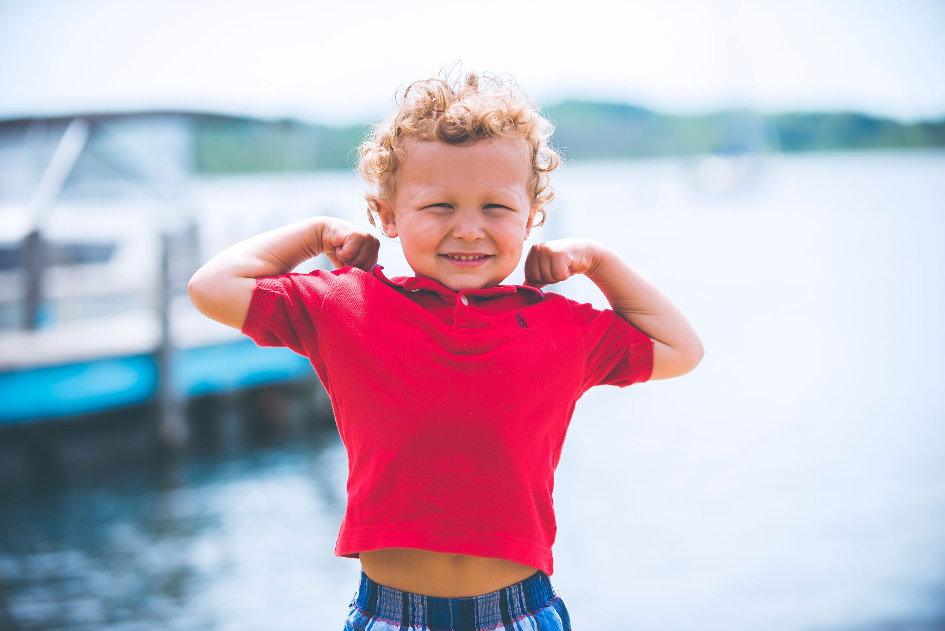
Notes:
But now we must take courage and do something for these people. Do you have courage?

Slide 32
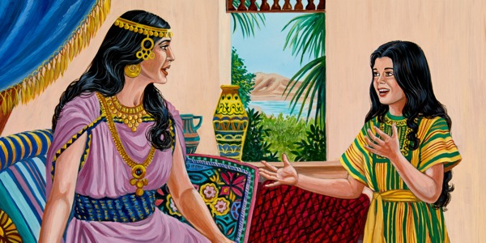
Notes:
How would that girl have acted?
She left her room, after speaking to God, and fearfully came up to her master and said:
-Master, I know a place where you can be cured.
He looked at her very intently and said:
- Where is it?
-It in the land of my people—Israel. There’s a prophet there, who can heal you. Go over there and you’ll see there is a cure. Her master listened.
The girl appreciated her master and knew how to help him, so she decided to do it.

Slide 33
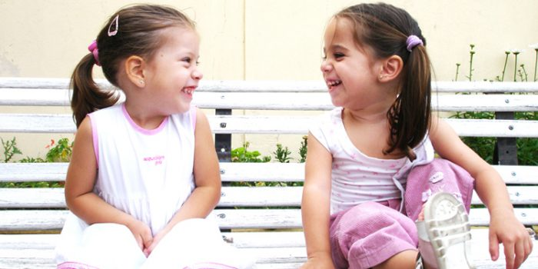
Notes:
We too should talk to people who do not know about Jesus—People who don’t know that there is someone who can forgive their sins. We should not stay quiet but should speak out like the girl did.

Slide 34
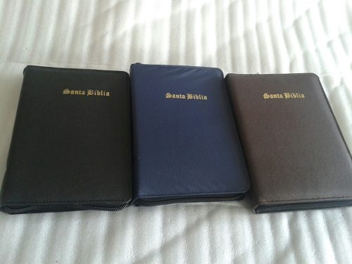
Notes:
We can tell people about God in many different ways. We can hand out flyers, make a card and give it to our friends, or directly talk to them and tell them:
-Friend, you know what? I’ve learned that there is a Savior who can forgiver our sins and help us to no longer commit them. We can also invite our friend to each week’s meeting at church. Luke 8:39 says,” Return to thine own house, and shew how great things God hath done unto thee.” It is very important to talk to others and teach them about Jesus.

Slide 35
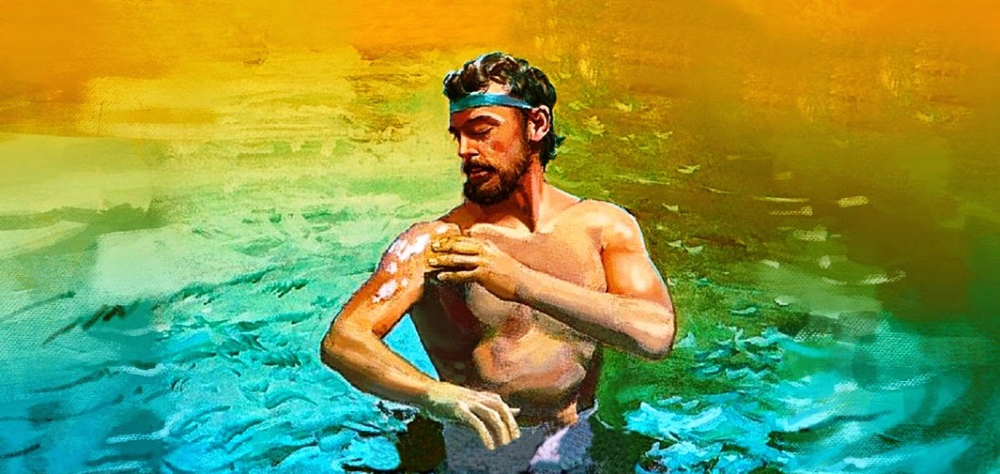
Notes:
And what happened to the general chief of the army? Naaman went to Israel, found the prophet Elisha, and was told all that he had to do to be healed. You know what happened then? He was healed completely! You can be sure that even if we do not have an immediate response from the message we give, the Word of God continues to work in the hearts of the people. You just have to go and talk, and then let the people give their hearts to the Lord.
Matthew 13:23 says: “But he that received seed into the good ground is he that heareth the word, and understandeth it; which also beareth fruit, and bringeth forth, some an hundredfold, some sixty, some thirty.”

Slide 36
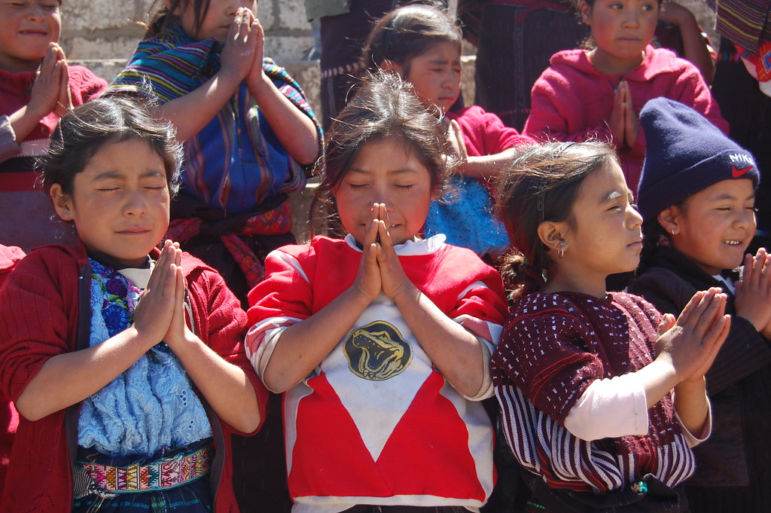
Notes:
There is something else we have to do, and it is to pray for those whom we have spoken about Jesus.
How about we pray together for two things? First, so that the Lord may give us strength to speak to others about Jesus, and secondly, so that the Lord may continue to work in the hearts of these people.
Let us pray: Our Father which art in heaven, we thank you because we know that you have sent a Savior to help us. I ask you to help me have the strength to speak to others of you and touch their hearts so that they will follow you and learn more about you every day. In the name of Jesus, Amen.
What a good gift God gives us: power to speak to others about the love of God!

Slide 37
Mark 16:15
Notes:
Teaching the Memory Verse
(You may memorize the Bible verse with the children before or after the lesson.)
Let’s remember that this is a very special moment. This moment is important, because we are helping the children keep the words of God in their minds.
Prepare a large poster in advance with the verse on it.
Memory Verse:
• And he said unto them, “Go ye into all the world
• and preach the gospel
• to every creature.”
• Mark 16:15
Follow the steps shown in the instruction booklet.
Introduction: Tell the children a short story about a missionary.
Presentation: Allow the children to read the Bible verse. The teacher should accompany the kids in the reading of the Bible verse.
Explanation: In this step, explain the most difficult words in the verse. Gospel, creature, preach.
Application: Talk about what God wants the child to learn about from text.
Repetition: Be innovative and creative in this step.

Slide 38
And he said unto them, “Go ye into all the world
Notes:
And he said unto them, “Go ye into all the world

Slide 39
and preach the gospel
Notes:
and preach the gospel

Slide 40
to every creature.”
Notes:
to every creature.” Mark 16:15

Slide 41
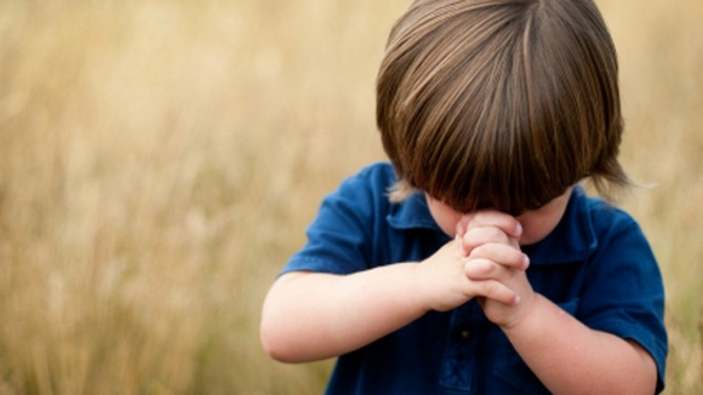
Prayer Time
Notes:
Prayer Time
Let’s remember that this is a special moment. It’s time to talk to God. In a paper bag or on a poster, write or paste the names of some friends the children want to pray for. Tell the children to ask God to help them understand and learn more about Jesus.
If there are multiple teachers, allow all the children to be in one group. Pray together thanking the Lord that we can walk beside him.

Slide 42
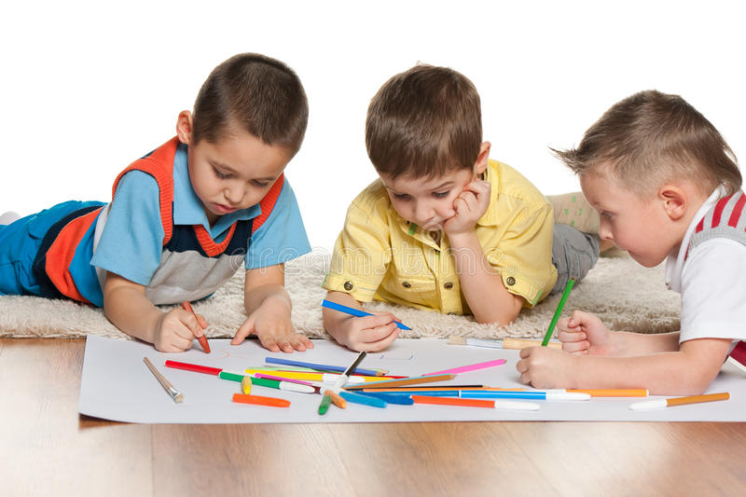
ACTIVITIES
Notes:
Activities
All children: Make invitation cards for other children to learn about Jesus.
Optional: Color the drawing.

Slide 43
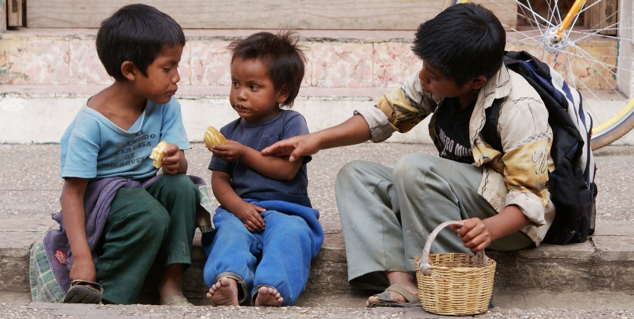
Thank you, Lord, for your wonders and for giving us the opportunity of sharing them with others.
Notes:
Conclusion
Thank you, Lord, for your wonders and for giving us the opportunity of sharing them with others.

Slide 44
Music Time
Heaven sent a challenge; that’s my mission today
Notes:
Music Time
“Heaven sent a challenge that’s my mission today.”

Slide 45
Music Time
Heaven sent a challenge
Tengo un desafío y una gran misión
Notes:
Heaven sent a challenge; that’s my mission today

Slide 46
Music Time
To tell others
Notes:
To tell others

Slide 47
Music Time
who it was that died for me:
Notes:
who it was that died for me:

Slide 48
Music Time
It’s my Saviour, Jesus Christ,
Notes:
It’s my Saviour, Jesus Christ,

Slide 49
Music Time
On the cross He gave His life,
Notes:
On the cross He gave His life,

Slide 50
Music Time
With the goal to make us free from sin.
Notes:
With the goal to make us free from sin.

Slide 51
Music Time
Good news,
Notes:
Good news,

Slide 52
Music Time
I will give of Him,
Notes:
I will give of Him,

Slide 53
Music Time
GOOD
NEWS
Good news,
Notes:
Good news,

Slide 54
Music Time
sent for everyone,
Notes:
sent for everyone,

Slide 55
Music Time
A new heart you will receive,
Notes:
A new heart you will receive,

Slide 56
Music Time
Filled with love and joy and peace,
Notes:
Filled with love and joy and peace,

Slide 57
Music Time
POWER
Through the power of the mighty God.
Notes:
Through the power of the mighty God.

Slide 58
Music Time
Heaven sent a challenge that’s my mission today,
Notes:
Heaven sent a challenge that’s my mission today,

Slide 59
Music Time
To tell others
Notes:
To tell others

Slide 60
Music Time
who it was that died for me,
Notes:
who it was that died for me,

Slide 61
Music Time
Two by two we will go out,
Notes:
Two by two we will go out,

Slide 62
Music Time
Visit every house in town,
Notes:
Visit every house in town,

Slide 63
Music Time
Bringing the good news of our Lord.
Notes:
Bringing the good news of our Lord.

Slide 64
Next Lesson:
^{God Gives You} ^{Promises}
biblewell.org
Notes:
Next Lesson:
God Gives You Promises

