Slide 2
biblewell.org

Slide 3
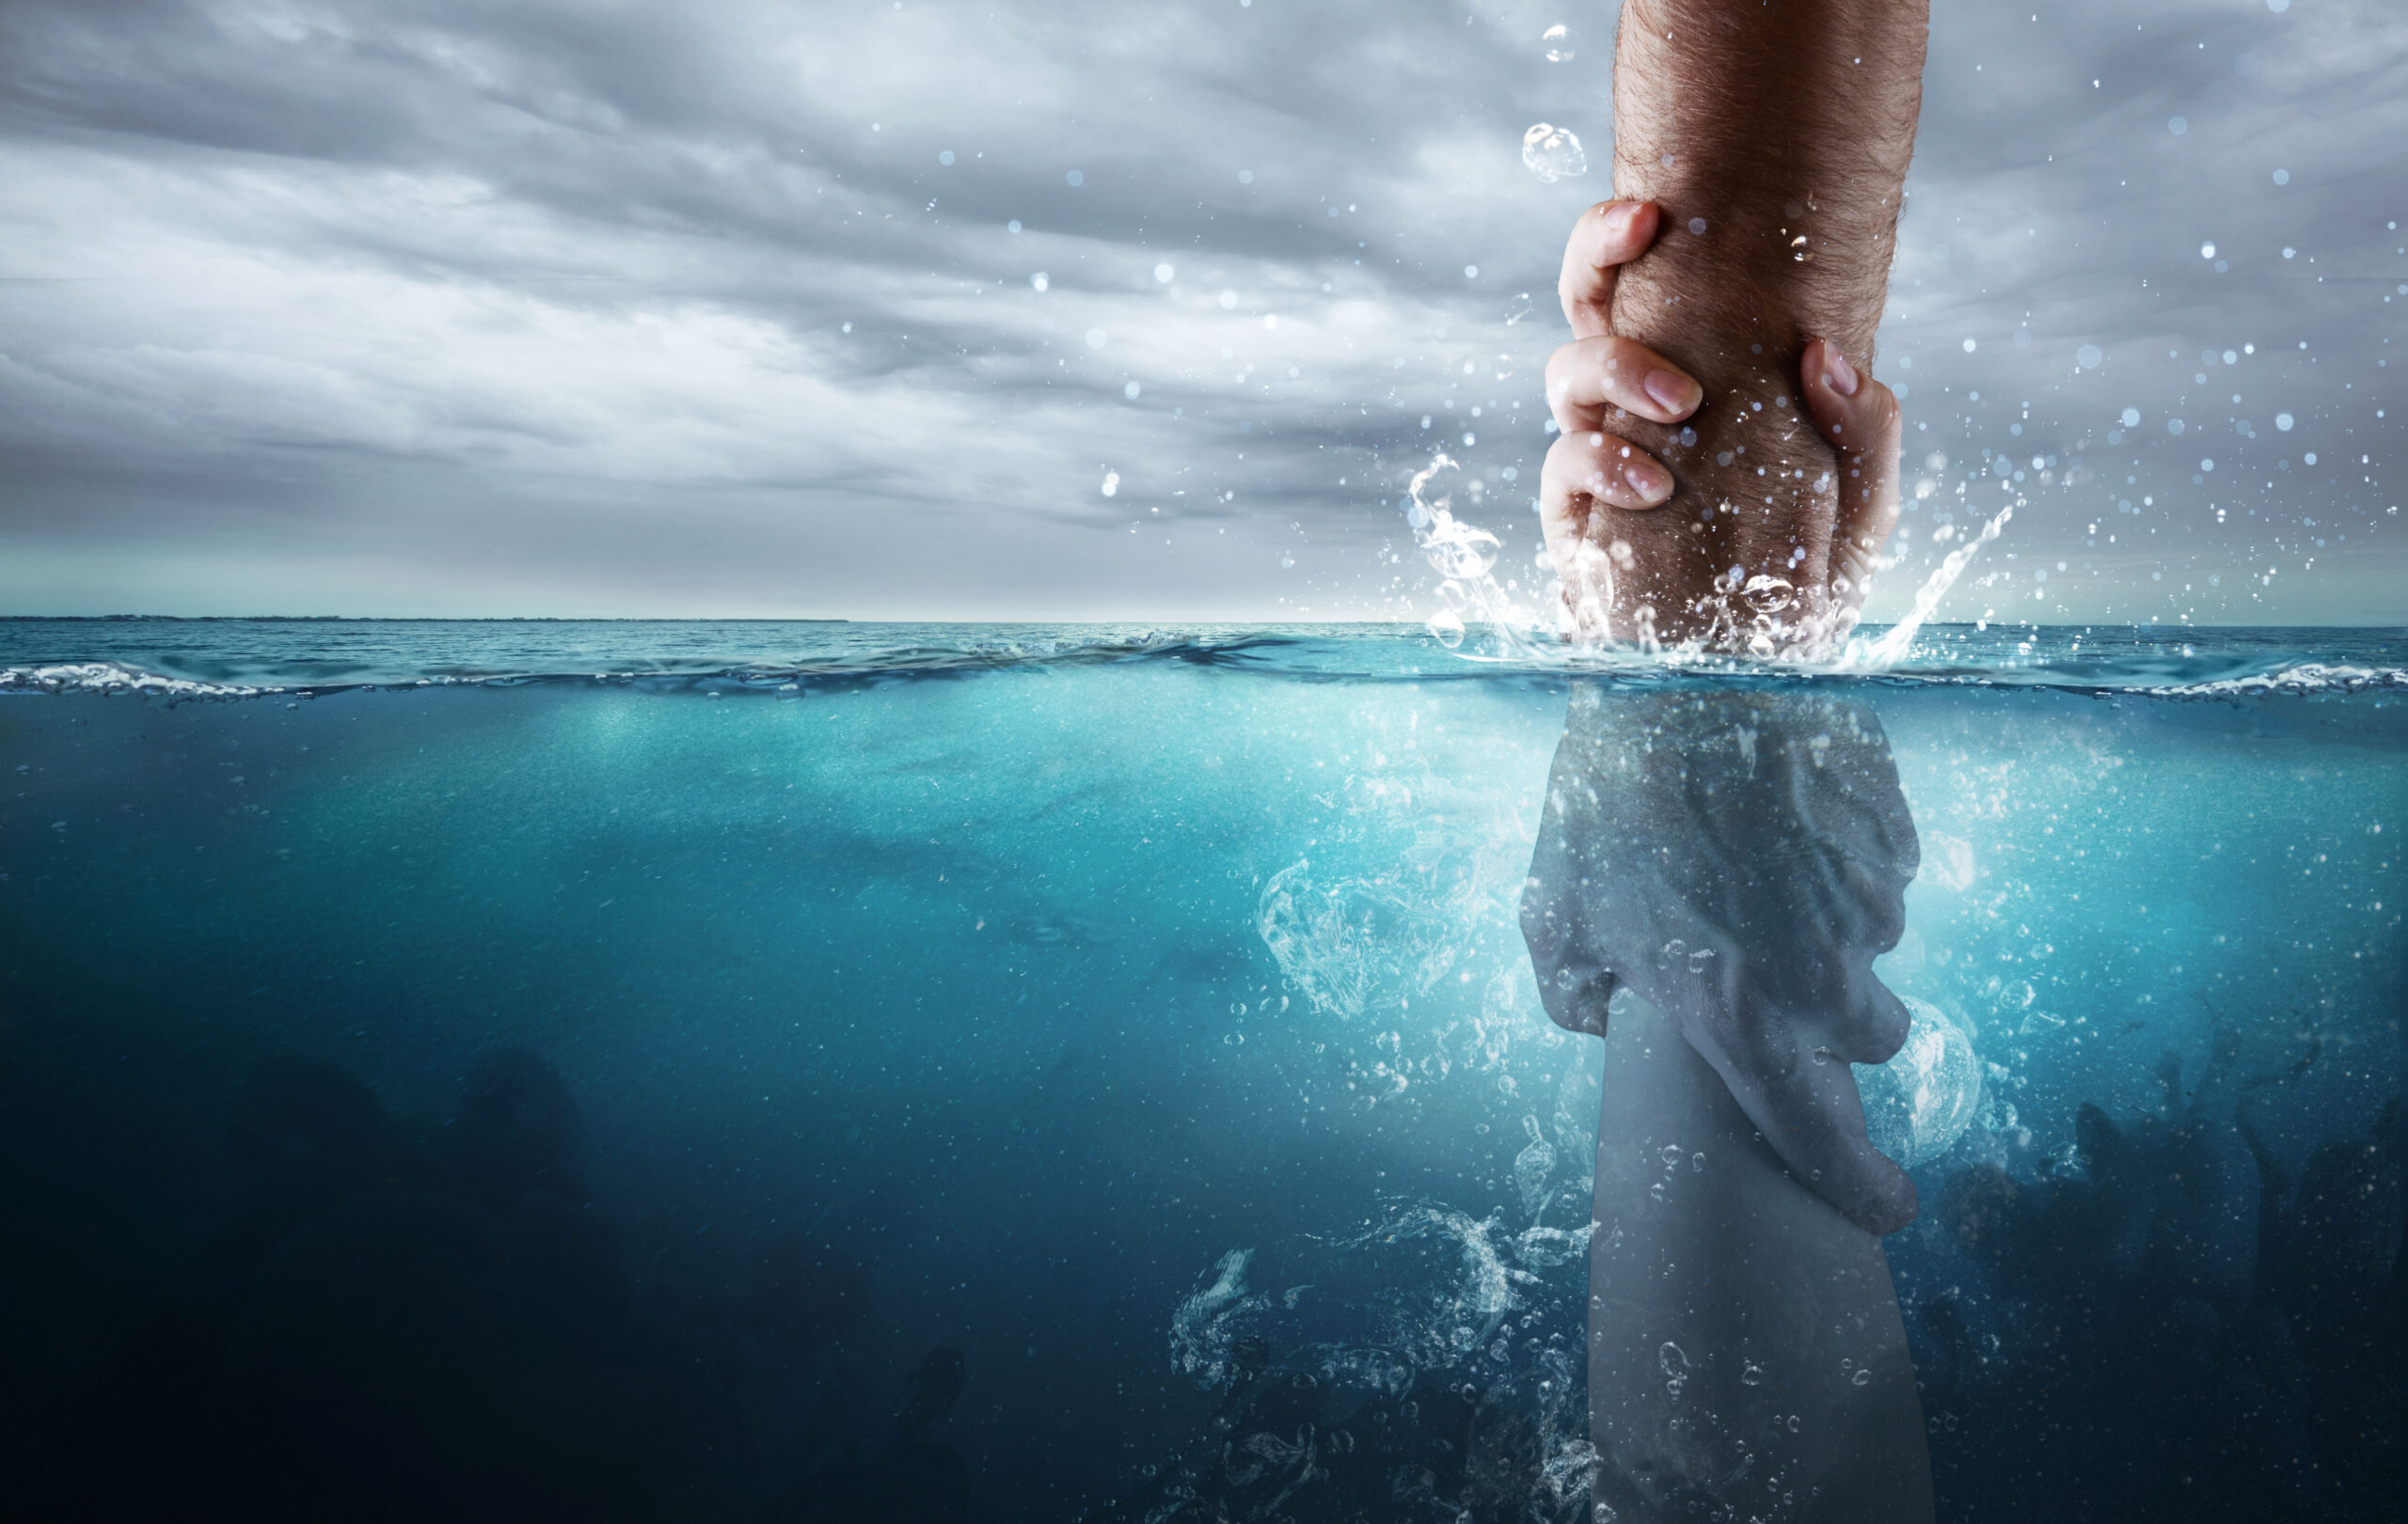
^{Rescuing Others}
Day 6
Notes:
Bible Lesson Nº 6
Rescuing Others
Biblical Reference: 2 Kings 5; John 13:34; Luke 19:10; John 3:16; Mark 16:15; Prophets and Kings pp. 244 (Chapter 20).
Main Topic: “Sharing with others”.
Bible Story: Naaman’s Servant Girl
Specific Objectives
That the children may:
• Learn that we can rescue others.
• Feel the desire to rescue others.
• Decide to share with others about the great rescue that Jesus wants to do in us.
Memory Verse: “And he said unto them, Go ye into all the world, and preach the gospel to every creature.” Mark 16:15.
Materials
1. Coloring pages for the lesson.
2. Theme song of the day and memory verse in illustrative pictures.
3. Illustrative materials for the time of prayer.
4. Craft activity with the memory verse of the day for each child to take home.
5. Materials for craft activities.

Slide 4
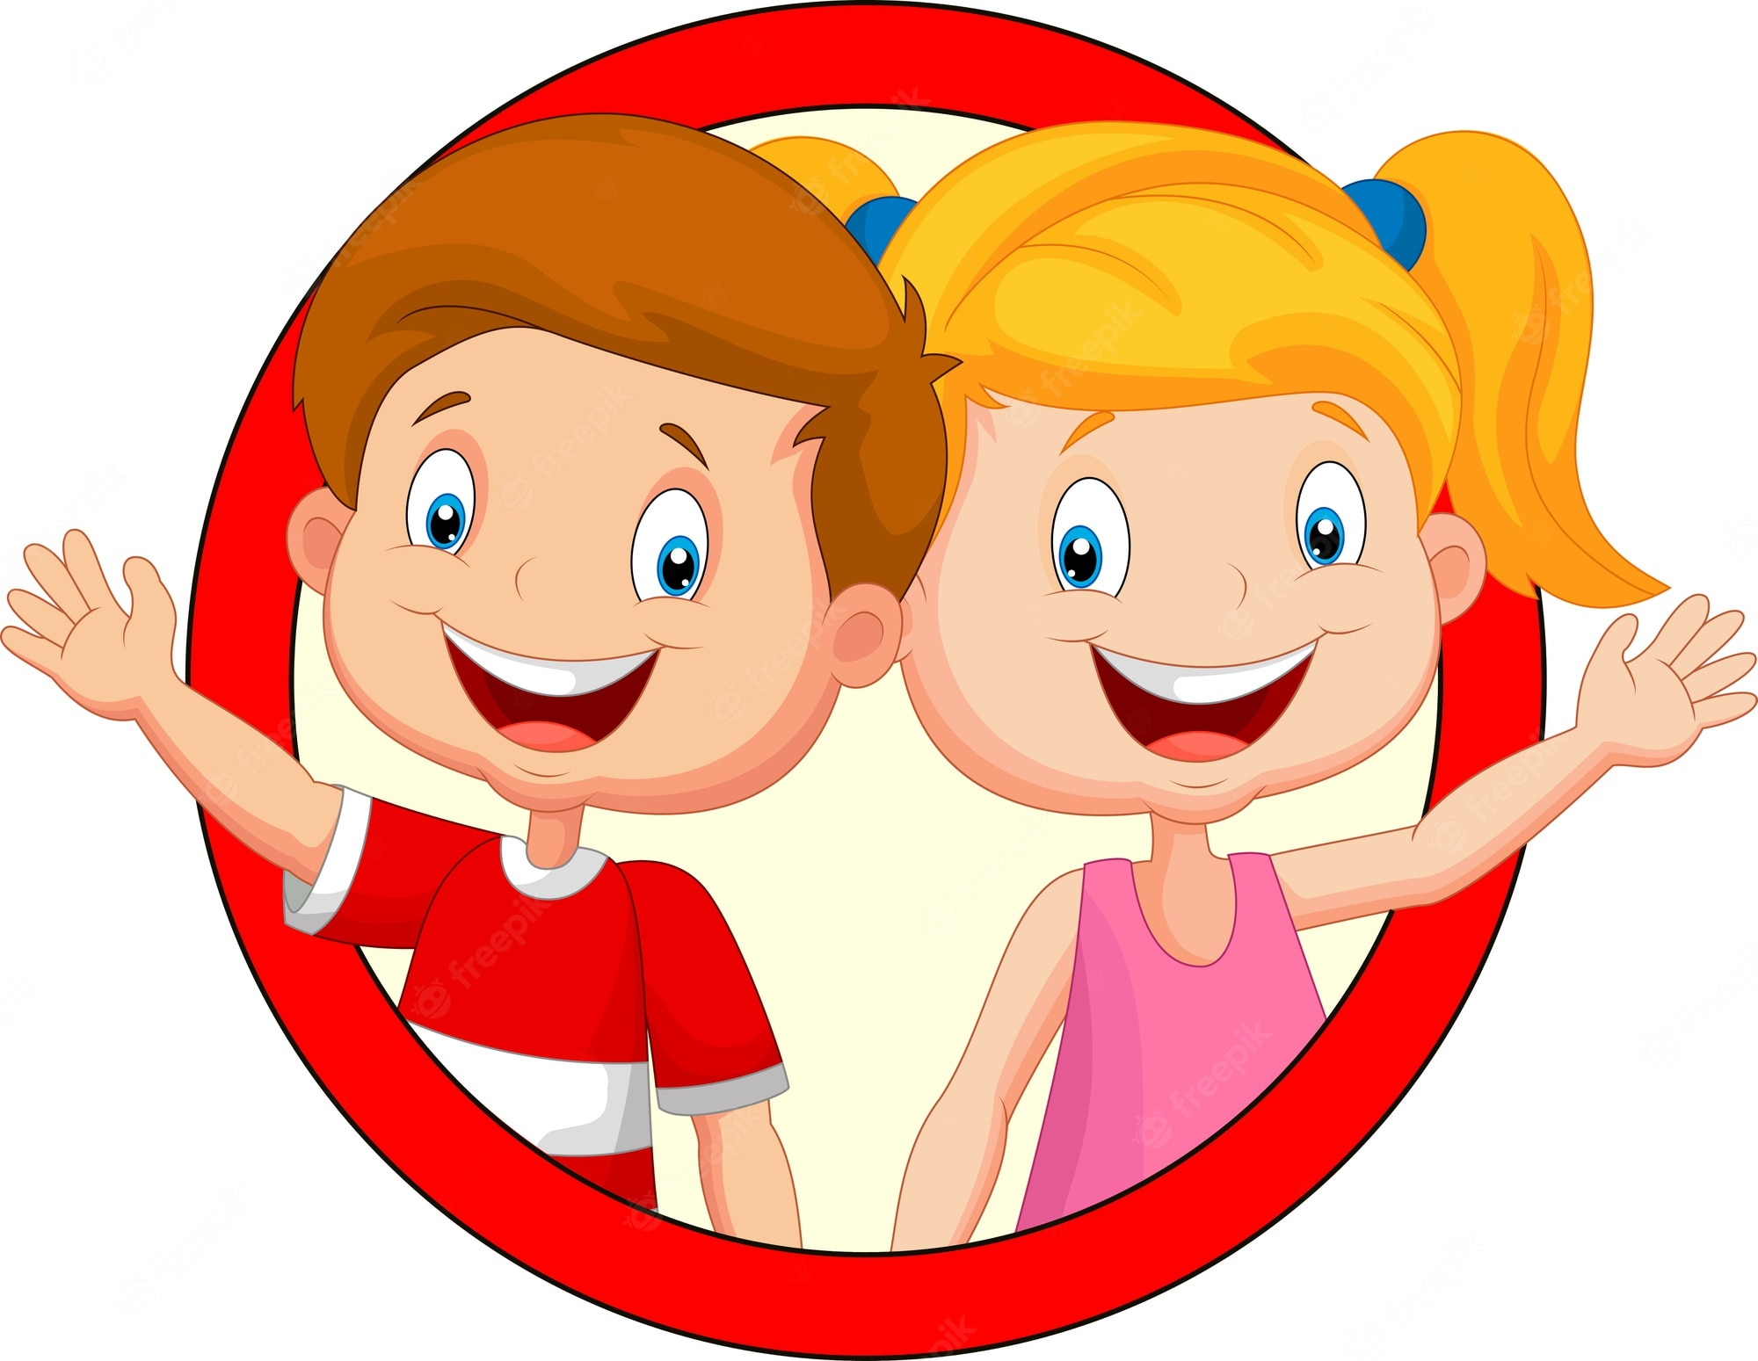
Welcome!
Notes:
Program Development
1. Welcome
Welcome everyone in a friendly, cheerful, and fun way, greeting the children in a group and general form. Present yourself and the other teachers.
Ice breakers can be done to welcome the new children. Reward those who invited new friends or congratulate those who attended every day.
Different starting activities and ice breakers can be scheduled for each day.

Slide 5
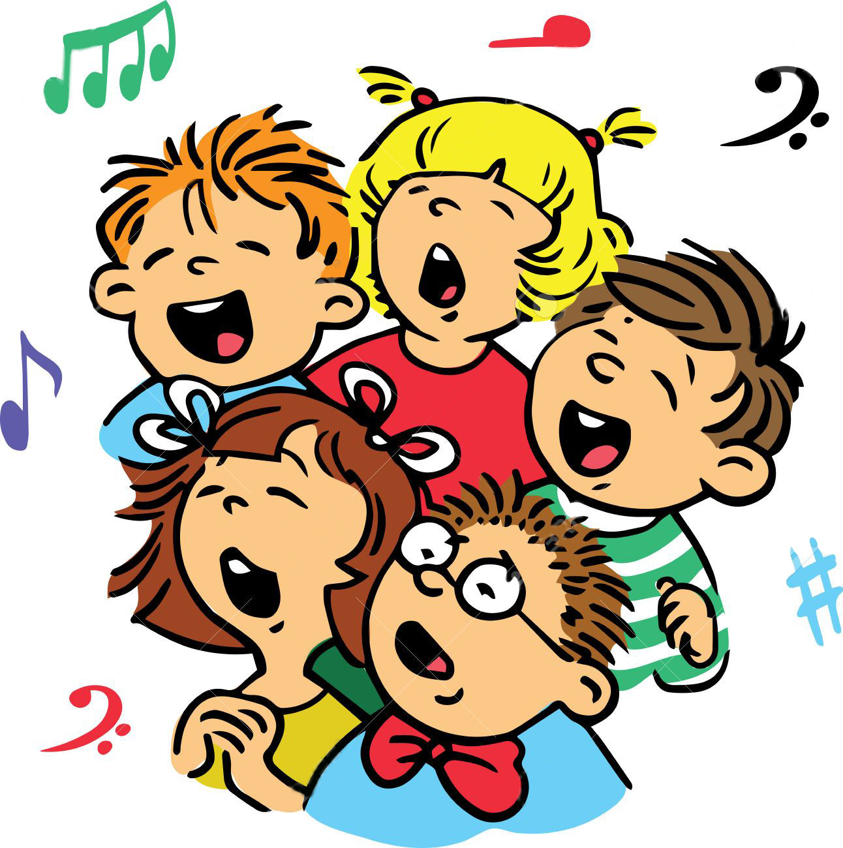
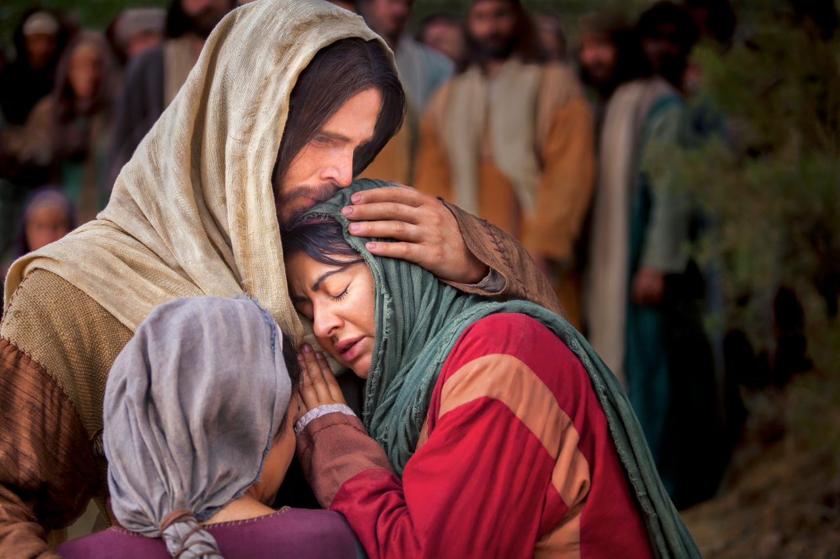
Musical moment
MY LOVE FOR GOD
Notes:
MY LOVE FOR GOD
2. Musical Moment
This is the first part of the program; therefore, we must start with dynamism to cheer those present and motivate them to continue coming to the program. Start with joyful songs that will fill their hearts with joy. Songs from previous days can be reviewed.
Don’t forget to sing the days song “Discovering Stars” (Martin Nievas).
Prepare the song written on a piece of paper or illustrate it so that children can easily learn it.
Review the Children’s Evangelization Manual to teach it more effectively

Slide 6
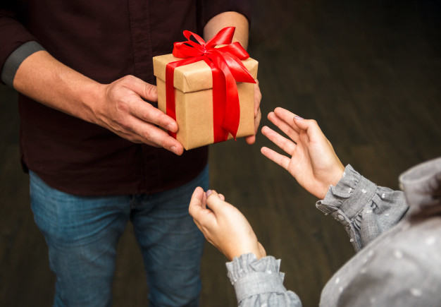
Musical moment
I have received God’s greatest gift
Given to me through his precious love
Notes:
I have received God’s greatest gift
Given to me through his precious love

Slide 7
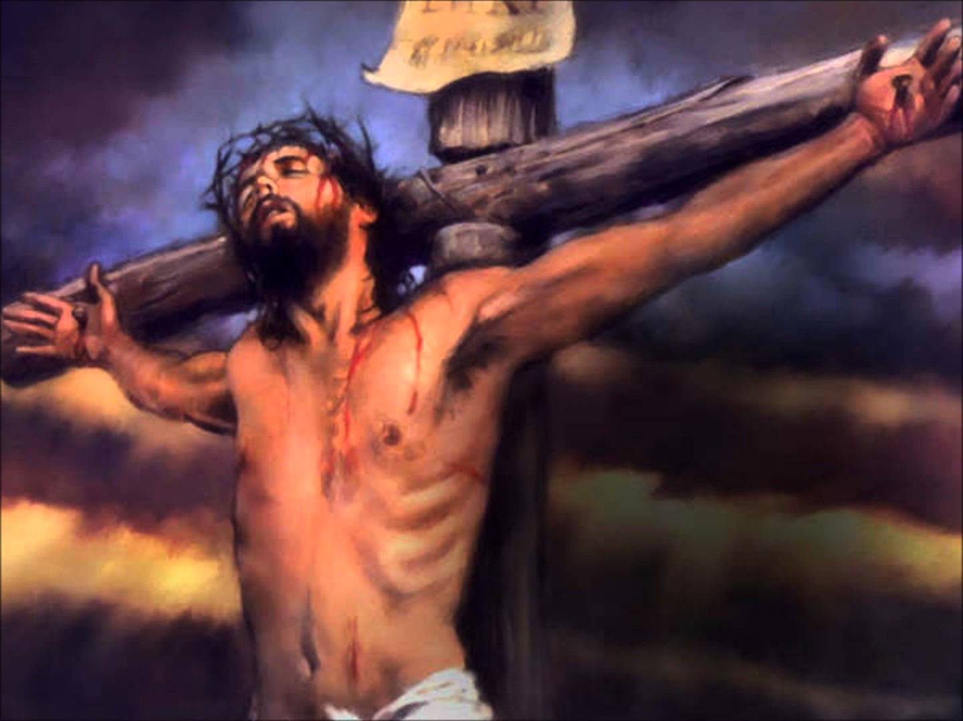
Musical moment
Upon a cross’ his life he gave
That through his love’ sinners be saved
Notes:
Upon a cross’ his life he gave
That through his love’ sinners be saved

Slide 8
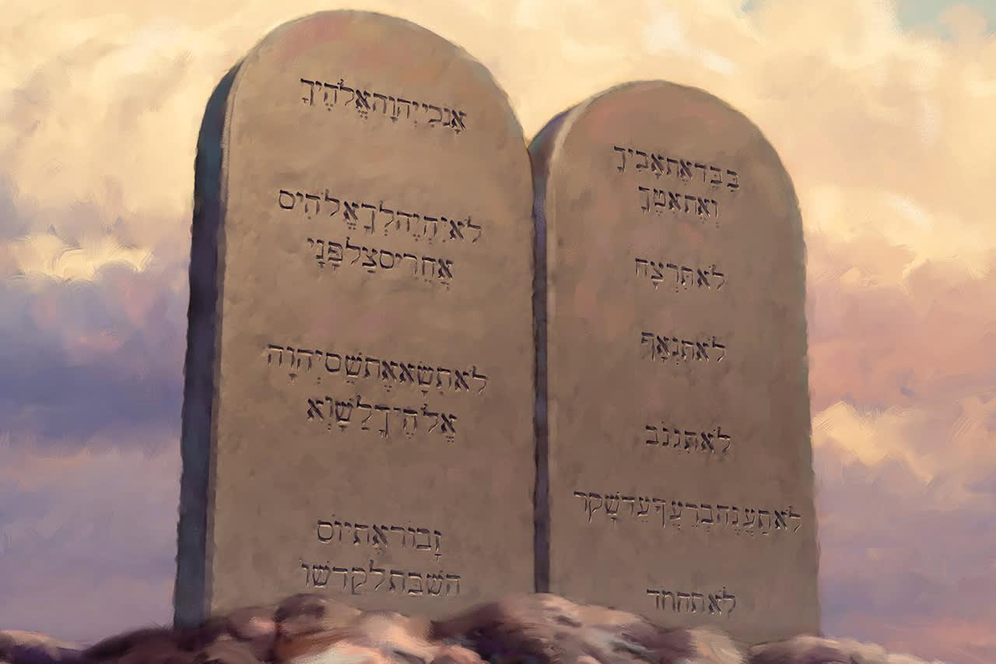
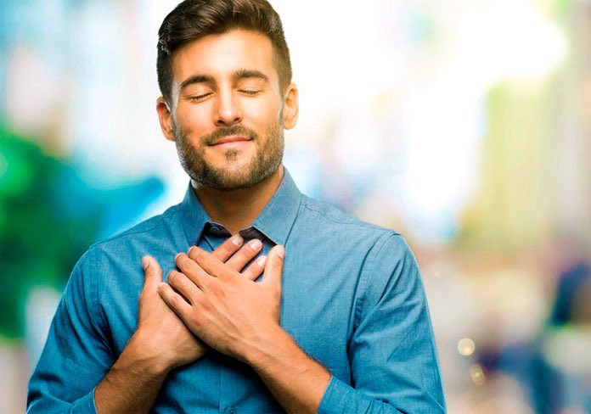
Musical moment (Pre-Chorus)
And to give him thanks will I now keep his law
Notes:
And to give him thanks will I now keep his law

Slide 9
Musical moment (Chorus)
All Ten Commandments have I received
All for my good if I believe
Notes:
All Ten Commandments have I received
All for my good if I believe

Slide 10
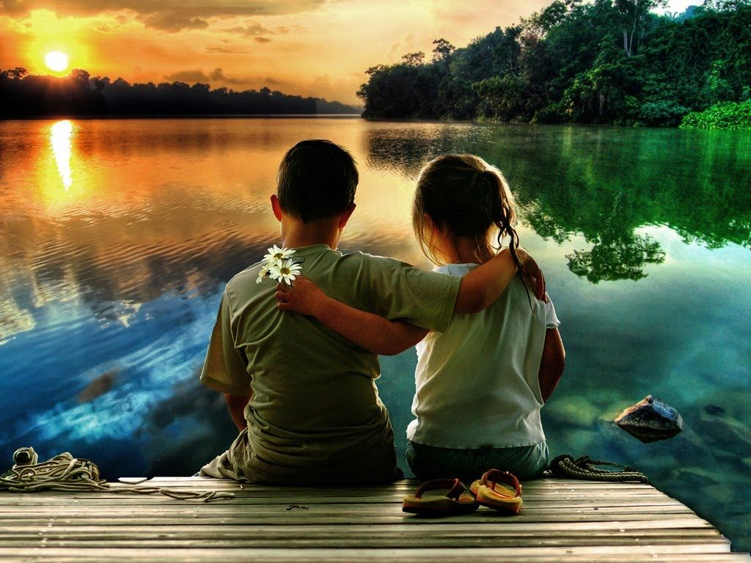
Musical moment (Chorus)
Love for those next to me,
and most of all’ my love for God, my love for God.
Notes:
Love for those next to me,
and most of all’ my love for God, my love for God

Slide 11
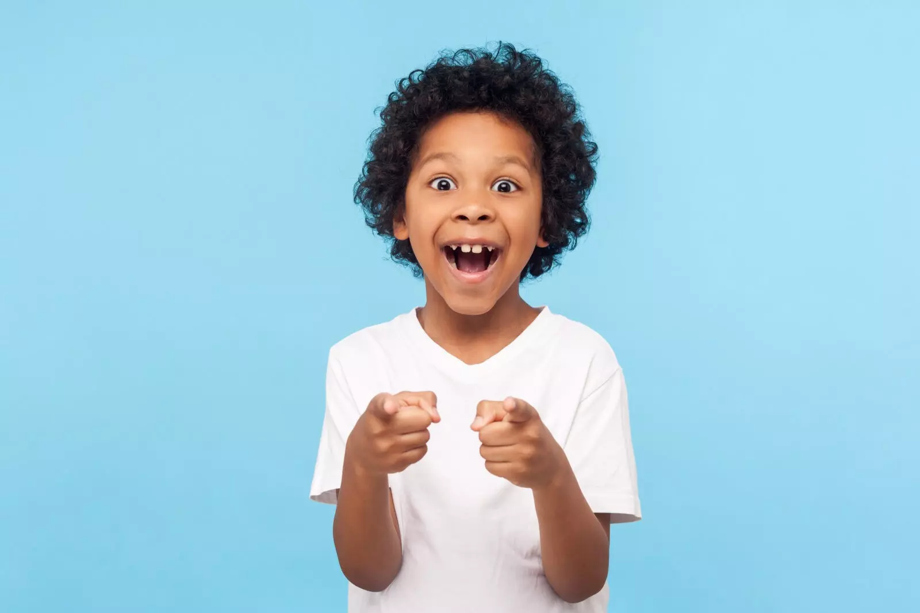
Musical moment
I want to share something with you
That youre invited to give thanks too
Notes:
I want to share something with you
A B
That youre invited to give thanks too

Slide 12
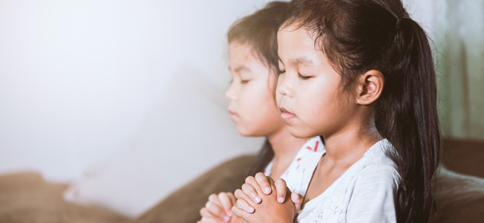
Musical moment
On to share more about his great love
All to give thanks to the father Above
Notes:
On to share more about his great love
All to give thanks to the father Above

Slide 13
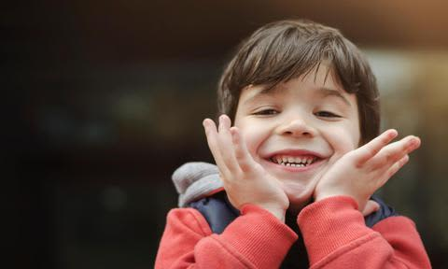
Musical moment (Pre-Chorus)
And to give him thanks will I now keep his law
Notes:
And to give him thanks will I now keep his law

Slide 14
Musical moment (Chorus)
All Ten Commandments have I received
All for my good if I believe
Notes:
All Ten Commandments have I received
All for my good if I believe

Slide 15
Musical moment (Chorus)
Love for those next to me,
and most of all’ my love for God, my love for God.
Notes:
Love for those next to me,
and most of all’ my love for God, my love for God

Slide 16
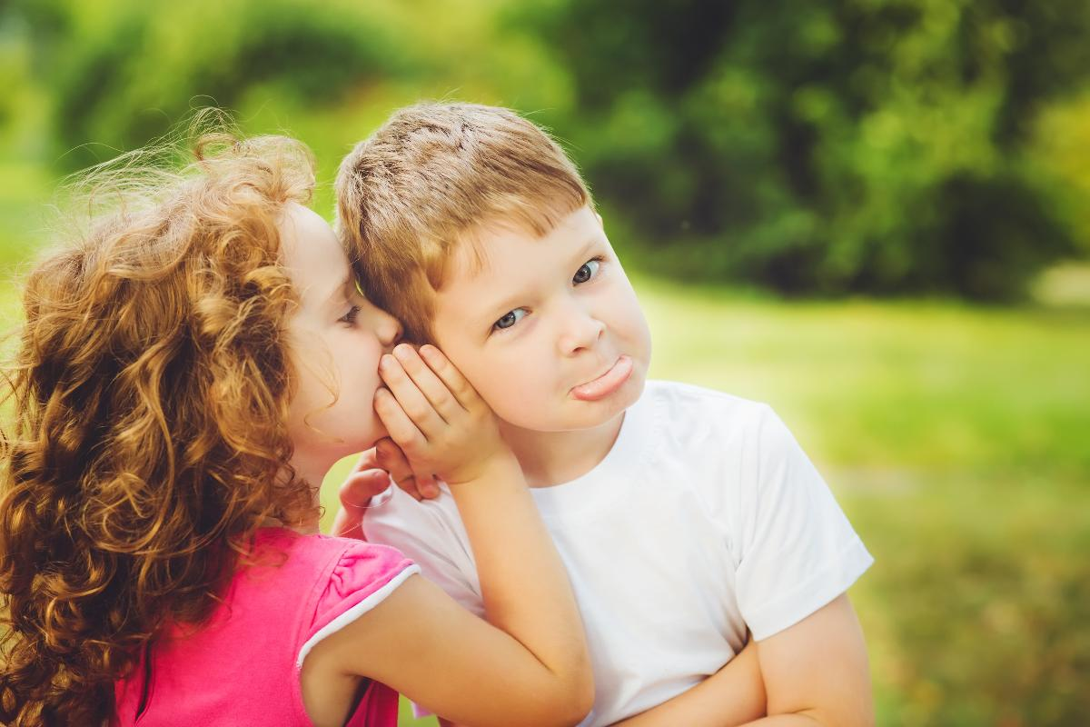
BIBLICAL LESSON
Notes:
3. Lesson
What do you do when something spectacular has happened to you?
Do you keep it a secret or do you talk about it?
When something very special or beautiful happens to us, we want to tell our friends about it right away. How nice it is to share with them the good things that happen to us!
When my little girl was little, she wanted to have a stuffed or plush rabbit.
But she didn’t know how to get one. She thought and thought and decided to pray that God would give her the doll for her birthday.
When the day came, an aunt came with a big present and when she opened it... Surprise! It was a stuffed animal in the shape of a super big rabbit.
She was happy and decided to tell all her friends about her experience.
She said I asked God for a stuffed animal and my aunt gave it to me.
How nice it is to tell our friends about our joys!
Today I will tell you the story of a little girl who saved a person by telling a story.

Slide 17
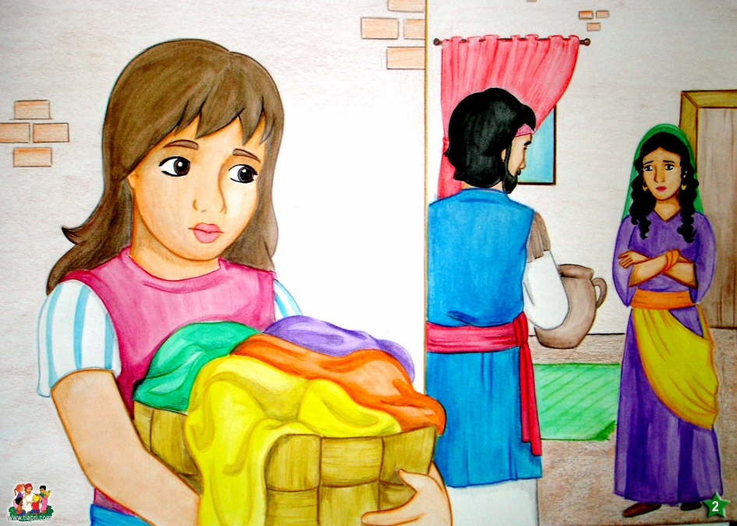
Notes:
Naaman was the head of the Syrian army. A great soldier. He was well liked by all the soldiers, even by the king. He was an important person because he was an authority and he was also a friend of the king.
The king loved him very, very much because thanks to him he had won many battles.
He lived with his wife and a Hebrew girl who worked in his house.
Years before, he had brought her to Syria as a slave.
Her parents were Hebrew and had taught her all about God. They had taught her that she should be a good girl, that she should always be obedient, that she should help, and that she should talk to God.
And that’s how she was. She was always a hard worker, obedient and always helped with the chores around the house.
When she was sent to do some work, she would run to do it.
And when she did a job, she did it with love and very well.

Slide 18
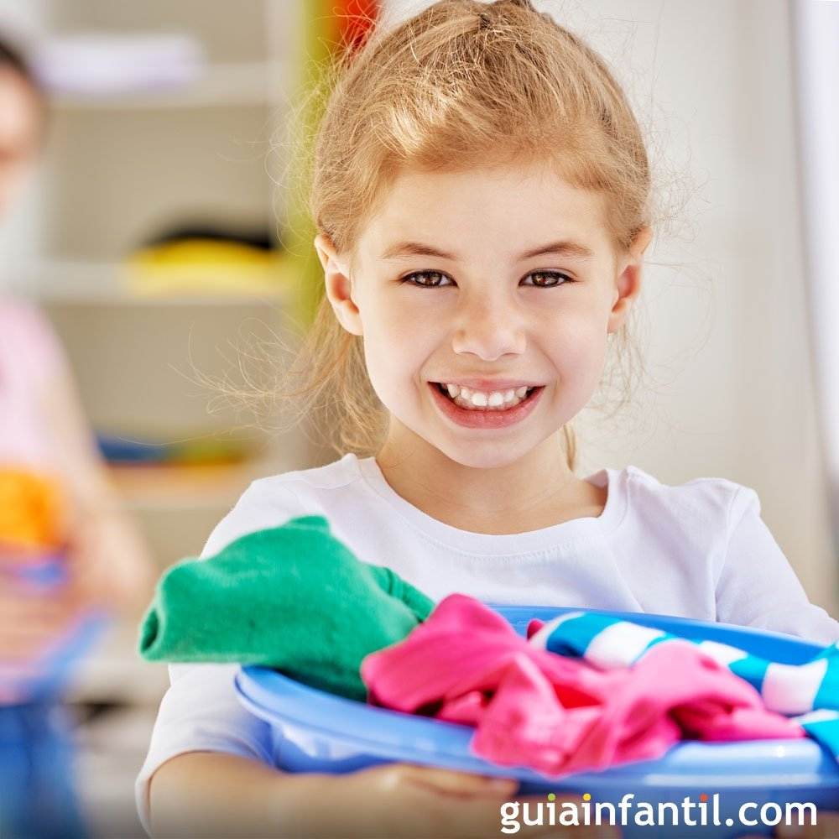
Notes:
What about you?
Do you help in your home with the housework?
Do you wash the dishes, clean the floor, or make your bed? When your mother sends you to do the chores, do you do them? Or do you grumble, don’t want to do it, turn around, run away, lie and say I swept the floor and put it under the bed?
We can be kind and cooperative when it is our turn to do the chores.
Always be happy to collaborate.

Slide 19
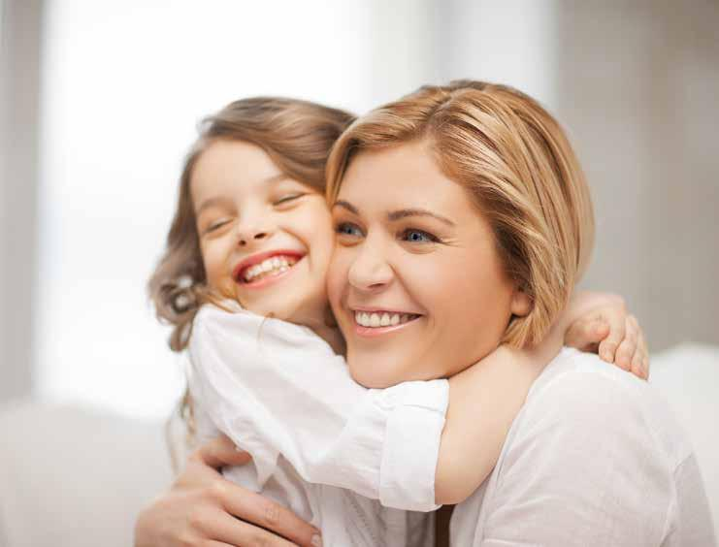
“A new commandment I give unto you, That ye love one another; as I have loved you, that ye also love one another” John 13:34.
Notes:
The Bible says in John 13:34 “A new commandment I give unto you, That ye love one another; as I have loved you, that ye also love one another.”
If we love the people around us, we should collaborate with them.
Our moms do a lot of chores around the house. And many of them work outside the home and come back tired. We love them very much, so we collaborate with them and together we can rest.
But let’s continue with the story.

Slide 20
Notes:
One day the girl was doing housework and overheard a conversation between Naaman’s wife and him.
They were saying: You know, my beloved. I am very sick. I have leprosy. I am going to die.
She cried and cried because there was no solution to her problem. Leprosy was a very terrible disease.
It starts with spots on the skin. But then the skin falls off and the flesh of the body falls off.
It is a very painful disease that had no solution.
The girl listened and became very sad because she loved them very much as they were very good.
Naaman and his wife were very sad and did not know who could help him.
How sad!

Slide 21
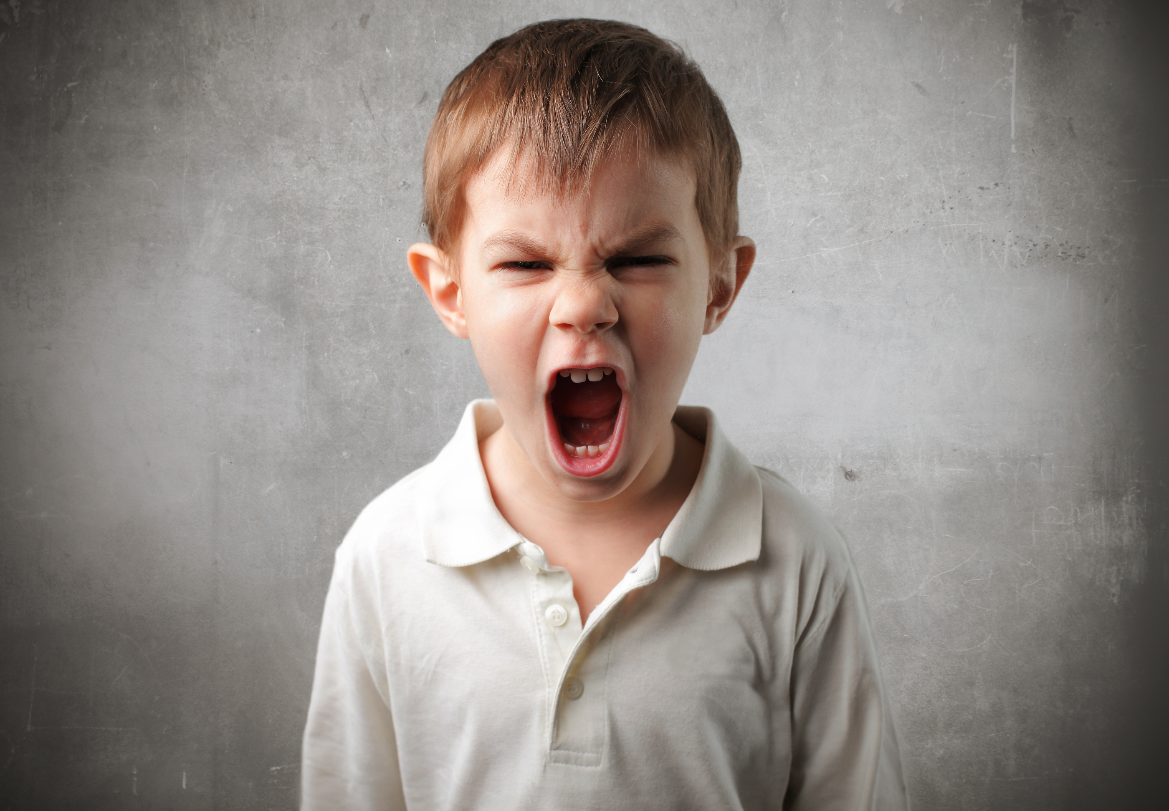
Notes:
Sometimes we have problems, and we don’t know who can help us.
Do you remember that we have learned the problem of sin? If you don’t remember, I’ll remind you.
We all have a very terrible disease too and that disease is sin.
Sin is all the bad things we do and say, like lying, fighting, stealing, saying bad words. Etc.
All of us have sinned and as a consequence of that we are far from God. Now we should die forever. We can no longer go to heaven. We can no longer be close to God.
But Jesus being God left heaven and came to earth to die in our place and thus unite man with God again.
He never sinned and he lived on this earth. He healed the sick. But then he died for all of us.

Slide 22
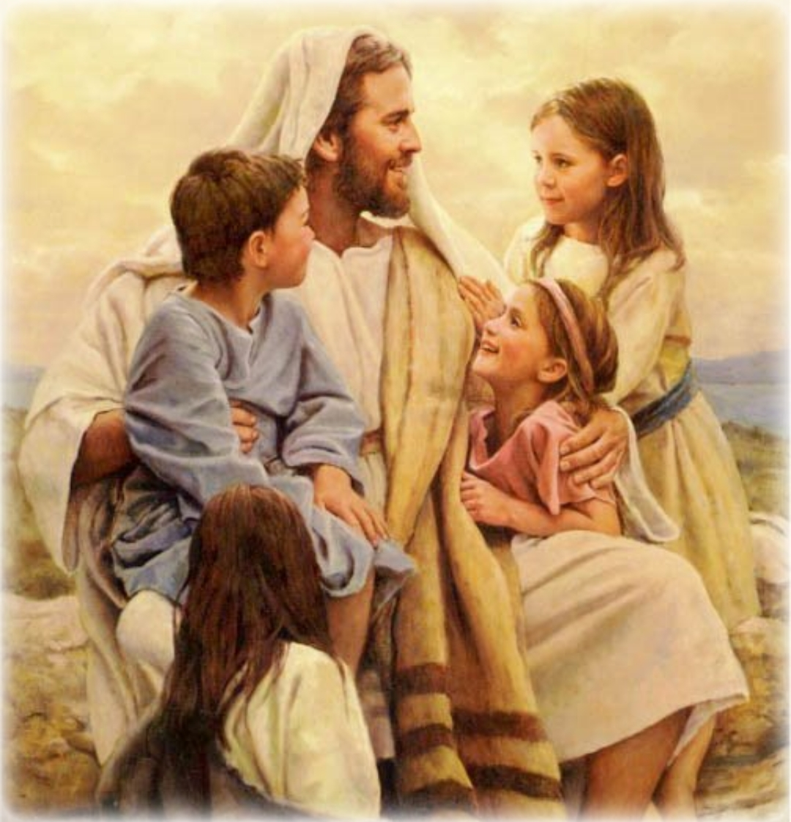
Notes:
Now we can go to heaven because of all that Jesus did for us.
We just have to ask him to forgive us of all our sins, for lying, stealing, and saying bad words, and tell him to live in our hearts forever.
Would you like Jesus to live in your heart? Talk to God and invite him to live in you forever.
You know, all children commit sin and must learn from Jesus.
Many people do not know this gift of Jesus and the gift of giving his life for us. They should know what he did for us.
Luke 19:10 says, “For the Son of man is come to seek and to save that which was lost.”

Slide 23
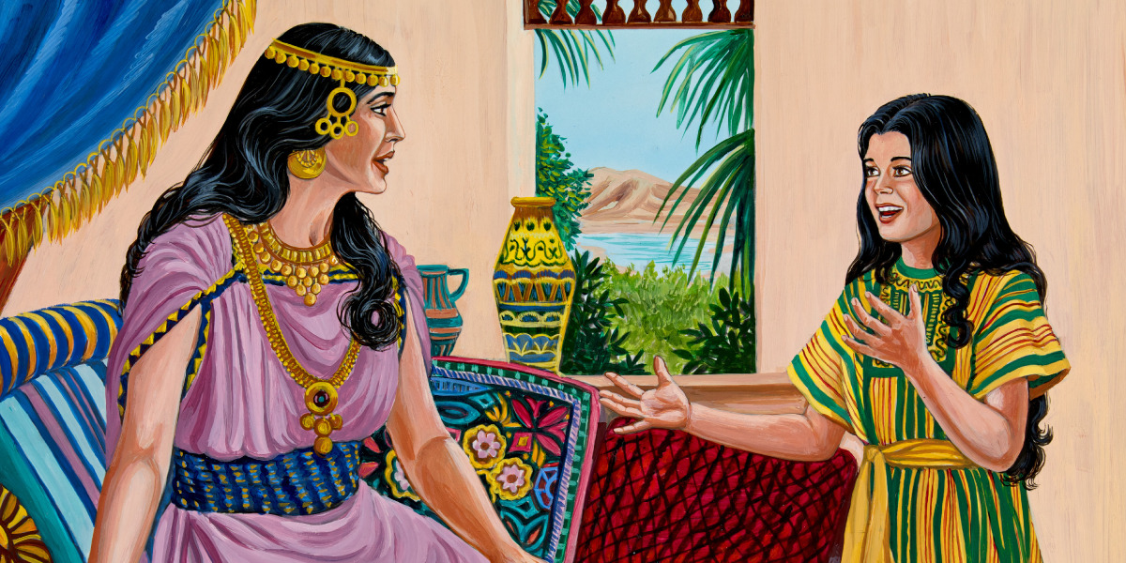
Notes:
But what happened in our story?
The girl told the Army captain’s wife that she knew who could heal him.
She attentively began to ask, “Who can heal him? Where? I want to know soon.”
The girl began to tell him about the prophet Elisha.
Elisha is a wise man that does the will of God. God speaks through the prophet and I know that God will tell him what he must do to be healed.
That girl said to Naaman’s wife: “And she said unto her mistress, Would God my lord were with the prophet that is in Samaria! for he would recover him of his leprosy.” 2 Kings 5:3

Slide 24
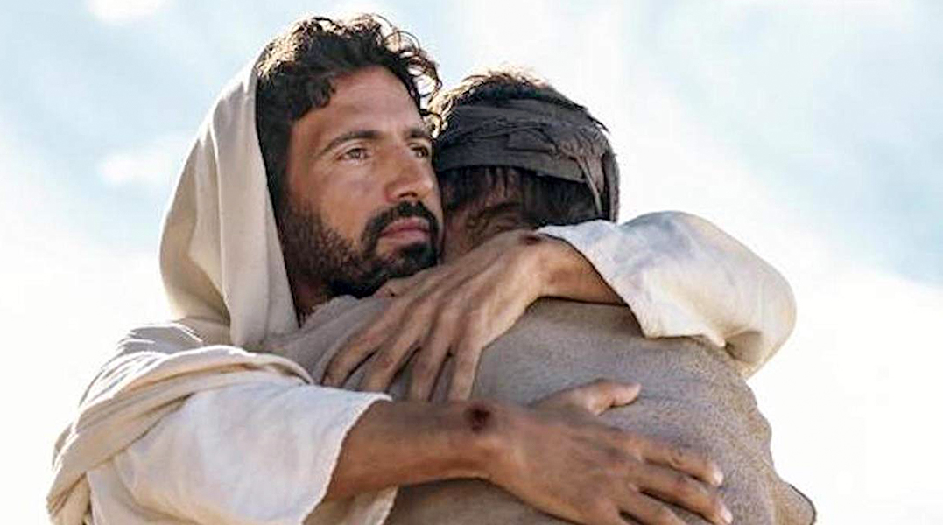
“For God so loved the world, that he gave his only begotten Son, that whosoever believeth in him should not perish, but have everlasting life” John 3:16
Notes:
So we too must tell others that Jesus came to save us. We must tell others that Jesus lived on this earth and was just like us. That he went through what we go through and that he also had temptations but he never sinned and one day he died on the cross for our sins. And now he is risen and is in heaven and soon he will come for all his children who have been faithful to him.
Do you remember John 3: 16?
“For God so loved the world, that he gave his only begotten Son, that whosoever believeth in him should not perish, but have everlasting life.”
You can learn this text and explain it to your friends. God loved us so much that he gave his son so that if we believe in him, we may have eternal life.
But... What happened to Naaman?

Slide 25
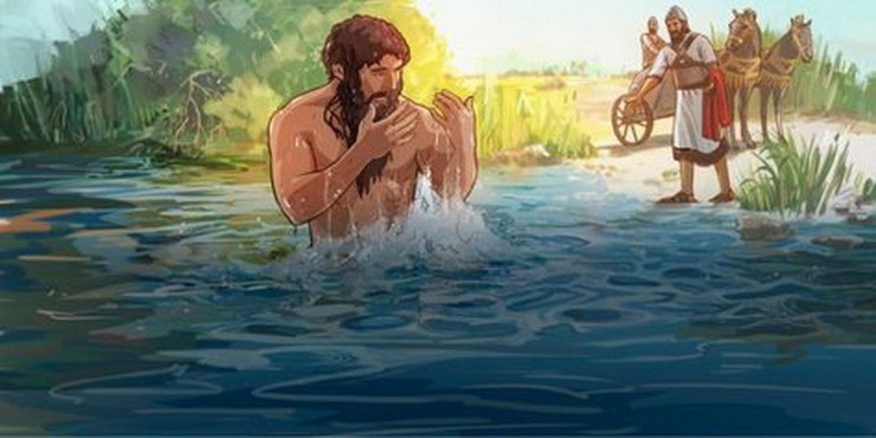
Notes:
He went to the prophet and he commanded him to wash himself 7 times in the Jordan river.
He obeyed. He immersed himself again and again in the river. And he was not healed but in the 7th time just as the prophet said he was healed.
Naaman returned home happy. He had been healed and he had also known the true God—the one who heals, the one who saves us.
When she returned home the girl was happy because she had been able to help save her master.
2 Kings 5:5, 10, 14.

Slide 26
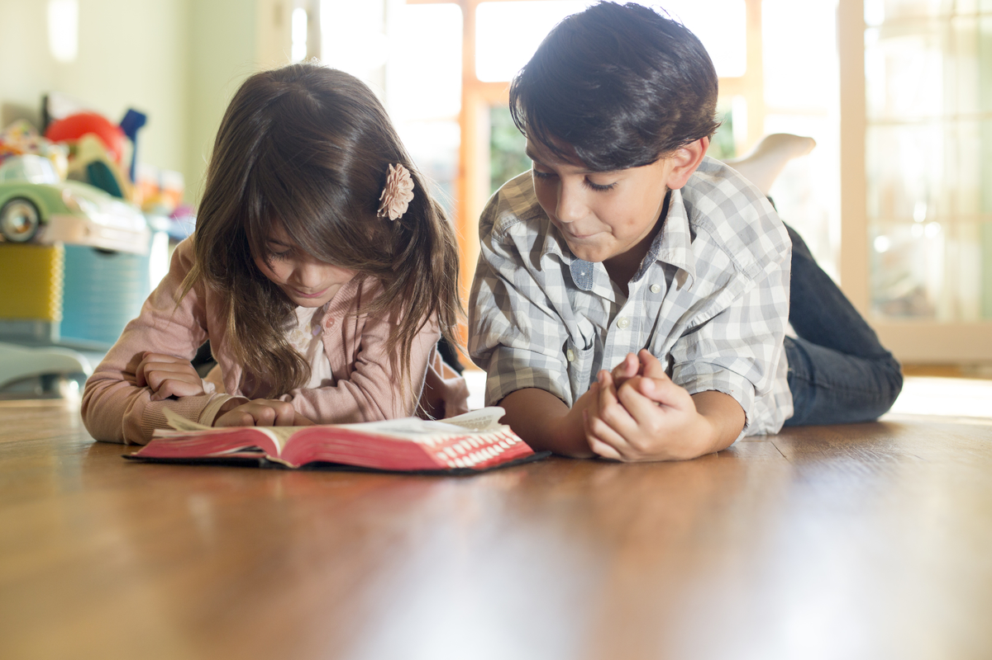
“Go ye into all the world, and preach the gospel to every creature” Mark 16:15
Notes:
Only we can help other children to know Jesus.
Only we can help Jesus and be rescuers of others by telling them about Jesus.
Surely you have friends who do not know the rescue plan that you already know. Surely you have siblings you may not know, or aunts, uncles, cousins, and classmates who need to be rescued from sin.
Are you willing to be God’s collaborator in his work? The bible says in Mark 16:15, “And he said unto them, Go ye into all the world, and preach the gospel to every creature.”
Many, many must know Jesus the savior. The one who rescued us from sin.

Slide 27
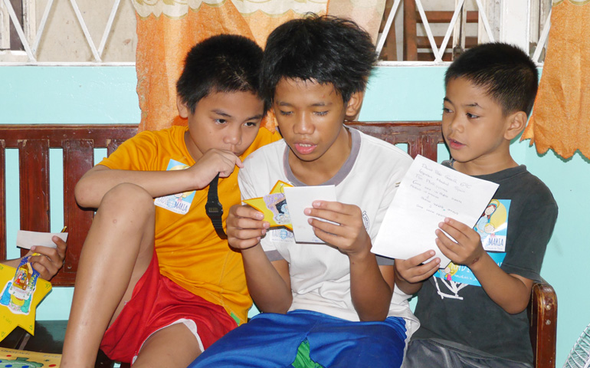
Notes:
As the Father has sent me, even so I send you. In John 20: 21, Jesus tells us that now it is our turn to speak. To speak that he lives in our hearts and to tell others.
Maybe you may say: I don’t know how to do it! I don’t know what to say.
You can ask the teachers for help. You can tell what you have learned. You can make a card with the verse from John 3:16 and give it to your friends.

Slide 28
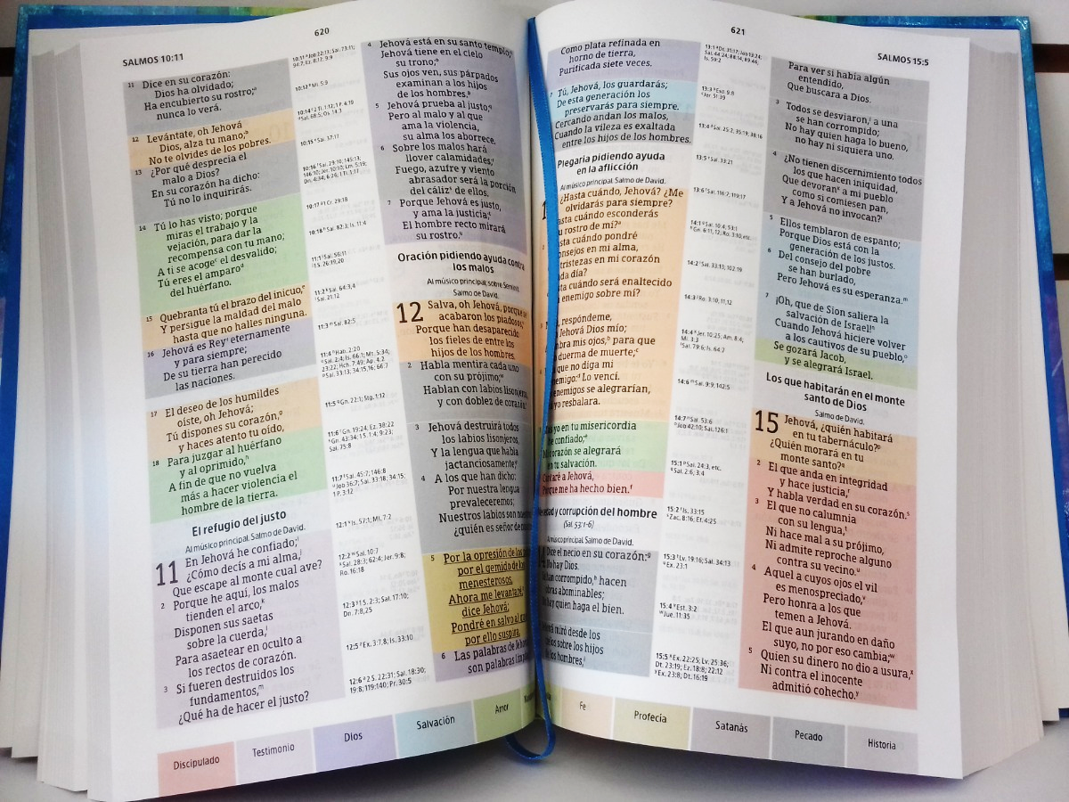
Notes:
You know, I will tell you one morelittle story.
My husband knew a little old lady who preached a lot. She talked about Jesus to a lot of people. And when he talked to her she told him that she couldn’t see. She was blind.
And he said to her: How do you talk about Jesus and teach?
She smiled a lot and said: I have my bible marked and I know many texts by heart.
Then I speak and say to them: Jesus came to die for you. Why don’t you read me the bible in John 3:16?
People look it up on their own and I explain it to them later. This is how I preach about Jesus. To those who greet me, to those who visit me.
We can do the same.

Slide 29
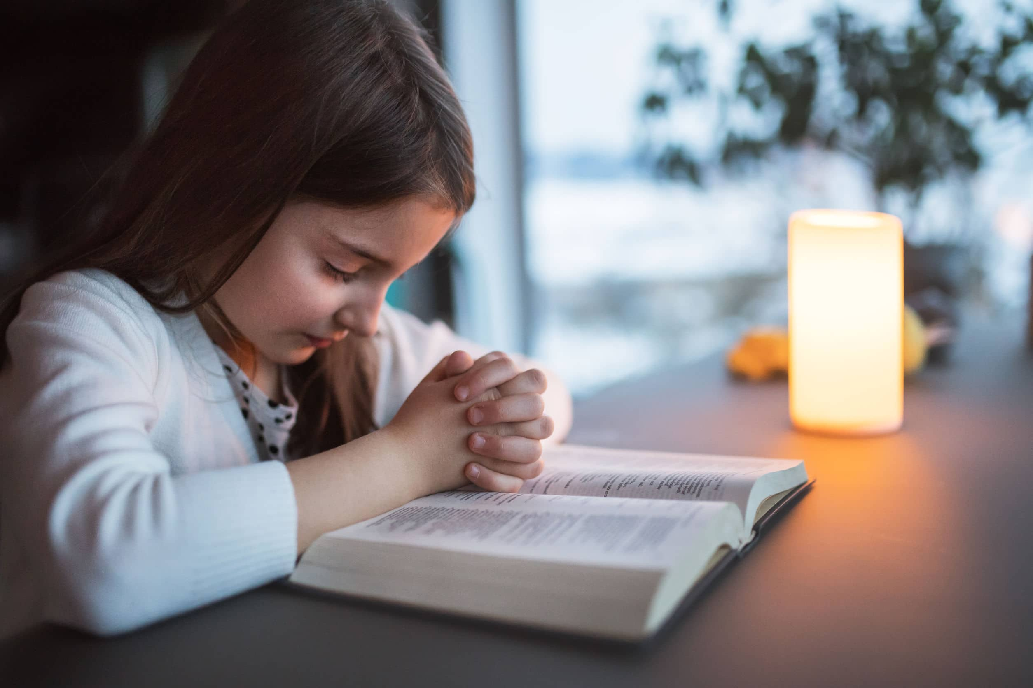
Notes:
What if we ask God to help us to be messengers. To be rescuers of others.
Let us pray together: Our Father in heaven. I thank you for sending your Son to rescue me. Today I ask you to help me to be able to speak of this beautiful plan with all my friends and many people so that they might know you too. I pray for all those who are listening to this program. In Jesus’ name, Amen.
I know that God will help you rescue many children. Just tell them about Jesus and why He came to the world. That was today’s story. I hope that you liked it and that today you might tell others the beautiful Rescue plan that you’ve come to know.

Slide 30
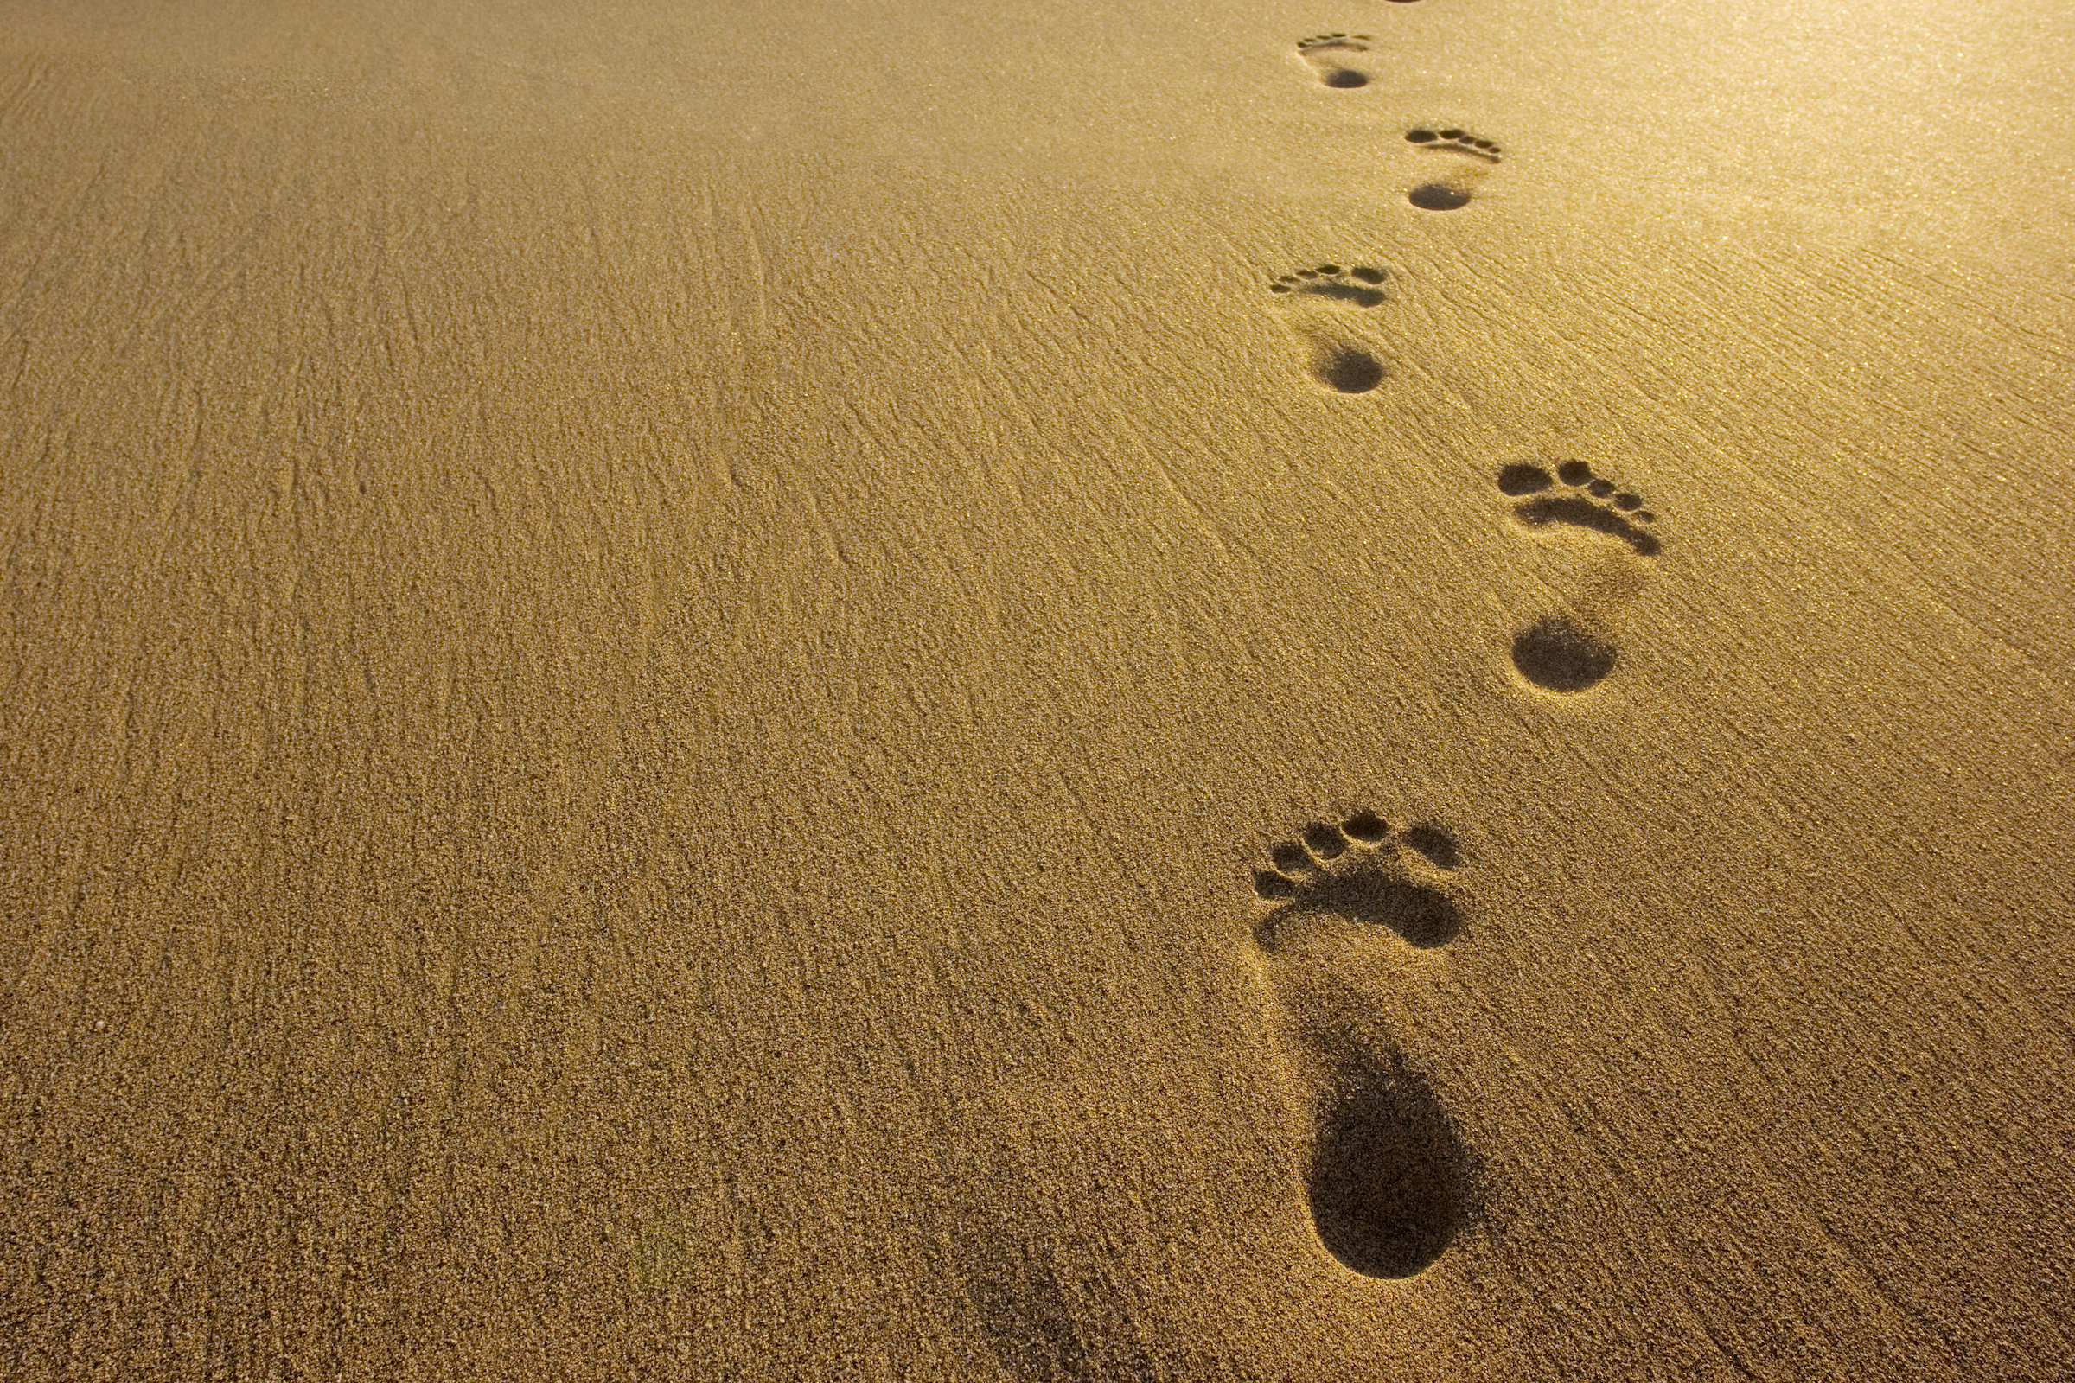
Mark 16:15
Notes:
4. Teaching the Memory Verse
This moment is important, as we are engraving the very word of God in the hearts and minds of our children.
Review the instruction manual to remember how to teach the verse.
Today’s verse is: “And he said unto them, Go ye into all the world, and preach the gospel to every creature.” Mark 16:15.
Prepare a small book where, when opened, each part of the verse is written. You can also draw steps where a part of the verse is written on each step.
Follow each step of the lesson so that the truths of God’s word are etched in the children’s minds.
It is important to explain the verse clearly so that children can understand God’s message written in His Word.

Slide 31
“Go ye into all the world,
Notes:
“Go ye into all the world,

Slide 32
and preach the gospel
Notes:
and preach the gospel

Slide 33
to every creature”. Mark 16:15
Notes:
to every creature”.
Mark 16:15

Slide 34
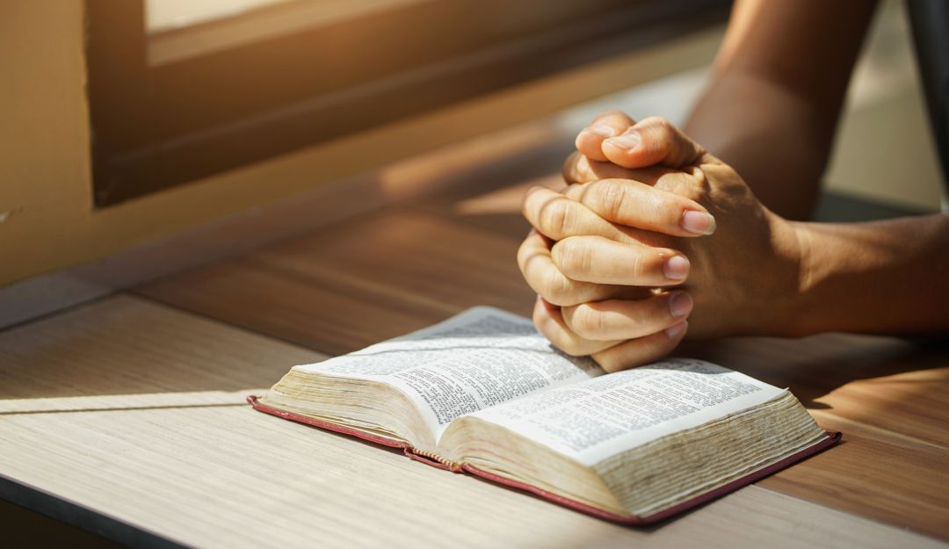
Moment of prayer
Notes:
5. Moment of prayer
Each part of the program must be carried out continuously, without spaces of silence. Review the time of prayer in the instruction manual to know how to do it.
In class we will prepare a list of friends who we want to share more about Jesus with. Bring the papers and pens in advance so that everyone has the opportunity to write down the names of their friends for whom they will pray.
We will pray for them every day so that they may know God as we do. Let a child among those present pray by repeating after the teacher.

Slide 35
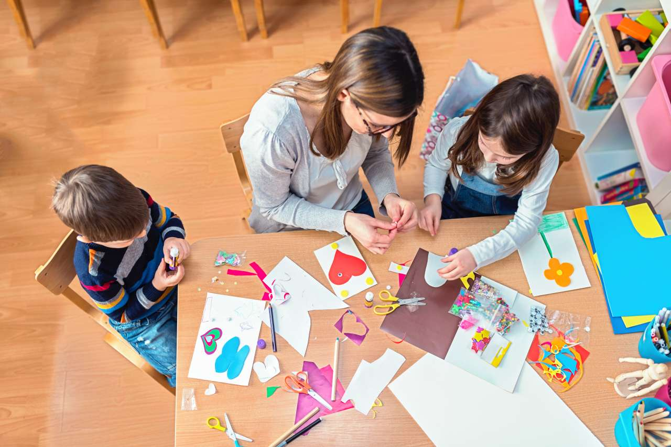
ACTIVITIES
Notes:
6. Activities:
Activity 1
Prepare cards with the verse of John 3:16 on them and decorating them very nicely to distribute amongst friends.
Activity 2
Color the drawing.

Slide 36
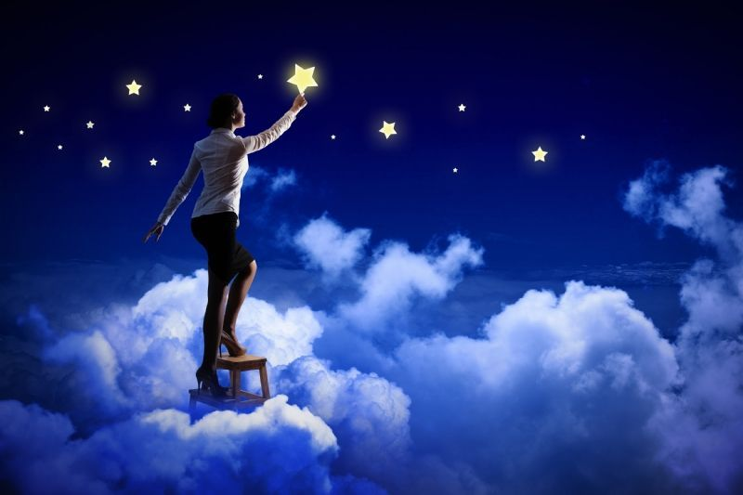
Musical moment
DISCOVERING STARS

Slide 37
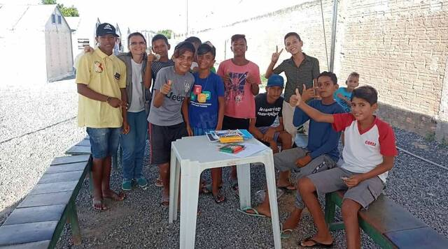
Musical moment
I want to be a missionary
Working for the Lord
Notes:
I want to be a missionary
Working for the Lord

Slide 38
Musical moment
Traveling the whole wide world
Spreading my God’s Word
Notes:
Traveling the whole wide world
Spreading my God’s Word

Slide 39
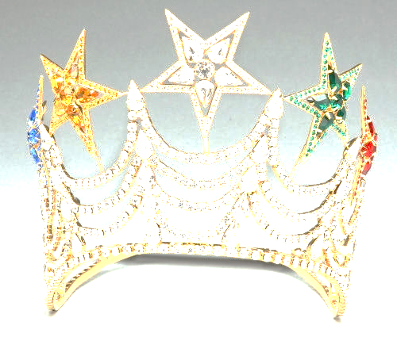
Musical moment (Chorus)
I’m discovering stars upon my crown
A great reward for all his own.
Notes:
I’m discovering stars upon my crown
A great reward for all his own

Slide 40
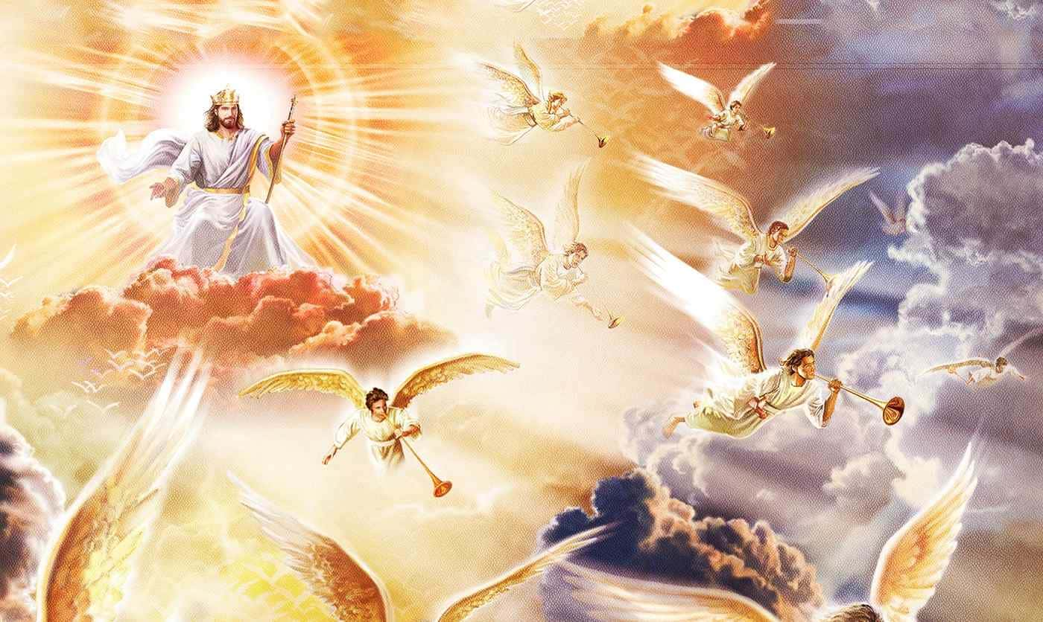
Musical moment (Chorus)
//Don’t stop now. This world is falling apart
Jesus is coming His Word we will share//
Notes:
//Don’t stop now. This world is falling apart
Jesus is coming His Word we will share//

Slide 41
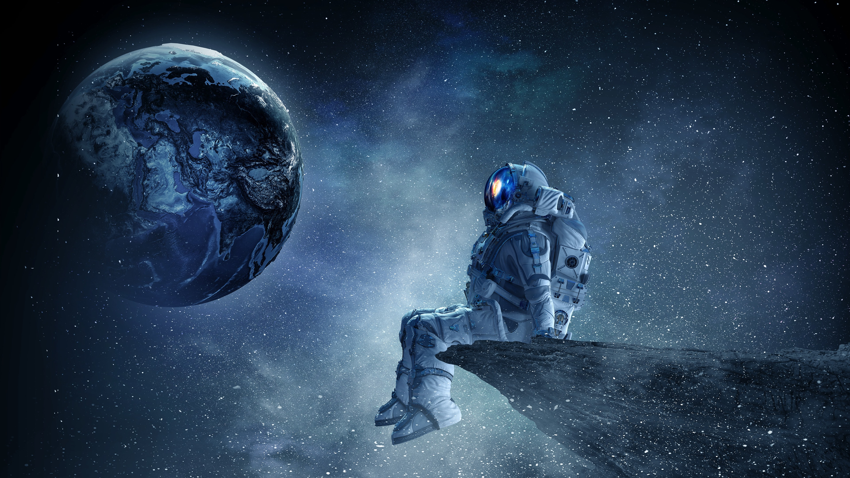
Musical moment
I do not travel on spacecrafts
I’m seeking stars for God
Notes:
I do not travel on spacecrafts
I’m seeking stars for God

Slide 42
Musical moment
Each star is a precious life
Embraced by Christ the Lord.
Notes:
Each star is a precious life
Embraced by Christ the Lord.

Slide 43
Musical moment (Chorus)
I’m discovering stars upon my crown
A great reward for all his own.
Notes:
I’m discovering stars upon my crown
A great reward for all his own

Slide 44
Musical moment (Chorus)
//Don’t stop now. This world is falling apart
Jesus is coming His Word we will share//
Notes:
//Don’t stop now. This world is falling apart
Jesus is coming His Word we will share//

Slide 45
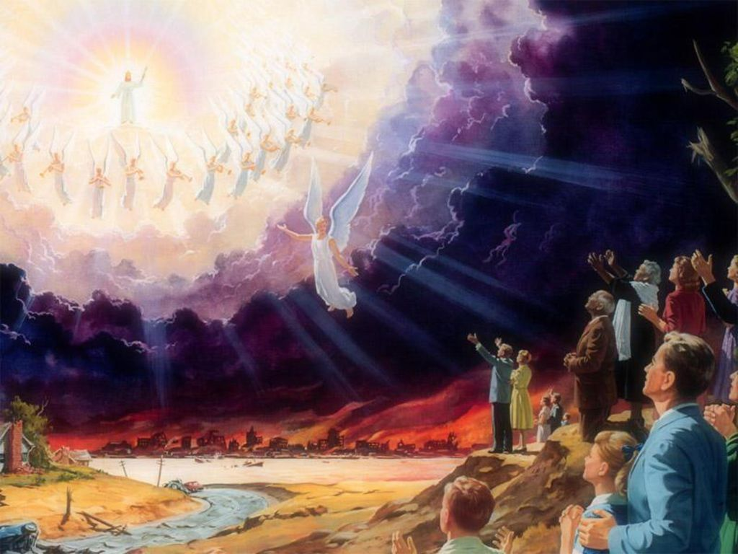
Next Topic:
^{The Great Rescue}
biblewell.org
Notes:
Next Topic:
The Great Rescue

