Slide 2
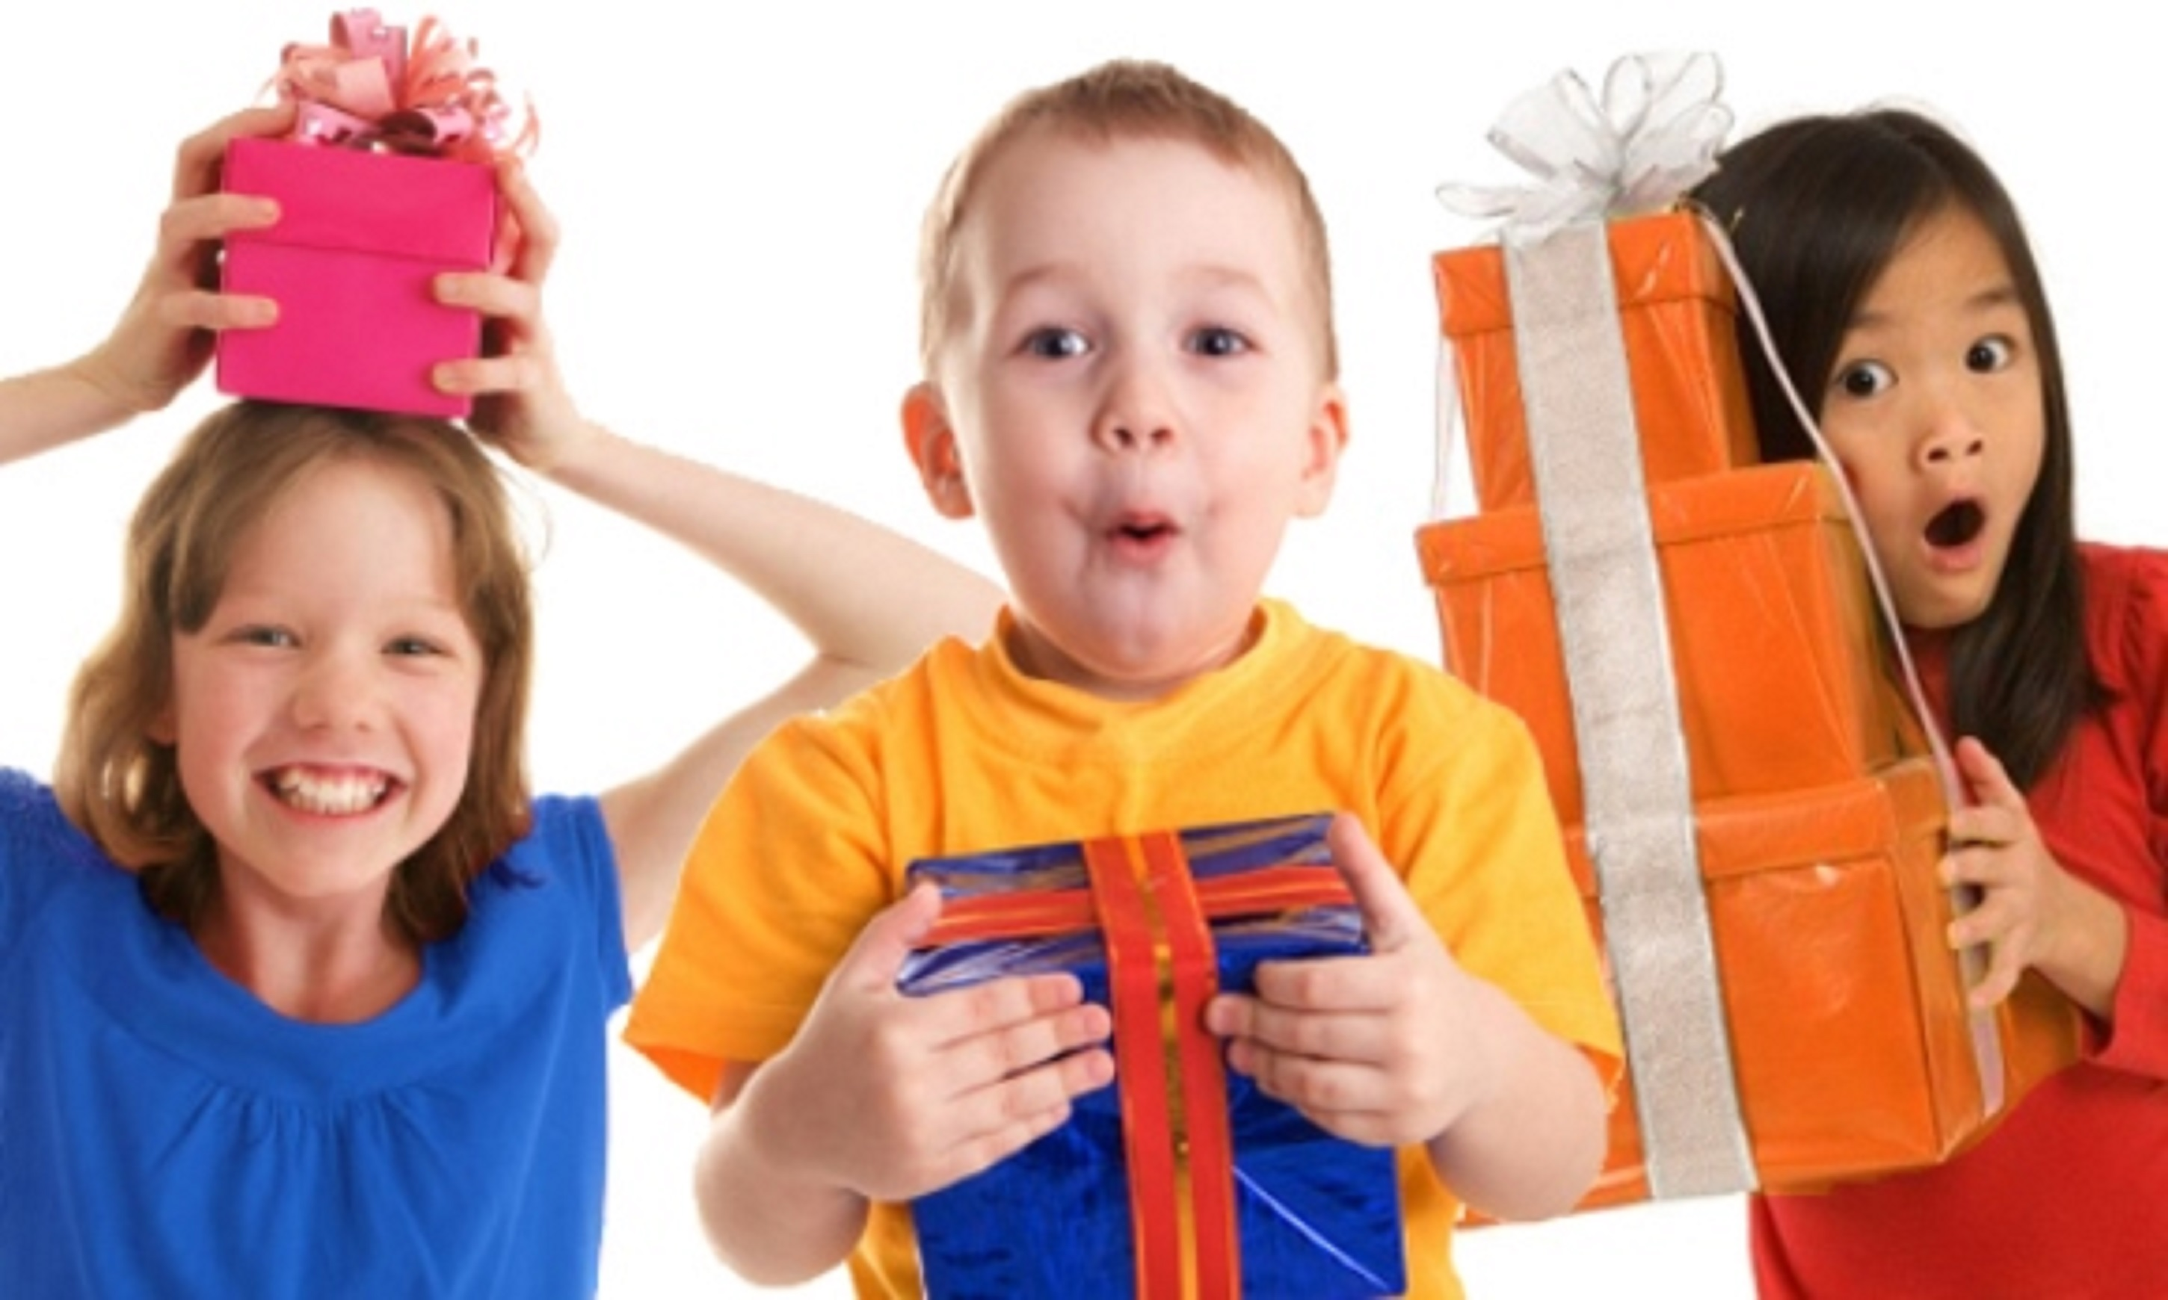
7 Days of Children’s Evangelization
^{God’s Gifts for} ^{His Children}
biblewell.org

Slide 3
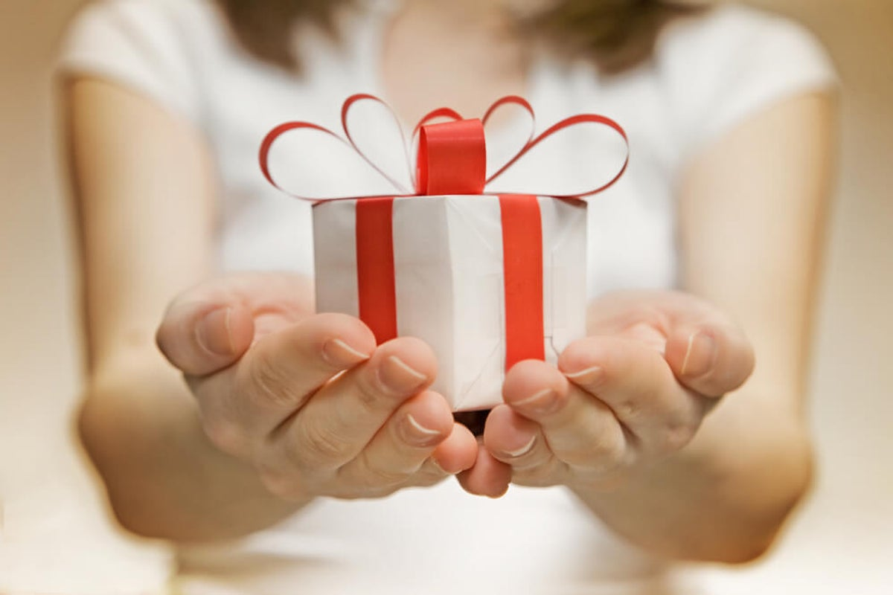
God Gives You Promises
Bible Lesson No. 7
Notes:
Bible Lesson No. 7
God Gives You Promises
Biblical base: Daniel 3; Isaiah 43:2; Matthew 7:7; Haggai 2:5;Psalms34:4; Isaiah 26:3;Psalms89:34; Psalm 27:1;Psalm 56:11; Romans 8:31; Deuteronomy 31:6; Isaiah 41:13;Luke 18:27; Isaiah 41:10; Revelation 2:10;Proverbs 16:20.
Main theme or lesson: God has given promises for each of His children.
Story: Rescued from the fiery furnace
Objectives
That the children may...
Learn that God has left us promises.
Learn about God’s promises for us.
Believe that God speaks to us through His word.
Materials
Drawings for the lesson. Theme song of the day and illustrated memory verse. Illustrative materials for prayer time. Souvenir consisting of the day’s memory verse. Materials for crafts.

Slide 4
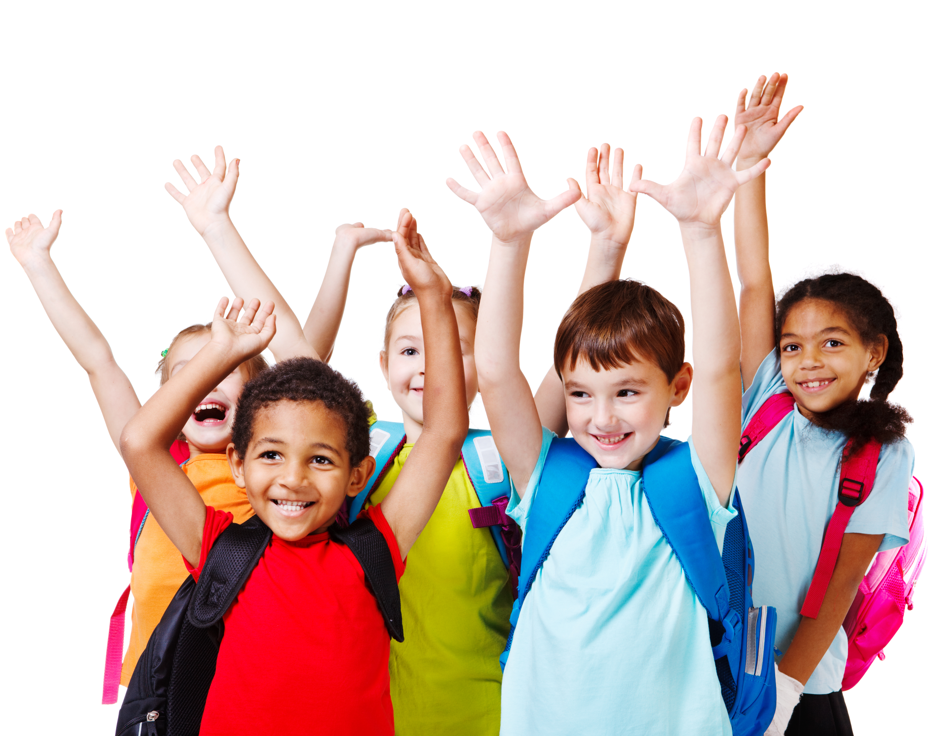
Welcome!
Notes:
Welcome
Give the welcome in a cheerful and fun way. Greet all children in a general way.

Slide 5
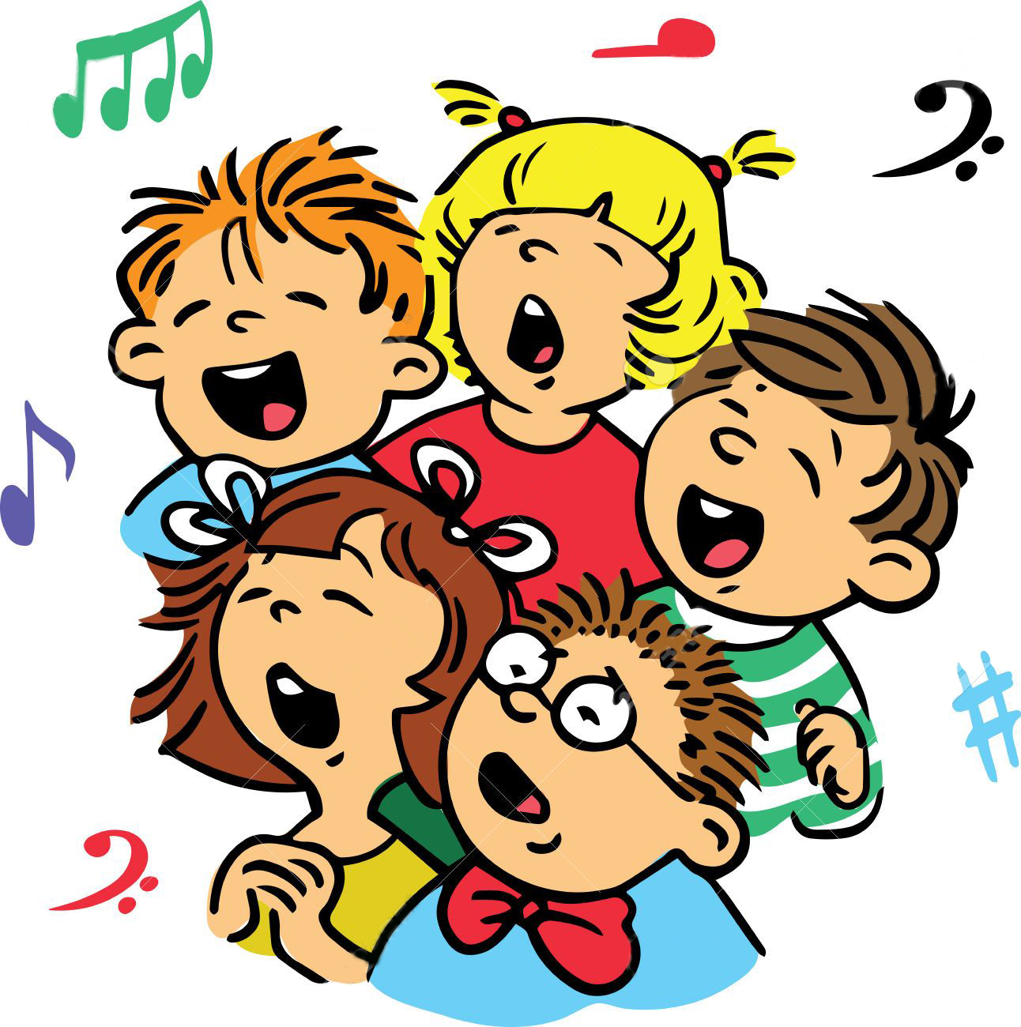
Music Time
Exodus 14:14
Notes:
Music Time
Start by teaching joyful songs that can motivate the group. You can use some greeting songs for this occasion.
Then teach the theme song. Consider the instruction booklet.
Option: Exodus 14:14 (“The Lord God He will fight, fight for you”).

Slide 6
Music Time
Exods 14:14
LORD GOD
The Lord God,
Notes:
The Lord God,

Slide 7
Music Time
He will fight for you,
Notes:
He will fight for you,

Slide 8
Music Time
The Lord God, He will fight
Notes:
The Lord God, He will fight

Slide 9
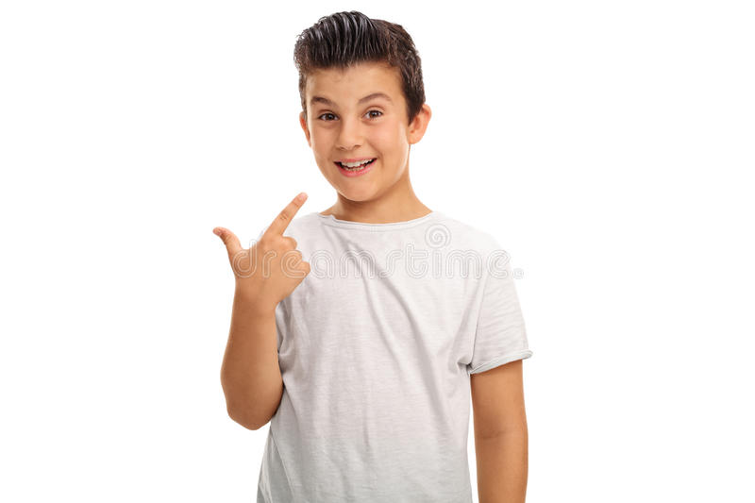
Music Time
for me.
Notes:
for me.

Slide 10
Music Time
GOD
The Lord God,
Notes:
The Lord God,

Slide 11
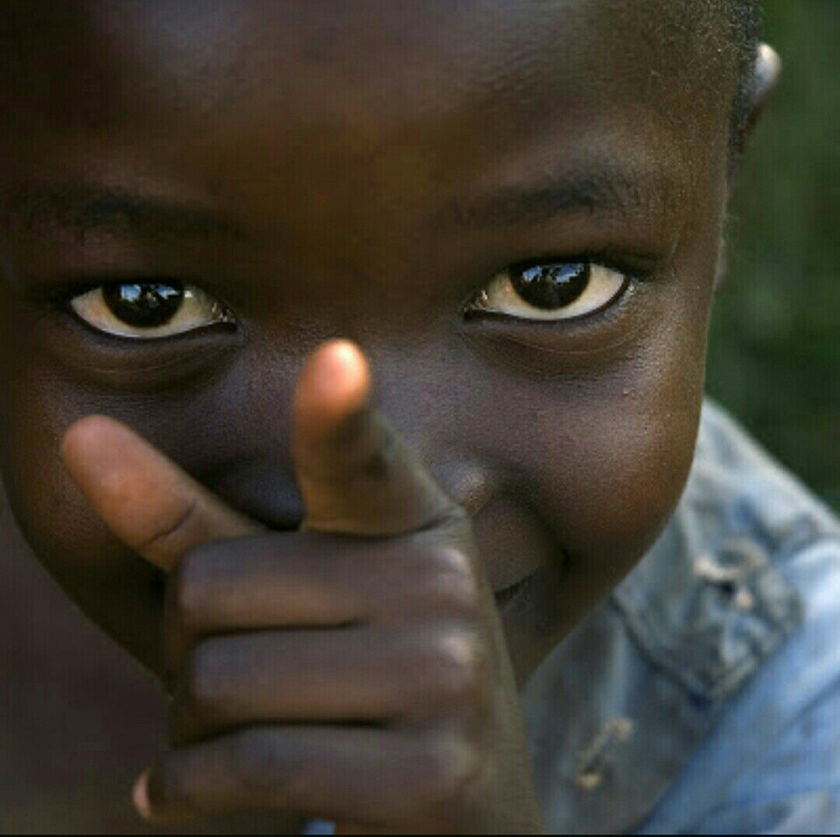
Music Time
He will fight for you,
Notes:
He will fight for you,

Slide 12
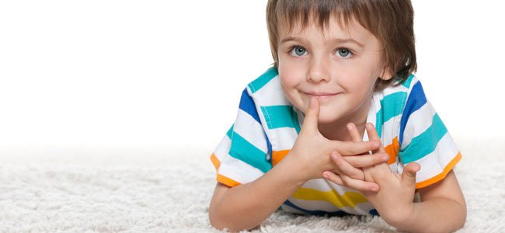
Music Time
And you need only to be still.
Notes:
And you need only to be still.

Slide 13
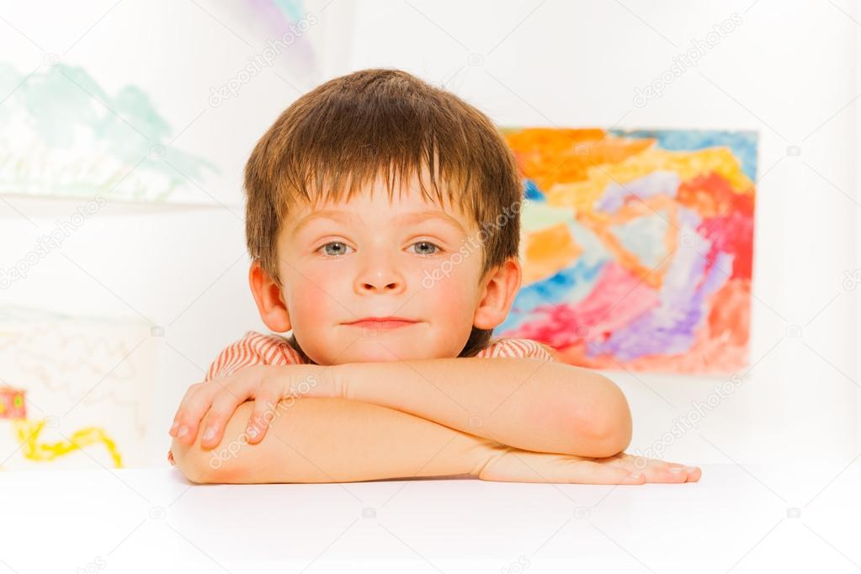
Music Time
/(And you need only to be still)/
Notes:
/(And you need only to be still)/

Slide 14
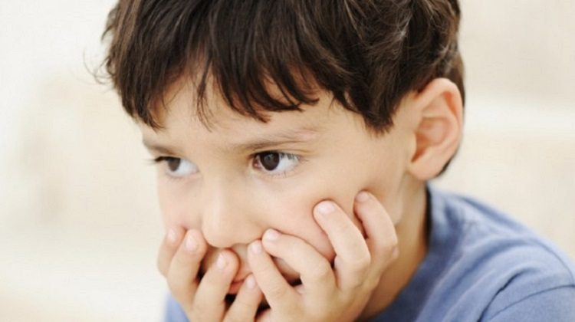
INTRODUCTION
Notes:
Introduction
Have you ever gone through a hard time? I’ve gone through a lot of hard moments. The other day, I heard about a small child who was very, very sick and sad. I was able to tell him about Jesus and he got better. We often have to go through many difficult moments. Today we will study about some boys who had an extremely difficult life.

Slide 15
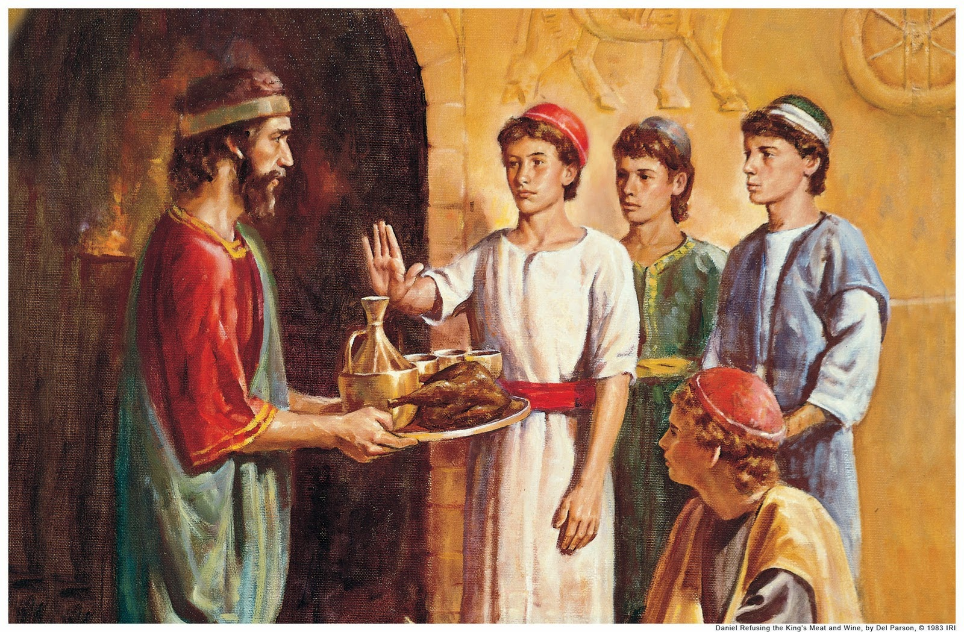
Notes:
Lesson
There was a group of young men who worked in a king’s palace. They were known for their love to God, their loyalty, and their responsibility. They did everything as they were asked to do. They knew God and knew God’s promises to each of His children and were confident that these promises would come true for their lives.
Everything they did was done with great affection, as if God Himself were with them.

Slide 16
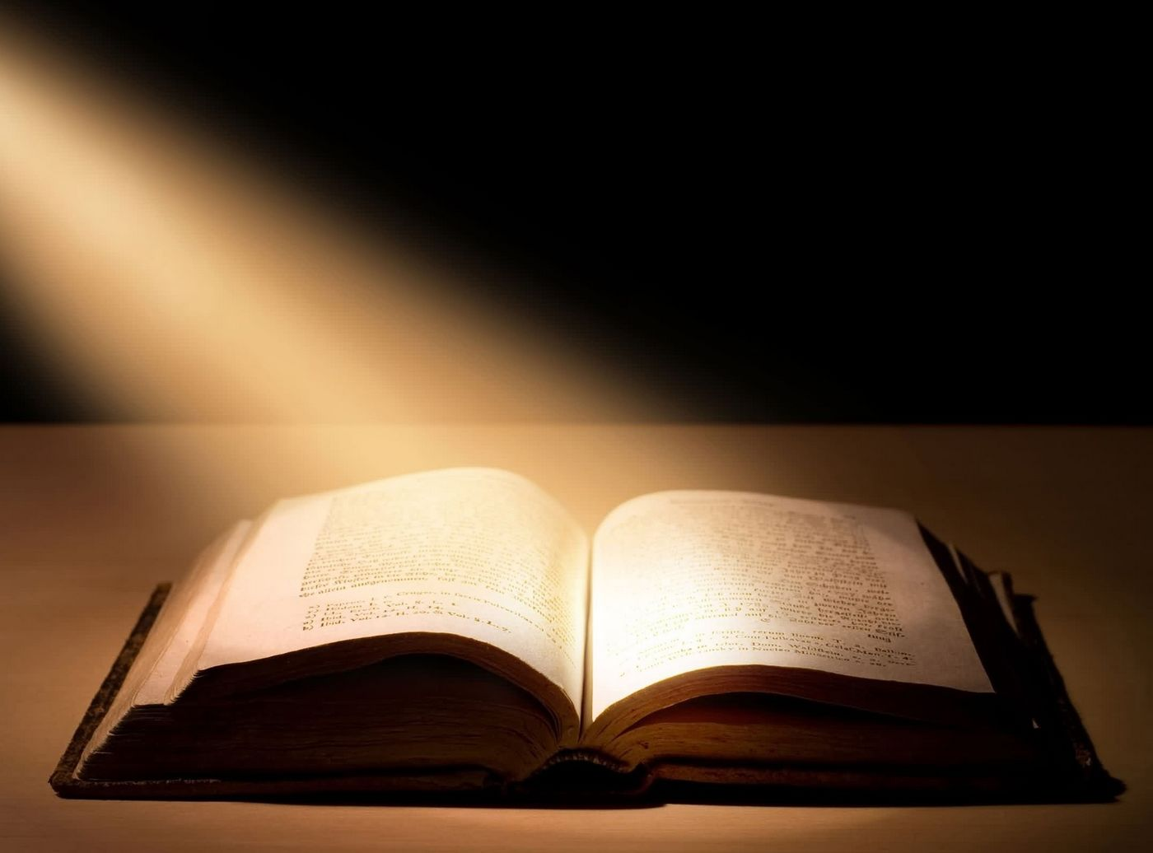
PROMISES
Notes:
Do you know what promises God has given you? I’m going to name a few:
Psalm 34:4 says, “I sought the LORD, and he heard me, and delivered me from all my fears..”
Isaiah 26:3 says, “ Thou wilt keep him in perfect peace, whose mind is stayed on thee: because he trusteth in thee.. “
And another promise says:” My covenant will I not break, nor alter the thing that is gone out of my lips..” Psalms 89:34.
The Bible has many promises ready for us, so that when the time comes, we will have them there.

Slide 17
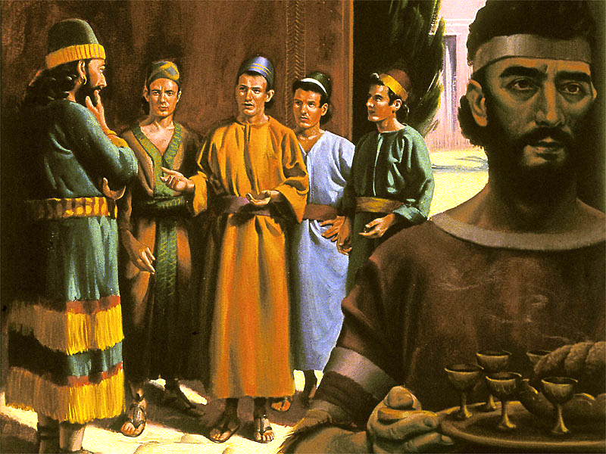
Notes:
But what happened in the story? These boys were informed that they should quickly go to a distant field. When they arrived, they saw a lot of people and they knew that they would have to worship a giant statue that was there. That statue was the image of the king himself. The three knew that they should only worship God, and now what? They had to go through a very difficult test now! ¿What would happen if they didn’t worship the statue? What if they worshiped it?! The three friends gathered together and took the decision to be faithful to God because they remembered God’s promises, for example one that is written in Revelation 2:10 “...Be thou faithful until death, and I will give thee the crown of life”.

Slide 18
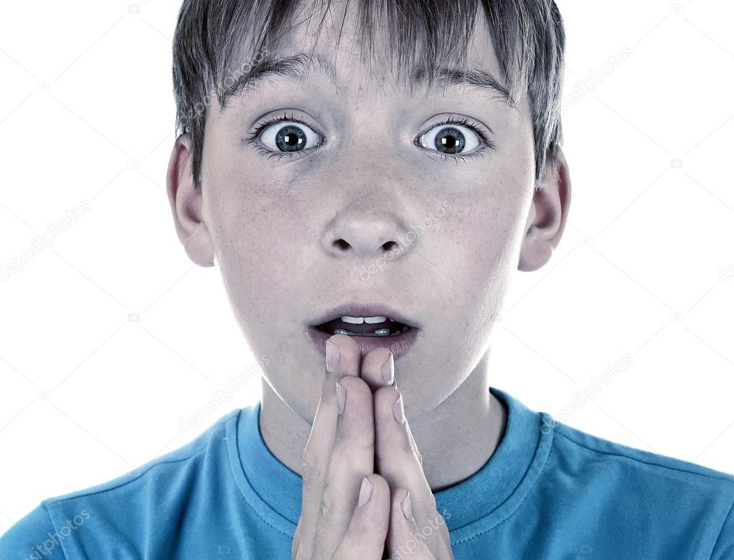
Notes:
Have you gone through tough times in your life? Never forget the Lord’s promises, “The Lord is my light and my salvation; Whom shall I fear?” David once said in Psalm 27:1. “ David also said in Psalm 56:11 “ In God have I put my trust: I will not be afraid what man can do unto me. There are many promises that we can learn and remember as we go through difficult times like these three men.

Slide 19
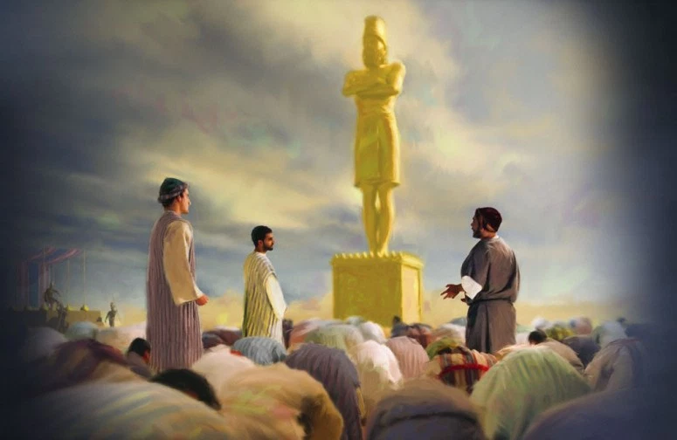
Notes:
The king was happy and proud, as he looked at the statue, and all the people were ready to worship it.
-Ha! ¡Look at that tremendous golden image that I have made to worship!
Suddenly the music sounded, and all the people gathered together and knelt down in worship. But the three friends stayed standing.
“We will not kneel before the statue,” they said.
They learned not to worship any images at home, and most importantly: they had been taught to obey God before man,” Whoso trusteth in the LORD, happy is he!” Proverbs 16:20.

Slide 20
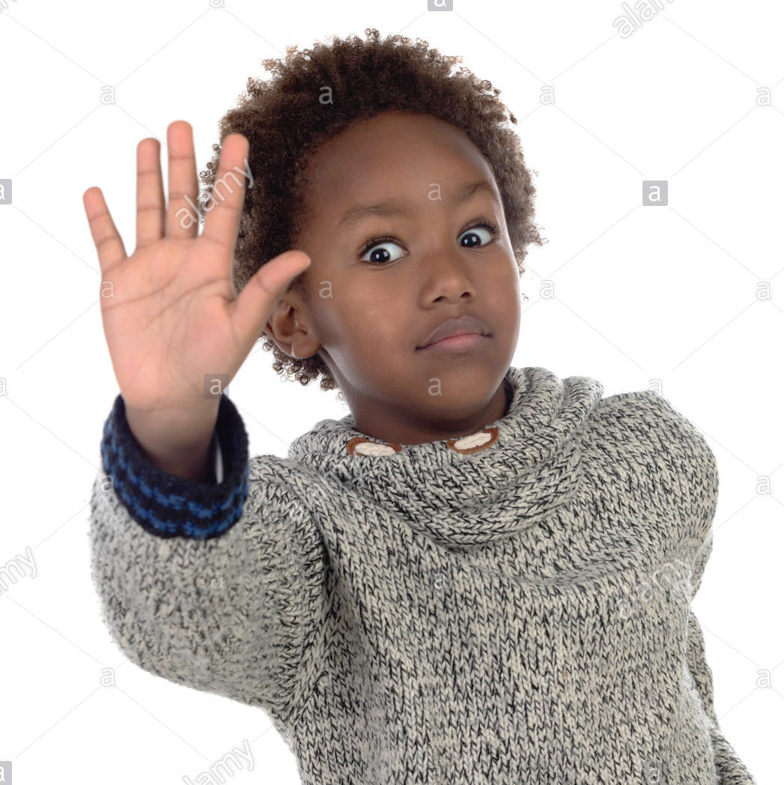
Notes:
Maybe you’re also invited to do something wrong sometimes, like making fun of someone, stealing what is not yours, or lying to your parents. God’s promise in Deuteronomy 31:6 remains firm, “Be strong and of a good courage, fear not, nor be afraid of them: for the Lord thy God, he it is that doth go with thee; he will not fail thee, nor forsake thee.”
You must always be courageous when you do the right, because the promise of the Lord states that: “Be brave and fear not, because I will be with you. “
You have to say:
-No to the bad things.
God has promised that if you are faithful, He will be with you always and will never leave you.

Slide 21
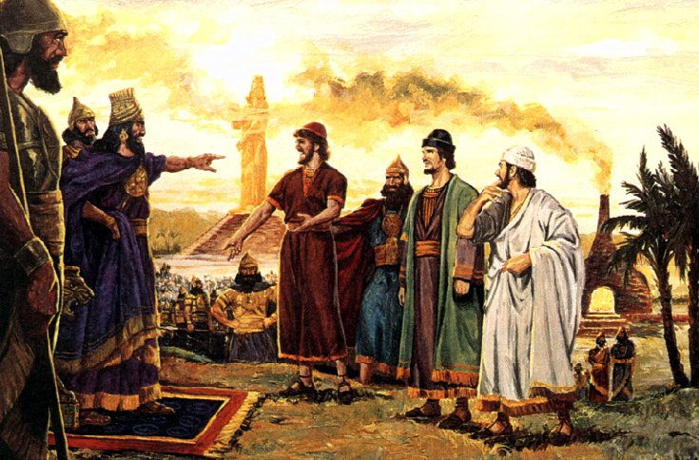
Notes:
So, what happened to the three friends? Some of the people who were worshipping the image at that event immediately went to the king when they saw the three standing and said:
-Look! There are three people who have not knelt!
The friends were sure that God would deliver them, and even if He did not, they would remain steadfast and would not kneel before the statue. The friends remembered God’s promise in Isaiah 41:10, “ So do not fear, for I am with you; do not be dismayed, for I am your God. I will strengthen you and help you; I will uphold you with my righteous right hand.” That’s what the Bible says.

Slide 22
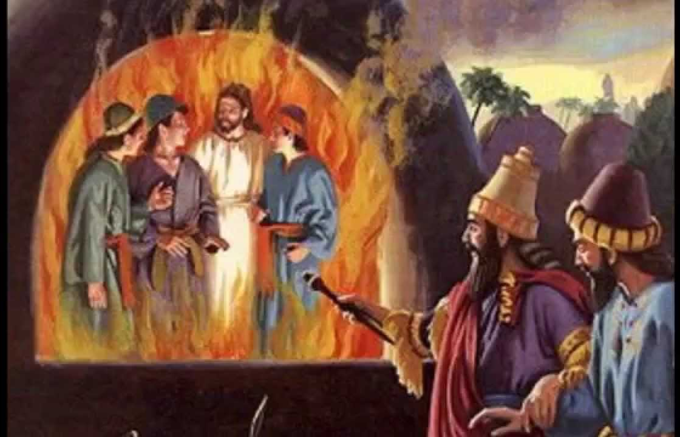
Notes:
The king was extremely angry and commanded the soldiers to heat the furnace.
-“Heat the furnace 7 times hotter than before!,” he said.
The three friends were tied up and thrown into the furnace by very strong men. But soon the king saw four people in the furnace! Hadn’t he put three in the furnace? He looked again and there were four! And the fourth was “like the son of the Gods,” said the king.

Slide 23
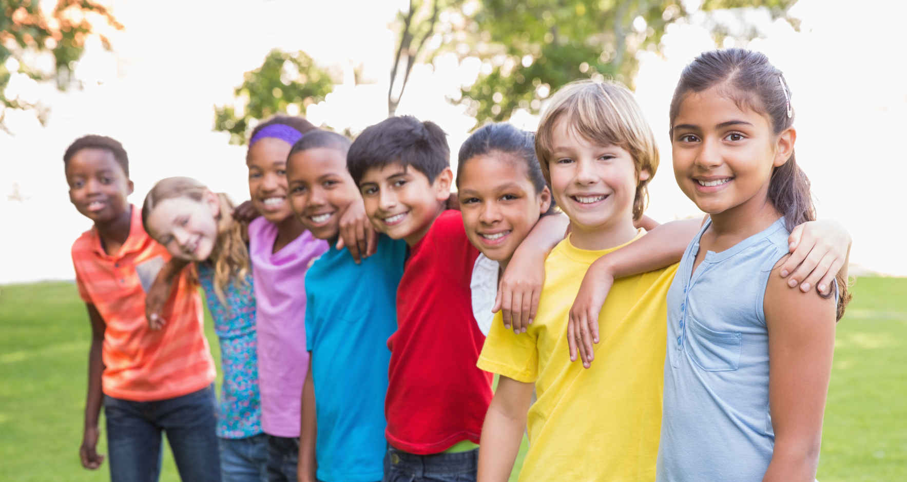
Notes:
You must always stay faithful to God, even if there are strong people who are angry at you and want to mistreat you or hurt you. Jesus will protect you, and because you trust in His promises, you can be sure that Jesus will be with you at all times. He will not leave you alone under any circumstances.
Isaiah 41:13 says, “ For I the LORD thy God will hold thy right hand, saying unto thee, Fear not; I will help thee.”
Just like the friends trusted the Lord’s promise, you should also trust Him. The king approached the furnace and called the friends to come out, “one, two, three...”Three came out, not four! It was at this moment that the king recognized that the men were servants of the Most High God and He had been there with them.

Slide 24
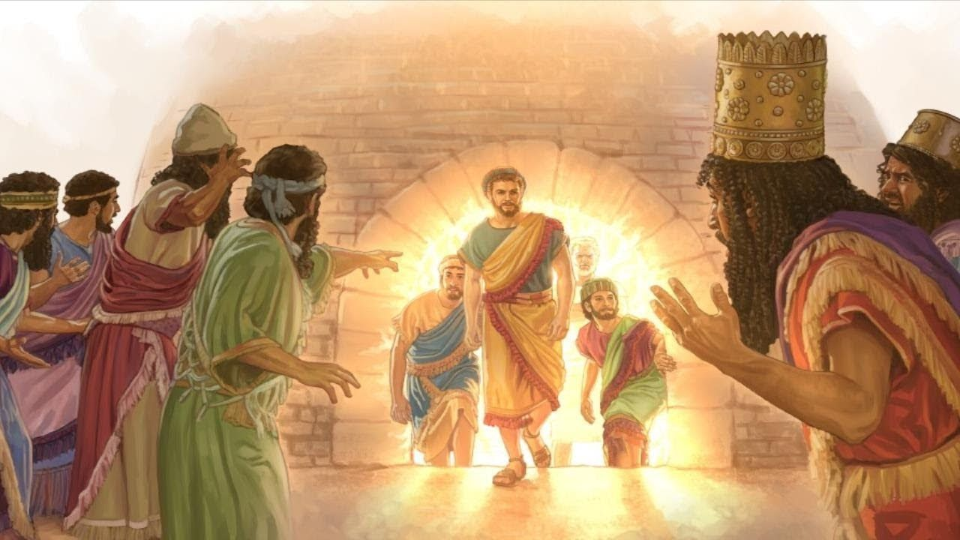
Notes:
When the young men came out, they were not hurt one bit! The only thing that had burned were the ropes with which they had been bound. Their hair, their eyes, their skin, their clothes, were perfect and no smell of fire penetrated their clothes! When they came out of the furnace, the three friends saw the soldiers who had thrown them in the furnace. They were dead on the ground along with other people who had surrounded the area. Th three friends were protected by that fourth person who was with them. It was Jesus who accompanied them into the furnace.

Slide 25
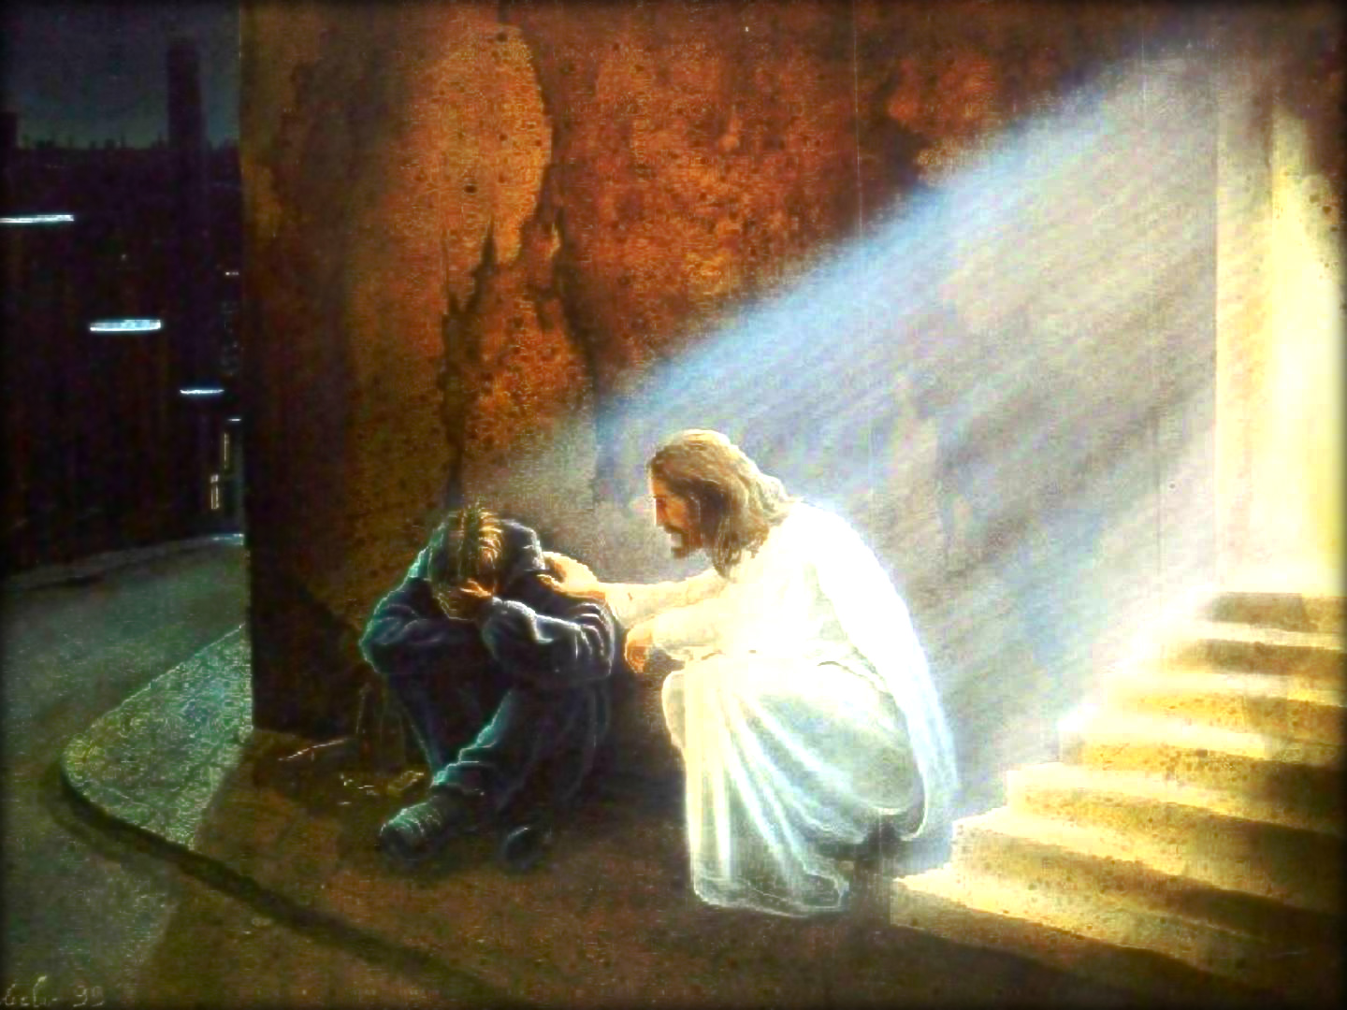
Notes:
The Lord will also protect you when you are in trouble and when your companions want you to do something wrong. When it seems like there’s no solution, God is faithful and will be at your side. In Luke 18:27 it says, “ The things which are impossible with men are possible with God..” God knows what is best for our lives, even if we do not understand it. God has a plan, but we must believe the promise that the Lord wants what is best for us and will accompany us in our lives. Our greatest desire must be to always do God’s will.

Slide 26
Isaiah 41:13
Notes:
Teaching the Memory Verse
(You may memorize the Bible verse with the children before or after the lesson.)
Let’s remember that this is a very special moment. This moment is important, because we are helping the children keep the words of God in their minds.
Prepare a large poster in advance with the verse on it.
Memory Verse:
• For I the Lord
• Thy God
• Will hold thy right hand
• saying unto thee, Fear not;
• I will help thee.
• Isaiah 41:13
Introduction: Two children will be called, one of them will sit on the ground and the other will help pick up the one on the ground by holding his right hand.
Presentation: Allow the children to read the Bible verse. The teacher will accompany the children in the reading.
Explanation: Explain the most difficult words in the verse.
Application: Talk about what God wants the child to learn about from this verse.
Repetition: Be innovative and creative in this step.

Slide 27
For I the Lord
Notes:
For I the Lord

Slide 28
Thy God
Notes:
^{Thy God}

Slide 29
Will hold thy right hand
Notes:
Will hold thy right hand

Slide 30
saying unto thee, Fear not;
Notes:
saying unto thee, Fear not;

Slide 31
y te dice: No temas,
Notes:
y te dice: No temas,

Slide 32
I will help thee.
Notes:
I will help thee.
• Isaiah 41:13

Slide 33
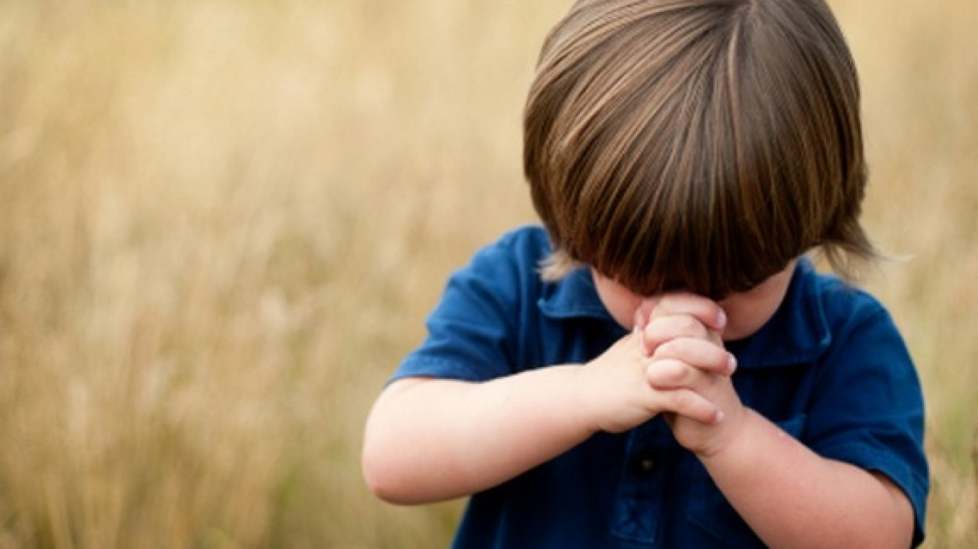
Prayer Time
Notes:
Prayer Time
Let’s talk to God. We’ve been talking about prayer these last few days, and today we will give the opportunity for a child in our class to pray alone. He will pray to God with his heart’s desires.

Slide 34
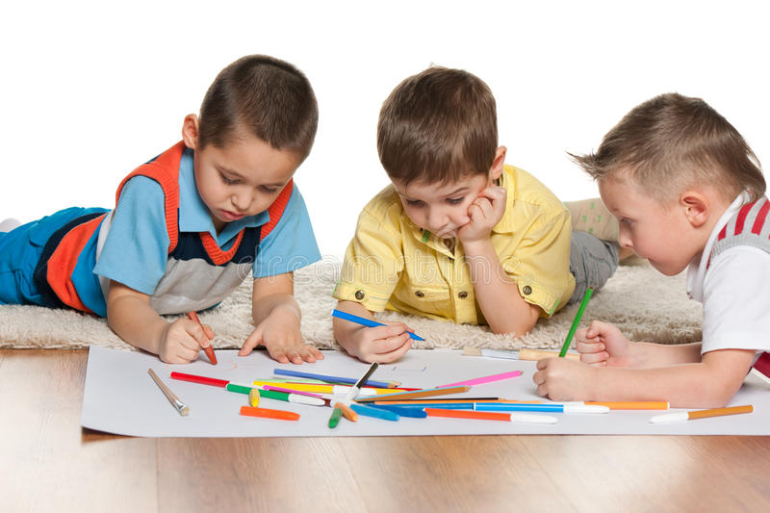
ACTIVITIES
Notes:
Activities
Children +8: Write some of Gods promises for the children to take with them and share it with their companions, friends, neighbors and anyone else who might be going through a difficult time. Write them on a nice colored paper.
Children 0-7: Color the drawing.

Slide 35
Thank you, Lord, for giving me promises written in your Word.
Notes:
Conclusion
Thank you, Lord, for giving me promises written in your Word.

Slide 36
Music Time
Exodus 14:14
Notes:
Music Time
Start by teaching joyful songs that can motivate the group. You can use some greeting songs for this occasion.
Then teach the theme song. Consider the instruction booklet.
Option: Exodus 14:14 (“The Lord God He will fight, fight for you”).

Slide 37
Music Time
Exods 14:14
LORD GOD
The Lord God,
Notes:
The Lord God,

Slide 38
Music Time
He will fight for you,
Notes:
He will fight for you,

Slide 39
Music Time
The Lord God, He will fight
Notes:
The Lord God, He will fight

Slide 40
Music Time
for me.
Notes:
for me.

Slide 41
Music Time
GOD
The Lord God,
Notes:
The Lord God,

Slide 42
Music Time
He will fight for you,
Notes:
He will fight for you,

Slide 43
Music Time
And you need only to be still.
Notes:
And you need only to be still.

Slide 44
Music Time
/(And you need only to be still)/
Notes:
/(And you need only to be still)/

Slide 45
^{GOD BLESS YOU!}
biblewell.org
Notes:
GOD BLESS YOU!

