Slide 2
biblewell.org

Slide 3
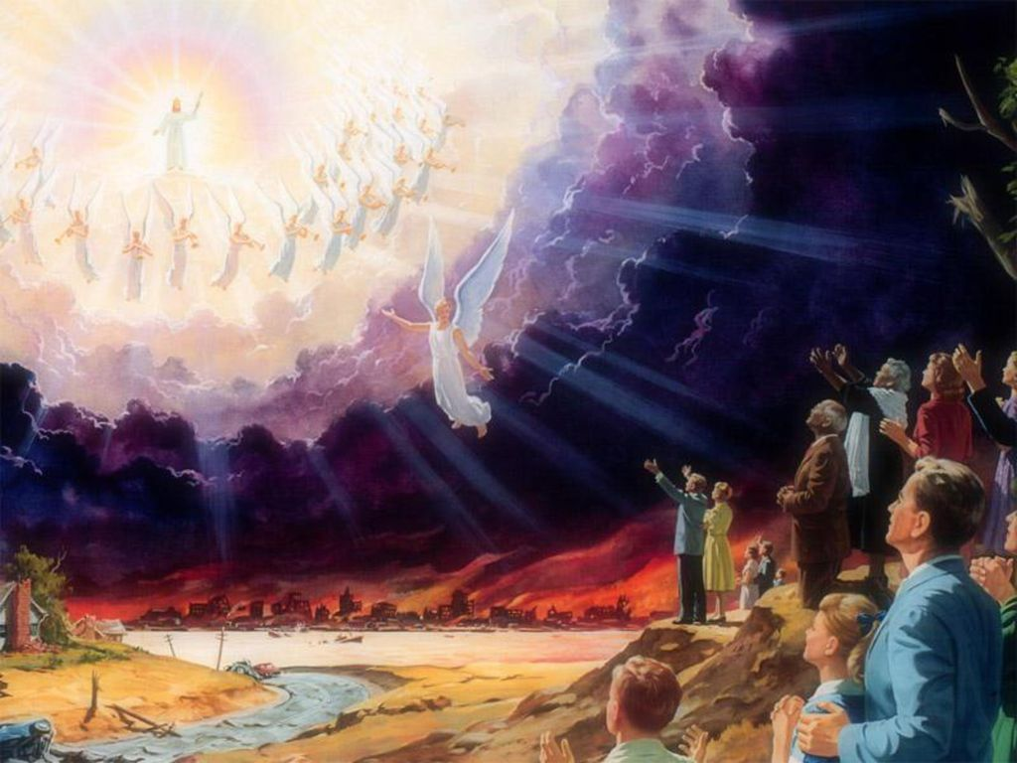
^{The Great Rescue}
Day 7
Notes:
Bible Lesson Nº 7
The Great Rescue
Biblical Reference: Mark 16:19; Revelation 21:21; Matthew 24:3-8; Isaiah 65:17;
Hebrews 10:37; Matthew 24:27; Revelation 21:4.
Main Topic: “Jesus is coming for me.”
Bible Story: The Second Coming.
Specific Objectives
That the children may:
Learn that God has prepared a place for us to go and live with Him forever.
Feel the desire to go live with him.
Memory Verse: “And if I go and prepare a place for you, I will come again, and receive you unto myself; that where I am, there ye may be also.” John 14:3.
Materials
1. Coloring pages for the lesson.
2. Theme song of the day and memory verse in illustrative pictures.
3. Illustrative materials for the time of prayer.
4. Craft activity with the memory verse of the day for each child to take home.
5. Materials for craft activities.

Slide 4
Welcome!
Notes:
Program Development
1. Welcome
Welcome everyone in a friendly, cheerful, and fun way, greeting the children in a group and general form. Present yourself and the other teachers.
Like in the last class, reward all the children who have attended the program during the week.
Encourage the children to continue attending weekly Bible studies or invite them to church.

Slide 5
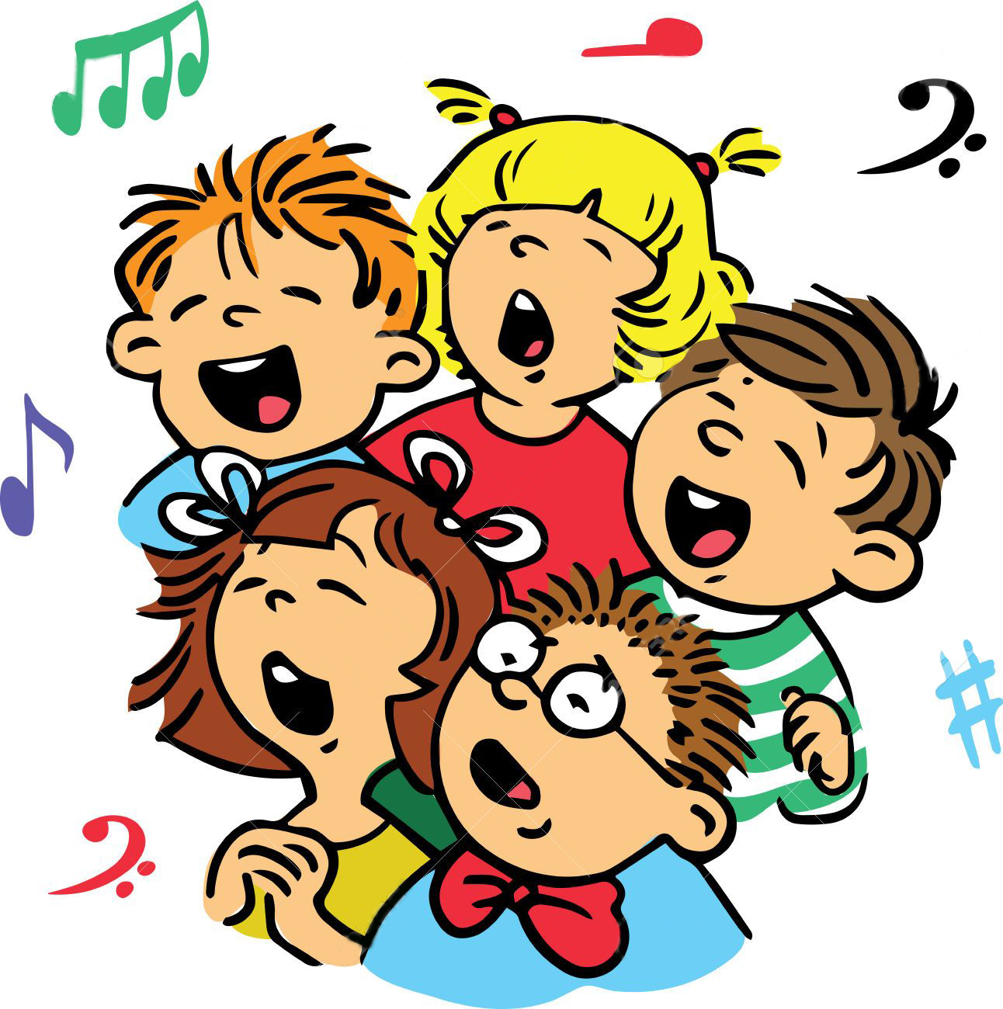
Musical moment
Notes:
2. Musical Moment
Start the program with cheerful songs, like every other day.
You can let the children pick their favorite song from the series.
Teach them the theme song and the song of the day.

Slide 6
Musical moment
S.O.S I am so lost
S.O.S come Lord save our souls
S.O.S I am so lost
S.O.S come Lord save our souls
Notes:
S.O.S I am so lost
S.O.S come Lord save our souls
S.O.S I am so lost
S.O.S come Lord save our souls

Slide 7
Musical moment
Now a long long time ago
he came to earth
To deliver us
He died for you and me
Notes:
Now a long long time ago
he came to earth
To deliver us
He died for you and me

Slide 8
Musical moment
Such a sinner I
So undeserving too
Yet he gave his life
To rescue me and you
Notes:
Such a sinner I
So undeserving too
Yet he gave his life
To rescue me and you

Slide 9
Musical moment
S.O.S I am now free
S.O.S the Lord has rescued me
S.O.S I am now free
S.O.S The Lord has rescued me
Notes:
S.O.S I am now free
S.O.S the Lord has rescued me
S.O.S I am now free
S.O.S The Lord has rescued me

Slide 10
BIBLICAL LESSON
Notes:
3. Lesson
Today is our last day but today’s story is beautiful. Are you ready to start? You’ve learned a lot, right?
Do you remember everything we studied?
Let’s see:
We have studied that God gave us the world because he loves us and that man did not listen to God and turned away from him and now we are all sinners.
We also studied that God devised a great rescue plan for man?
That he came to save us, that he died for our sins.
We learned that he can live in our hearts and be our life preserver.
That though storms come he will always be our help.
We learned that we must rescue others by telling what we have learned from the Bible.
And today we will talk about a great rescue, the ultimate super rescue.
Let’s listen to the story.

Slide 11
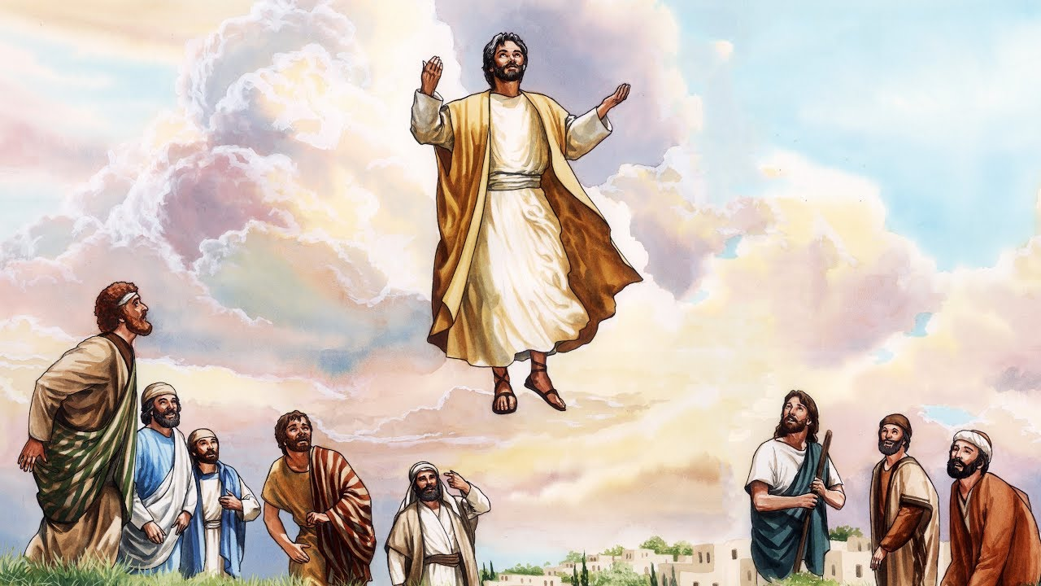
Notes:
After Jesus died on the cross he was with his disciples one more time.
And he made them a promise: “In my Father’s house are many mansions: if it were not so, I would have told you. I go to prepare a place for you. And if I go and prepare a place for you, I will come again, and receive you unto myself; that where I am, there ye may be also.” John 14:2-3. After this he ascended to heaven while his disciples saw him and now he is living with God.
The bible says in Mark 16: 19: “So then after the Lord had spoken unto them, he was received up into heaven, and sat on the right hand of God.” That is to say, at God’s side.
Now in heaven there is God, Jesus and many, many angels.

Slide 12
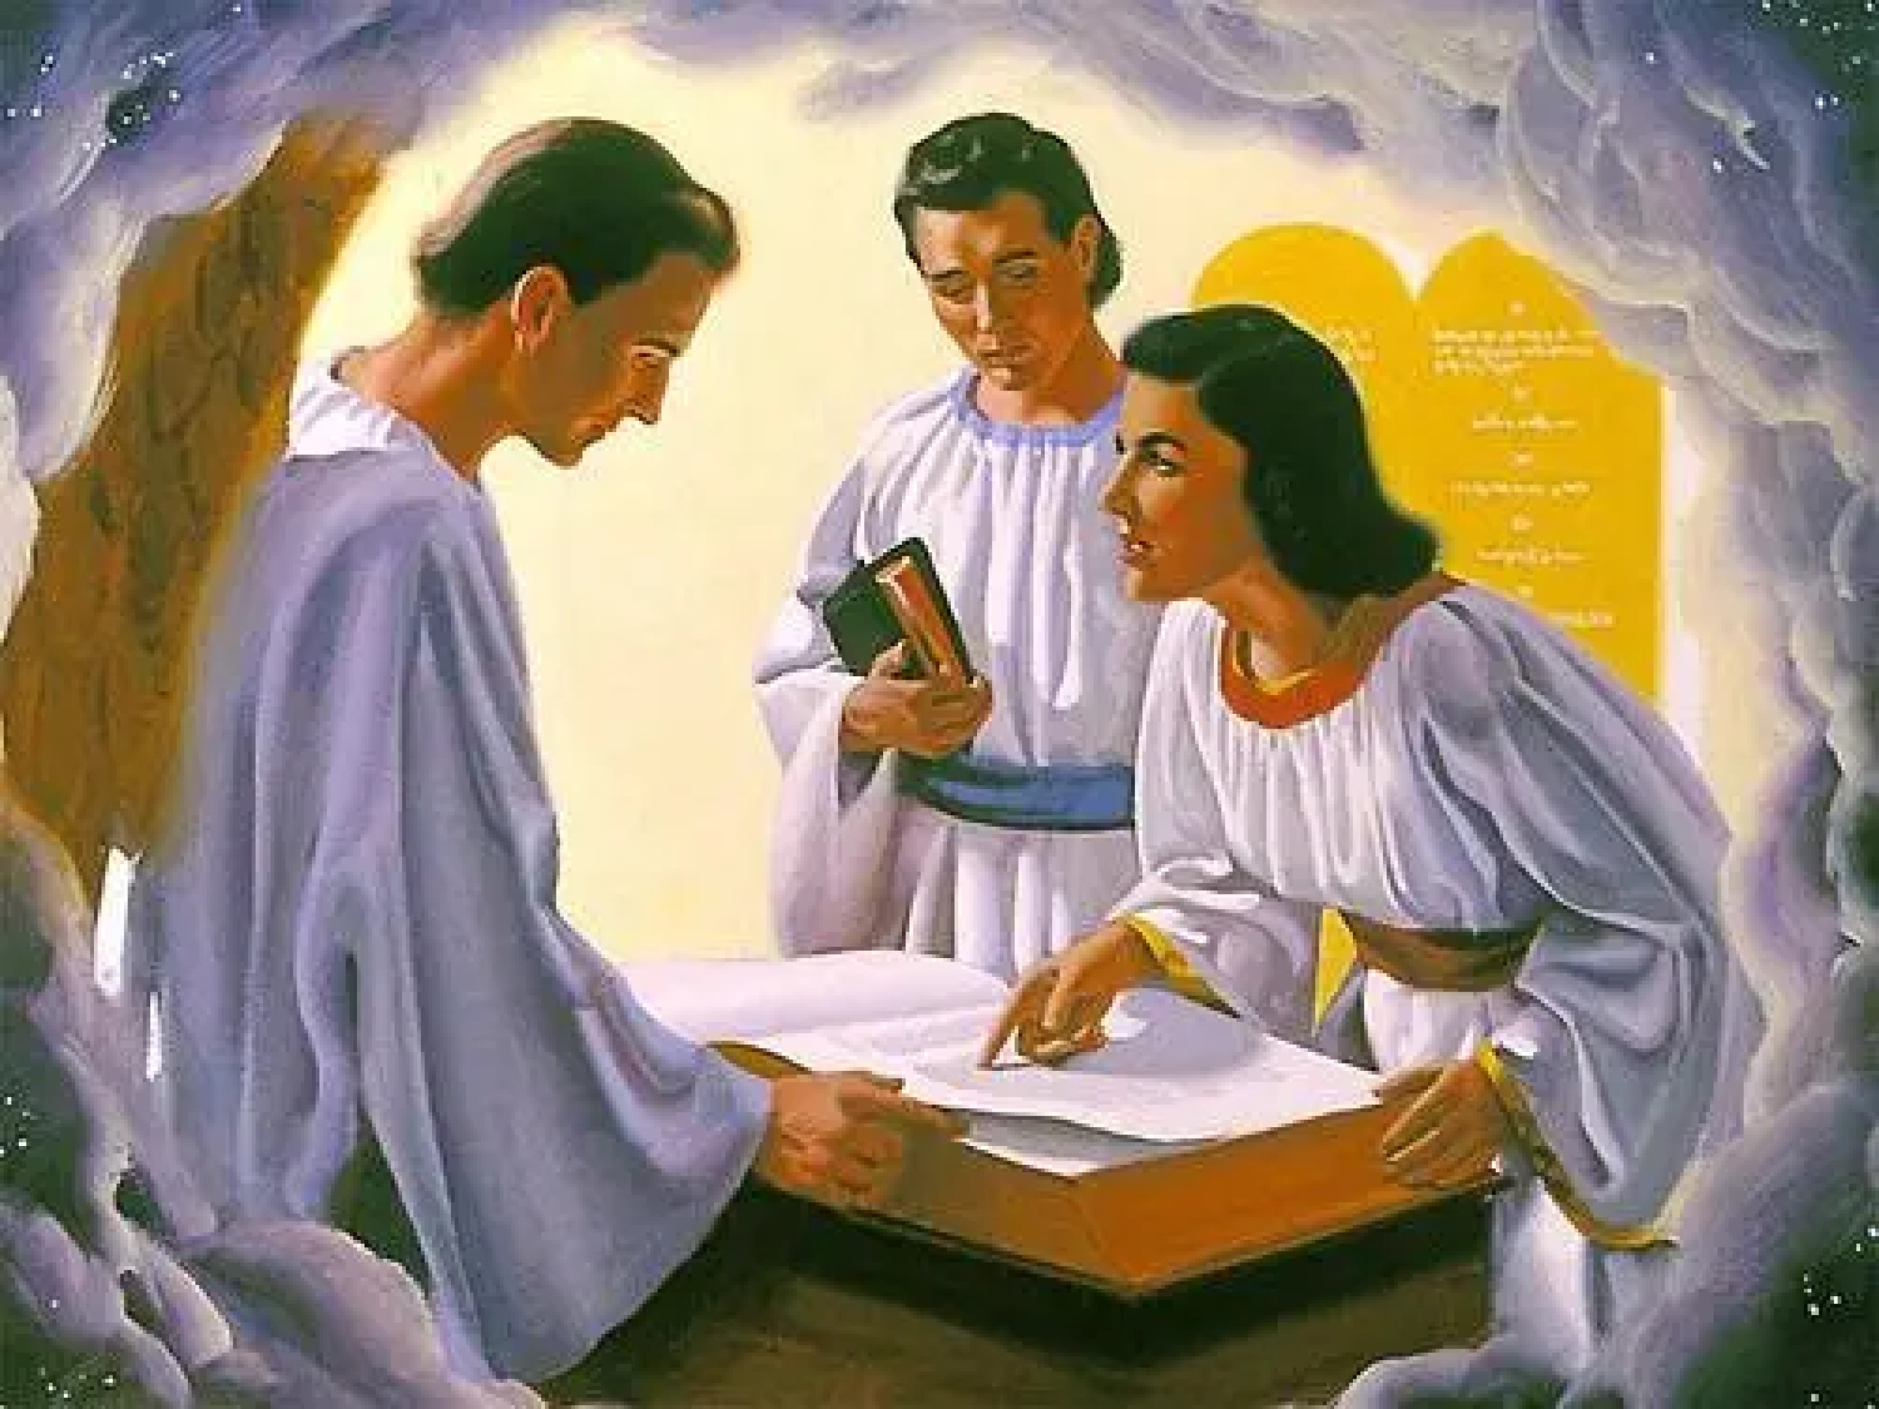
Notes:
You know?
The rescue plan for man was almost finished.
Now Jesus was back in heaven. Do you know what Jesus is doing in heaven?
He is interceding before God for man.
When we commit sins, for example, when we lie and we realize that it is not right, we must do two things. Ask forgiveness from the person we have lied to and then ask God for forgiveness. Repent of having sinned.
When we commit sins, they are written down in a book. And when we repent Jesus says to the father. Look, I died for this child who lied. Then Jesus writes in the book. Forgiven.
When we repent Jesus shows, before the father, his hands saying that he died in our place so we are forgiven.
Wonderful isn’t it?
God wants us to go and live with him forever in heaven. He wants all those who believe in him to go and live with him. All the children of God. And so now he is preparing a place where there will be no more sin. A wonderful place, a heavenly city.
How extraordinary!

Slide 13
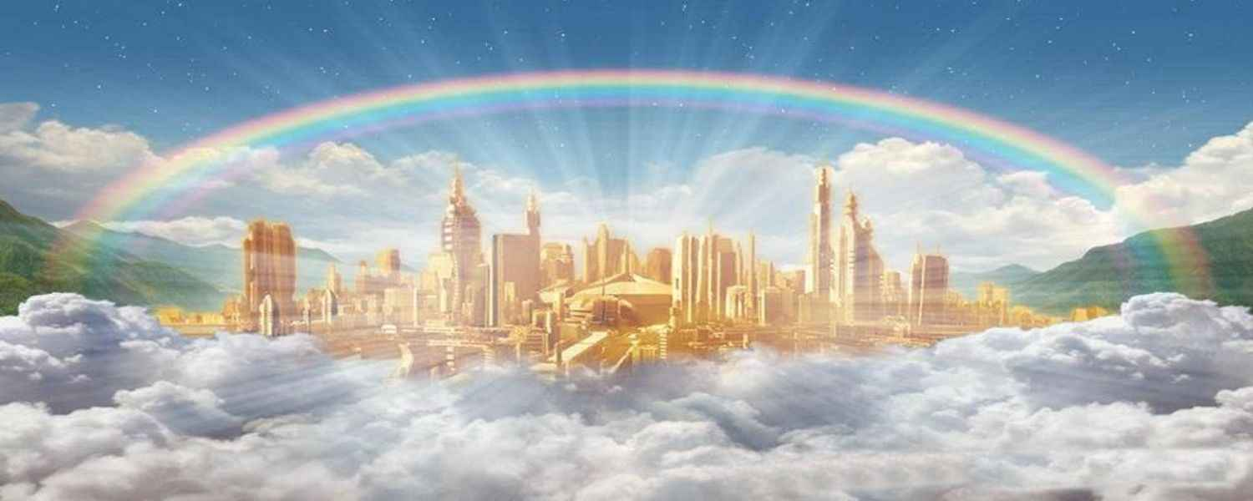
“For, behold, I create new heavens and a new earth: and the former shall not be remembered, nor come into mind” Isaiah 65:17.
Notes:
Remember this week we talked about what the golden city will be like?
“And the twelve gates were twelve pearls; every several gate was of one pearl: and the street of the city was pure gold, as it were transparent glass.” Revelation 21: 21
Just close your eyes and imagine this special place. Gates of pearl... streets of gold... Everything shining.
“For, behold, I create new heavens and a new earth: and the former shall not be remembered, nor come into mind,” Isaiah 65: 17
A city where only joy reigns, a city without sorrow or evil. A place where we will remember no evil. A new earth.

Slide 14
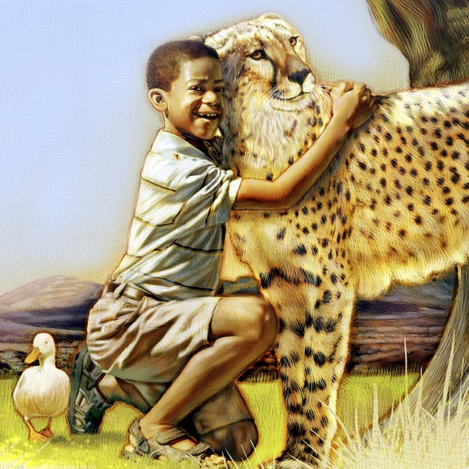
Notes:
And you…
Would you like to live with Jesus in heaven?
The sea of glass
Playing with the animals. To run through the meadows. To be with Jesus forever.
It will be wonderful.
Who would you like to go to heaven with? I want to go with my children, my husband, my brothers and sisters and my parents. Oh, of course I want to go with you and thousands of little friends who are watching.

Slide 15
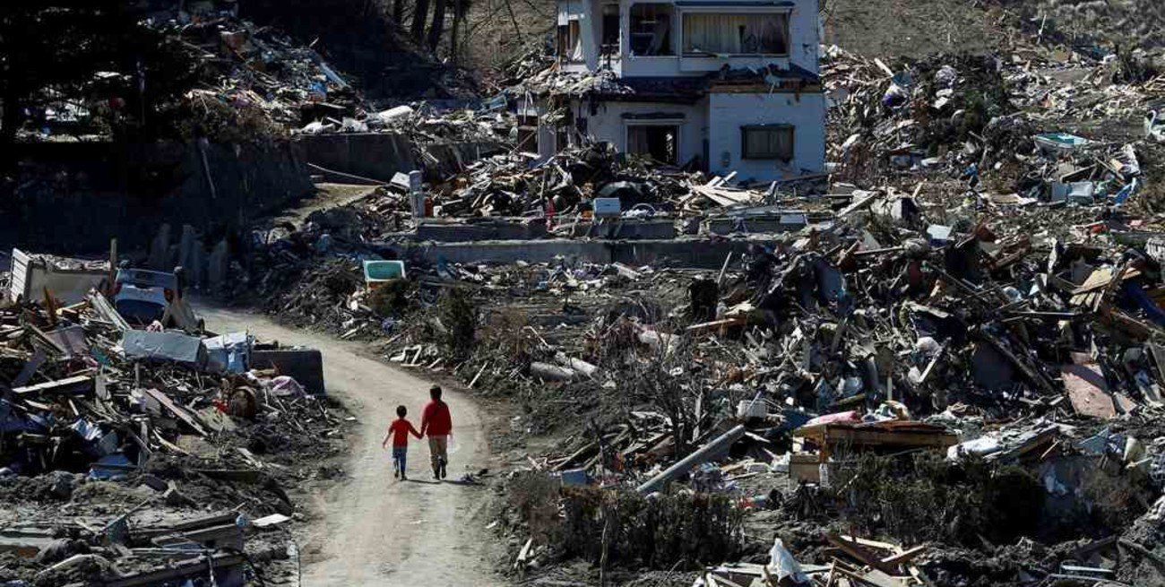
Notes:
You know?
Jesus gave the signs of when he would come.
The Bible says that Jesus was asked.
Tell us, when will these things be, and what sign will there be of thy coming, and of the end of the age?
“And Jesus answered and said unto them, Take heed that no man deceive you. For many shall come in my name, saying, I am Christ; and shall deceive many. And ye shall hear of wars and rumours of wars: see that ye be not troubled: for all these things must come to pass, but the end is not yet. For nation shall rise against nation, and kingdom against kingdom: and there shall be famines, and pestilences, and earthquakes, in divers places. All these are the beginning of sorrows.” Matthew 24: 4-8

Slide 16
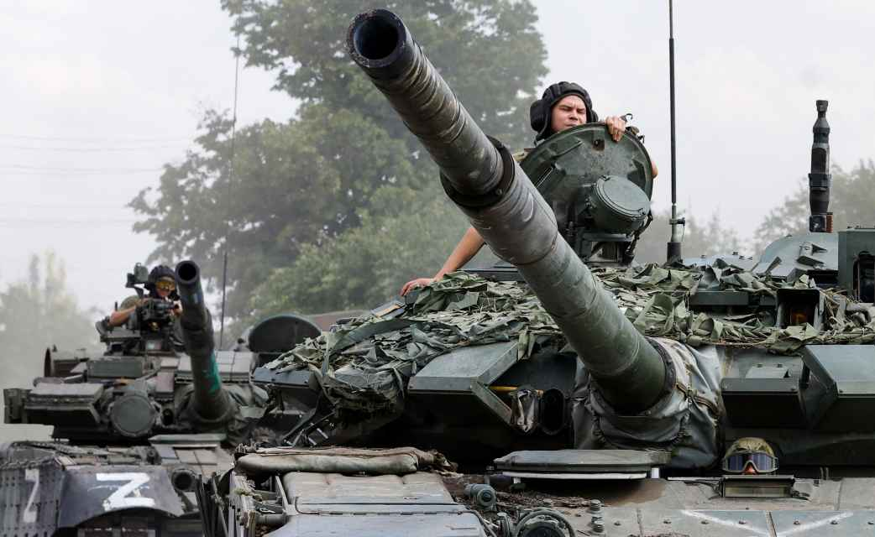
“For yet a little while, and he that shall come will come, and will not tarry” Hebrews 10:37
Notes:
And...
Now we see many of these signs.
There is war in Ukraine and in other countries. Surely you have seen pictures on the internet or on television.
Many children are starving to death and there is also an increasing lack of food. There are children who eat only once a day, or every other day. There are children who beg for bread in the street because they have nothing to eat. Or children who eat only at school when someone gives them something.
Pestilences like covid 19 still exist almost everywhere in the world. Have you had covid? Surely you have had covid or you know someone who has had covid.
I have been sick and it was not nice to go through this sickness.
I have also heard of other pestilences like monkeypox which is already in several countries.
But there are other signs.
Earthquakes and tidal waves that we see on the news. Many children probably already know what an earthquake is.
The whole floor moves very severely. The walls, the roof, and many times the walls fall down.
Where I live there are many strong earthquakes.
What about tidal waves? It’s an earthquake in the sea, and the sea that goes towards the city.
Every day we see all these signs of the coming of Jesus.
How sad is it? Sad because some of us are afraid of all that. But that should remind us that these are signs that we will soon live with Jesus forever. That is why we should not be afraid but happy that we will live with Jesus.
The Bible says: “For yet a little while, and he that shall come will come, and will not tarry.” Hebrews 10:37

Slide 17
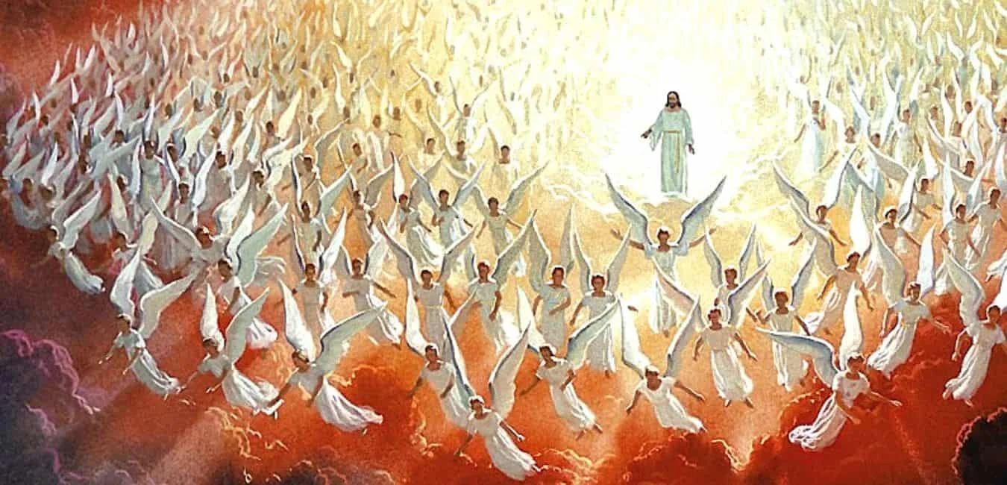
“Behold, he cometh with clouds; and every eye shall see him, and they also which pierced him: and all kindreds of the earth shall wail because of him. Even so, Amen” Apocalipsis 1:7
Notes:
I ask you something: How will Jesus come?
Revelation 1:7 says, “Behold, he cometh with clouds; and every eye shall see him, and they also which pierced him: and all kindreds of the earth shall wail because of him. Even so, Amen.”
Jesus will come in the clouds and all of us will be able to see Him coming. Even those who hurt Jesus the most will see Him.
He will not come alone. He will come with thousands of angels blowing trumpets.
How beautiful! Can you imagine how it will all happen?
A small cloud in the sky coming closer and closer to the earth. A cloud and a spectacular sound of angels.
Some people who are not ready will be very, very afraid. Others will be happy because they will be waiting for the Lord. They will be ready to go and live in heaven.

Slide 18
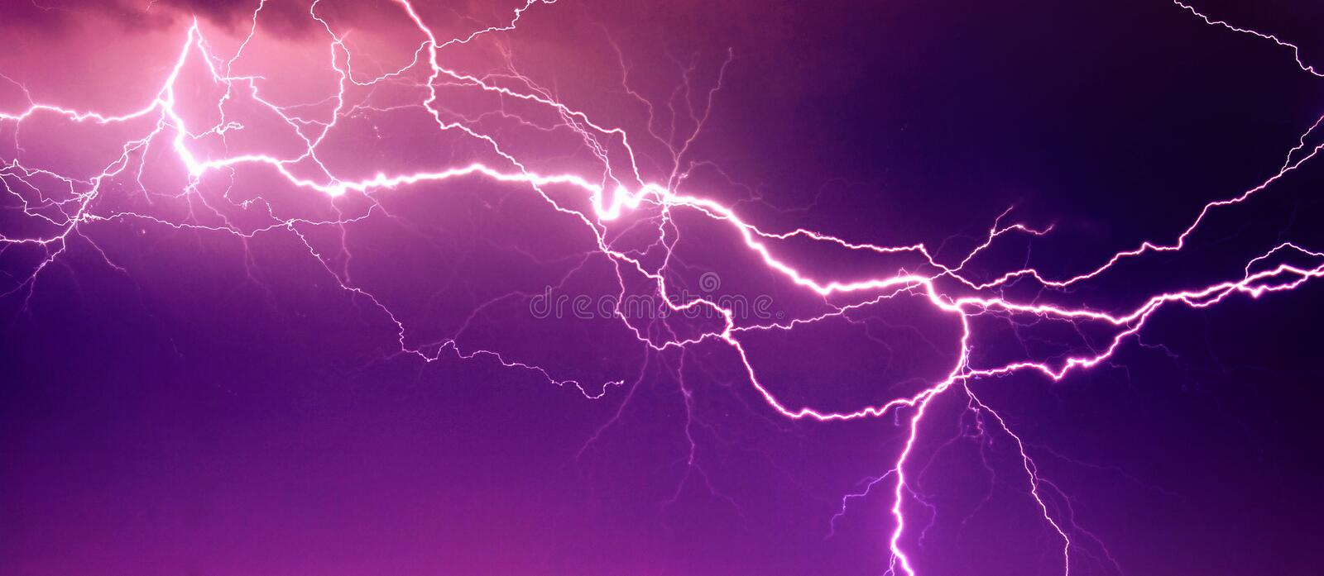
“For as the lightning cometh out of the east, and shineth even unto the west; so shall also the coming of the Son of man be” Matthew 24:27
Notes:
The Bible says in Matthew 24:27, “For as the lightning cometh out of the east, and shineth even unto the west; so shall also the coming of the Son of man be.”
We will all be able to see Jesus. As the lightning that we all see, so shall the coming of Jesus be.
Then we will go with Jesus on this great journey to heaven. This trip will last 7 days. We will travel through the planets and it will be spectacular.
When we get to heaven Jesus will give us a crown and a harp when we get there.
And we will live there forever.

Slide 19
“And God shall wipe away all tears from their eyes; and there shall be no more death, neither sorrow, nor crying, neither shall there be any more pain: for the former things are passed away” Revelation 21:4
Notes:
Revelation 21:4 says, “And God shall wipe away all tears from their eyes; and there shall be no more death, neither sorrow, nor crying, neither shall there be any more pain: for the former things are passed away.”
We will no longer suffer there, we will no longer lose our friends, there we will all be happy.
We will play with the lion, we will fly to other worlds and learn about everything in creation.

Slide 20
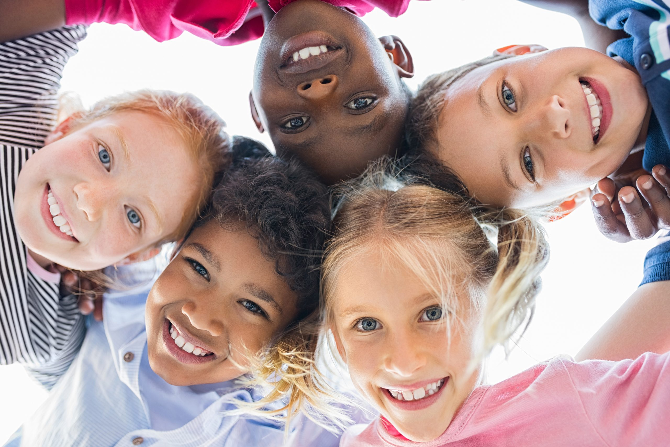
Notes:
Yes, I can’t wait to go to live in heaven with Jesus, what about you, do you want to go to live with him in heaven?
How I wish I could meet the children of Colombia, Peru, Mexico, America, Spain, Philippines, Ukraine, Italy. To be able to hug them tightly. Together we can play and talk with Jesus.
For this we must prepare ourselves to live with him forever.

Slide 21
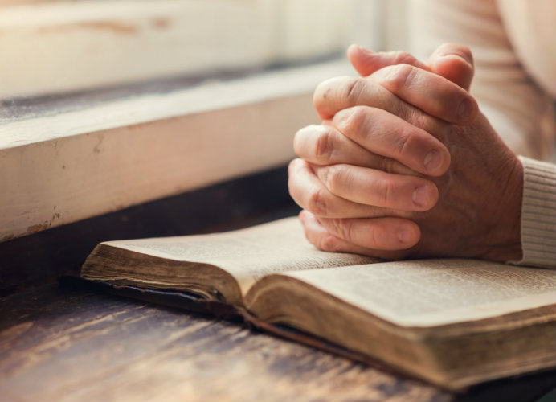
Obey God’s word.
Read the Bible every day.
Talk to God through prayer
Go and listen to more of the Bible.
Notes:
But how can we prepare ourselves?
We see that we need to:
1. Obey God’s word.
2. Read the Bible every day.
3. Talk to God through prayer
4. Go and listen to more of the Bible.
Then you will know how to do God’s will. Learning more and more every day about God and his plan to save us.
And when we get there, to heaven, the great rescue of man will be over. That rescue plan he made to save us will be finished.
There we will be able to live with him forever, far from sin and saved forever.

Slide 22
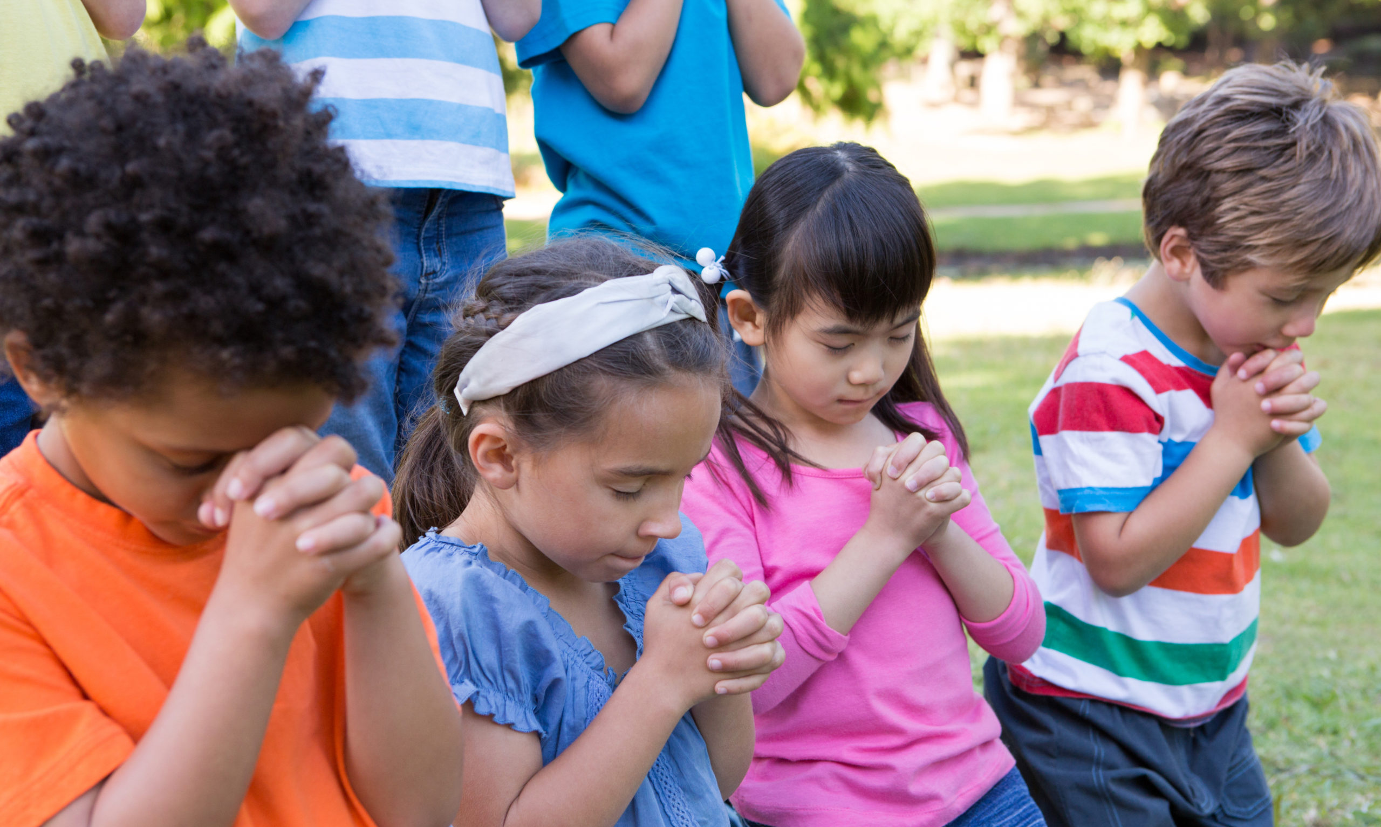
Notes:
Why don’t we thank God for this great rescue?
For the great rescue He planned for us. Let’s pray
Our Father who art in Heaven. We give you thanks for this great RESCUE plan that you made to save us. Thank you for the city of Gold that you are preparing so that I might go live there. Thank you for all of these children that have heard and that also want to go to heaven. We thank you for the opportunity you give us to be there with you. Thank you for what you’ve taught us the last 7 days. I ask you to forgive my sins. I ask you to help me to be prepared every day for your coming. Help me to tell other children about you and to go on this great trip with you when you come to get me in the clouds. Amen.

Slide 23
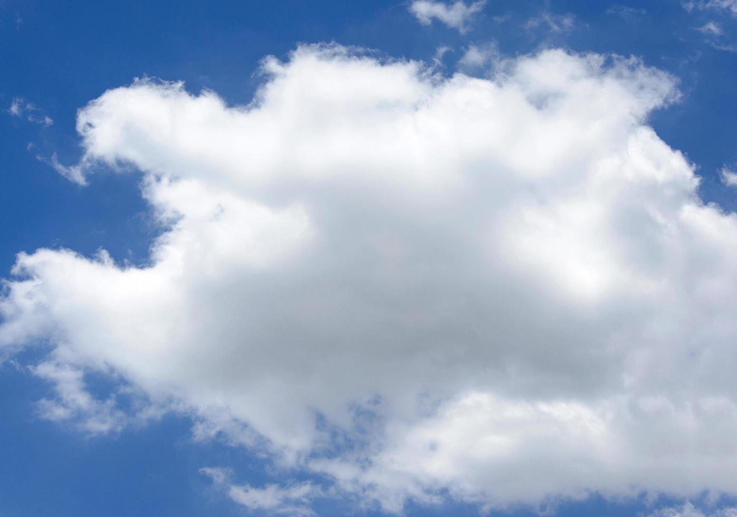
John 14:3
Notes:
4. Teaching the Memory Verse
This moment is important, as we are engraving the very word of God in the hearts and minds of our children.
Review the instruction manual to remember how to teach the verse.
Today’s verse is:
“And if I go and prepare a place for you, I will come again, and receive you unto myself; that where I am, there ye may be also.” John 14:3.
Divide the verse into four parts and paste them in a cloud.
Don’t forget to follow each step of teaching the verse especially providing the explanation of the verse. That way, you’ll leave the lesson and verse engraved in the minds of the children.

Slide 24
“And if I go and prepare a place for you,
Notes:
“And if I go and prepare a place for you,

Slide 25
I will come again,
Notes:
I will come again,

Slide 26
and receive you unto myself;
Notes:
and receive you unto myself;

Slide 27
that where I am, there ye may be also”. John 14:3
Notes:
that where I am, there ye may be also”.
John 14:3

Slide 28
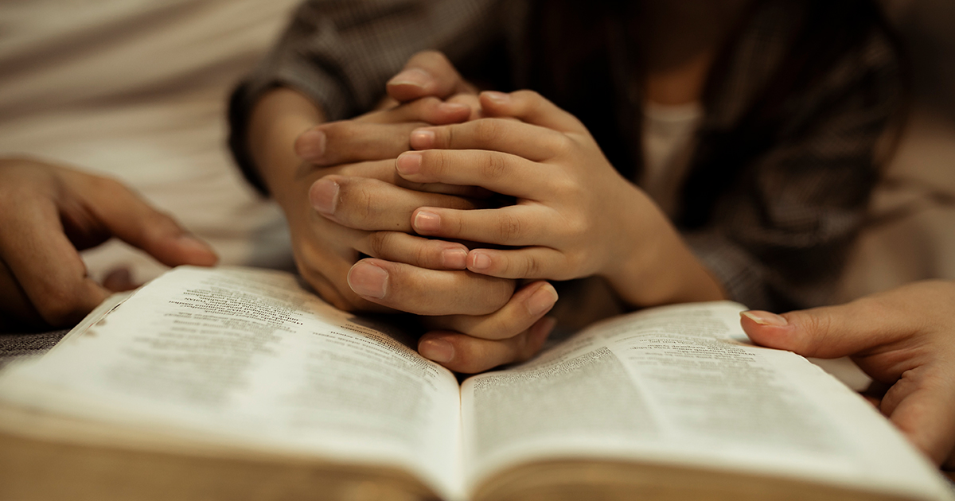
Moment of prayer
Notes:
5. Moment of prayer
Each part of the program must be carried out continuously, without spaces of silence. Review the time of prayer in the instruction manual to know how to do it.
Review what prayer is. Thank God for the great rescue He has prepared for all his children.
We can perform the prayer in a large circle by holding all the children’s hands, and thanking God for the beautiful week we spent together.

Slide 29
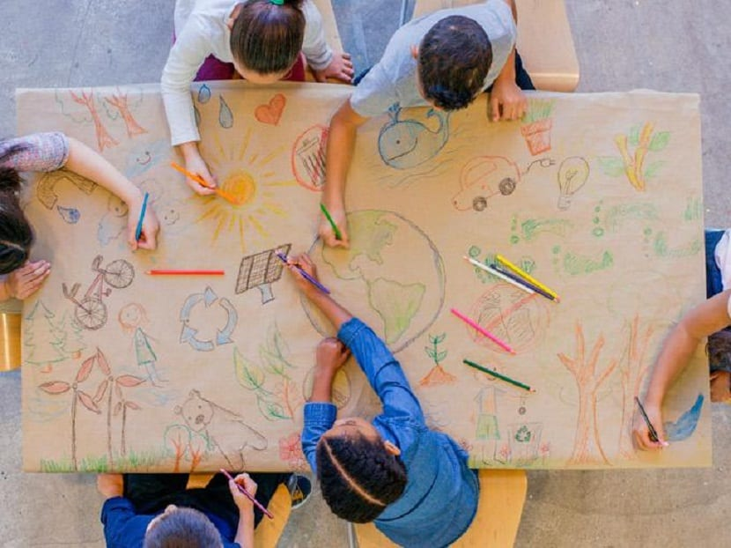
ACTIVITIES
Notes:
6. Activities:
Activity 1
Make a list of all the people you want to go to heaven with. Then draw everyone waiting for Jesus.
Activity 2
Color the drawing.

Slide 30
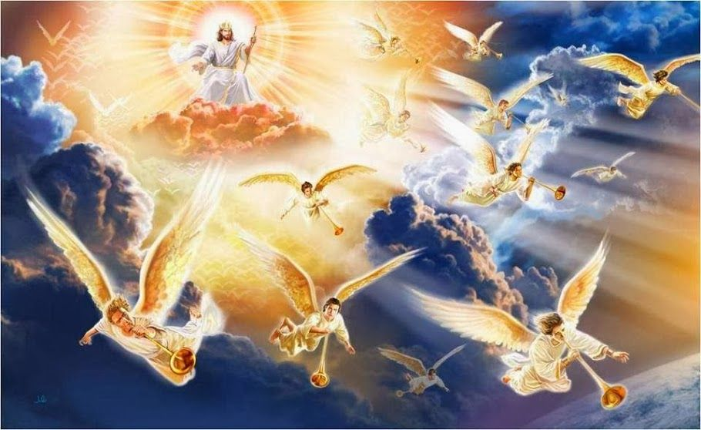
Musical moment
WHEN CHRIST RETURNS
Notes:
WHEN CHRIST RETURNS

Slide 31
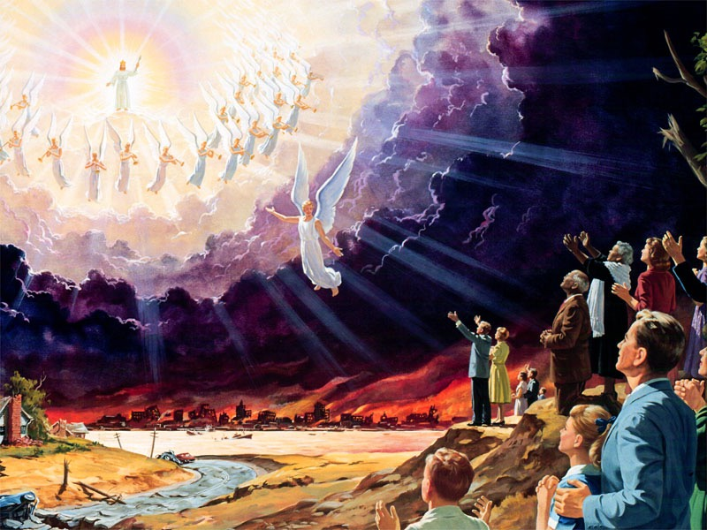
Musical moment
When Christ returns
He’ll rescue us from all dangers
Notes:
When Christ returns
He’ll rescue us from all dangers

Slide 32
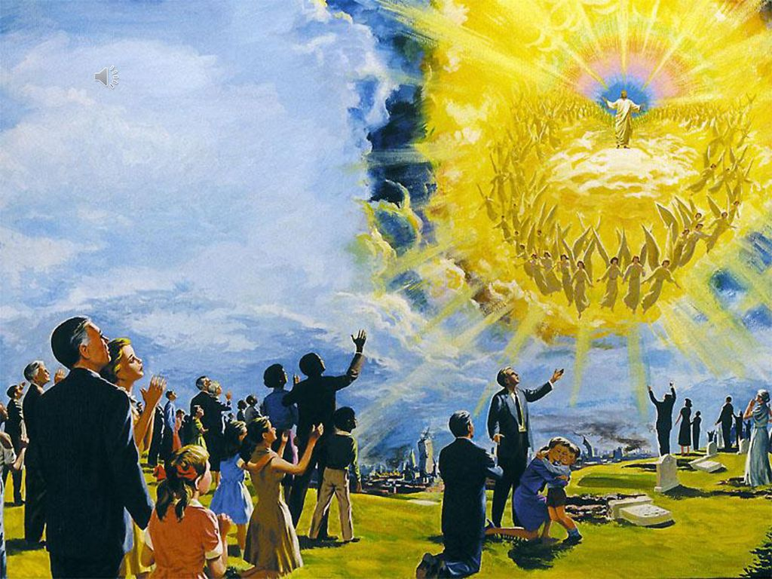
Musical moment
The pain and the tears will be gone
Everything’ll be so beautiful.
Notes:
The pain and the tears will be gone
Everything’ll be so beautiful.

Slide 33
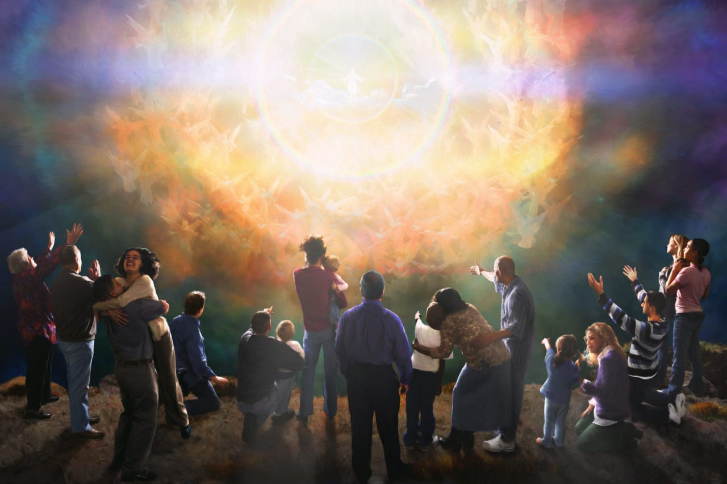
Musical moment
When Christ returns
All will be reunited
Notes:
When Christ returns
All will be reunited

Slide 34
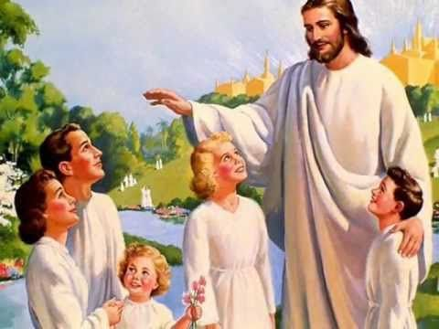
Musical moment
Children him will see
They’ll spread their wings and fly with him forever
Notes:
Children him will see
They’ll spread their wings and fly with him forever

Slide 35
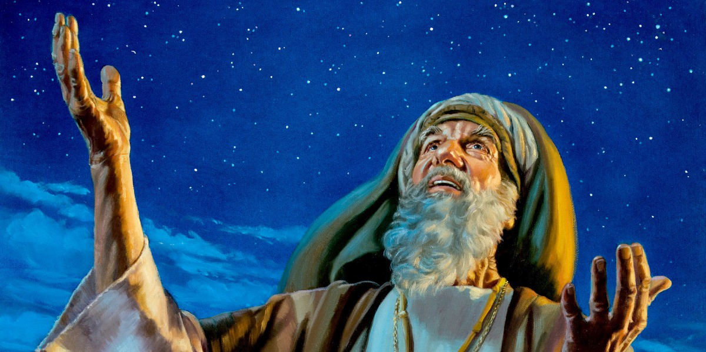
Musical moment (Chorus)
The Children will rejoice
Meeting with God face to face
Laughing having fun
As they play’ with father Abraham
Notes:
The Children will rejoice
Meeting with God face to face
Laughing having fun
As they play’ with father Abraham

Slide 36
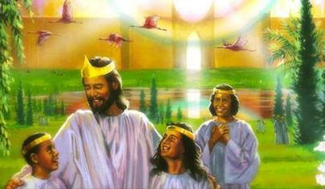
Musical moment (Chorus)
Living so pleasantly
From all fears they’ll be free
All the children of God
Grateful for his love.
Notes:
Living so pleasantly
From all fears they’ll be free
All the children of God
Grateful for his love.

Slide 37
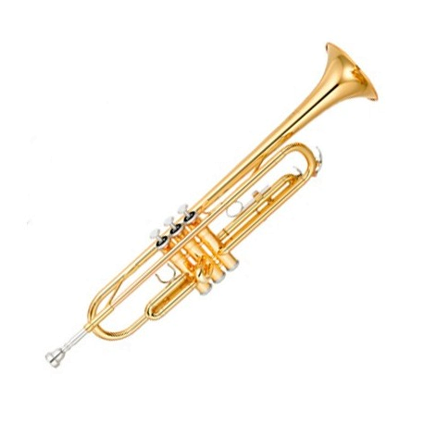
Musical moment (Bridge)
Paparaparapara, paraparapararapa…..
And they’ll hear the words
Notes:
Paparaparapara, paraparapararapa…..
And they’ll hear the words

Slide 38
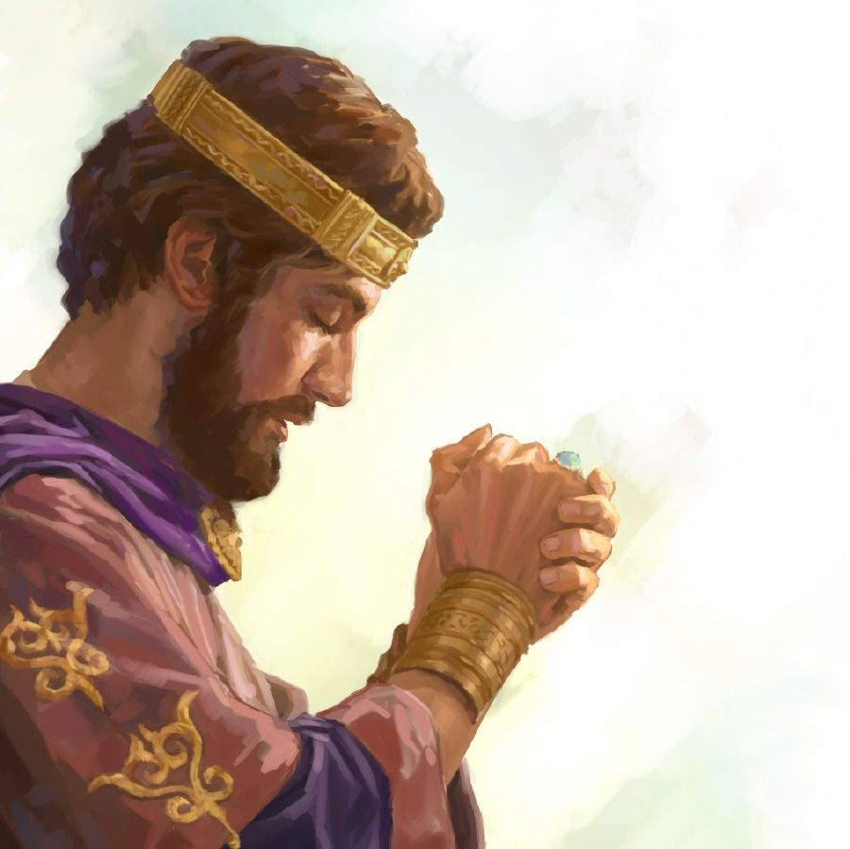
Musical moment
Of the wise king Solomon
Others will be there too
Notes:
Of the wise king Solomon
Others will be there too

Slide 39
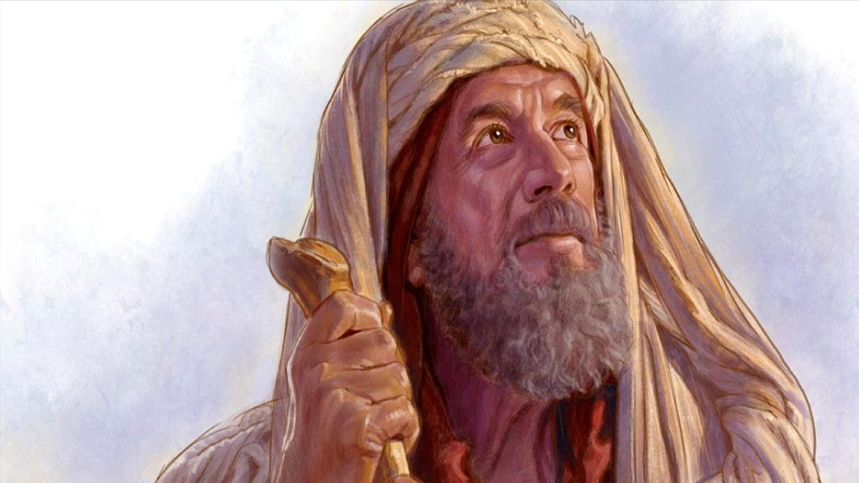
Musical moment
Daniel, Joseph, and Ruth
Moses, Enoch they’ll see
Notes:
Daniel, Joseph, and Ruth
Moses, Enoch they’ll see

Slide 40
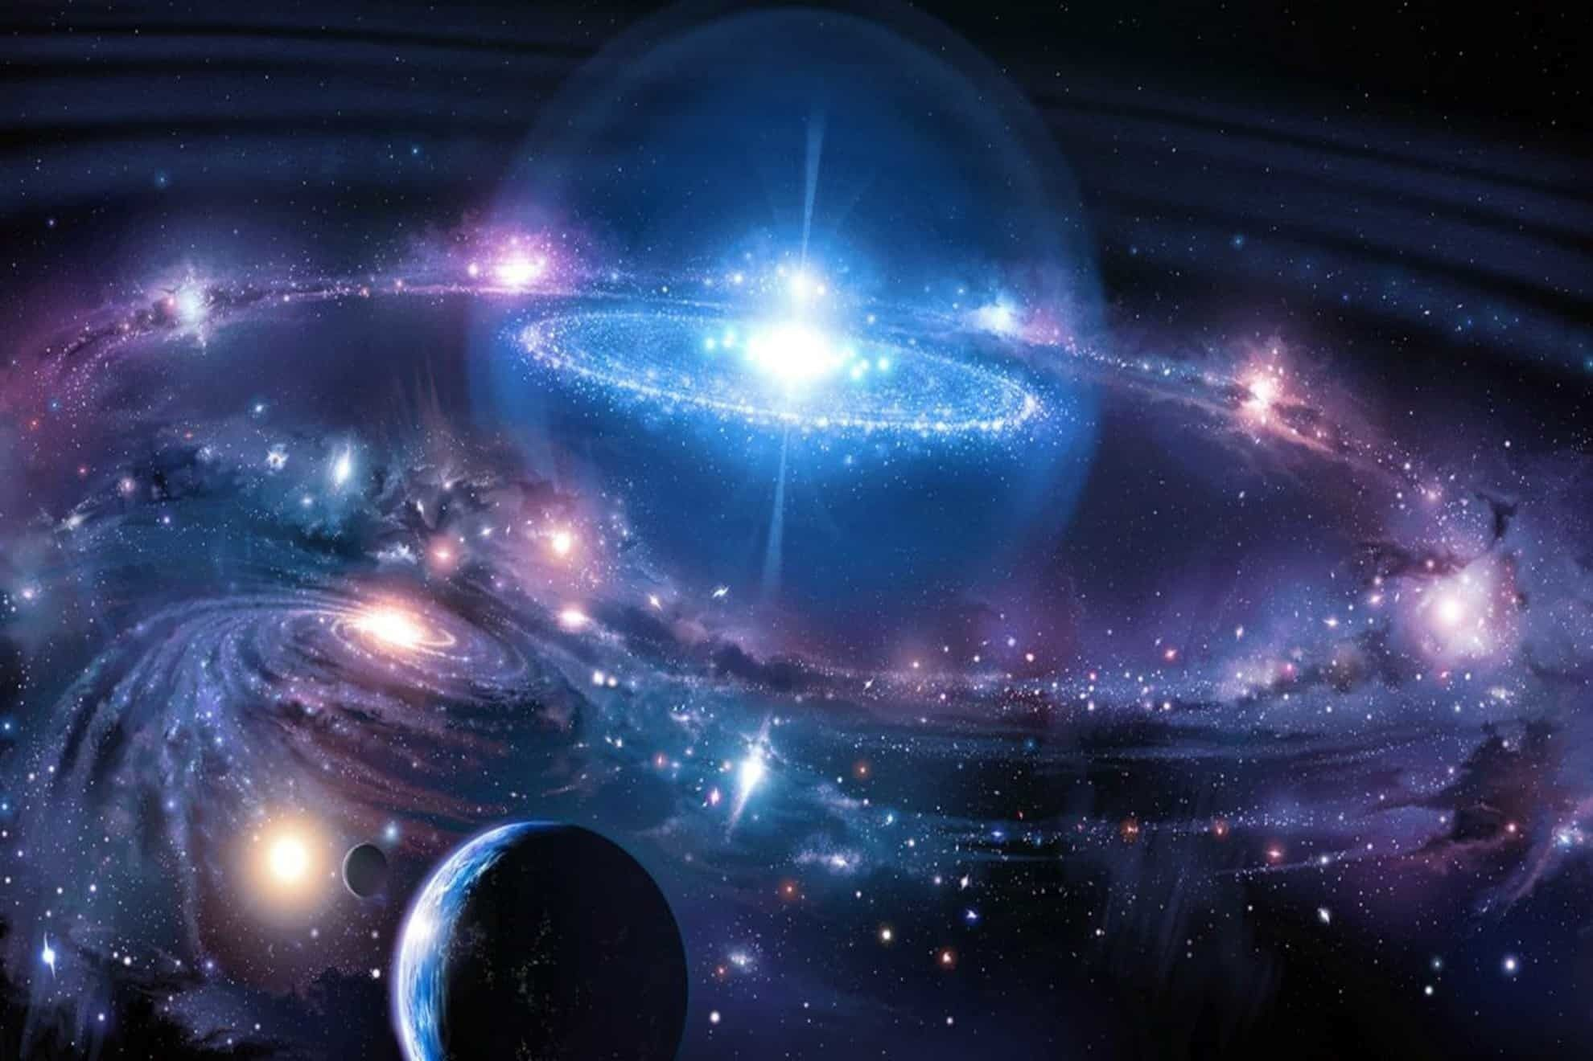
Musical moment
And reigning the worlds
The children with Christ they will be.
Notes:
And reigning the worlds
The children with Christ they will be.

Slide 41
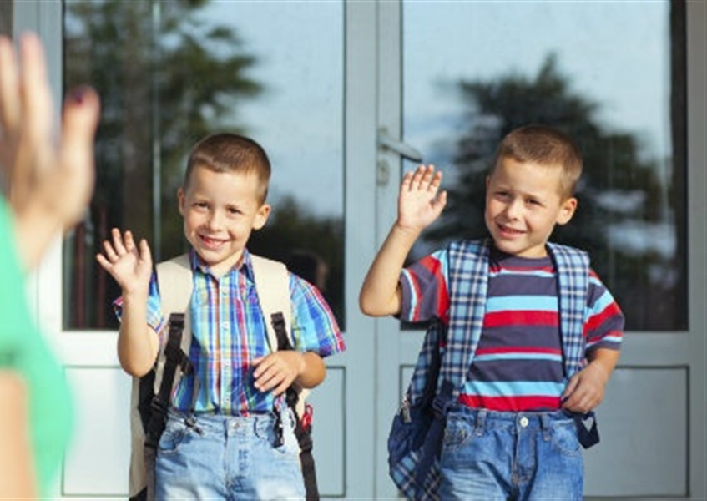
^{Until next time!!}
biblewell.org
Notes:
Until next time!!

