Slide 1
3

Slide 2
^{PRESENTS:}

Slide 3
7 Days of Programs for Children
biblewell.org

Slide 4
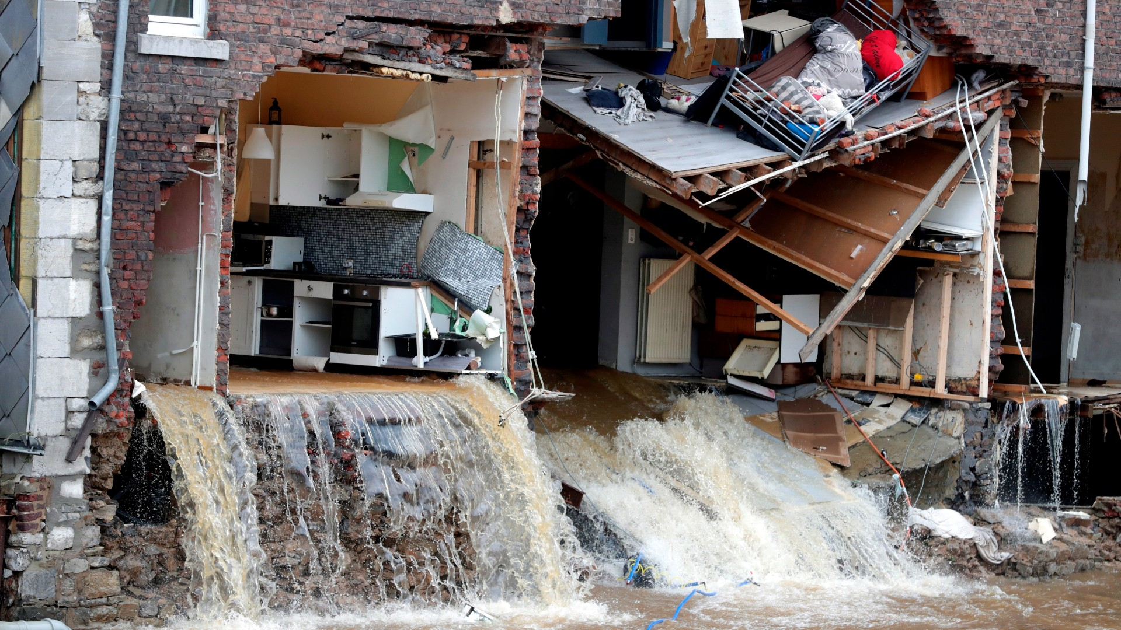
SIGNS OF THE GREATEST TRIP
Notes:
Bible Lesson Nº 3
Signs of the Great Trip
Bible References: John 14:2; Luke 21:25; Great Controversy, p. 383.2-385.2.
Main Lesson: “Signs of the Coming of Jesus”.
Specific objectives
At the end of the topic, children will be able to:
Understand that the signs tell us that Jesus is coming soon.
Know the signs of the coming of Jesus.
Decide to wait for the coming of Jesus.
Materials
1. Drawings for the lesson.
2. Motto song of the day and memory verse in illustrative pictures.
3. Illustrative materials for the time of prayer.
4. Memories with the verse of the day for each child to take home.
5. Materials for manual activities.

Slide 5
Welcome
WELCOME
Notes:
Program Development
1. Welcome:
Welcome everyone in a cheerful and fun way, greeting all children as a group and in a general way.
Remember and emphasize this week’s theme of evangelism: “THE GREAT JOURNEY!”
Briefly review what we learned in the previous topic about the journeys that Jesus took to save us.

Slide 6
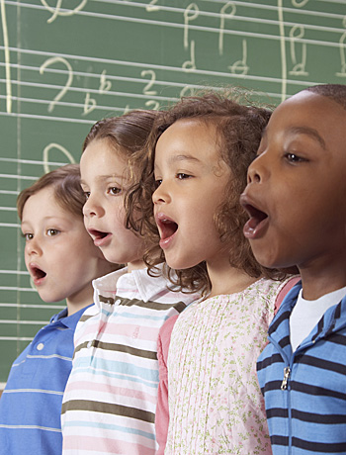
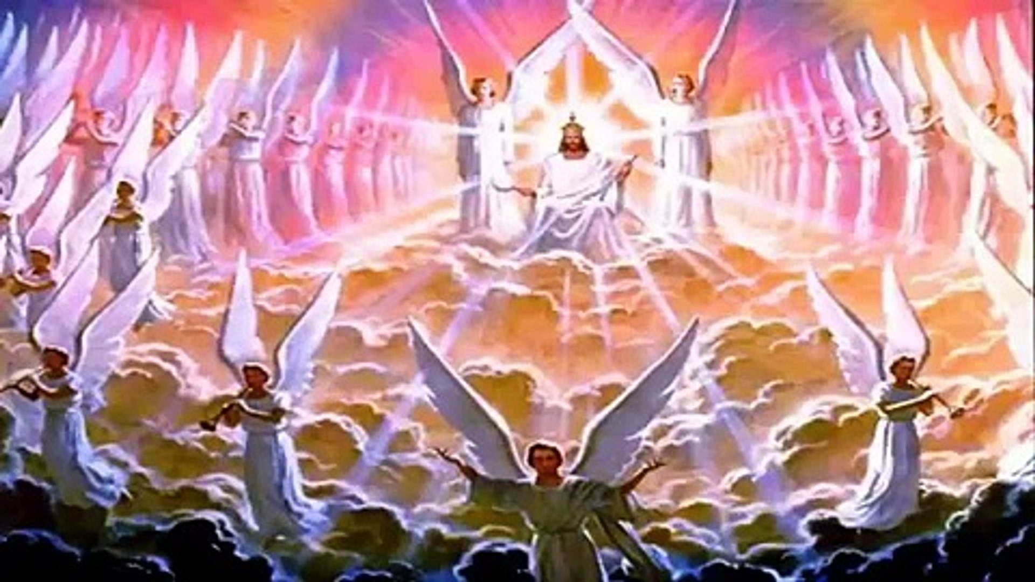
Musical moment
Jesus is Coming Soon
Notes:
2. Musical moment:
Start by teaching cheerful songs that can motivate the group. You may use a greeting song at this time. You can review the songs from previous years.
One option is to teach “We’re Happy”, “Oh, What Joy”, “Hallelujah” etc.
Set apart time to teach the song of the day “Jesus is Coming Soon.” Look in the manual for instructions on how to do it.

Slide 7
Musical moment
Jesus is coming soon; He’s coming to get me.
Notes:
Jesus is coming soon; He’s coming to get me.

Slide 8
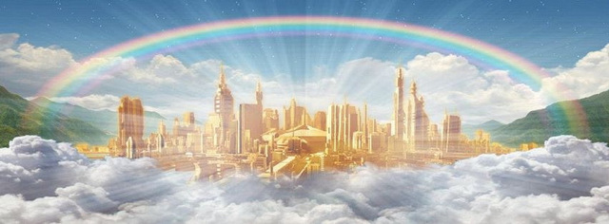
Musical moment
So that up there in heaven I can go live.
Notes:
So that up there in heaven I can go live.

Slide 9
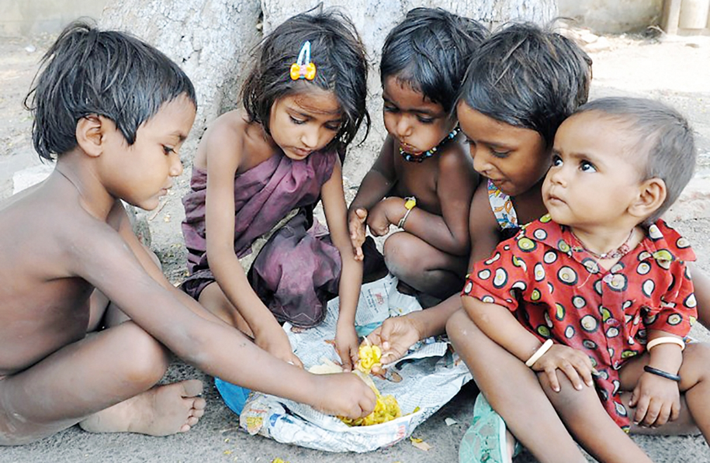
Musical moment
Earthquakes and hungers,
Notes:
Earthquakes and hungers,

Slide 10
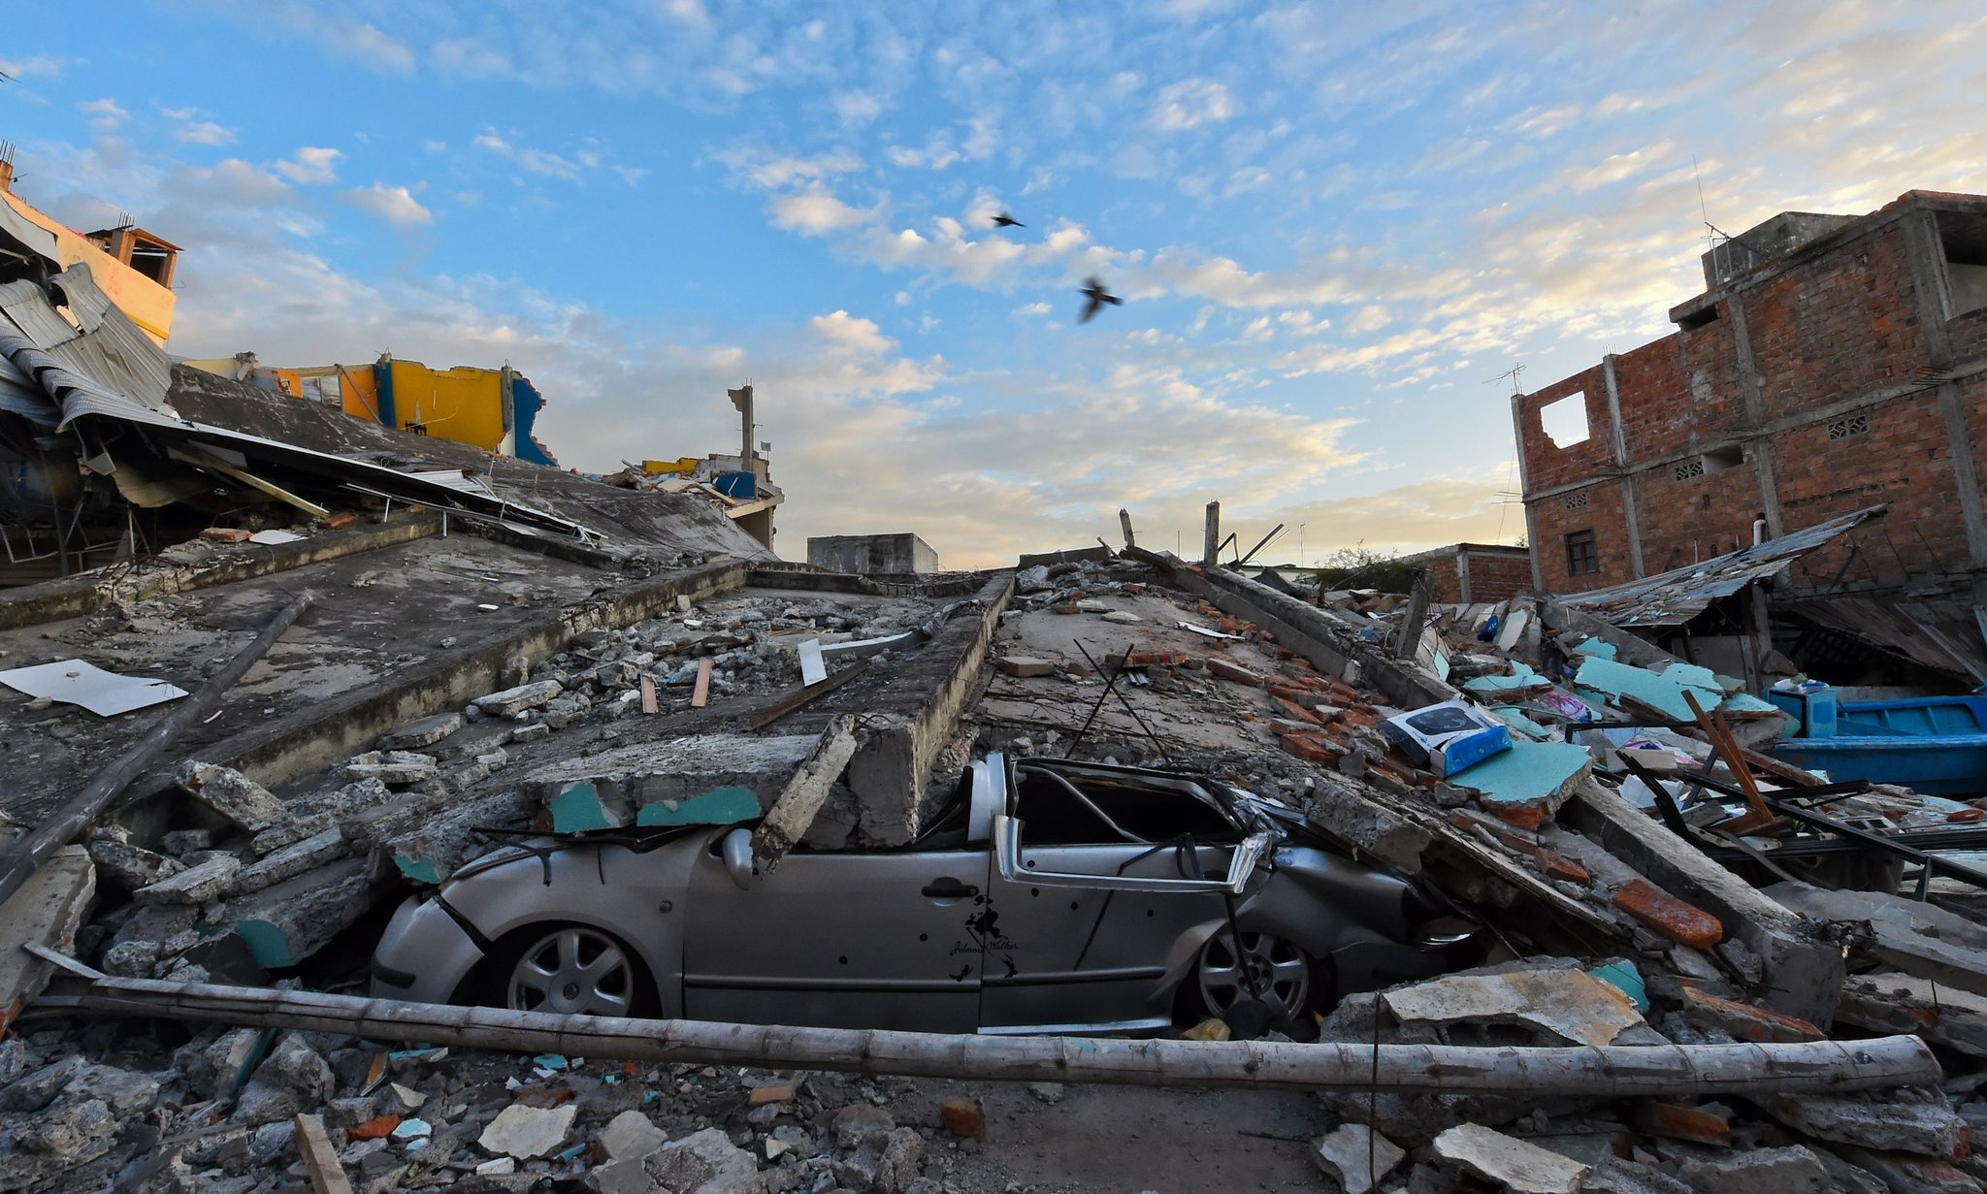
Musical moment
And wars all around;
Notes:
And wars all around;

Slide 11
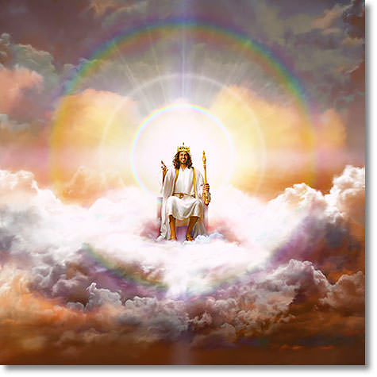
Musical moment
These are the signs the King’s coming back.
Notes:
These are the signs the King’s coming back.

Slide 12
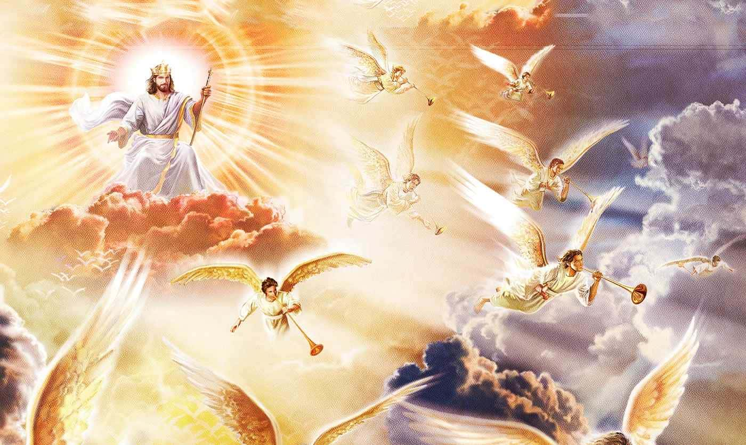
Musical moment
These are all signs that Jesus will come.
Notes:
These are all signs that Jesus will come.

Slide 13
Musical moment
My God and King,
My saving Lord.
Notes:
My God and King,
My saving Lord.

Slide 14
Musical moment
Jesus is coming soon; He’s coming to get me.
Notes:
Jesus is coming soon; He’s coming to get me.

Slide 15
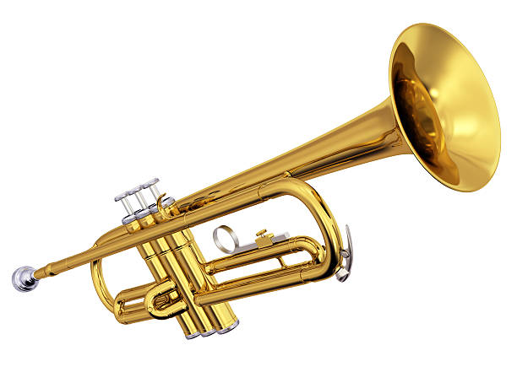
Musical moment
At the sound of the trumpet, He’ll take me home.
Notes:
At the sound of the trumpet, He’ll take me home.

Slide 16
Musical moment
Ready and prepared I need to be found,
Notes:
Ready and prepared I need to be found,

Slide 17
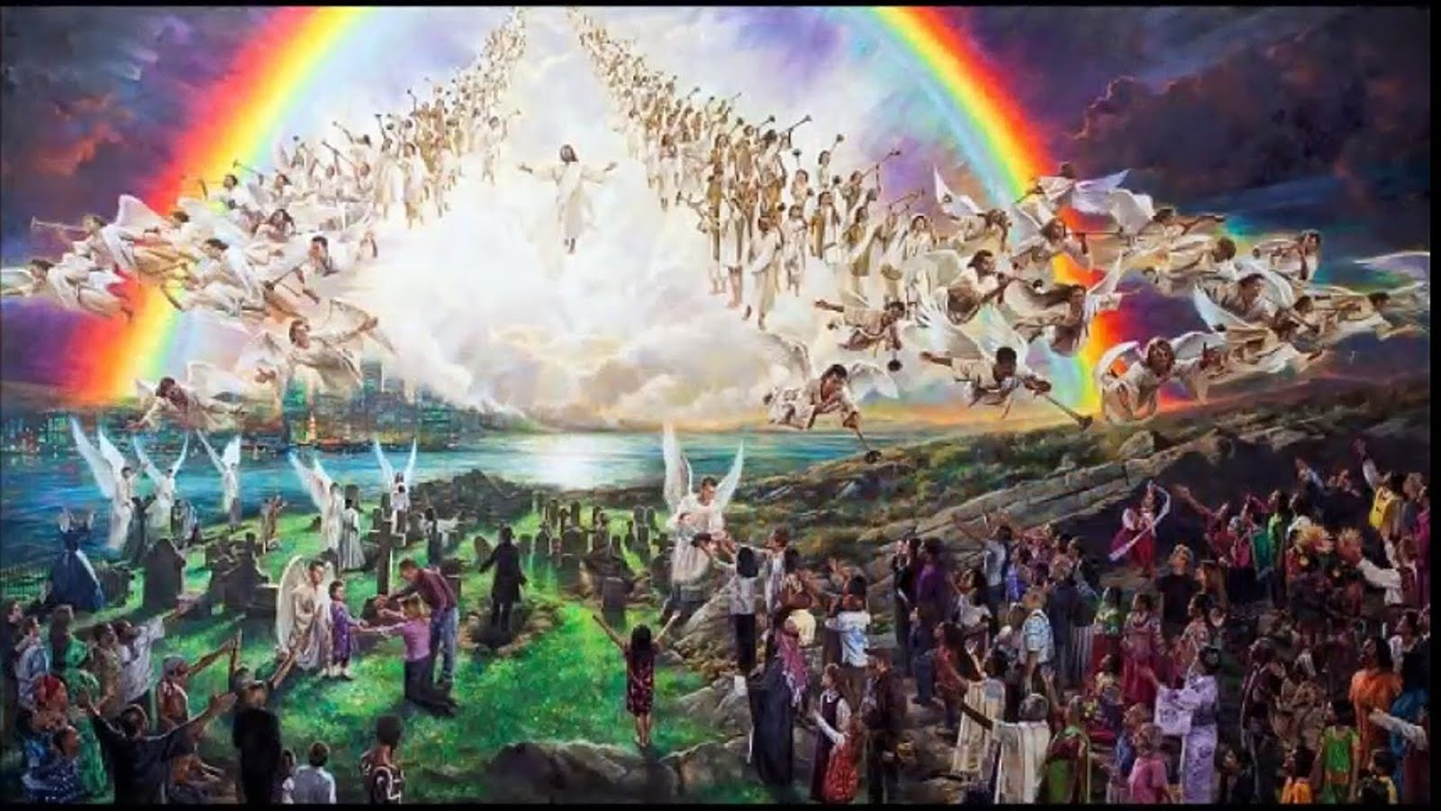
Musical moment
Jesus soon is coming; it won’t be long.
Notes:
Jesus soon is coming; it won’t be long.

Slide 18
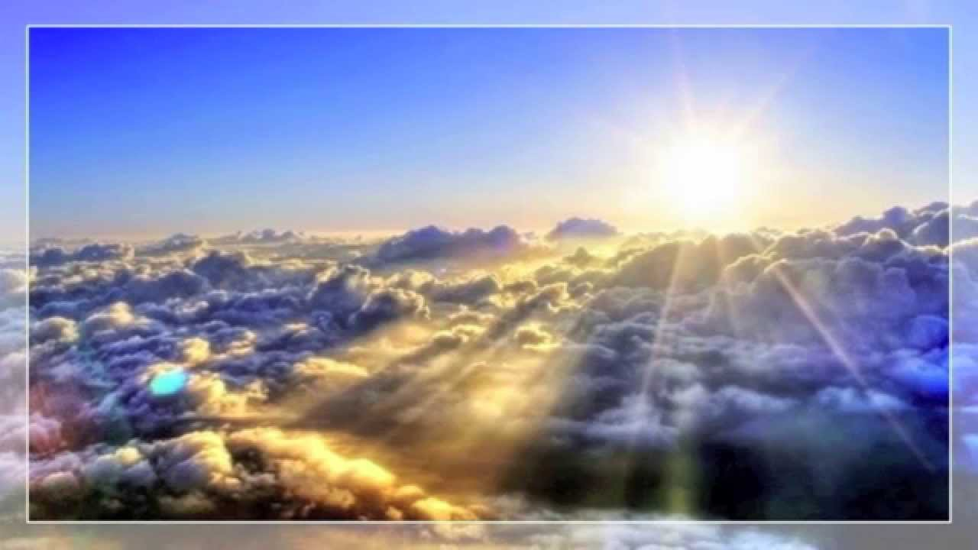
Musical moment
Soon in heaven’s mansions I will go live.
Notes:
Soon in heaven’s mansions I will go live.

Slide 19
Musical moment
/My God and King, my saving Lord/.
Notes:
My God and King, my saving Lord.
My God and King, my saving Lord.

Slide 20
Introduction
Notes:
3. Lesson
3.1 Introduction:
(Bring prepared suitcases)
Hello children! Look, I’m ready to go on a trip! (show the suitcase).
As you know, this week’s theme is “The Greatest Trip”! and I definitely want to go on a trip!
Would you also like to go on a trip to the Heavenly Home?
Are you ready for the trip? Are you ready?
I know you want to go to live with Jesus in heaven very soon.
We will go on this trip very, very soon.
So when will that trip be? What date and what time?
We will look at that in today’s topic.
Come!

Slide 21
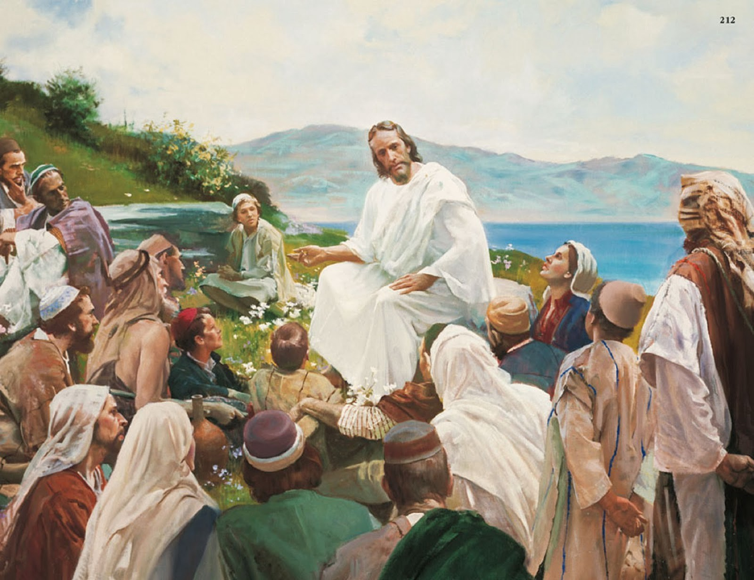
Development
Notes:
3.2 Lesson Development
One day, after walking through different places and having been in the temple, Jesus went to the Mount of Olives to rest.
A long time ago, when Jesus was on this earth and walked with His disciples, He told them about the Heavenly Homeland.
He told them that He would return to heaven to be with His Heavenly Father, but He would also go to prepare a special place for every boy and girl, and for all the people who wished to live with Him forever happy in heaven, where everything is beautiful and full of love, where there are no tears, no death, and no pain. Only true happiness!
Upon hearing this, they had been left thinking -- what do you think they wanted? Do you think they longed to be in heaven? Of course! They were happy to receive the news: THEY WERE INVITED TO GO ON A TRIP TO THE HEAVENLY HOMELAND! and not only them, but all of US who wish to go to heaven are invited as well.
But you know what? The disciples approached Jesus to ask him some questions: How will we know when you will return to earth Lord? When will the trip be? What day and time?
Jesus answered them, “But of that day and hour knoweth no man, no, not the angels of heaven, but my Father only. But as the days of Noe were, so shall also the coming of the Son of man be.” (Matthew 24:36).
Then the disciples said to Jesus, “What SIGNS will there be of your return to earth to seek us to go and live with you in heaven?

Slide 22
Development
Notes:
Dear boy, dear girl: Do you know what the signs of Jesus’ coming are? (Let the children speak).
Maybe, you’ve already heard something.
Remember that we learned that Jesus took a great trip to earth to save us?
When he was here, he said he would go prepare a place for us to go and live with him in heaven. He promised, “In my Father’s house there are many dwellings; if it weren’t, I would have told you; I am therefore going to prepare a place for you” (John 14:2).
But when would this be?

Slide 23
“And there shall be signs in the sun, and in the moon, and in the stars; and upon the earth distress of nations,” (Luke 21:25).
Development
Notes:
The disciples wanted to know more and more about what all these events would be like. How interested they were in going on this great trip! Although they would not know the day or time of the journey, it was at least necessary to know the SIGNS that indicated the second coming of Jesus to earth to take those who were prepared to make the GREAT TRIP TO HEAVEN.
Then, Jesus began to give them some hints of when He would come.
These signs of the coming of Jesus are written in the Bible and you can also find them there.
The SIGNS mentioned by Jesus and their fulfillment are:
1. “And there shall be signs in the sun, and in the moon, and in the stars; and upon the earth distress of nations,” (Luke 21:25). (Show the poster where this sign is written or illustrated).

Slide 24
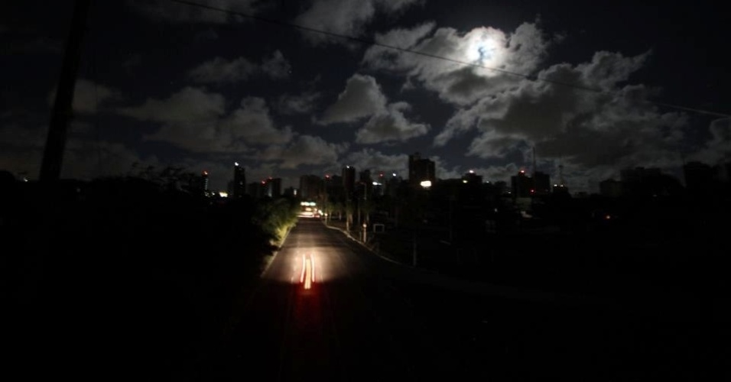
Development
Notes:
Could it be that any of this has happened? Has it already been fulfilled? Is it being fulfilled? Or will it be fulfilled?
THE SIGN IN THE SUN. Yes, it has already been fulfilled! Long ago in North America, on May 19, 1780, this day was recorded in history as the dark day... Shortly before lunchtime the whole earth went dark, as if it were night... Animals returned to the barn to sleep, birds to their nests, workers returned home, children were dismissed from schools and fled to their homes in fear. It was all so dark and they had to turn on the street lights and houses.
It was something that had never happened before! It was supernatural! Many people were very afraid because it seemed to be night at lunchtime. Can you imagine that?
This darkness disappeared a little at dusk, but when the sun hid again, a terrifying darkness covered the earth; although that night was a full moon, you could not see anything.

Slide 25
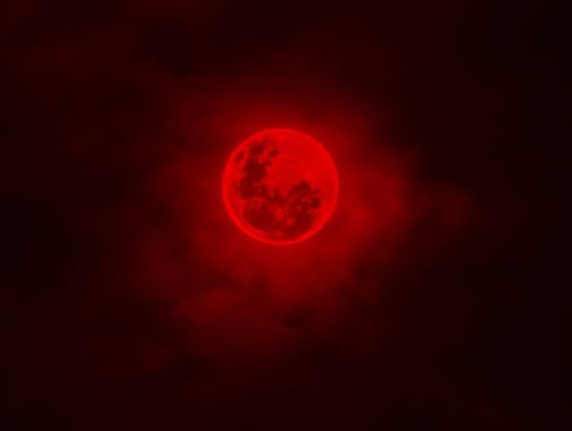
Development
Notes:
THE SIGN OF THE MOON. This sign has also already been fulfilled, followed by the darkening of the sun, when, after midnight, the darkness disappeared, the moon was seen again and seemed the color of blood. (20 May 1780). This was another event that no one expected and which the Bible prophesied would happen. The signs that Jesus is coming soon are being fulfilled, just as Jesus mentioned it.

Slide 26
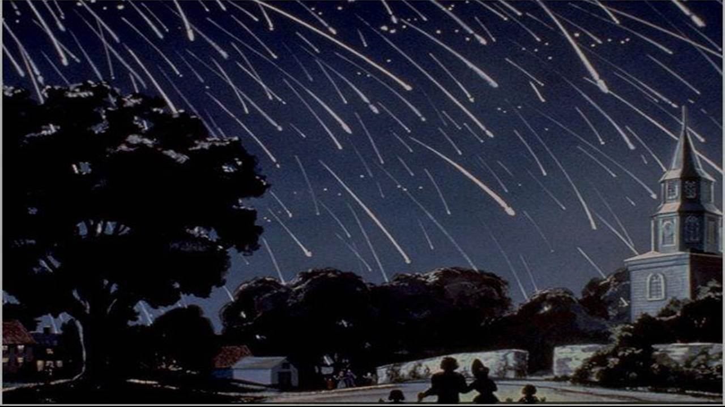
Development
Notes:
THE SIGNS IN THE STARS. It was also fulfilled, on November 13, 1833. This was also a never-before-seen event!
It was a night with a very starry sky. The whole sky could be seen very clear. When, suddenly, all the stars in the sky began to move. It was a display of shooting stars that men had never contemplated. It was as if there was a shower of stars. What is a shooting star? It is a star that appears to move very fast and disappears immediately.
I’m sure we are surprised when we see a shooting star. It’s wonderful to see one, but can you imagine seeing millions?
Everyone was frightened in that moment and remembered that they were signs of Jesus’ coming.
But will there be more signs that Jesus is coming soon?

Slide 27
Development
Notes:
The Bible goes on to tell us:
2. “But the wise took oil in their vessels with their lamps. While the bridegroom tarried, they all slumbered and slept. And at midnight there was a cry made, Behold, the bridegroom cometh; go ye out to meet him. Then all those virgins arose, and trimmed their lamps. And the foolish said unto the wise, Give us of your oil; for our lamps are gone out.” (Matthew 24:5-7). (Display illustrations depicting these signals.)
Yes!, We find a lot of deception on earth now.
Many people deceive, even when they teach messages from the Bible. There are many falsehoods that people teach.
Some people say, I am the Christ and deceive people who truly believe in Jesus.
You’ve also surely heard that there are wars, where many children die, or are left without a dad, mom or siblings. Many countries fight and say: Let’s go to war! Their armies prepare to fight.
Have you seen anything like that?
All of that is happening every day.

Slide 28
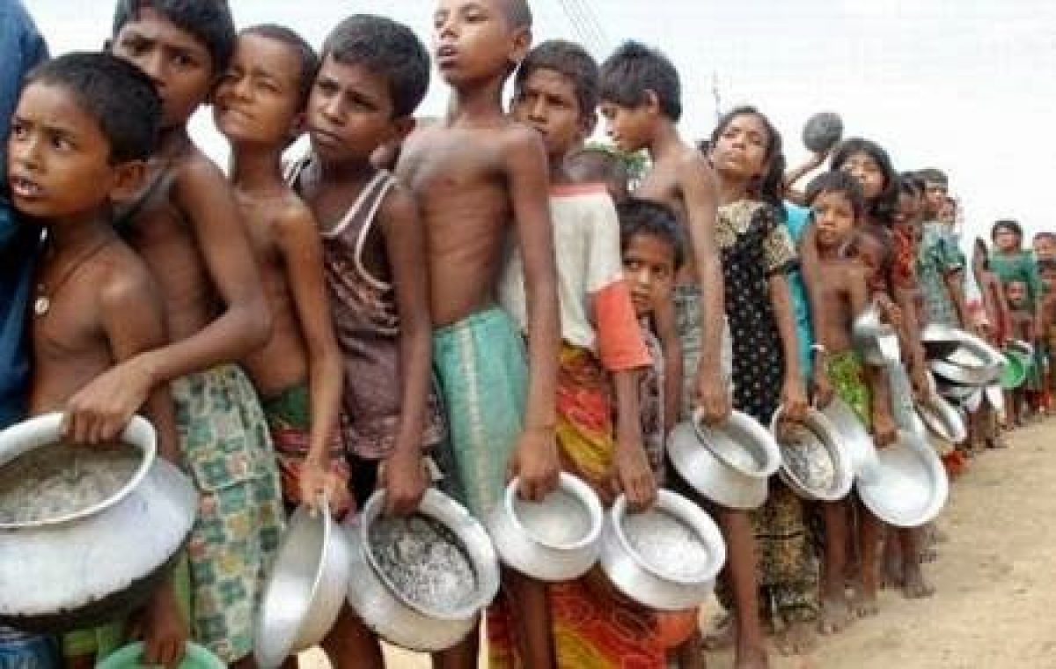
Development
Notes:
How many children in the world do not even have to eat! There is more and more hunger on earth.
Children starve as they walk the streets, asking for something to eat, or digging up trash to find something to eat.

Slide 29
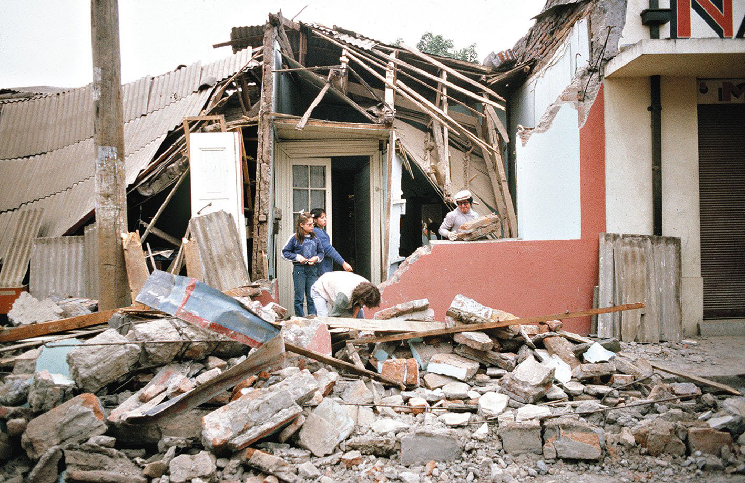
Development
Notes:
There are earthquakes in many countries: Japan, Chile, Argentina; and sometimes there are even tsunamis where many people die.
These are all signs of the end of this world.

Slide 30
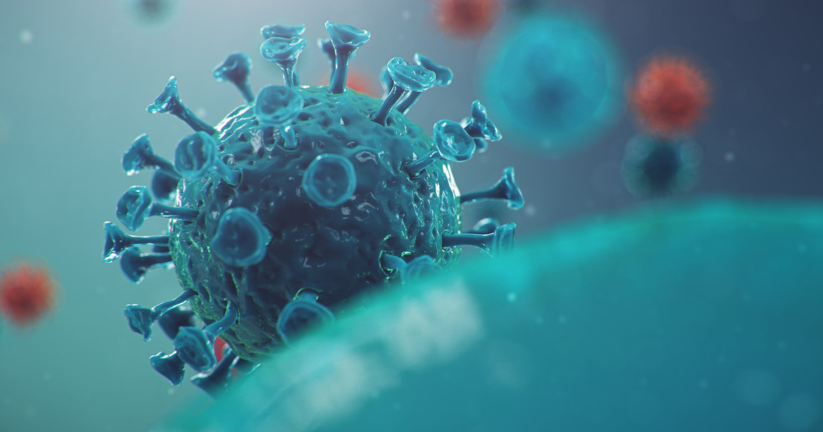
“... and there shall be famines, and pestilences, and earthquakes, in divers places,” (Matthew 24:7).
Development
Notes:
3. “... and there shall be famines, and pestilences, and earthquakes, in divers places,” (Matthew 24:7).

Slide 31
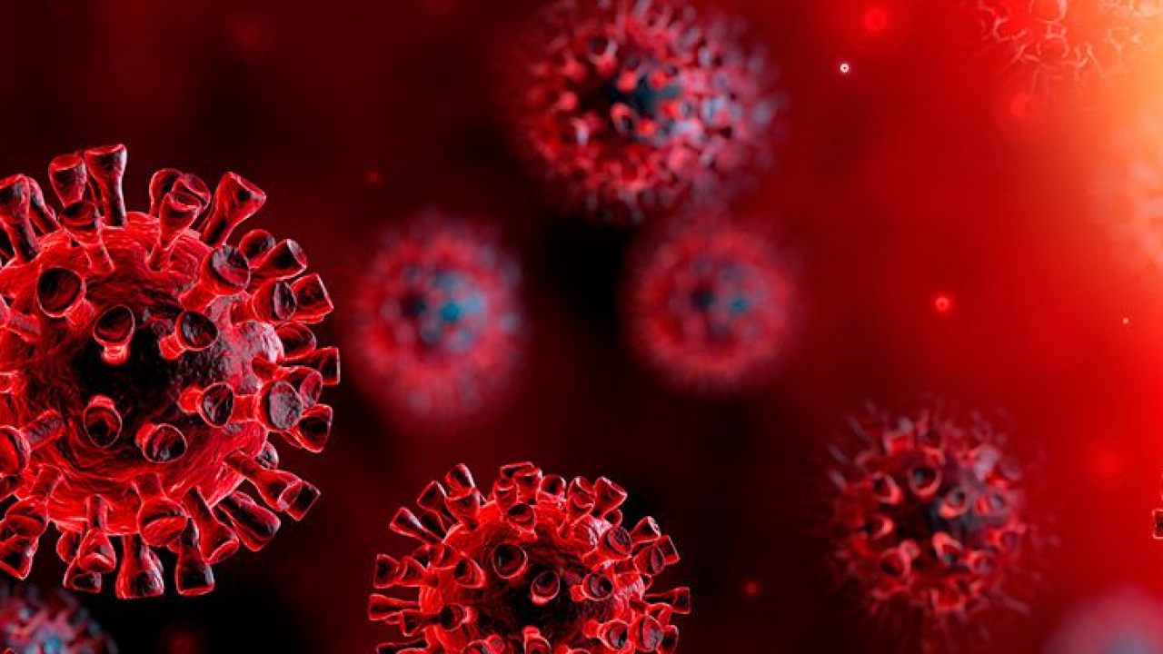
Development
Notes:
Do you know what a plague is?
They are diseases that affect a large number of humans or animals, and many die as a result.
Surely, you’ve just thought about a plague that is affecting the entire planet today.
Everyone today is talking about the coronavirus or covid-19. Do you know what it is? It’s a virus that affects the world today.
Many people have died of coronavirus, and many more were sick.
This disease that was born in China traveled all over the world, and it is in our country as well.
You know what? The coronavirus or Covid-19 is not the only plague that exists today. There are many viruses such as influenza, AIDS, measles, smallpox, etc. For some plagues, a cure has already been found, but for many of them there is none.
The coronavirus has affected the world so much that many children are unable to go out on the streets, go to school, walk, or go out to visit their relatives.

Slide 32
Development
Notes:
There are other signs about the coming of Jesus:
• There will be a lot of gluttony; people who just want to eat, and have fun.

Slide 33
Development
Notes:
• There will also be violence. It’s sad how many people beat and even kill other people!

Slide 34
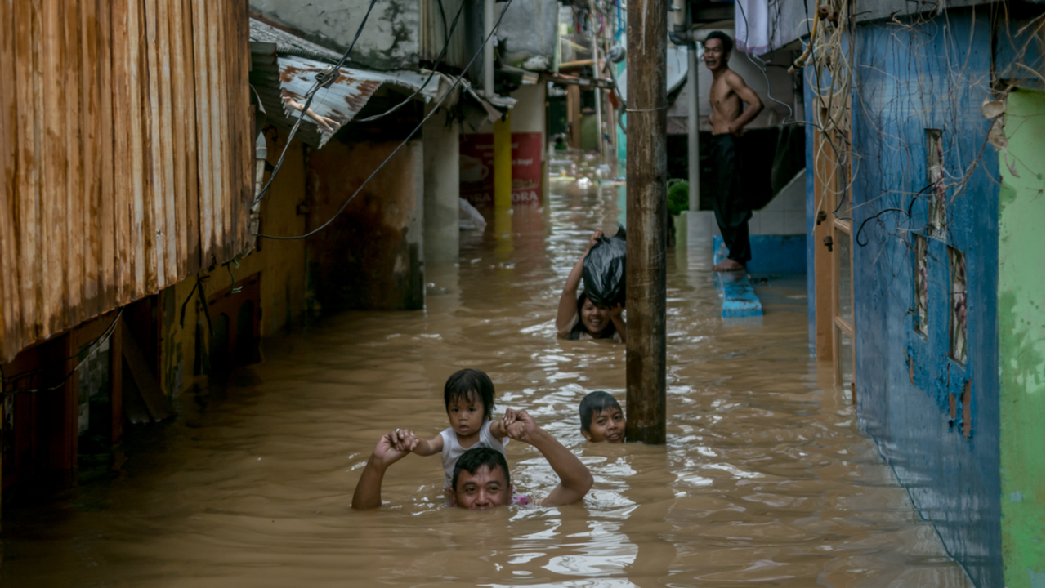
Development
Notes:
• In nature, you see many disasters: cyclones, hurricanes, tsunamis, and fires everywhere.

Slide 35
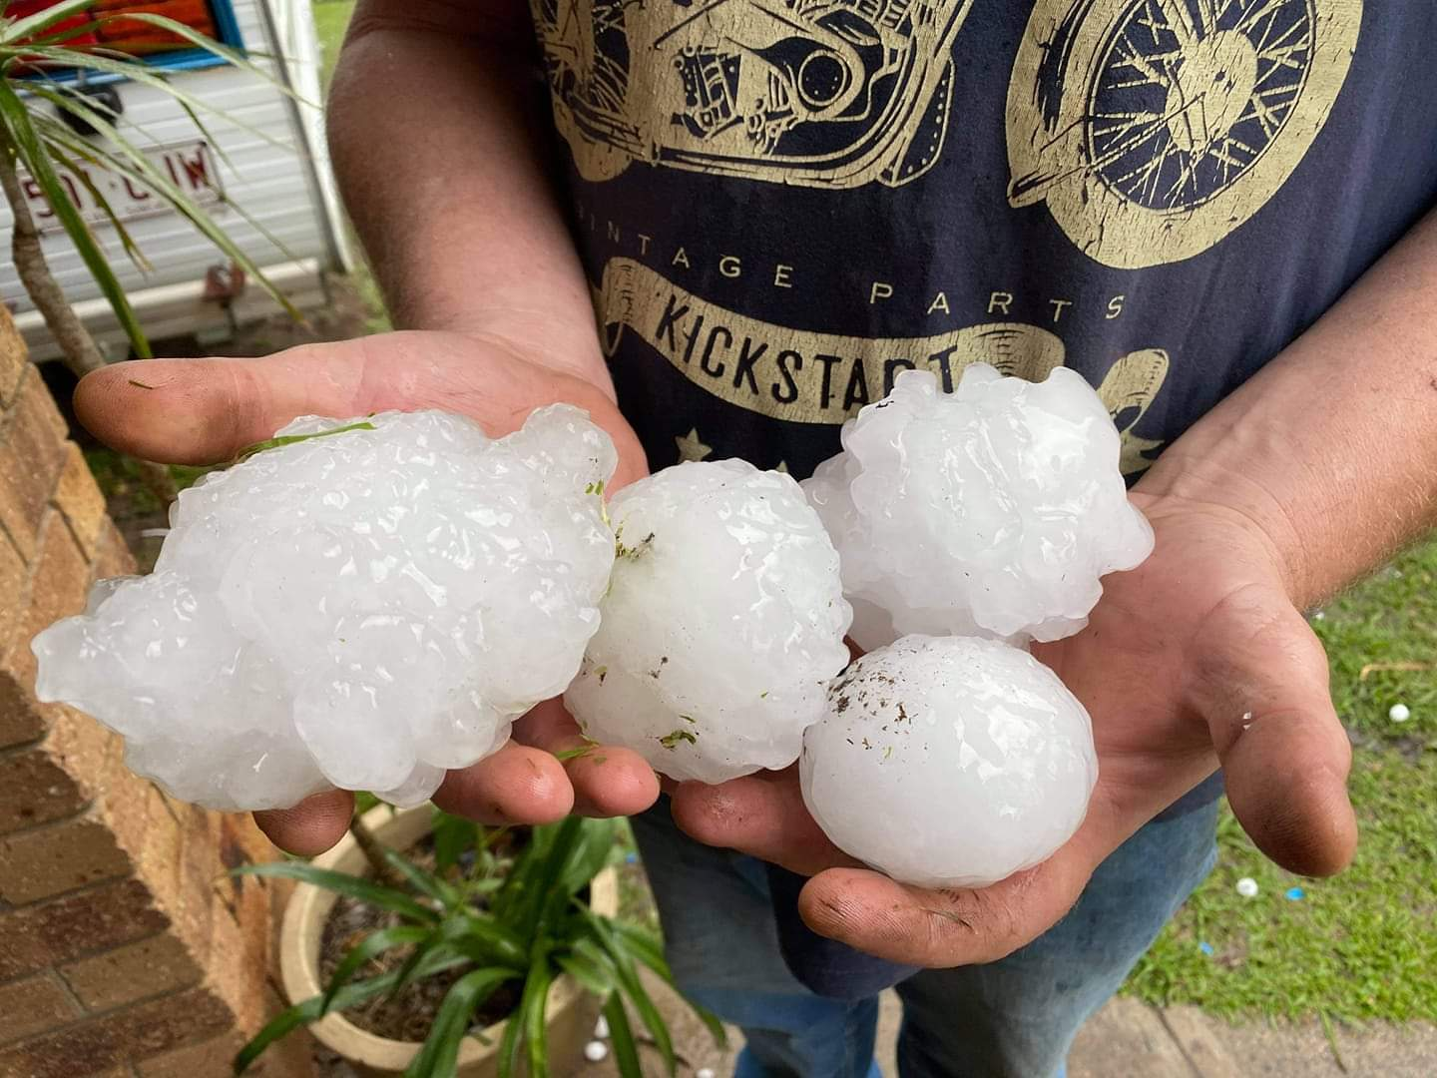
Development
Notes:
• Hail, larger and larger hailstorms!

Slide 36
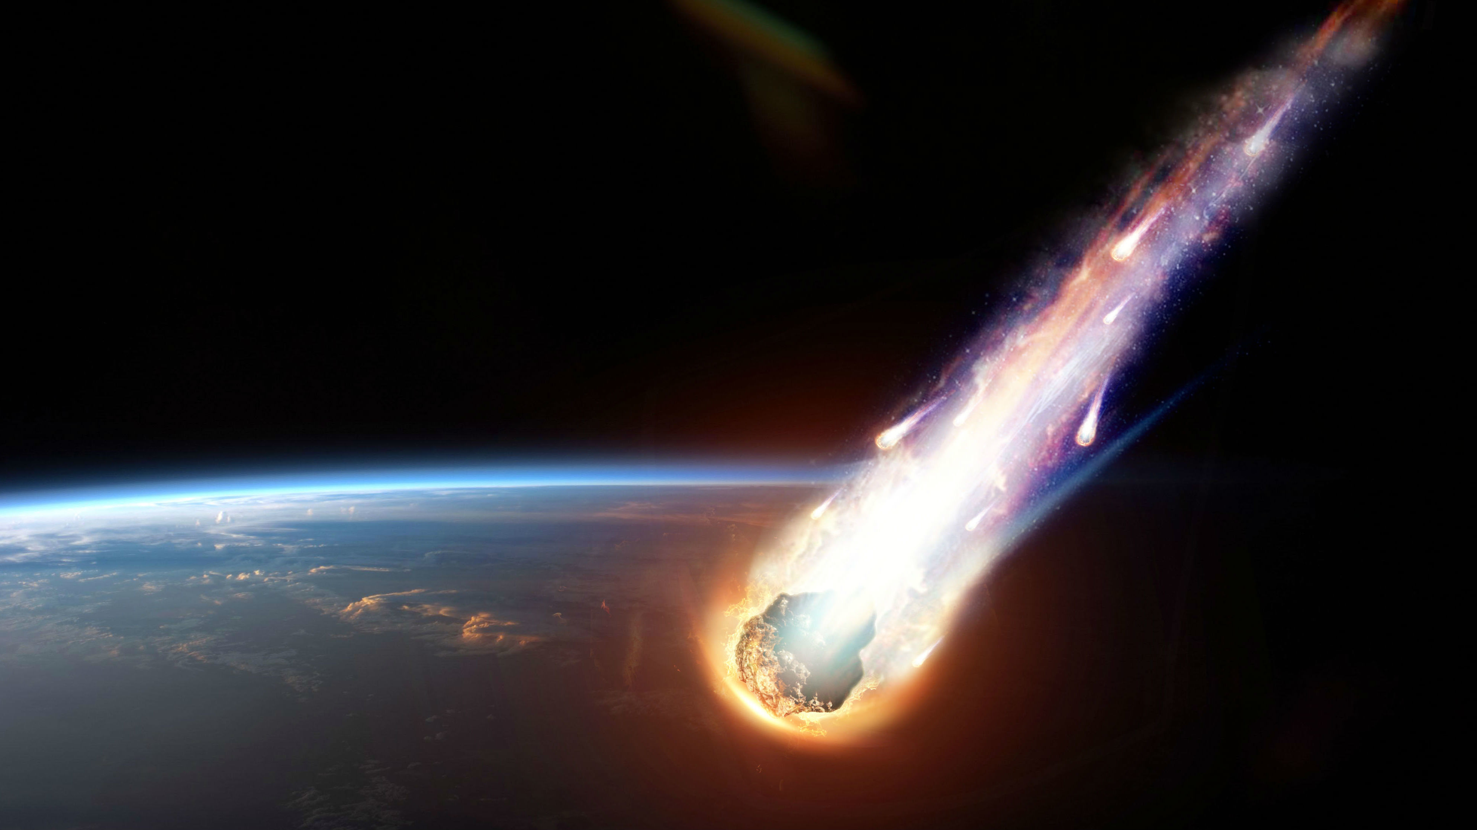
Development
Notes:
• Large fireballs will also fall from the sky.
But did you know that God has a purpose in allowing these calamities to occur? For “They are one of His means of calling men and women to their senses. By unusual workings through nature God will express to doubting human agencies that which He clearly reveals in His Word.” (Last Day Events/Manuscript Releases 19:279, 1902).
Everything that happens in this world God knows it and knows why it happens!
God wants us to know that soon, very soon, Jesus is coming to look for his children to go and live with Him.
But, don’t be distressed by all this because Jesus in the Bible left a message for you.
In Matthew 24:6 it says, “You will have news that there are wars here and there; but don’t panic, for that’s how it has to happen.”

Slide 37
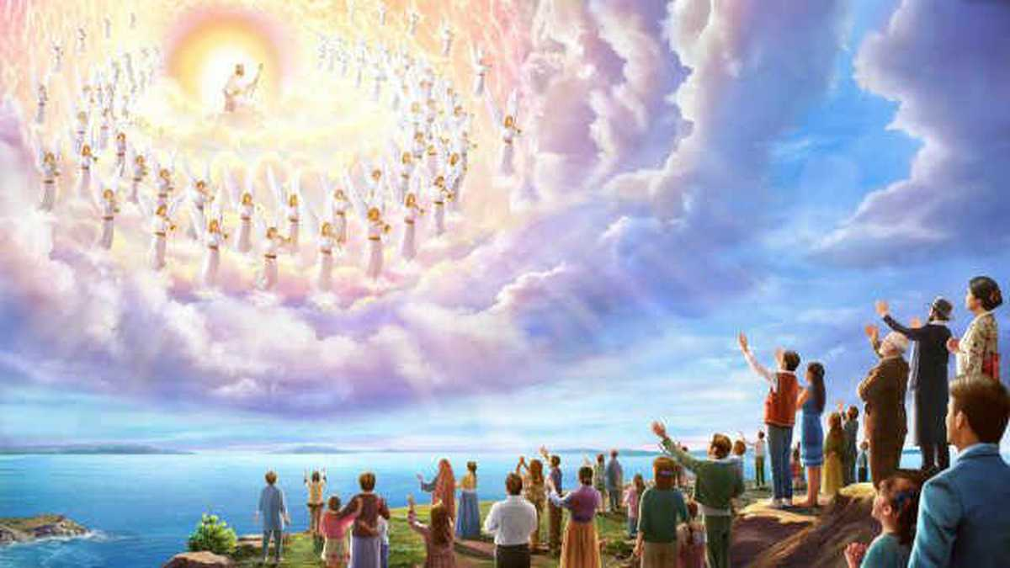
Development
Notes:
We must not be frightened, all this has to happen. God is in control of everything!
Many people must realize that Jesus is already coming.
Every time you hear some of these signs, remember that Jesus will soon come to find all his children, all those who love Him and want to go live with Him.
The signs are there. We just have to be prepared to go on that great journey we will make with Jesus.
Are you ready to make that trip? Don’t miss a moment! Hurry up and wait for the coming of Jesus!

Slide 38
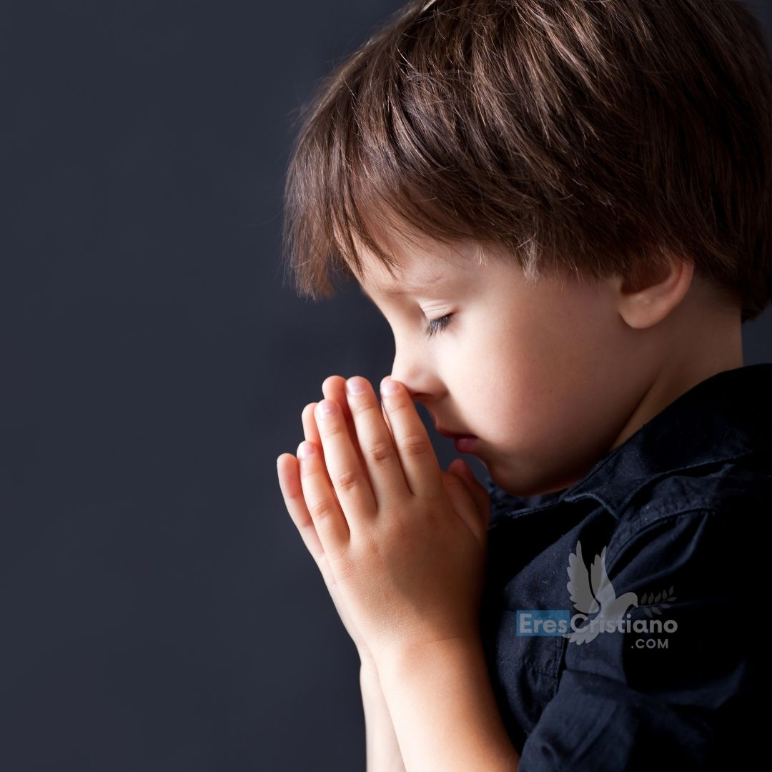
“For yet a little while and he that shall come will come and will not tarry.” (Hebrews 10:37)
Development
Notes:
“For yet a little while and he that shall come will come and will not tarry.” (Hebrews 10:37)

Slide 39
Hebrews 10:37
Memory Verse
Notes:
4. Teaching the Memory Verse
Remember that this moment is important, as we are engraved in our children the very word of God in their minds.
One idea for today is to prepare the Bible verse on a scroll like those of antiquity.
You can also do it in an illustrated way i.e., illustrating every word in the text. Follow all the instructions in the manual. Remember that, within this material, you have the illustrations and the texts, ready to print.
The Bible verse may be learned before or after the lesson.
Introduction: Today we have learned that Jesus left signs in the Bible for us to realize how far Jesus’ coming is. In Hebrews 10:36 the text reads as follows:

Slide 40
For yet a little while
Memory Verse
Notes:
For yet a little while

Slide 41
and he that shall come will come
Memory Verse
Notes:
and he that shall come will come

Slide 42
and will not tarry.
Memory Verse
Notes:
and will not tarry.
There is very little time left until that great trip to heaven.
Presentation: Display the Bible verse presented in a visual. Allow someone to read it. Then look for it in the Bible and have one of those present read it again. Show that it is written in the Bible.
If you do it on a roll you can open it little by little or all at once for the children to see.
Explanation: Explain in each part of the text in detail for better understanding of our students.
How good it is to know that very little time is left until Jesus returns! And the Bible says it: it won’t take long!
Application: The signs are already there: plagues like the coronavirus, war, hunger and many more signs. Can you help me with a few more signs?
The Lord is not long in coming. We must be fully ready because the Lord is no longer slow.
And what about you, are you ready?
Repetition:
Invite the children to read the text by repeating it several times. Repetition should be joyful, and not repetitive.
We can have the boys go first, then the girls, then everyone, then the tall, the medium, those who have shoes, etc. Using different repetition methods. You have to make your repetition a fun moment.

Slide 43
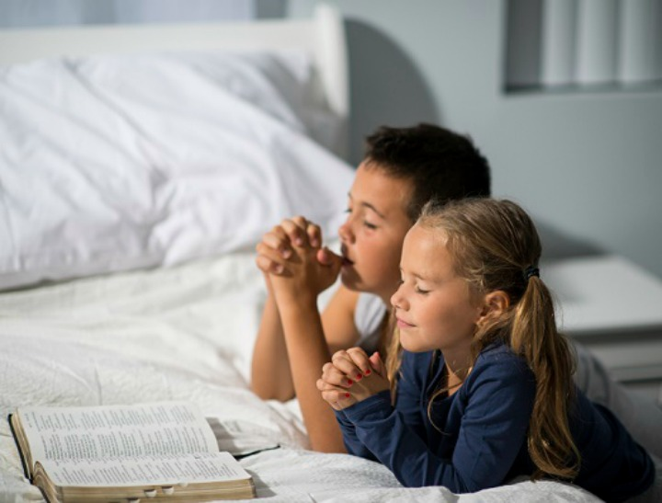
Prayer
Notes:
5. Moment of Prayer
Continuing with the program, without an intermission, hold the moment of prayer. At this time, we will devote ourselves to talking to God.
Today is the time to teach the children that we can ask God for what we need.
We can teach them what requests we can ask the Lord for. Also give the children the opportunity to share their requests.
For example:
A super special moment has come. The time to talk to God.
Remember what it’s like to pray? It’s talking to God as if to a friend.
We have also learned to give thanks for what we have received.
Many times we go through difficult times. It is in these moments that we pray to the Lord and ask Him for help in solving our difficulties.
The Bible says “ask and it will be given to you.” It tells us that if we ask, He listens to us and answers us.
And what can we ask of the Lord?
We can ask Him for everything we need: for those who have needs, for the weak or sick, for our authorities and our parents, for our friends, and also for ourselves.
If you want to, you can remember this with the fingers of your hand. Do you have other requests to make to the Lord? Now it’s time to pray. Pray.
(Remember to always speak in the plural, us, including words of thanks for their attention). We can teach a song to prepare for this moment. In the children’s hymnal you will find the song entitled “The Prayer Song “, or “Waiting for the Prayer”.

Slide 44
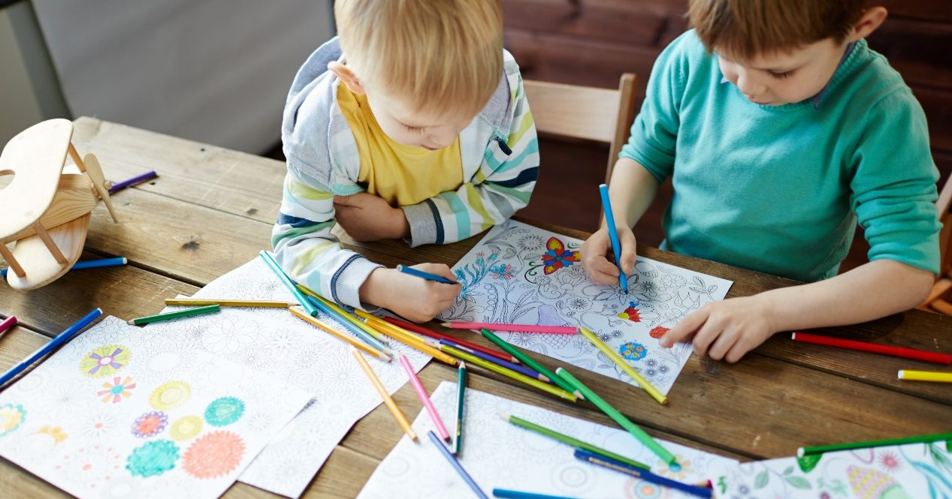
Activities
Notes:
6. Activities
Kids Ages 8+: Make a big box to put it somewhere you want.
This painting will be a collage about the signs of Jesus’ coming. You should look for images of wars, hungry children, earthquakes, children suffering in the cold, disease and others you want to look for.
You can paste them on a large piece of paper and put it on a wall or place you want.
Don’t forget to give it a big title that says “Jesus is coming soon.” The signs are being fulfilled!
2. Draw the Covid-19 virus and ask someone for help to write the following:
“Plagues are signs that Jesus is coming soon.” Then, hang the poster in the place you want.
Children Ages 0-7: Color the drawing on the signs of the coming of Jesus.

Slide 45
Prepared for the Trip
Next Topic:
biblewell.org
Notes:
Next Topic: Prepared for the Trip

