Slide 1
j
7

Slide 2
^{PRESENTS:}

Slide 3
7 Days of Programs for Children
biblewell.org

Slide 4
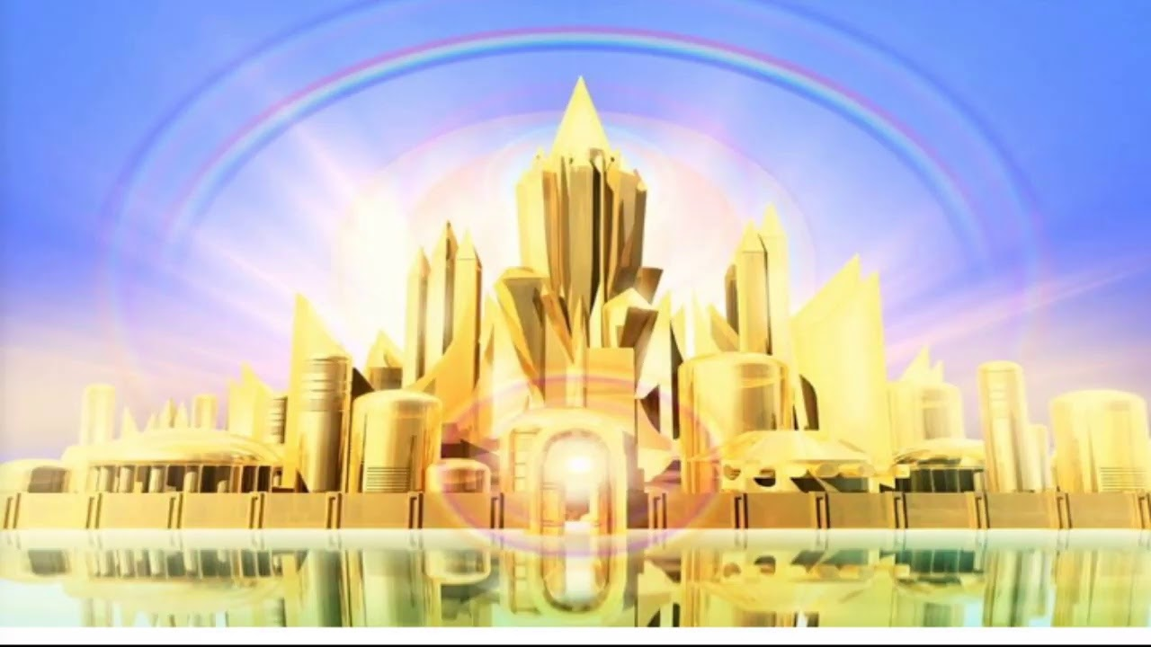
THE GREAT HEAVENLY CITY
Notes:
Bible Lesson Nº 7
The Great Heavenly City
Bible References: Revelation 21; 1 Corinthians 2:9; 1 Corinthians 13:12; Isaiah 11:6-9; Heaven, ch. 15; The Upward Look, pg. 76; Counsels on Stewardship, 363.
Main Lesson: “The Lord has a new home prepared for each of his children”.
Specific objectives
At the end of this topic the children will be able to:
Learn what heaven will be like when we live there.
Understand that God wants to give us the best of heaven.
Feel the desire to live with Jesus in that new heavenly land.
Materials
1. Drawings for the lesson.
2. Theme song of the day and memory verse in illustrative pictures.
3. Illustrative materials for the moment of prayer.
4. Souvenirs with the verse of the day for each child to take home.
5. Materials for manual activities.

Slide 5
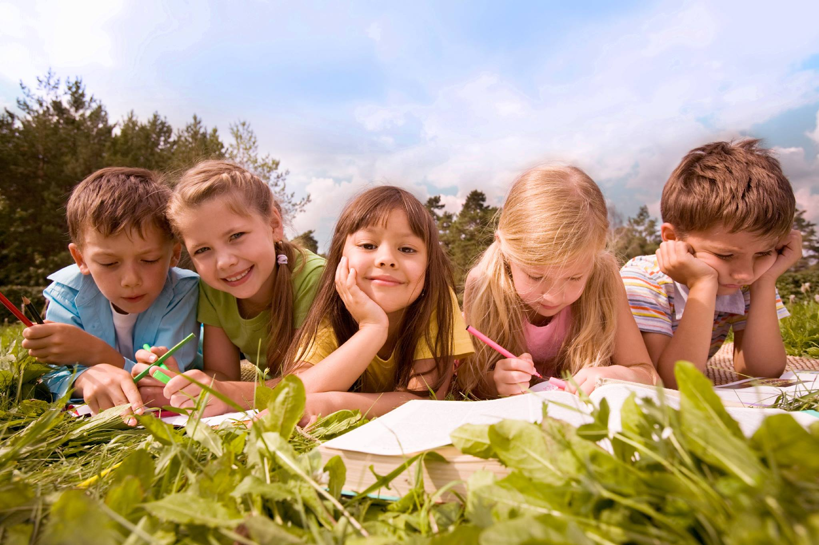
WELCOME!
Welcome
Notes:
Program Development
1. Welcome: Welcome everyone in a friendly, cheerful, and fun way, greeting all children in a group and general way. Introduce yourself and all the teachers who will be in charge during the activity to the children.

Slide 6
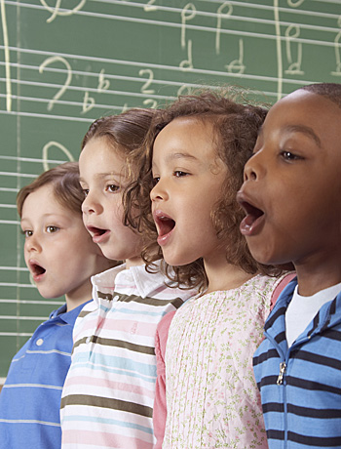
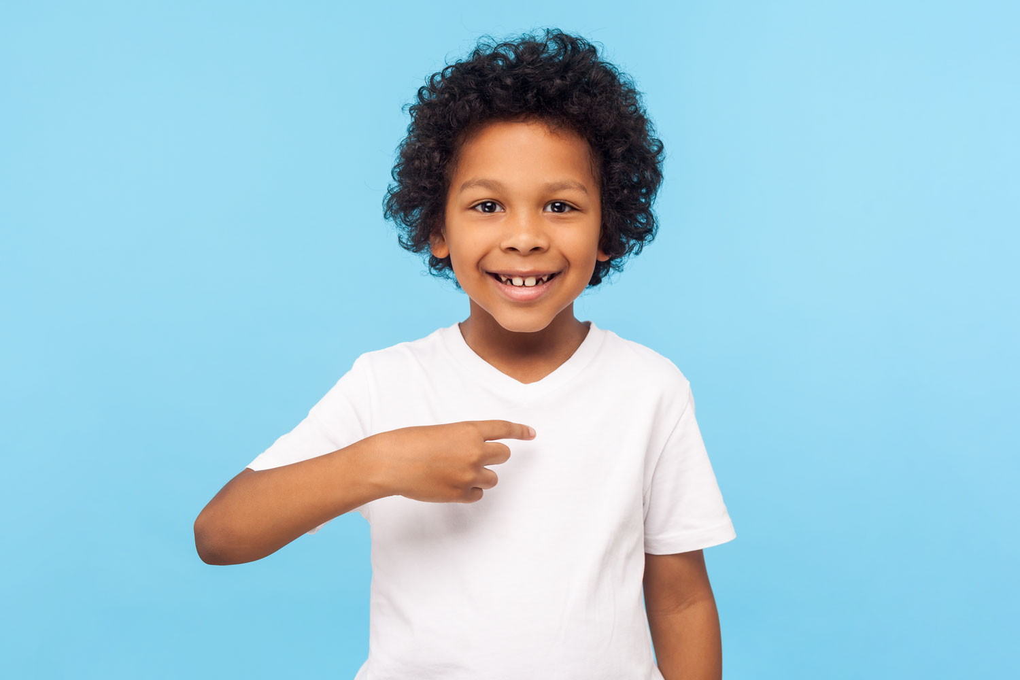
Musical moment
I Want to Go
Notes:
2. Musical moment:
Start teaching cheerful songs that can motivate the group. You may use a greeting song for this occasion. You can review the songs from previous years
Some options to teach are “We’re Happy”, “Oh, What Joy”, “Hallelujah” etc.
Remember to find a moment during class to teach today’s new song. “I Want to Go”

Slide 7
Musical moment
God’s preparing now for me,
building me a special home.
Notes:
God’s preparing now for me,
Building me a special home.

Slide 8
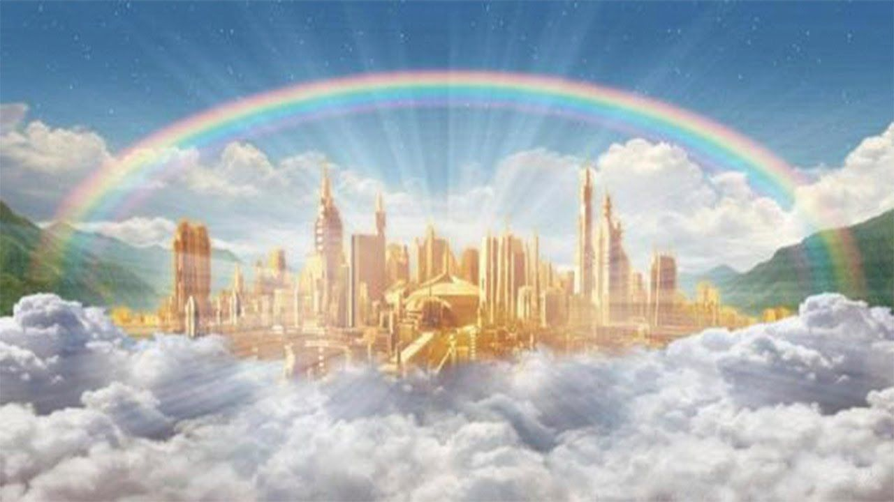
Musical moment
A golden city shining brightly,
traveling there I want to go.
Notes:
A golden city shining brightly,
Traveling there I want to go.

Slide 9
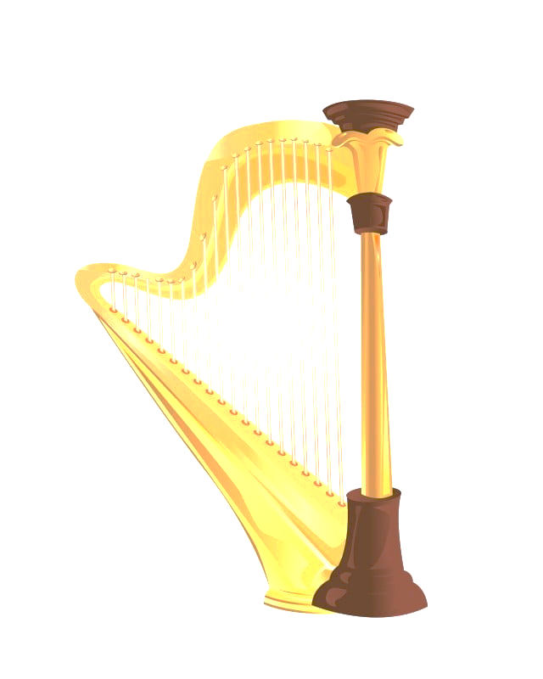
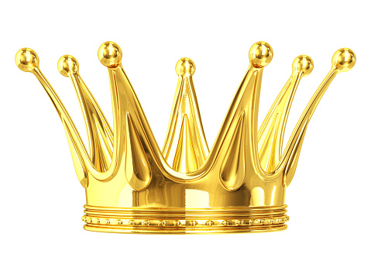
Musical moment
I will have a golden crown,
where the harps in chorus sound
Notes:
I will have a golden crown,
Where the harps in chorus sound.

Slide 10
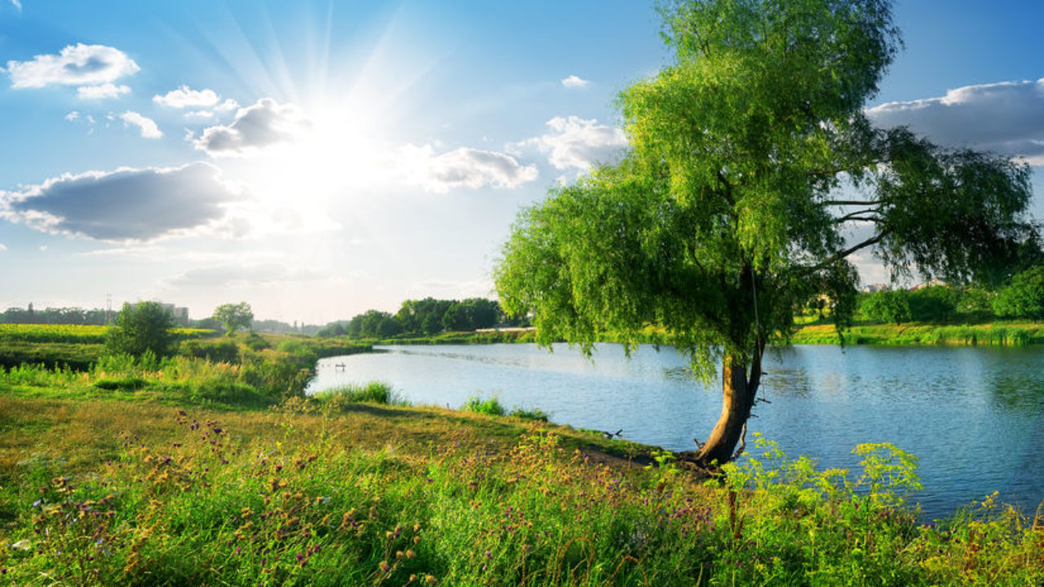
Musical moment
And with my God then I will be,
standing by the crystal sea.
Notes:
And with my God then I will be,
Standing by the crystal sea.

Slide 11
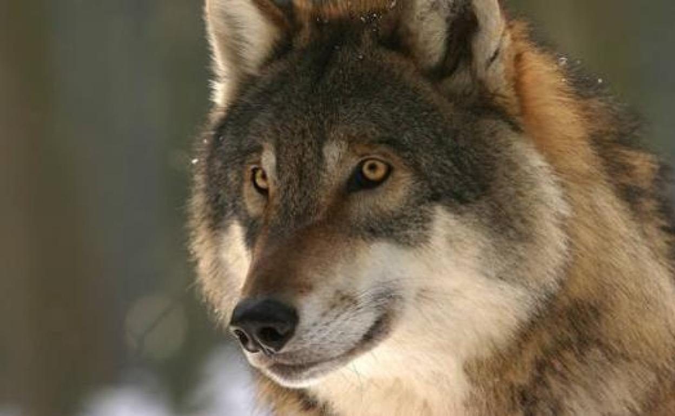
Musical moment
I’ll play, have fun with the lions and with wolves,
Notes:
I’ll play, have fun with the lions and with wolves,

Slide 12
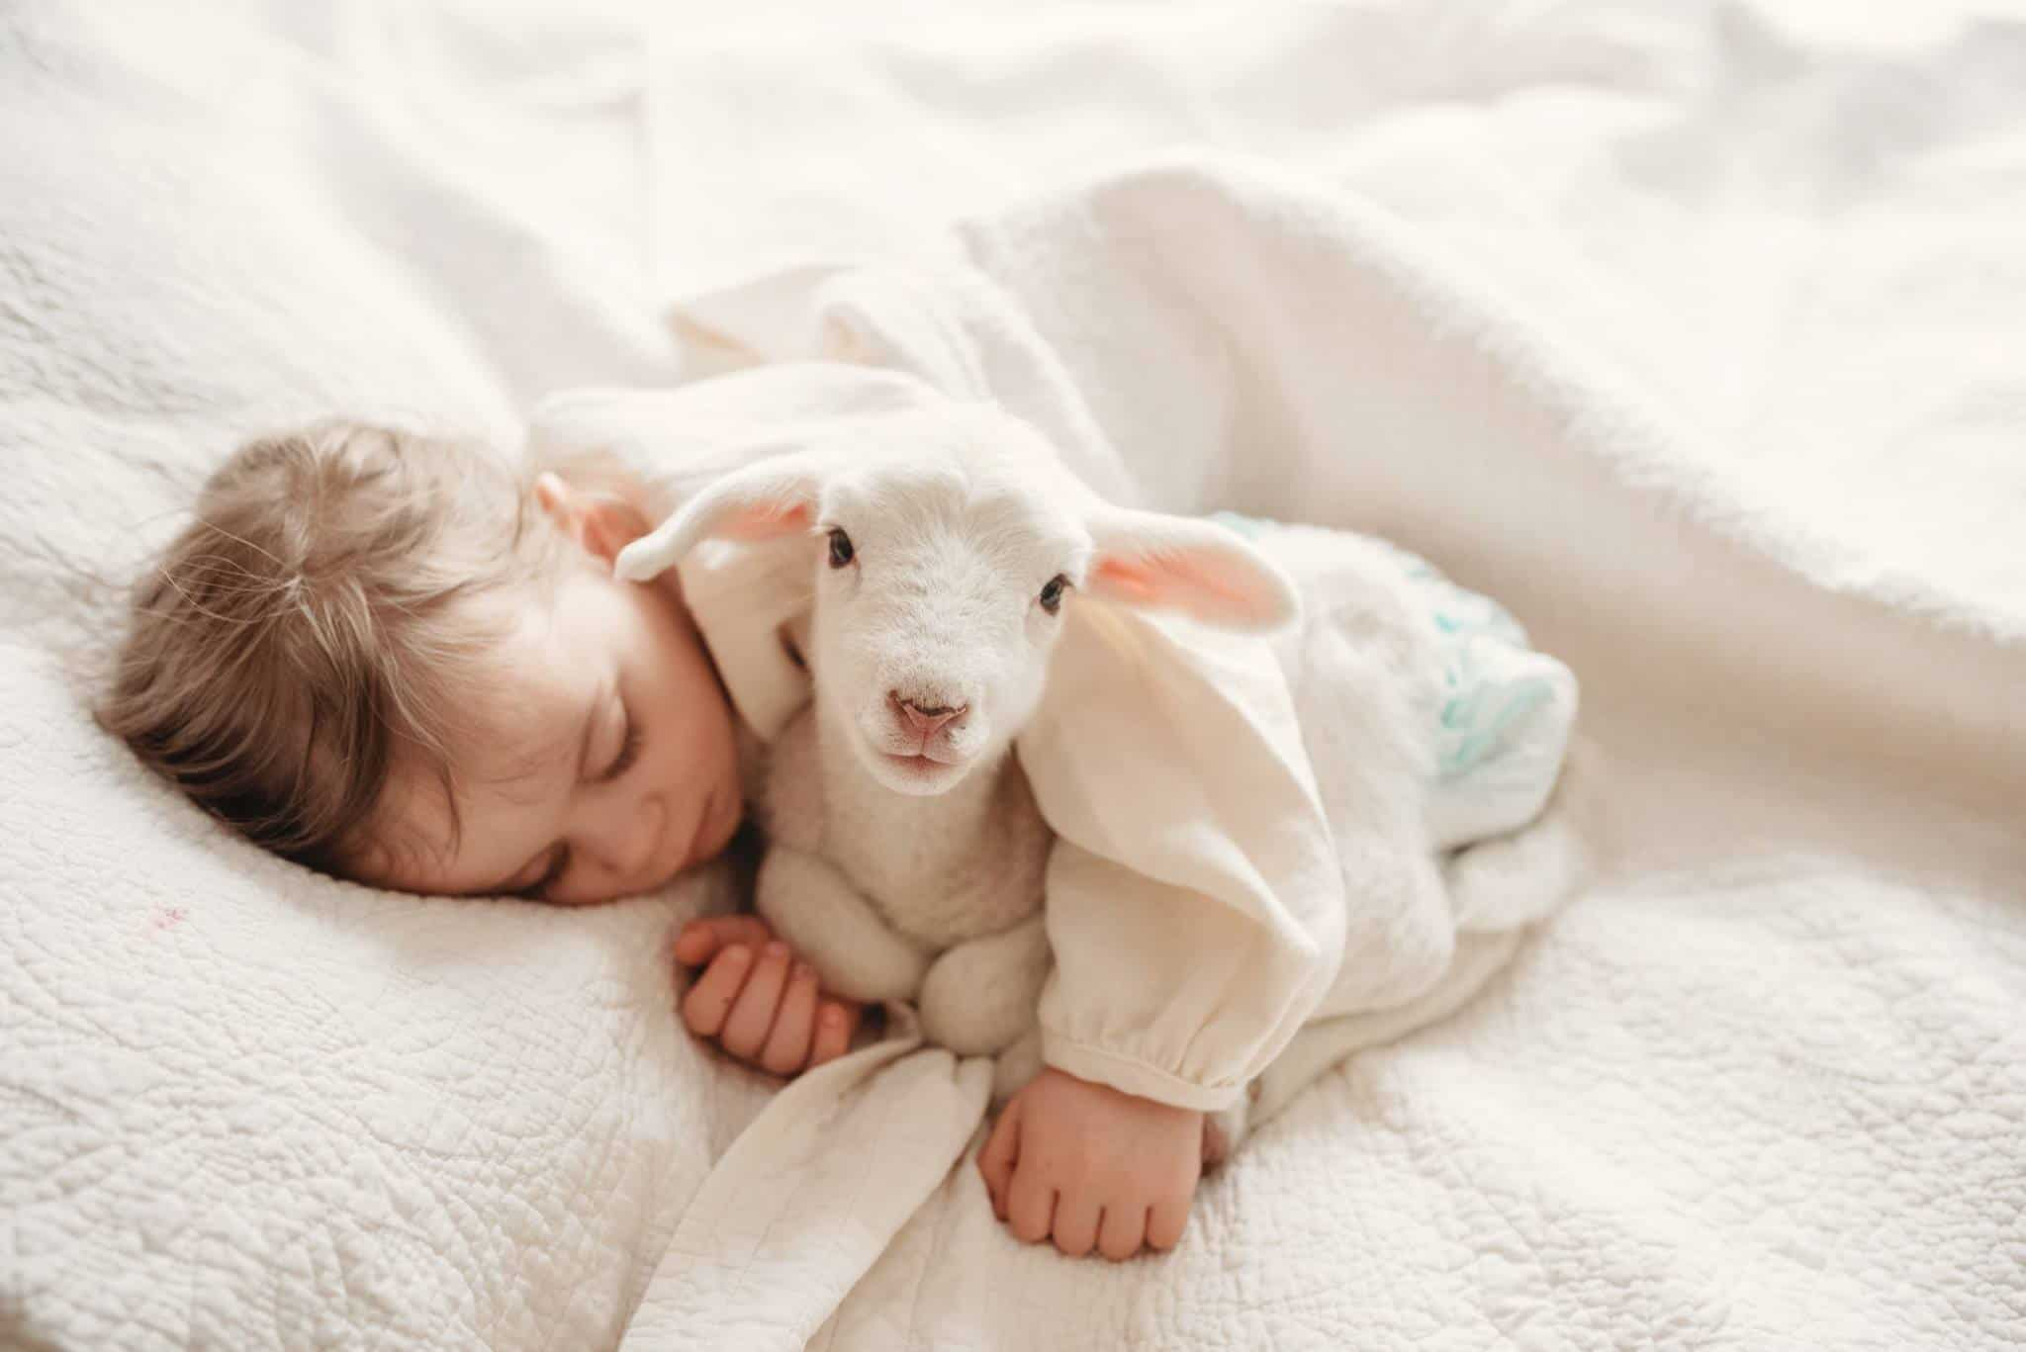
Musical moment
A baby lamb will leap right by our side,
Notes:
A baby lamb will leap right by our side,

Slide 13
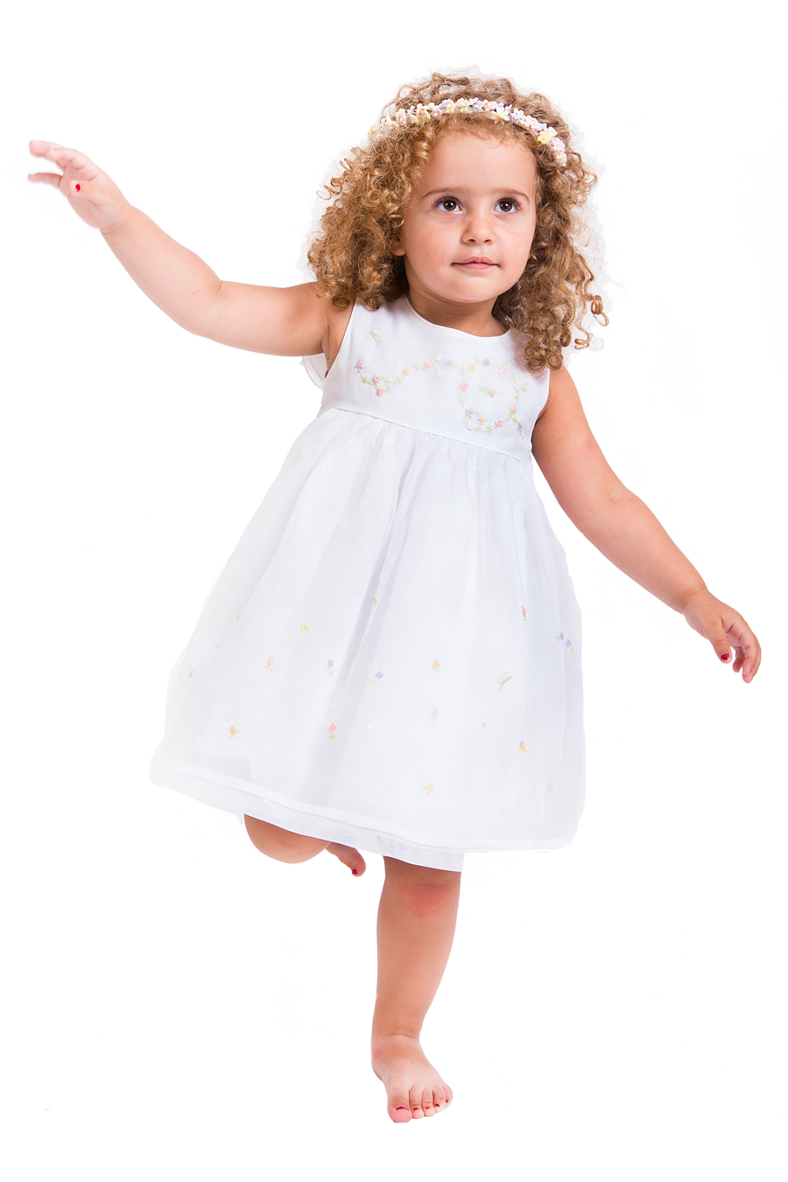
Musical moment
I’ll have white robes, and wings ready for flight.
Notes:
I’ll have white robes, and wings ready for flight.

Slide 14
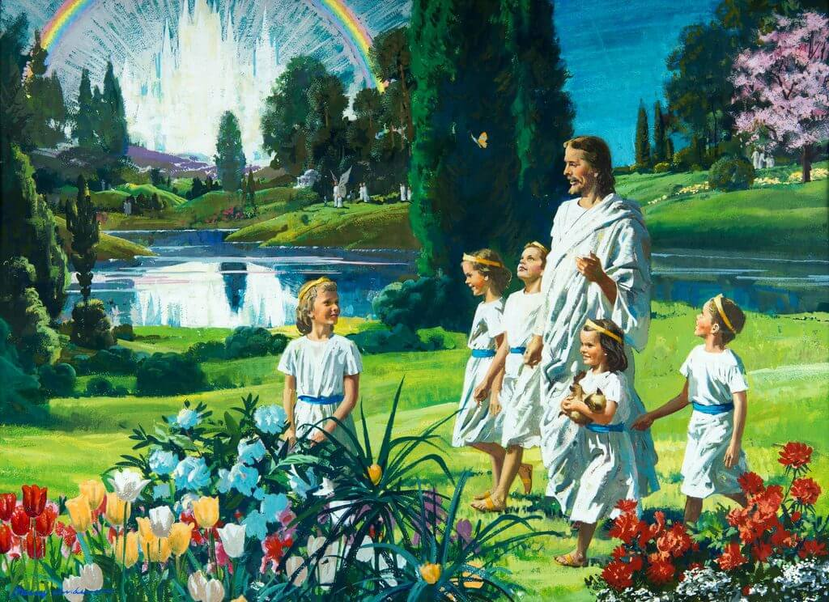
Musical moment
Oh, I can’t wait to be there,
In that home so bright and fair,
Notes:
yo allí quiero estar
en aquel bello lugar

Slide 15
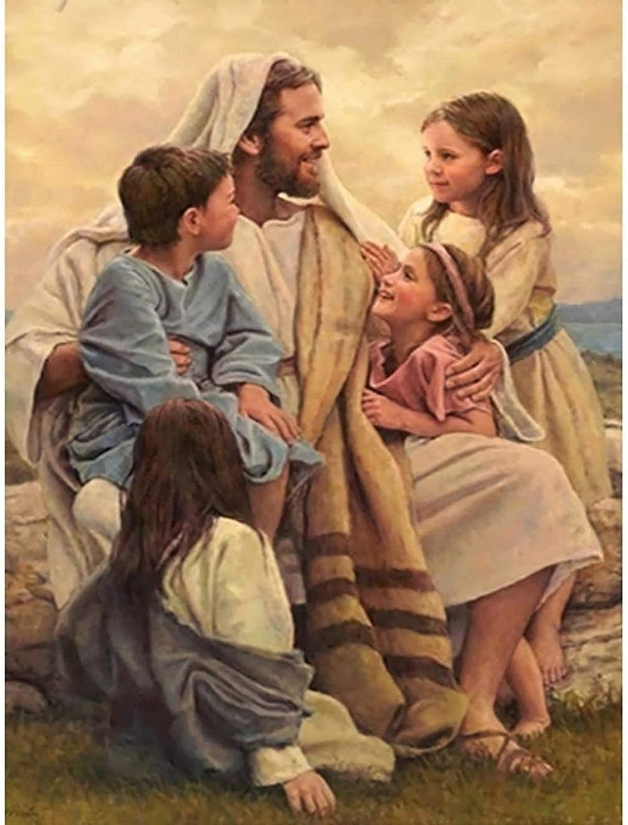
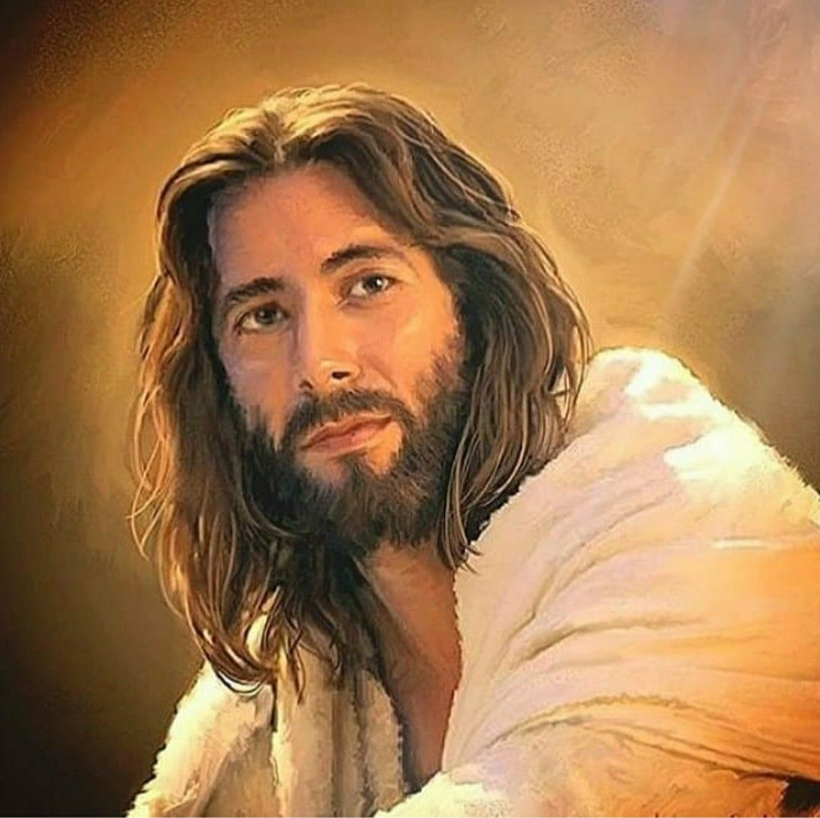
Musical moment
Face to Face with Him who cared.
Notes:
Face to Face with Him who cared.

Slide 16
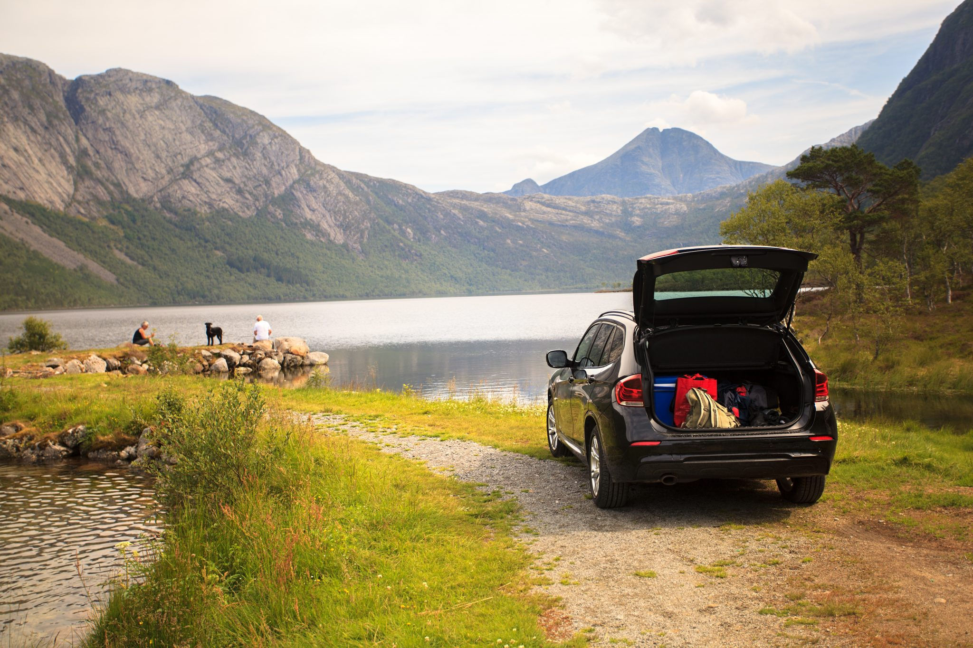
Introduction
Notes:
3. Lesson
3.1. Introduction:
Hello boys and girls, isn’t it so wonderful when vacation comes! And even more so, if mom and dad say that we’ll travel to a place we love most?!? And don’t we get so happy when we’re allowed to choose the place and country? So, where would we go? (Show photos of wonderful places from different parts of the world and talk a little bit about the beautiful places on this planet). What beautiful places!
Oh, I would so love to be a bird and fly through all those beautiful places on the planet!
Did you see the beautiful places?
Is there a place you prefer to go to?
You know what kids? There is a much nicer and more beautiful place than these pictures I showed you earlier. It’s more beautiful than any place on land! Prettier than this planet!
And we are invited to go there, the trip is free, because Jesus has already paid the price. What place is it? It’s the new earth!!!
Today we will study: What will the new earth look like?

Slide 17
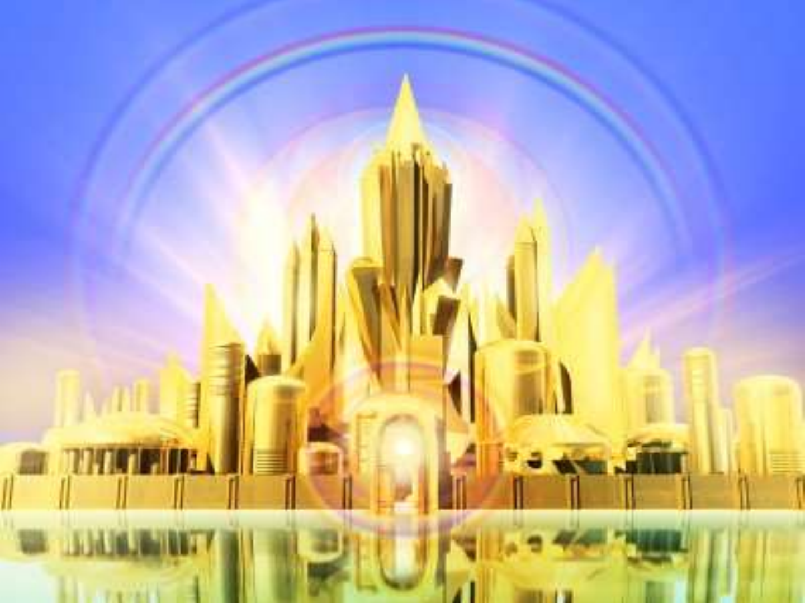
Development
Notes:
3. 2. Lesson Development
The Bible reveals what heaven and the new earth will be like. In Revelation 21:18, God gives us some details of what that wonderful place will look like: “And the building of the wall of it was of jasper: and the city was pure gold, like unto clear glass.”
Can you imagine, a city of gold? And transparent?
The Bible also tells us that the city has walls of jasper. And what is Jasper? Jasper is a soft rock that is red, or grey on black. It can sometimes also be green, yellow, brown, and a mix of colors.
Everything in heaven is beautiful and impossible to imagine!
“And the twelve gates were twelve pearls: every several gate was of one pearl: and the street of the city was pure gold, as it were transparent glass.” (Revelation 21:21). So, the city of heaven has gates of pearls…. meaning, every door is a giant pearl!
If you read the whole chapter of Revelation 21, then you can find other features of what that city will be like.
The apostle John saw that city and tells us in the Bible, “And I saw a new heaven and a new earth: for the first heaven and the first earth were passed away; and there was no more sea. And I John saw the holy city, new Jerusalem, coming down from God out of heaven, prepared as a bride adorned for her husband.” (Revelation 21:1-2).
And something else! Its gates will never be closed. All the children of God will live there!

Slide 18
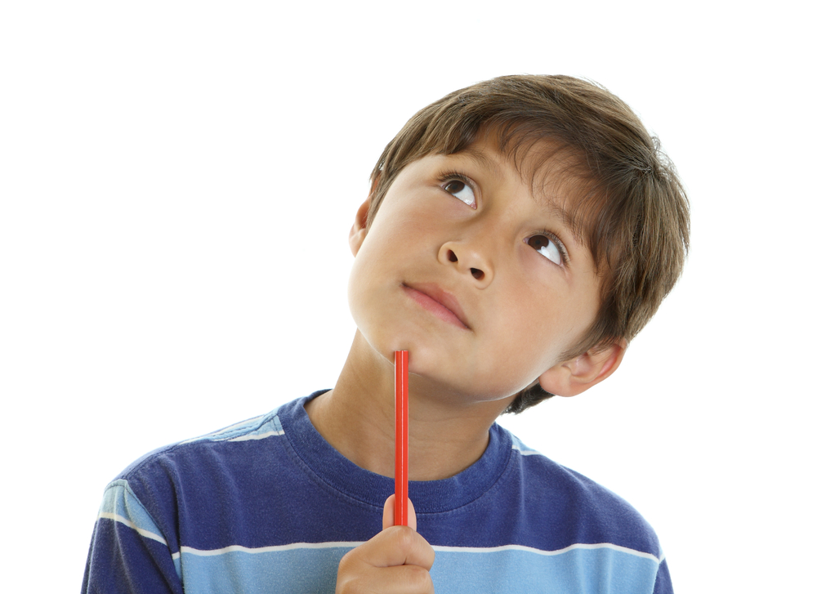
“Things that the eye did not see, nor heard, and that never entered into human thought, are the great things that God has prepared for those who love him.” 1. Corinthians 2:9
Development
Notes:
(Think)
It’s hard to imagine such a city!
There are very beautiful places here on earth today, but none of it compares to heaven and to the new earth, because they will be extraordinarily beautiful!!... So much more than our planet now. In 1 Corinthians 2:9 it says, “Things that the eye did not see, nor heard, and that never entered into human thought, are the great things that God has prepared for those who love him.”
Now, I invite you to close your eyes and imagine the beauty of heaven (wait a few seconds for the children to imagine heaven) Do you see its beauty? Yet, it will be so much more beautiful than we can imagine!

Slide 19
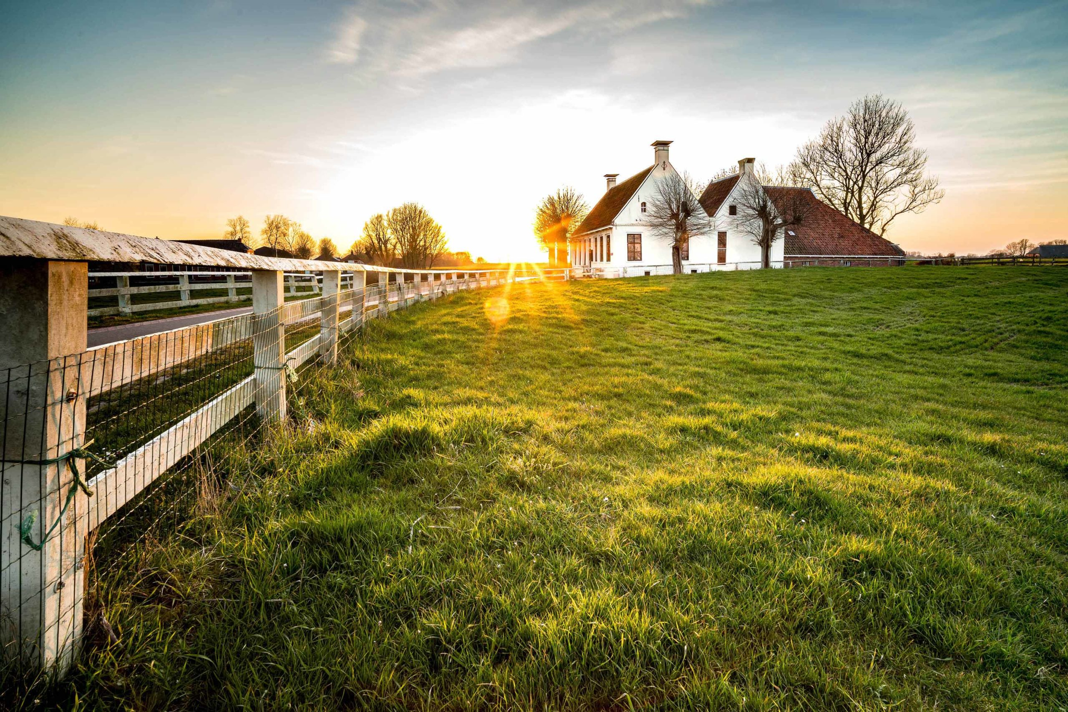
Development
Notes:
God continues telling us that the city, “Having the glory of God: and her light was like unto a stone most precious, even like a jasper stone, clear as crystal” (Revelation 21:11).
How wonderful! The glory of God will shine everywhere!
In heaven, there will also be beautiful houses that look like silver and will be supported by columns of pearls. It is in those houses where all those who go to heaven, will live.
Like we said before, when we reach heaven, we will receive a crown as a prize with a golden harp, do you remember? Of course, you do! Well, in each house we will have a golden shelf to leave our crowns. And when we take them off, a light will wrap around our head. We will also praise God. We will meet Adam and Eve, the great Samson, King David, Moses, Esther, Ruth, Joseph, Mary, etc. We will visit other worlds that never distrusted God and live happily. Everything in heaven will be joy and happiness!

Slide 20
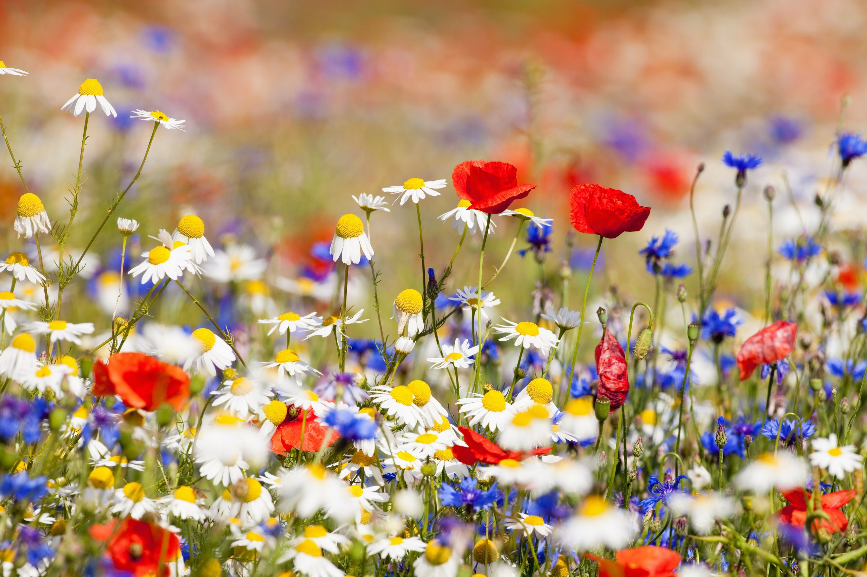
Development
Notes:
We will be on vacation in heaven, reigning with Jesus for a thousand years (Revelation 21:6). Then, we will return to a new heavens and new earth. It is there that we will farm our land, but not as we do now, with strength and sweat. We will cultivate the land with joy.
There will also be fields full of flowers. We will pick the flowers, and they will never fade, because there will be no more death. How wonderful!
Can you imagine how long such a wonderful place like this would last here on earth? Surely, in minutes everything would end because others would steal it. Evil reigns in this world… but in heaven, evil will no longer exist.
Sin cannot get into heaven. There will be no more pain or death.
In Revelation 21:4 we read, “And God shall wipe away all tears from their eyes; and there shall be no more death, neither sorrow, nor crying, neither shall there be any more pain: for the former things are passed away.”
No one will die anymore, not a single human. That’s why the flowers no longer wither. And no one else will ever suffer. There will be no pain or loss. Isaiah 33:24 says, “And the inhabitant shall not say, I am sick: the people that dwell therein shall be forgiven their iniquity.” Nor will we get sick because sin will no longer exist.

Slide 21
Development
Notes:
Many children suffer on this earth from illnesses or from losing a loved one. But in the new heaven and new earth that will not exist. We will no longer have cancer, no coronavirus, no colds, or diseases.
It will be so wonderful, because we can just enjoy the company of Jesus and all of his creation.
We may get so sad today when we lose something we love so much! But when we get to heaven, we will have a transformed body, and will never get sick anymore. Also, if we’ve ever lost a loved one, and if they believed in Jesus as their savior, then they will be resurrected when Jesus comes and will go to live with Him forever. So, all the sadness we have here, will no longer exist in heaven. Don’t you think that’s so great?
Alright, let’s keep learning about the new heaven and new earth!

Slide 22
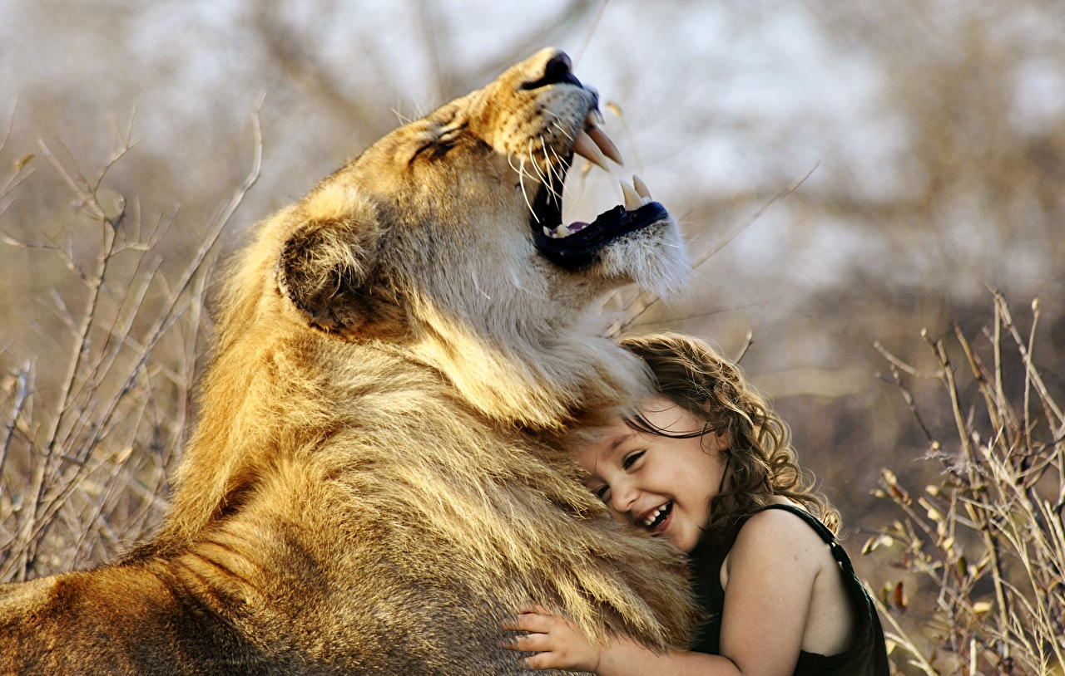
Development
Notes:
The fields will be green, full of bright reflections like silver and gold. There will be all kinds of animals in heaven. Lions, lambs, leopards and wolves will all live together in harmony and in perfect union.
Every child will also be able to play with all the animals without getting harmed by them.
Can you imagine running with a lion? Or that the lion is your playmate or friend?
Here on earth, we can’t get close to a lion because otherwise, it will eat us up in one bite.
That’s the result of sin. There are poisonous and very dangerous animals here on earth. They will no longer exist in heaven. Heaven will only have love and joy. There will also be many green trees, full of leaves in heaven. Forests that we will never be scared to walk through. Rivers will be crystal clear. Trees will have mighty shadows to sit under. We’ll have majestic hills and mountains to visit. Everything will be beautiful!

Slide 23
Development
Notes:
And God’s people will have the privilege of having direct communion with God and Jesus.
“For now we see through a glass, darkly, But then face to face” says 1 Corinthians 13:12, Now we see the image of God reflected as in mirror, without a veil to hide him from us. We will be in his presence and behold the glory of his face.
You know what? There will no longer be temptations in heaven, and therefore, we will no longer sin. Nothing will offer the opportunity of temptation. There is no temptation or possibility of injustice in heaven. All have triumphed by the blood of Jesus. It’s wonderful! Satan will no longer be able to harm us!

Slide 24
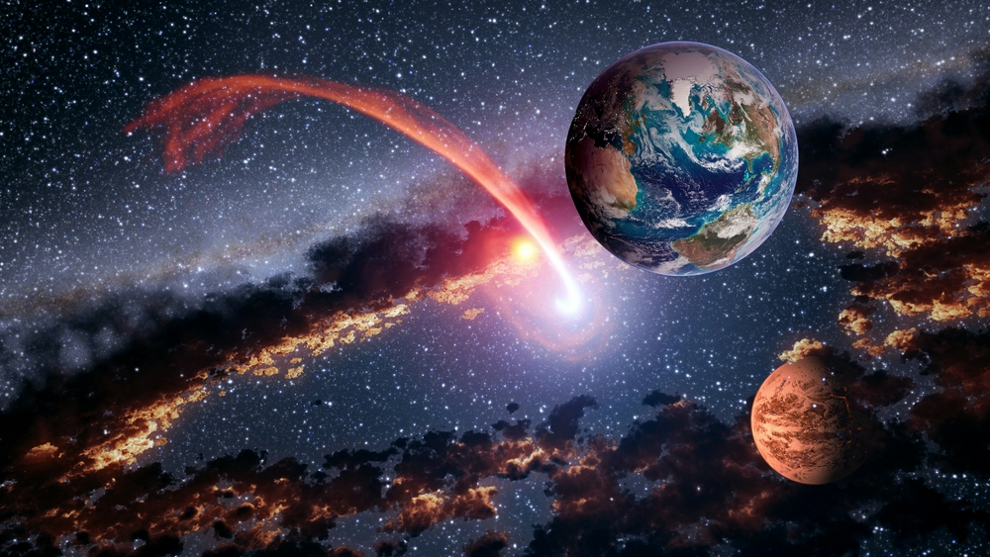
Development
Notes:
But there is something else we will do in heaven.
We will have so many opportunities to learn in heaven. We will have like a school to learn about all the treasures of the universe.
We will be able to travel to the far-off worlds, where we will learn the treasures of knowledge about God’s works. What a great time we will have studying—studying God’s creation where evil has never set foot.
Now, we cannot contemplate so much beauty, for sin does not allow us to open our minds to so much beauty. Imagine creation without any ugly, dead, or destroyed thing!
But do you know who our teacher will be? Christ, our heavenly teacher, will guide us through every lesson. Jesus will be our great teacher.

Slide 25
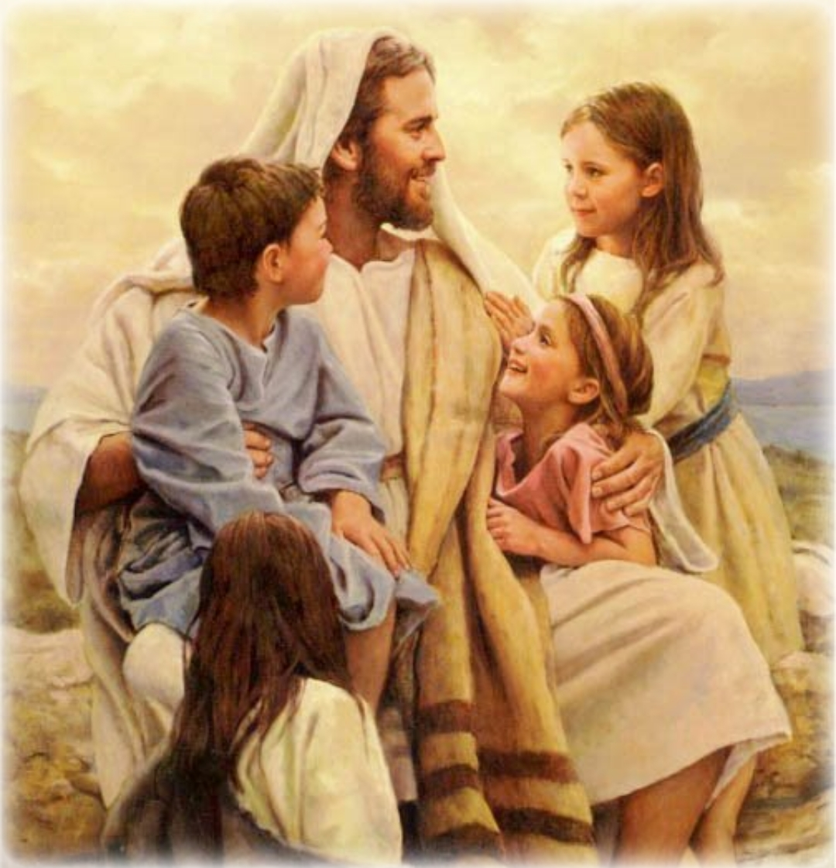
“He that overcometh shall inherit all things; and I will be his God, and he shall be my son” (Revelation 21:7)
Development
Notes:
We can ask him anything we want. We will learn all the mysteries about salvation. We will learn of the journey He took to come to Bethlehem to be born on earth. We will learn about how he healed the sick, what it felt like to be crucified, how he gave his life for us, and how he arose from the dead.
From his very own words, we will find out what it was like for him to die for us. And all we will have is gratitude for that great sacrifice.
You know what? In heaven, we will get to know all about God and his power. Jesus will reveal what he is to us and what we are to him. We will get to know the truth that we know don’t understand because of our limitations. In heaven we will learn about the great truths that God has for us.
The Bible says, “He that overcometh shall inherit all things; and I will be his God, and he shall be my son” (Revelation 21:7).

Slide 26
Development
Notes:
We are God’s heirs, because through Jesus, we can overcome! Thanks to the death of Christ, we can once again be children of God.
I can’t wait to start that great and special journey!
I can’t wait to see Jesus in the clouds!
I already want to know what gifts God has for me in heaven!
I already want to know about the new land he has prepared for me!
I want to get to heaven to see all that the Lord has prepared for us!
And you, do you want to join me in this experience?
Well, don’t wait any longer! Prepare yourself each day to meet Jesus!
If you know someone who already knows Jesus, then join them so that together you can go on “The Great Journey to Heaven!”, but don’t forget to tell others to join you in this great experience. Amen.

Slide 27
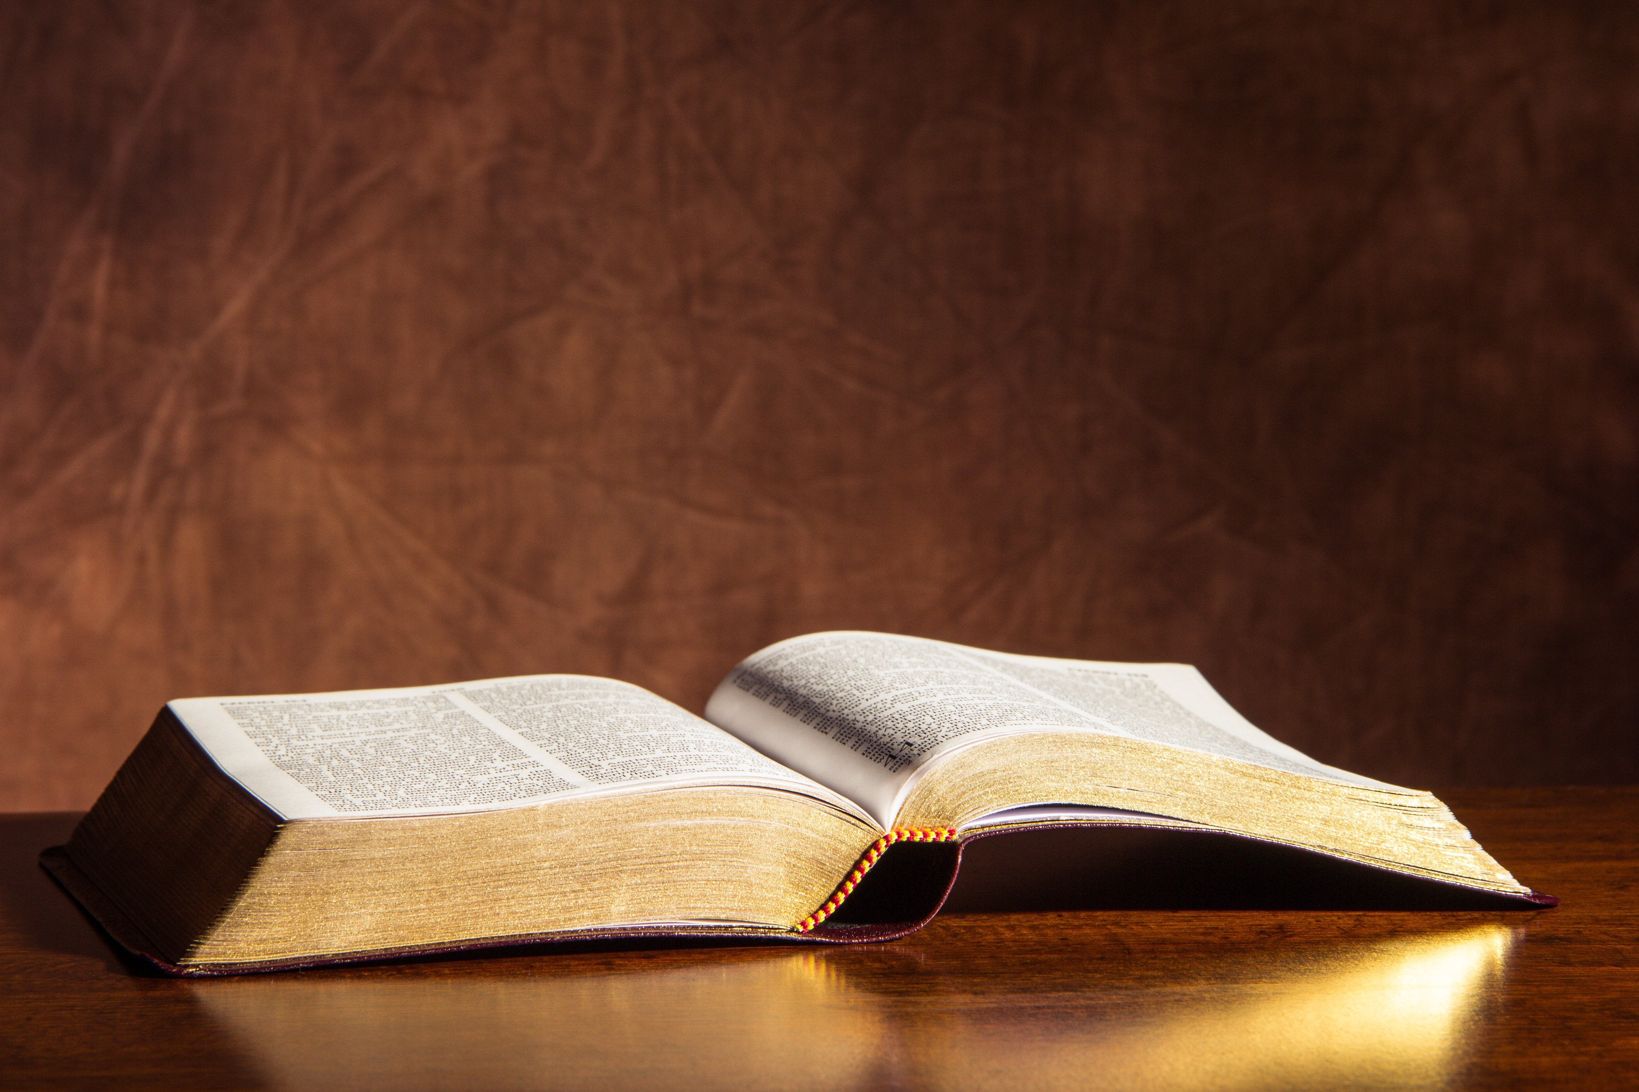
Revelation 21:7
Memory Verse
Notes:
4. Teaching the Memory Verse
(Learning the memory verse can be done before or after the lesson.)
Prepare the visual presentation of the verse beforehand. You can do a word for every poster/paper or a phrase per poster/paper. This will help the kids memorize the verse by repetition through this “puzzle”.
Memory Verse:
• He that overcometh
• shall inherit all things;
• and I will be his God,
• and he shall be my son.
• Revelation 21:7.
Introduction: Do you know what it’s like to win? You can give an example of what winning is by winning a small tug of war with a rope. We will now see that all of us who overcome here on earth will gain something wonderful.
Presentation: Allow the children to read the Bible verse. The teacher will read aloud to accompany the children in the reading.
Explanation: In this step explain the most difficult words in the verse. Overcome- Inherit.
Application: Talk about what God wants the child to learn about this verse. Explain the verse by applying it to the children’s lives. What is winning? How can we win? Explain that thanks to the sacrifice of Jesus, we are conquerors. It is because he died on the cross in our place that we can once again be children of God.
Repetition: be innovative and creative in this step.

Slide 28
He that overcometh
Memory Verse
Notes:
He that overcometh

Slide 29
shall inherit all things;
Memory Verse
Notes:
shall inherit all things;

Slide 30
and I will be his God,
Memory Verse
Notes:
and I will be his God,

Slide 31
and he shall be my son.
Memory Verse
Notes:
and he shall be my son.

Slide 32
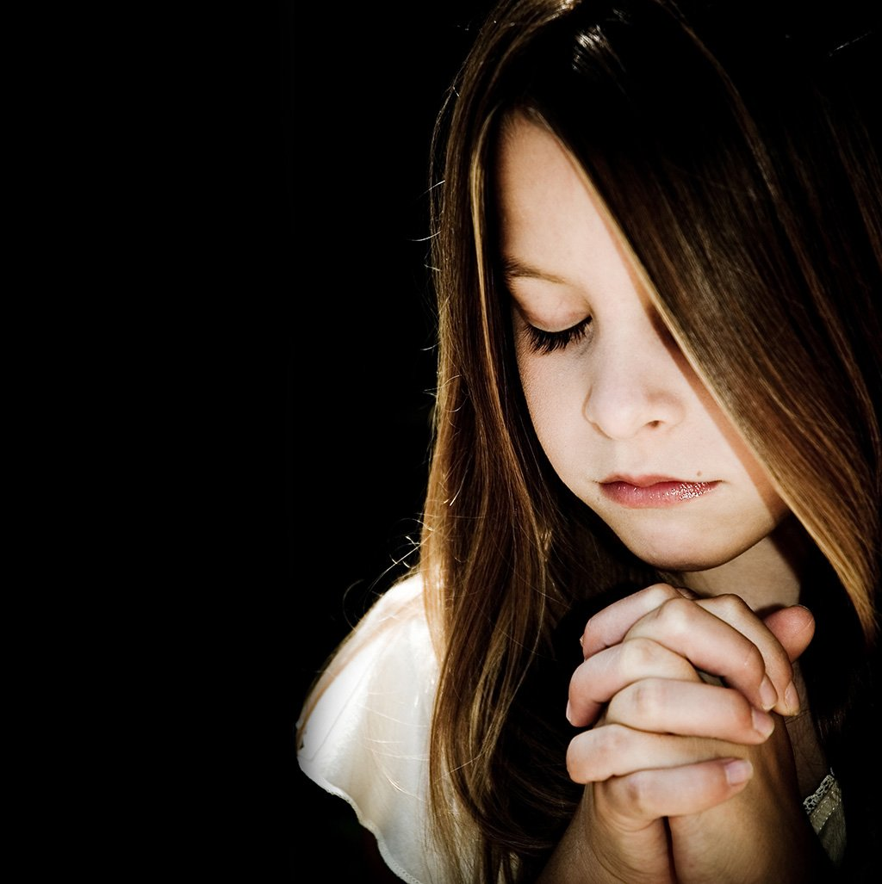
Prayer
Notes:
5. Moment of Prayer
Let’s talk to God. Since we’ve already been talking about prayer, then today we will give a child the opportunity to pray alone, talking to God about what their heart desires.

Slide 33
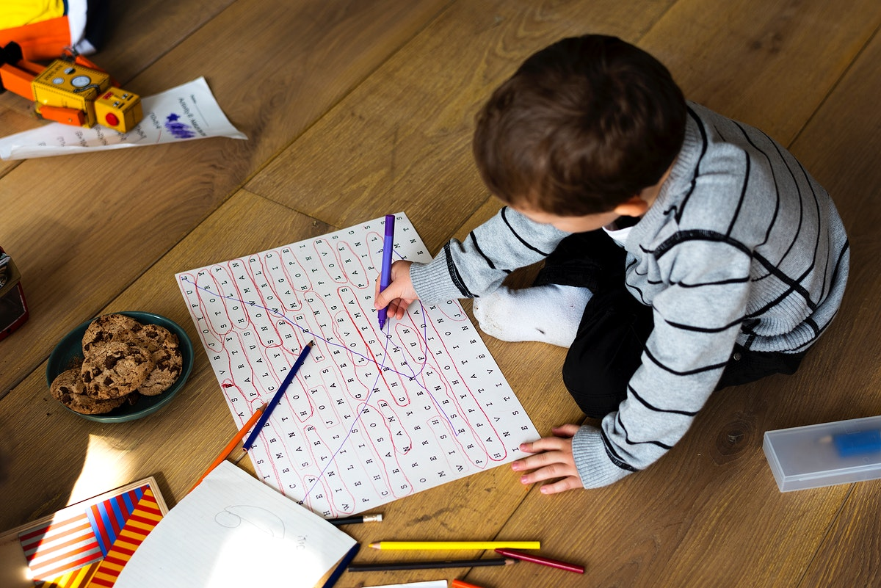
Activities
Notes:
6. Activities:
Children Ages + 8:
1. We will go to live with Jesus very soon. Draw the great city of gold that God is preparing for us.
2. Crossword puzzle. Follow the arrows and write what you discover on the lines below.
Children Ages 0-7: Let them draw what they imagine heaven to be like. Can you draw yourself with a lion?

Slide 34
SEE YOU NEXT TIME! GOD BLESS YOU!
biblewell.org
Notes:
UNTIL NEXT TIME! GOD BLESS YOU!

